Slide 1

YEAR 2 PUNCTUATION OBJECTIVE
Commas to separate items in a list

Slide 2
What are commas?
Commas (,) are used to create a small break between different parts of a sentence.
More than one comma may be used within a sentence.
Commas show the reader that they need to take a short pause whilst reading.
Read the following sentence making sure you take a short pause when you reach each comma.
In my lunchbox I had a cheese sandwich, a packet of crisps, some grapes, a banana and a drink.

Slide 3
Commas in lists
Commas are used within a sentence which includes a list. The words and or or must be used to separate the last two items in a list. Look at the examples below:
Tom ordered a hamburger, chips, ice-cream and lemonade from the menu.
Abdul needed a pencil, paper, water, a paintbrush and paints for his art project.
Tabitha cannot find her hat, coat or gloves.

Slide 4
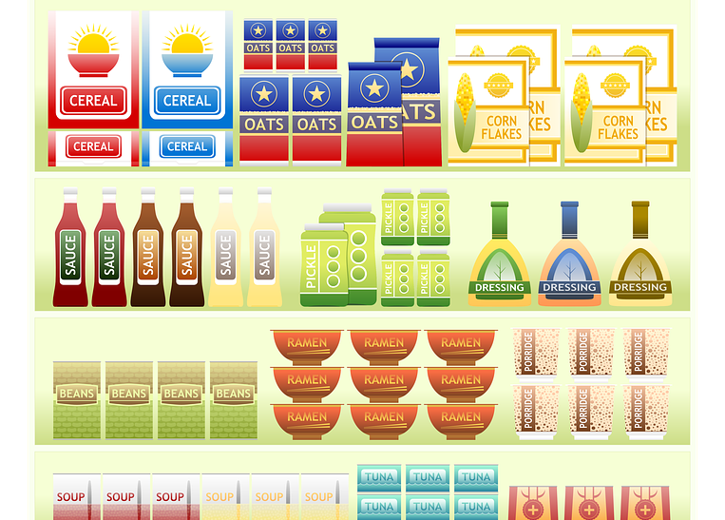
Have a go!
Lisa went to the shop and bought four of these items. Complete the sentence below including the items she bought. Remember commas!
Lisa bought

Slide 5

Have a go!
Eliza made this sandwich. Complete the sentence below to show what Eliza’s sandwich was made with. Remember commas!
Eliza’s sandwich contained

Slide 6
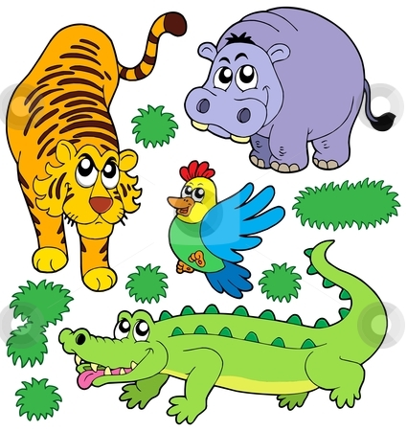
Have a go!
Tariq saw these animals when he went to the zoo. Complete the sentence below including the animals he saw. Remember commas!
When Tariq went to the zoo he saw

Slide 7

Have a go!
What types of fruit are in this basket? Complete the sentence below to show what fruits the basket contains. Remember commas!
The fruit basket contains

Slide 8
Have a go!
Where do commas need to be added in these sentences?
Jamie does not like onions carrots or peppers.
Omar’s favourite lessons are art music and maths.
I enjoy playing football netball and hockey.
At the fair, Rupert went on the bumper cars helter-skelter bouncy castle and merry-go-round.
My favourite Roald Dahl books are The Twits Charlie and the Chocolate Factory and James and the Giant Peach.

Slide 9
Were you right?
Jamie does not like onions, carrots or peppers.
Omar’s favourite lessons are art, music and maths.
I enjoy playing football, netball and hockey.
At the fair, Rupert went on the bumper cars, helter-skelter, bouncy castle and merry-go-round.
My favourite Roald Dahl books are The Twits, Charlie and the Chocolate Factory and James and the Giant Peach.

Slide 10
Have a go!
Complete the sentences below:
The four seasons of the year are
My top three favourite foods are
The colours of the rainbow are

Slide 11


Can you spot the missing commas in this information text?
Animal Diets
Carnivores are animals which meat. Examples of carnivores are lions crocodiles snakes polar bears and owls.
Herbivores are animals which eat plants. Their diets consist of foods like bark nuts berries wood and grass. Examples of herbivores include giraffes kangaroos horses beavers squirrels mice and cows.
Omnivores are animals which eat plants and meat. Examples of omnivores include monkeys hedgehogs rats pigs and crows.

Slide 12
Were you right?
Animal Diets
Carnivores are animals which meat. Examples of carnivores are lions, crocodiles, snakes, polar bears and owls.
Herbivores are animals which eat plants. Their diets consist of foods like bark, nuts, berries, wood and grass. Examples of herbivores include giraffes, kangaroos, horses, beavers, squirrels, mice and cows.
Omnivores are animals which eat plants and meat. Examples of omnivores include monkeys, hedgehogs, rats, pigs and crows.

Slide 13
Reflect and Discuss
One of these comma facts is incorrect. Which one is it?
Commas are used in sentences which contain a list.
Commas may be found at the end of a sentence.
The words and or or are used to separate the last two items in a sentence with a list.

