Slide 1
Reading – The flower
Recap the story
https://www.youtube.com/watch?v=uDswFXEEYh4

Slide 2

Monday 28th June
LO: To compare books
Discuss the two books mentioned in the border:
‘Jack and the Beanstalk’ and Alice in Wonderland.
What do they have in common and how do they differ? Why were they chosen?

Slide 3
Monday 28th June
LO: To use the belonging apostrophe

Slide 4

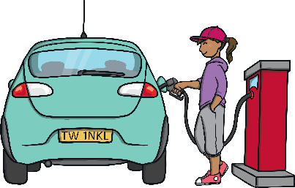
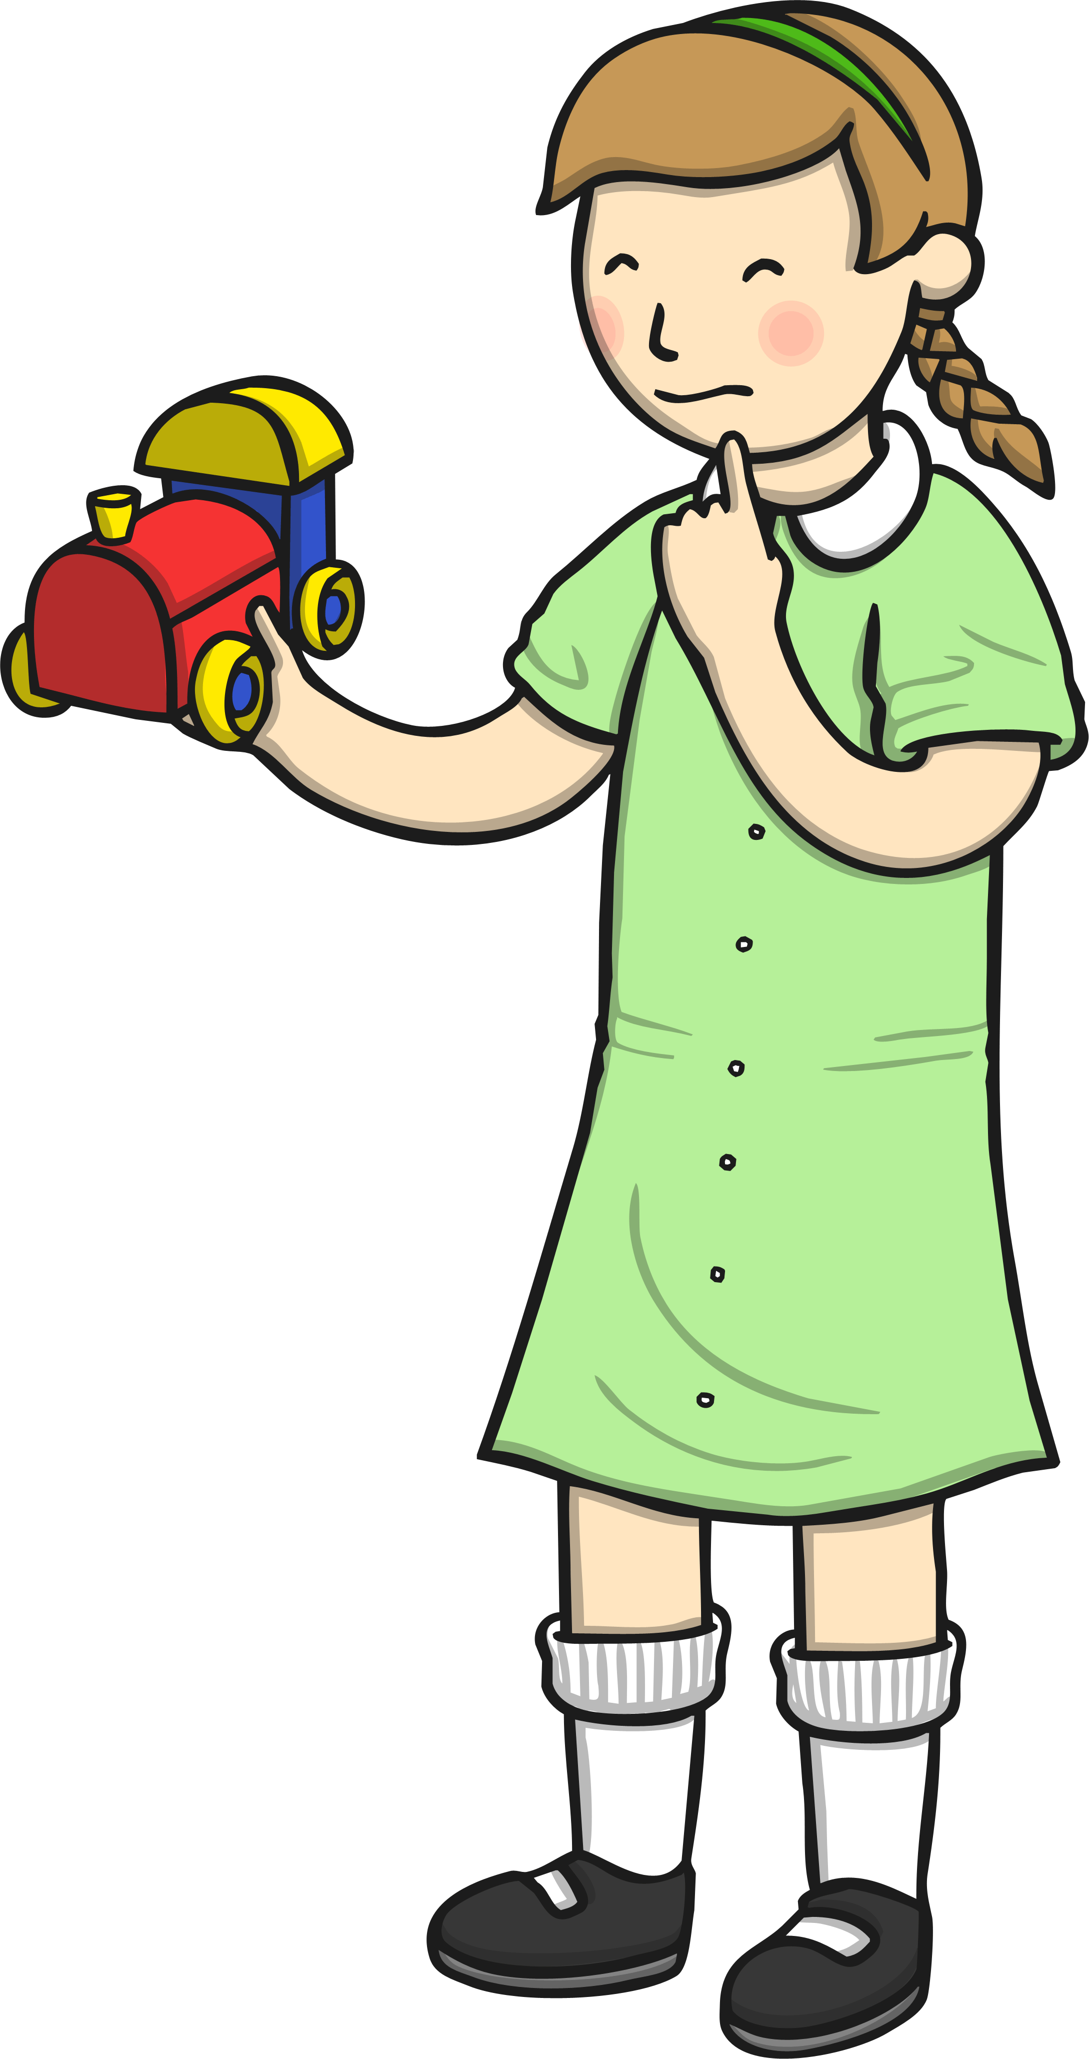
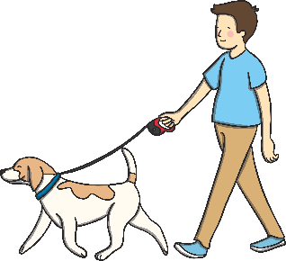

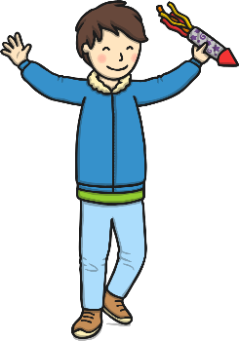
Expected Group
Can you write a sentence to describe each picture using an apostrophe to show possession? Click on the picture to see the answer.
Nadia
Rachel
Clara
This is Nadia’s radio.
This is Rachel’s car.
This is
This is
This is Clara’s train.
Owen
Kaylee
Malik
This is
This is
This is Kaylee’s book.
This is Malik’s rocket.
This is Owen’s dog.
This is

Slide 5
Monday 28th June
LO: To use a belonging apostrophe.
Write a new sentence for each picture using a belonging apostrophe.
Nadia
Rachel
Clara
Nadia’s radio is playing loud music
Owen
Kaylee
Malik

Slide 6
Watch to recap each say the sequence of events
Our Story Book
Tuesday
https://www.youtube.com/watch?v=JtQ4DdzCZMA

