Slide 1
J spelt dge and ge

Slide 2

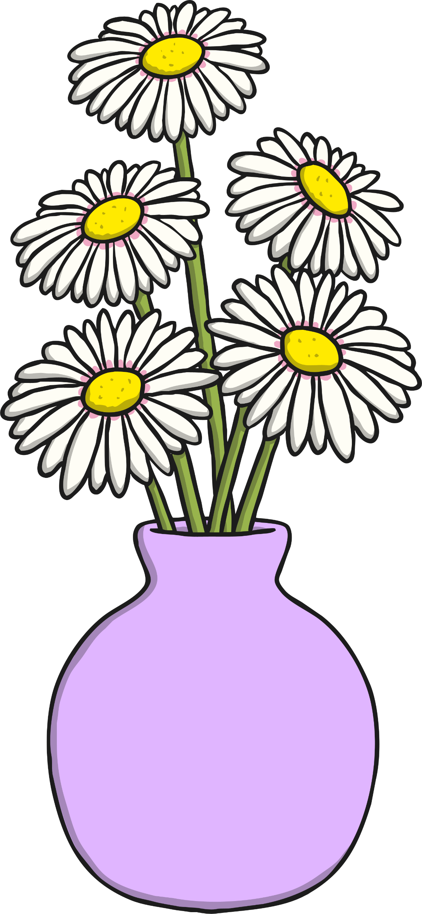

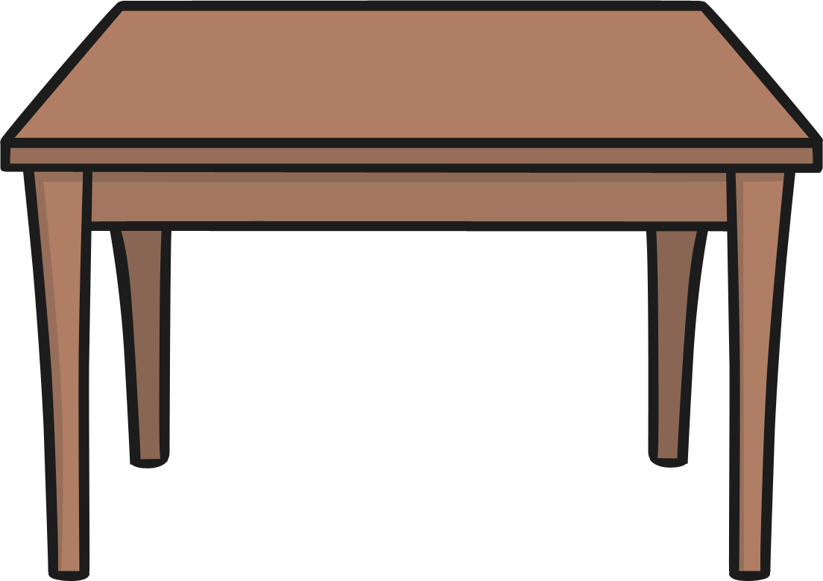
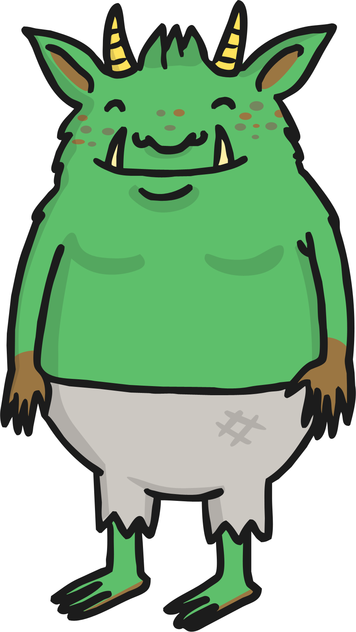
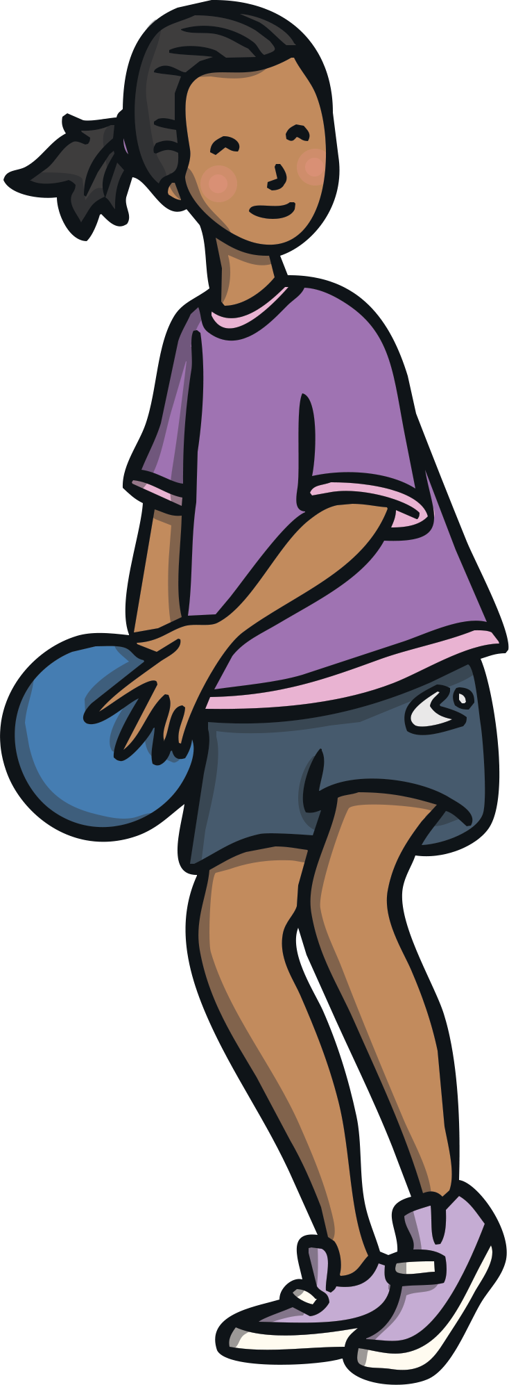
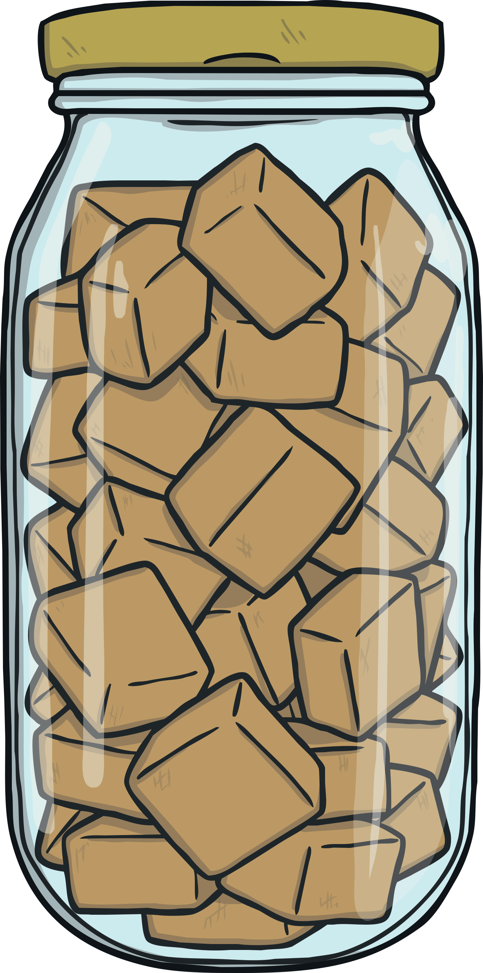
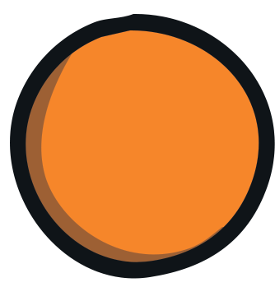
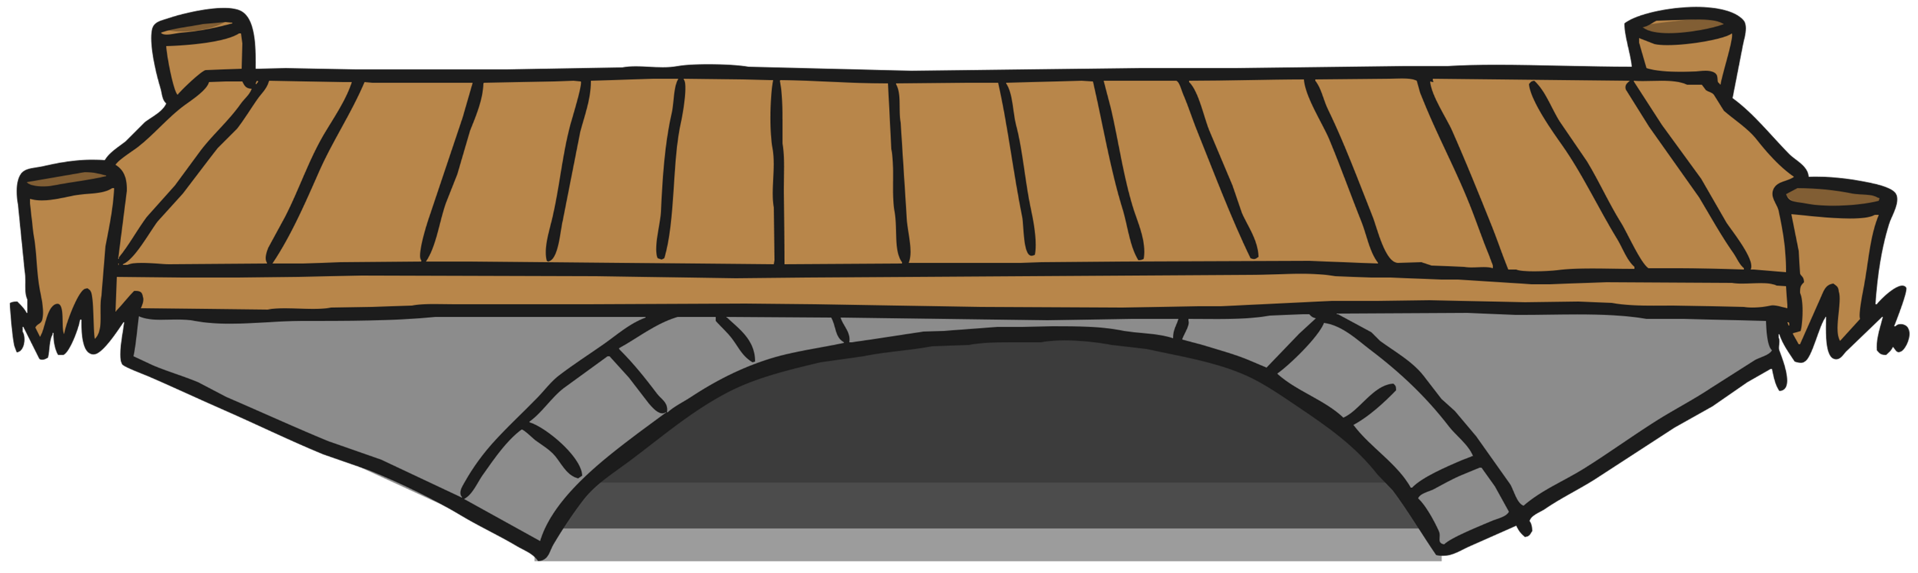
/j/ Spelt ‘-dge’
At the end of a word, the /j/ sound is spelt ‘-dge’
after the short vowel sounds /a/, /e/, /i/, /o/, /u/.
badge
edge
bridge
dodge
fudge

Slide 3
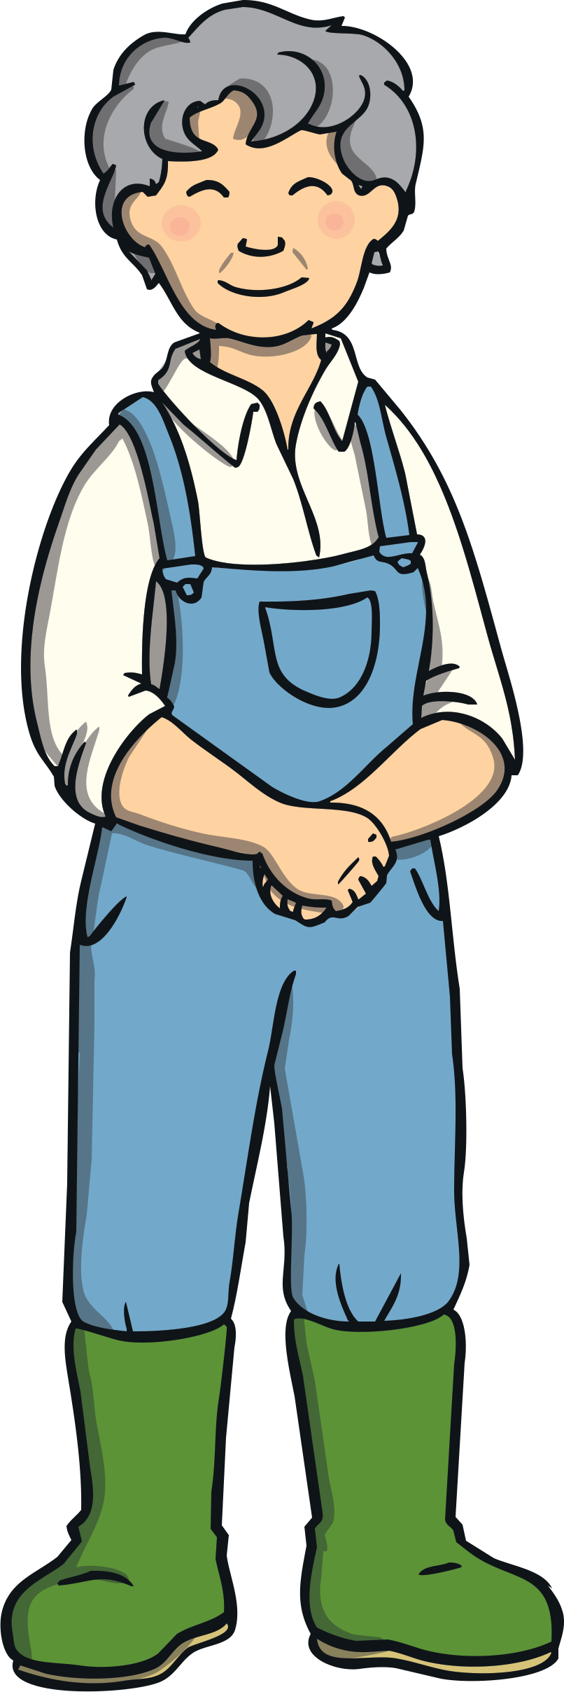
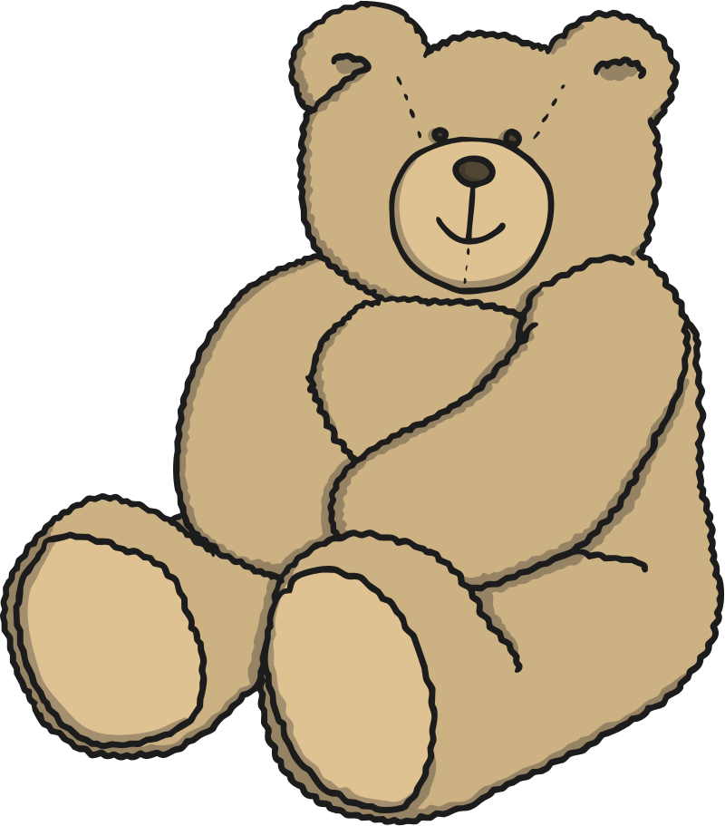
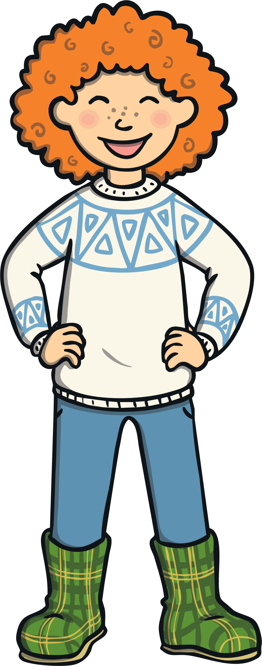
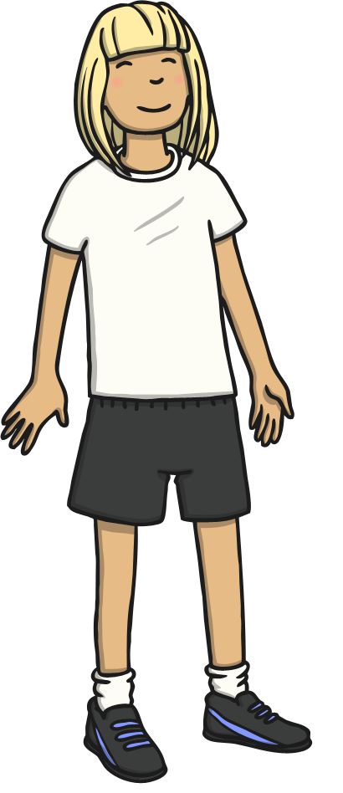
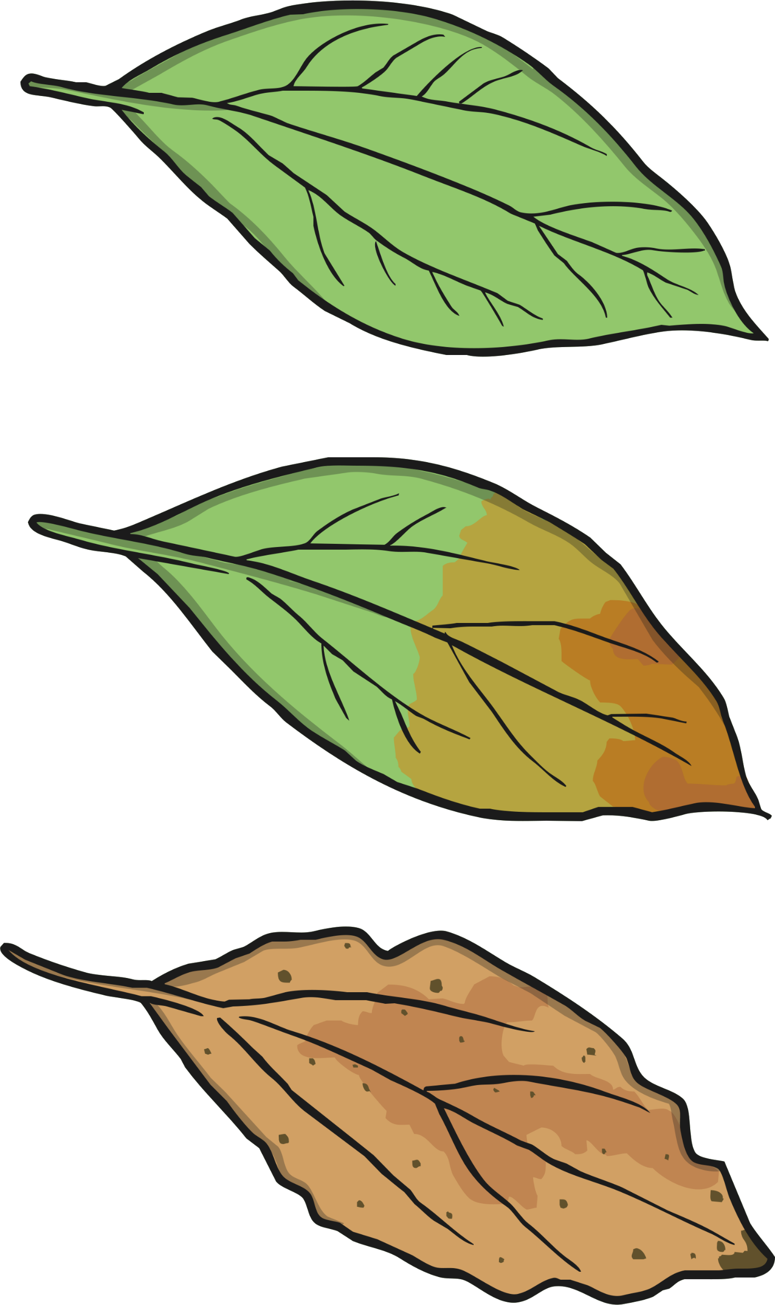
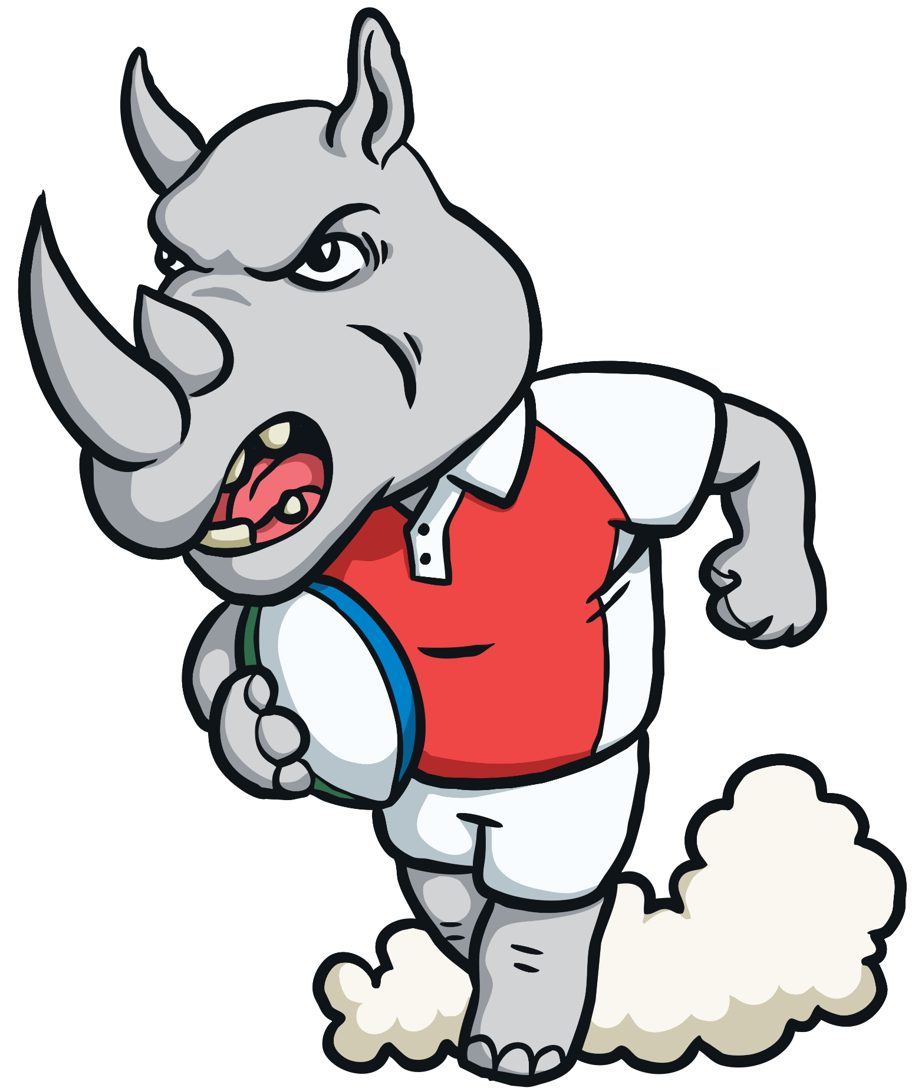
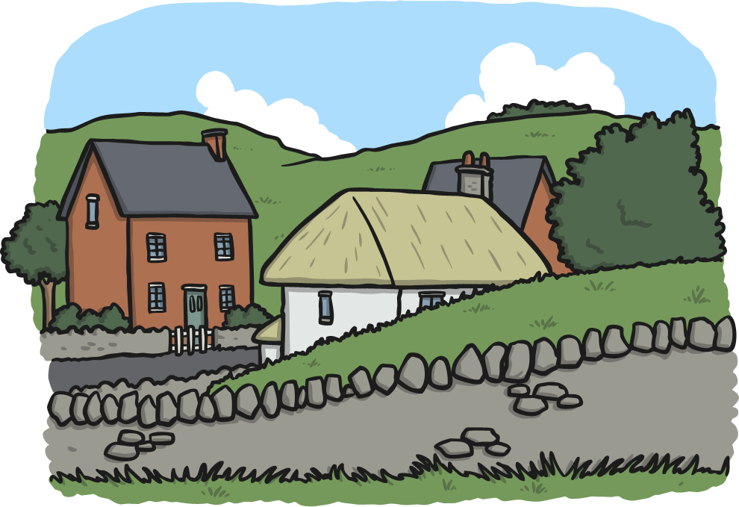
/j/ Spelt ‘-ge’
After all other sounds (vowels or consonants)
the /j/ sound is spelt ‘-ge’ at the end of a word.
age
huge
change
charge
village

Slide 4
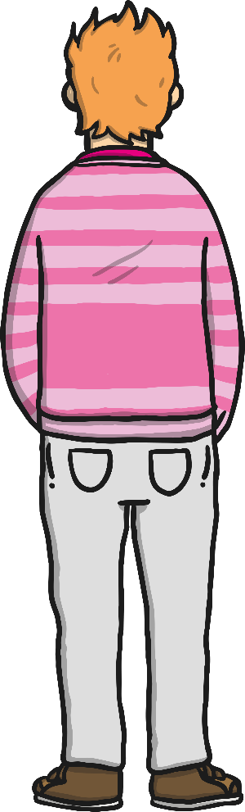
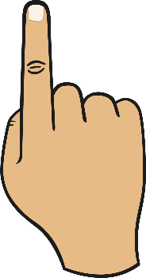
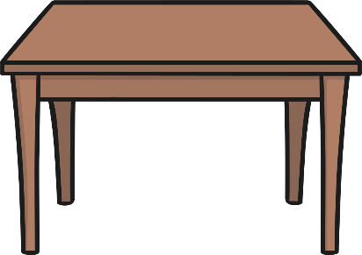



/j/ Spelt ‘-ge’
After all other sounds (vowels or consonants) the /j/ sound is spelt ‘-ge’ at the end of a word.
Can you air write a
‘-dge’ with your finger?
Can you write a ‘-ge’
on your table or
the carpet?
Can you write either a ‘-ge’ or a ‘-dge’ on a
partner’s back?
Can they tell what letters you have written?

Slide 5
Here are this week’s spellings to practise.
badge
edge
bridge
dodge
fudge
age
huge
change
charge
village

