Slide 2
28.6.21
LO: Solve simple problems in a practical context involving addition and subtraction of money of the same unit, including giving change
https://classroomsecrets.co.uk/find-change-year-2-money-learning-video-clip/

Slide 3

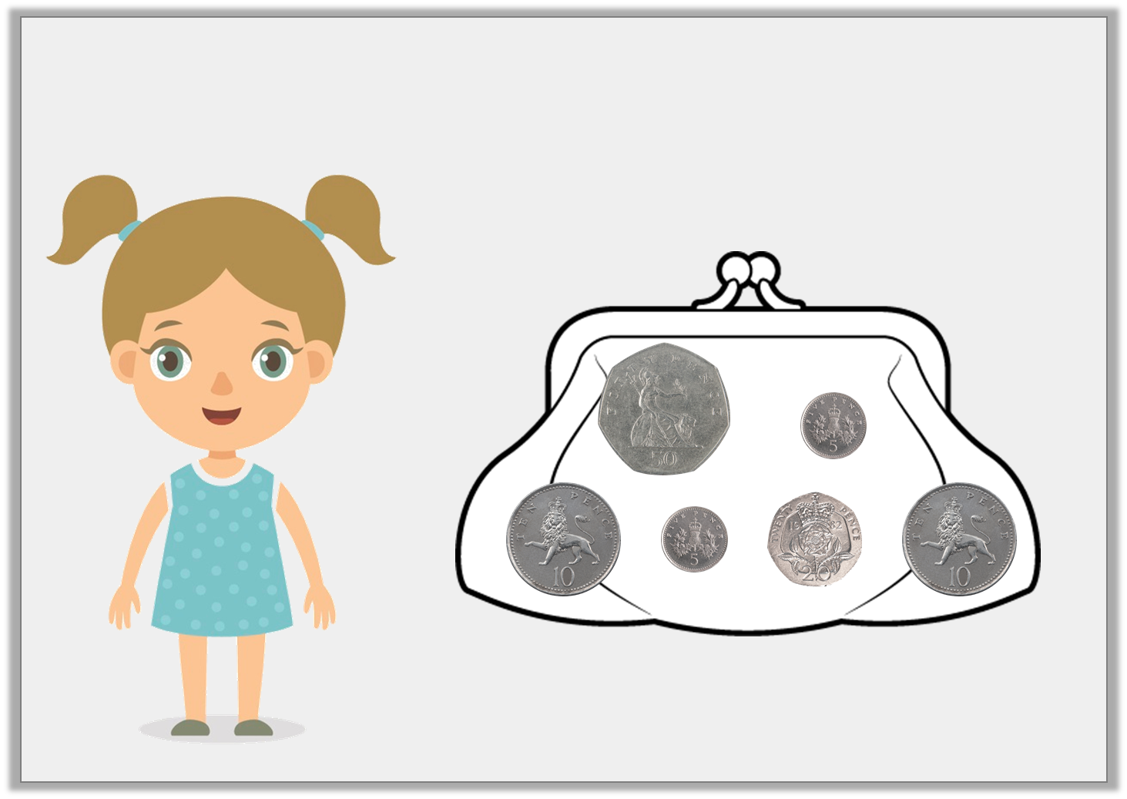

Introduction
How much money does Sara have?
© Classroom Secrets Limited 2018

Slide 4
Introduction
How much money does Sara have?
£1
© Classroom Secrets Limited 2018

Slide 5
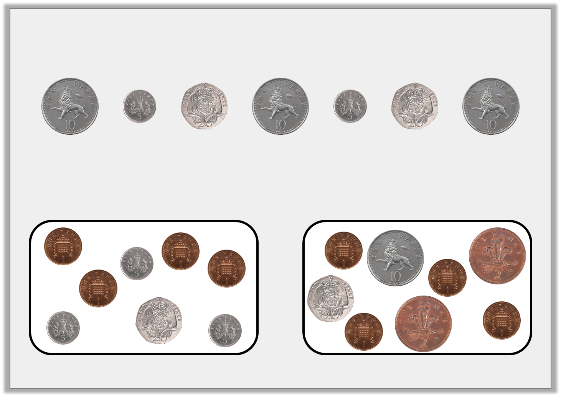
Varied Fluency 1
Philip has the coins below.
He spends 42p.
Tick the correct change.
© Classroom Secrets Limited 2018

Slide 6
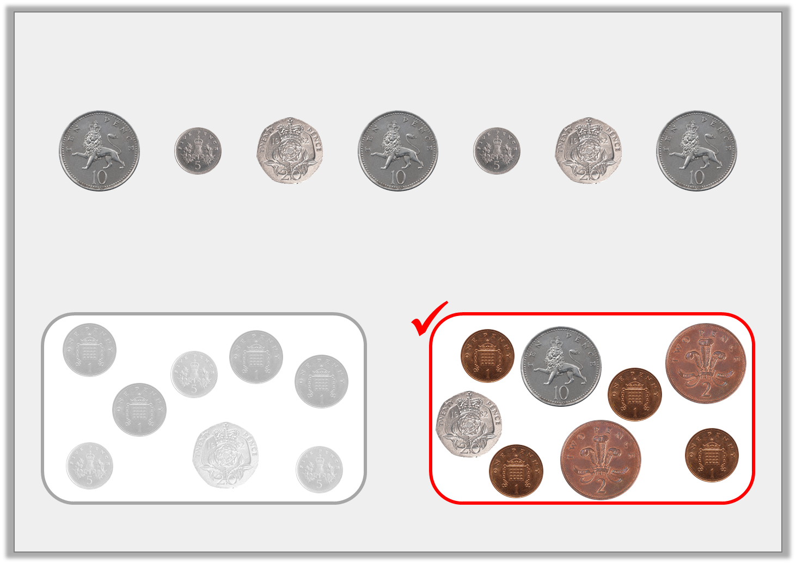
Varied Fluency 1
Philip has the coins below.
He spends 42p.
Tick the correct change.
© Classroom Secrets Limited 2018

Slide 7
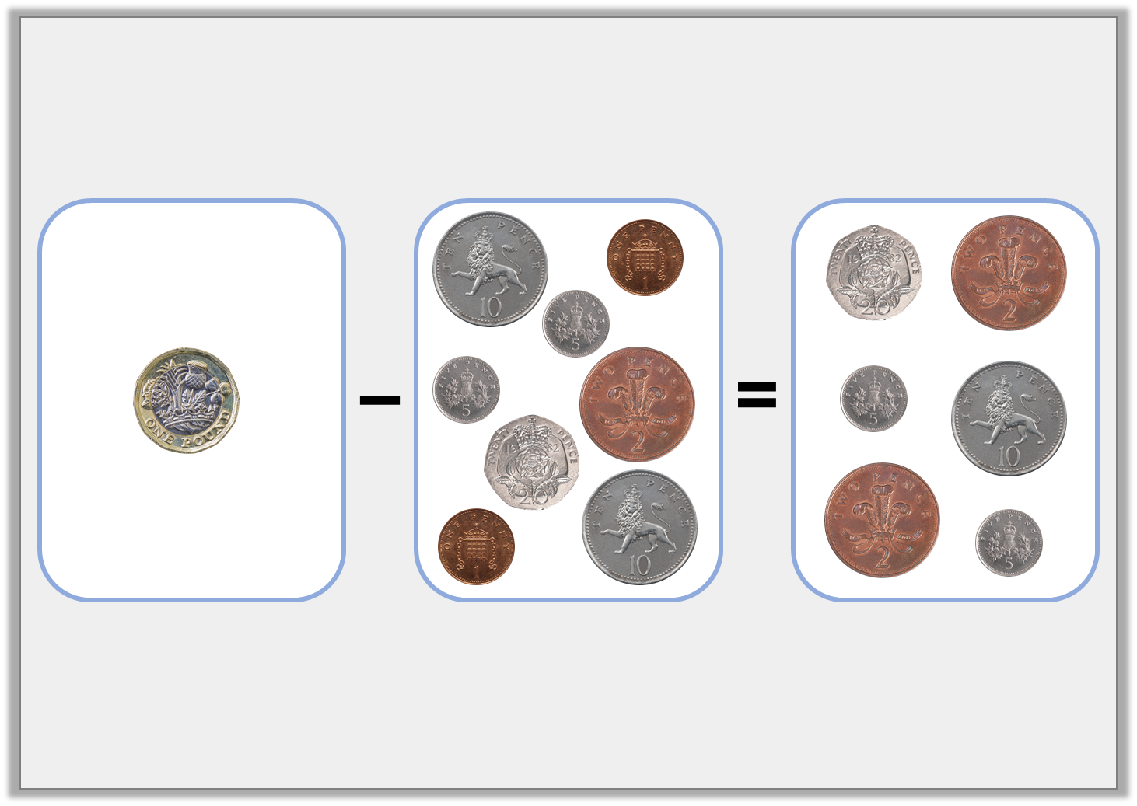
Varied Fluency 2
True or false?
© Classroom Secrets Limited 2018

Slide 8
Varied Fluency 2
True or false?
False
© Classroom Secrets Limited 2018

Slide 9
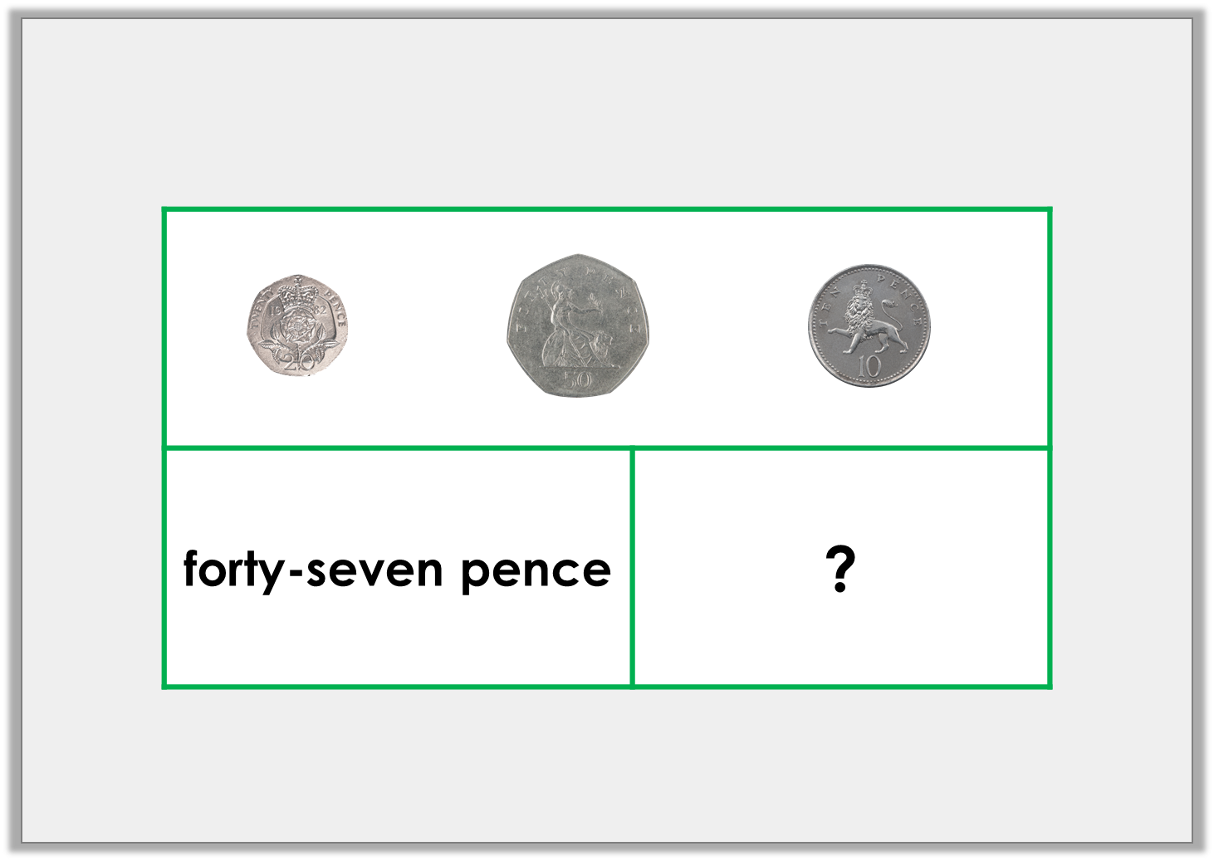
Varied Fluency 3
Complete the bar model.
© Classroom Secrets Limited 2018

Slide 10
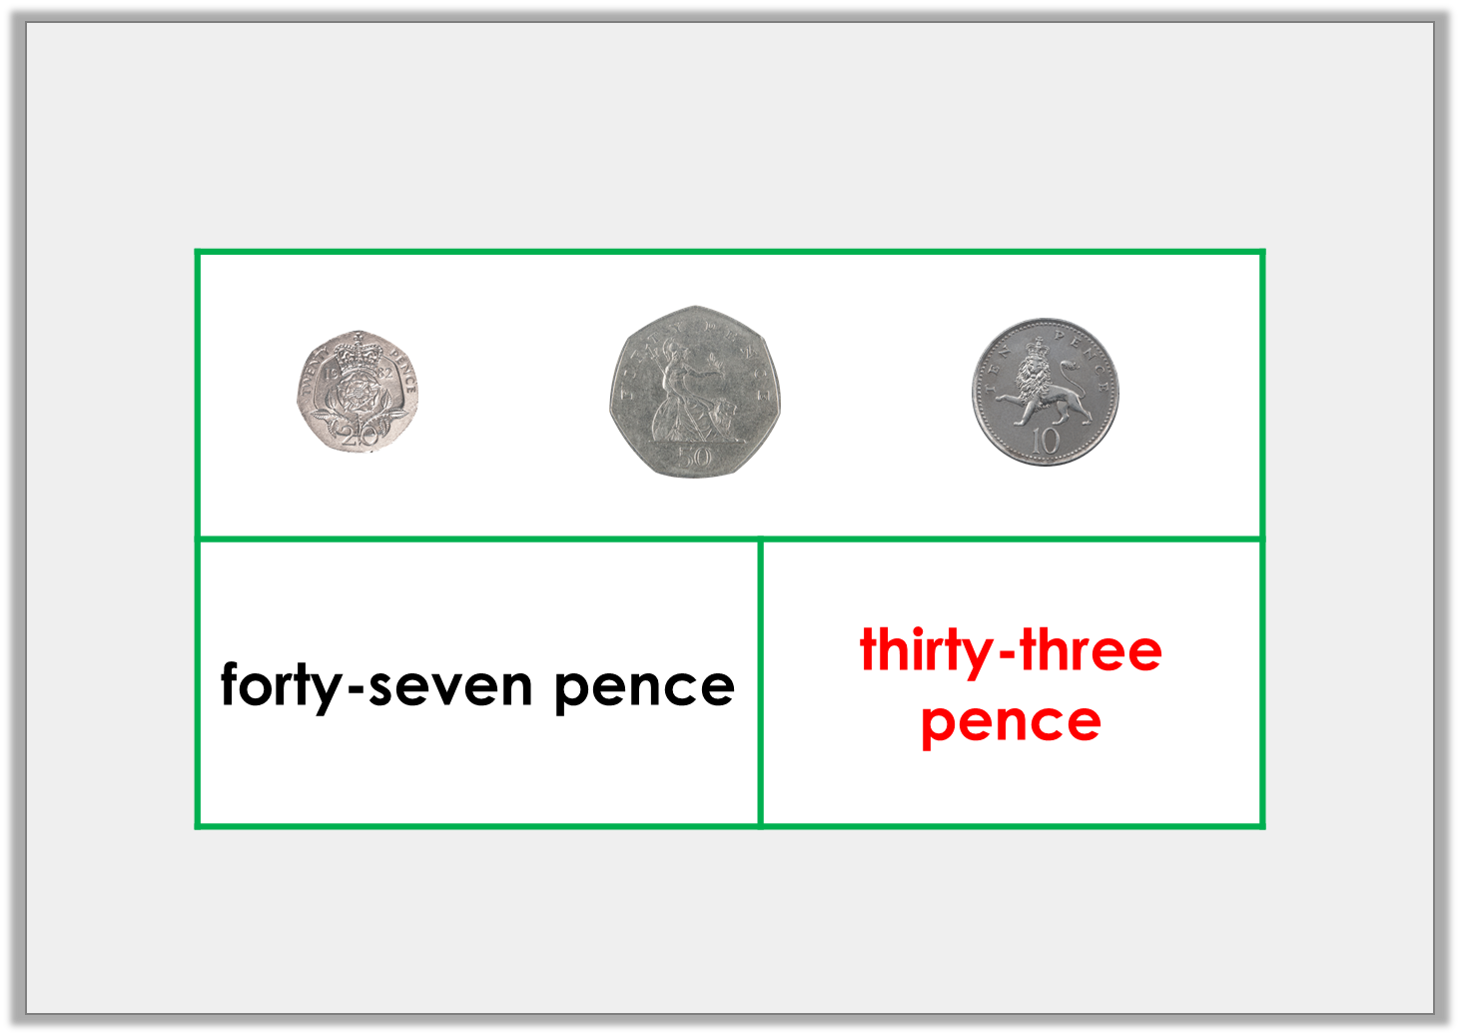
Varied Fluency 3
Complete the bar model.
© Classroom Secrets Limited 2018

Slide 11
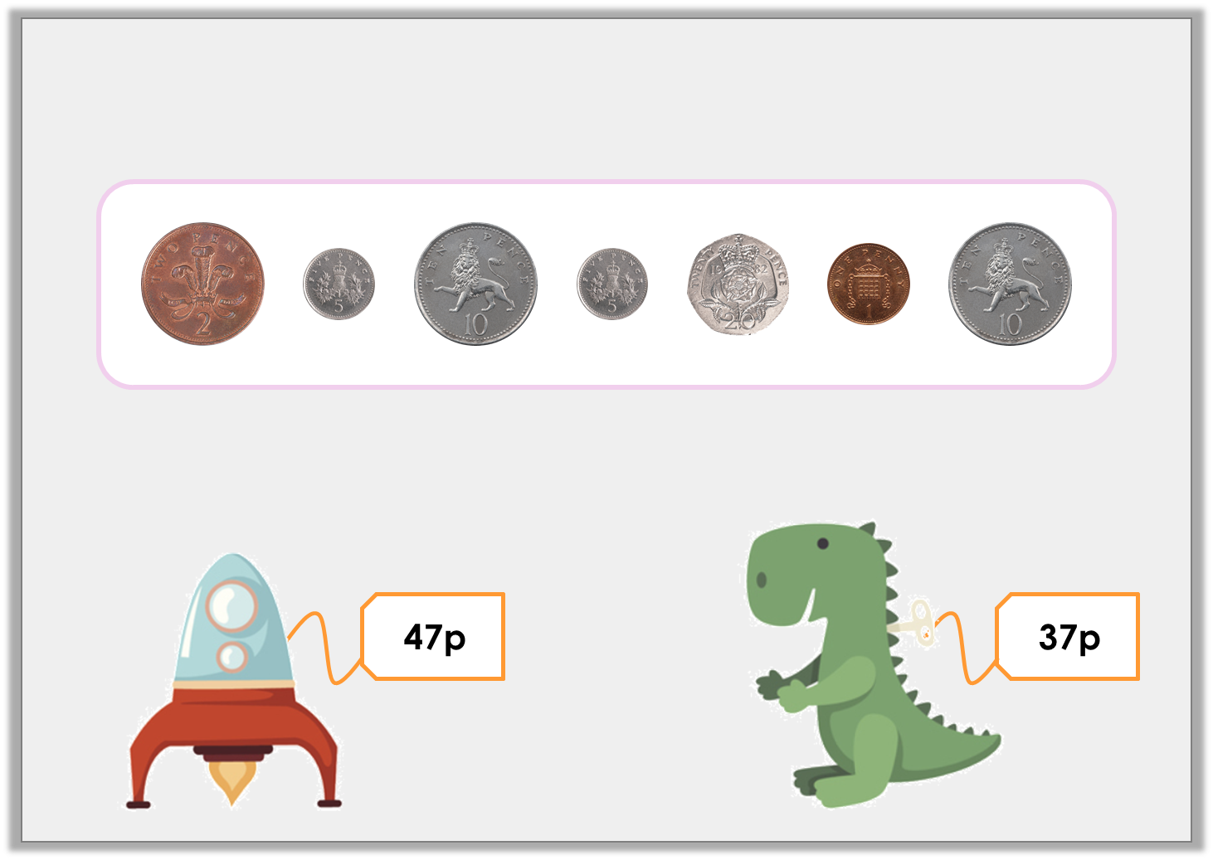
Varied Fluency 4
Nora has 90p and is given the coins below as change.
Which item did Nora buy?
© Classroom Secrets Limited 2018

Slide 12
Varied Fluency 4
Nora has 90p and is given the coins below as change.
Which item did Nora buy?
© Classroom Secrets Limited 2018

Slide 13
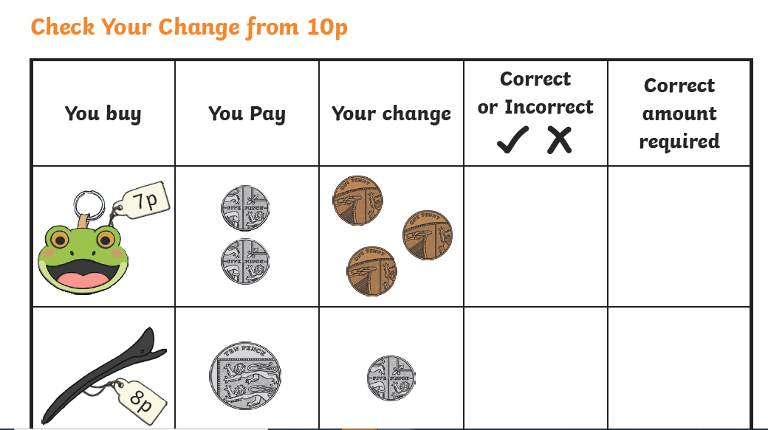
Group 1
Use 1ps to support learners
10p – 7p =
10p – 8p =

Slide 14
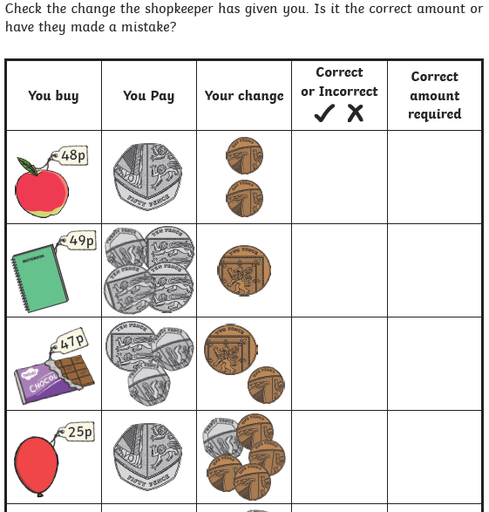
Group 2,3,4
Record the calculation to help
50p – 48p =
50p – 49p =

Slide 15
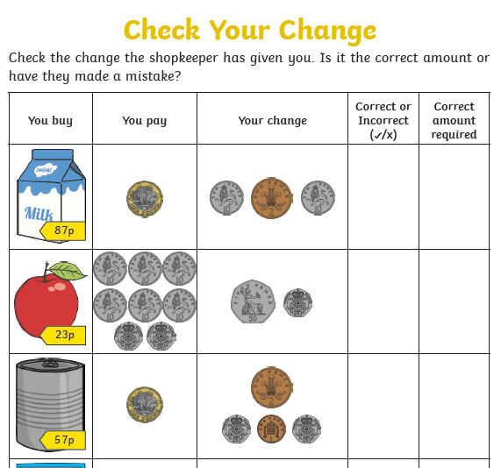
Group 5
100p – 87p =

Slide 16
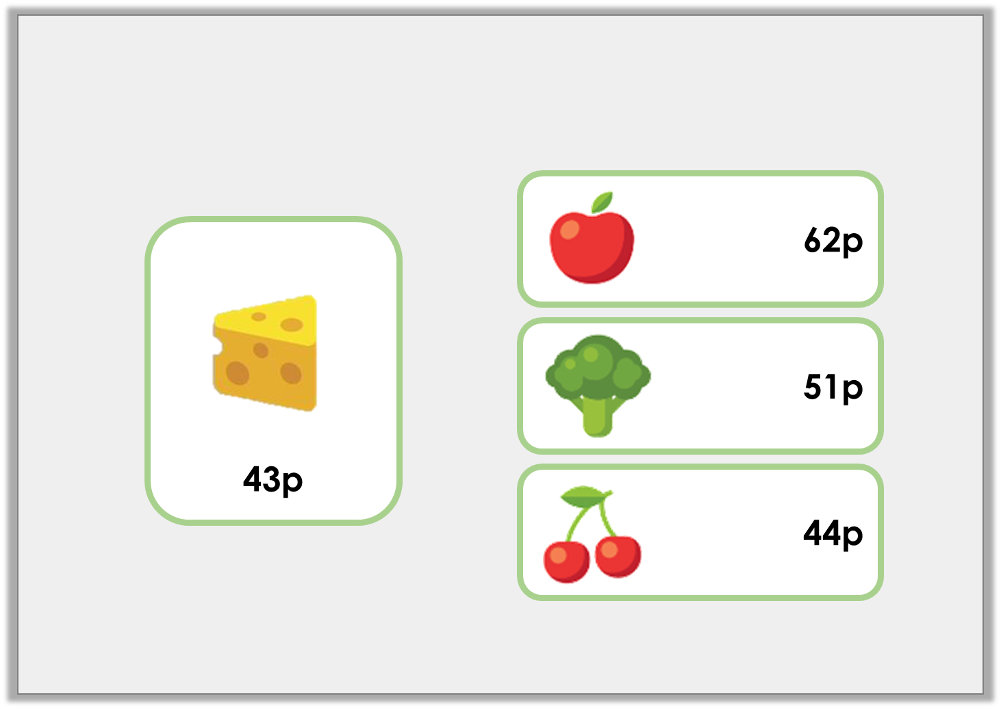
Problem Solving 1
Nicki is given £1 to buy cheese.
She is allowed to spend the change. What can she buy?
© Classroom Secrets Limited 2018

Slide 17
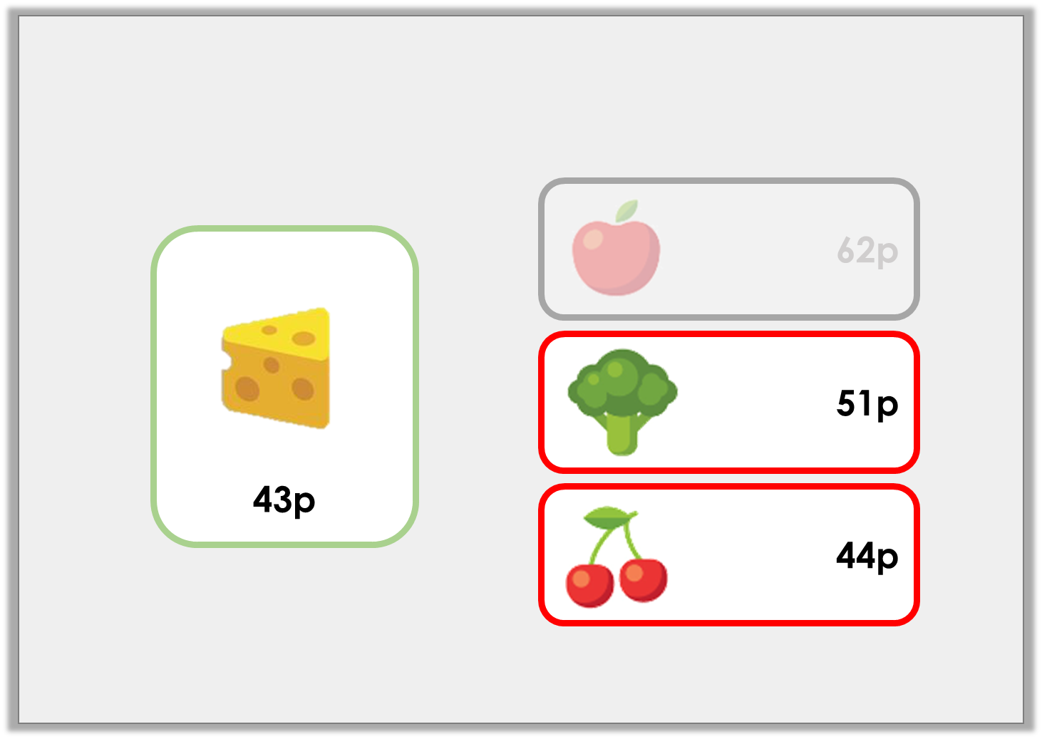
Problem Solving 1
Nicki is given £1 to buy cheese.
She is allowed to spend the change. What can she buy?
Nicki can buy the broccoli or the cherries because she has 57p change.
© Classroom Secrets Limited 2018

Slide 18
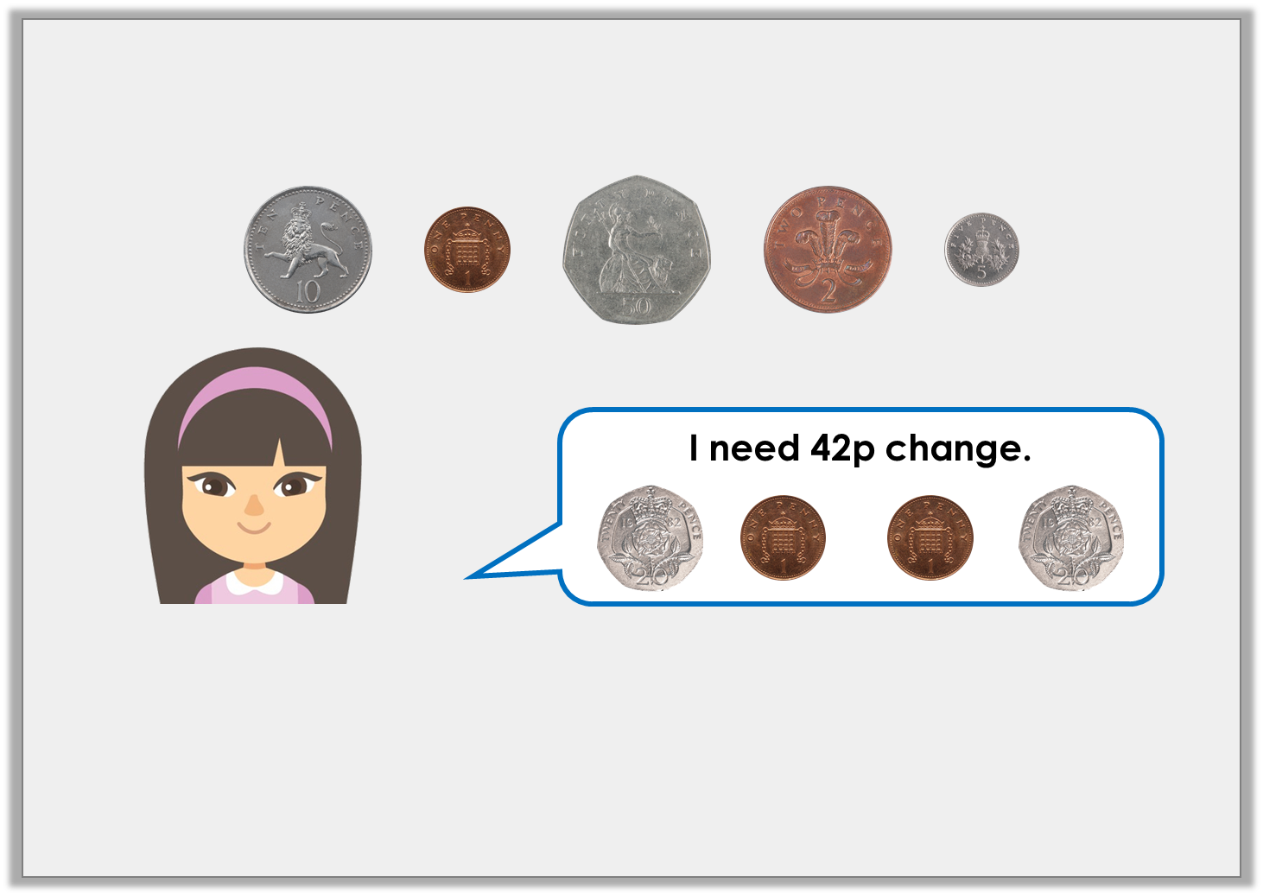
Reasoning 1
Eliza has £1. She buys some pencils that cost 68p.
Is Eliza correct? Explain your answer.
© Classroom Secrets Limited 2018

Slide 19
Reasoning 1
Eliza has £1. She buys some pencils that cost 68p.
Is Eliza correct? Explain your answer.
Eliza is incorrect because…
© Classroom Secrets Limited 2018

Slide 20
Reasoning 1
Eliza has £1. She buys some pencils that cost 68p.
Is Eliza correct? Explain your answer.
Eliza is incorrect because £1 – 68p = 32p.
She would have 10p too much change if she was given 42p.
© Classroom Secrets Limited 2018

Slide 21


