Slide 1
Thursday 1st July
LO: to read and spell words with the j sound
LO: To form lower-case letters of the correct size relative to one another
badge
edge
bridge
dodge
fudge
age
huge
change
charge
village

Slide 2
Inverse operations continued

Slide 3

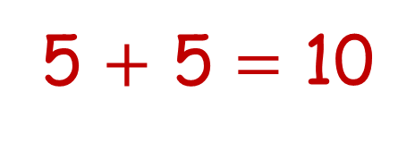
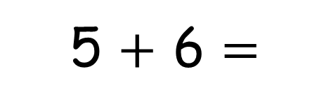
9
5 $+$ 6 $=$
11
5 $+$ 5 $=$ 10
1
5
1
2
3
4
5
6
4
2
3
10
0
1
2
3
4
5
6
7
8
9
10
11
12
13
14
15

Slide 4


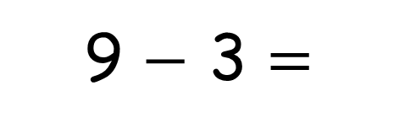
9 $−$ 3 $=$
Have a think
6
Oh I added them!
12

Slide 5
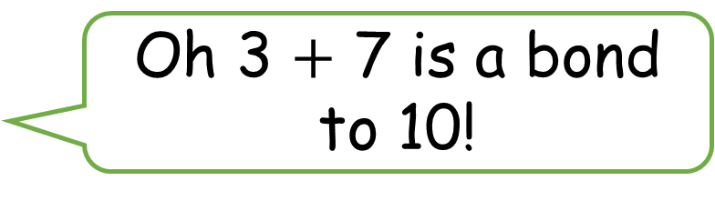
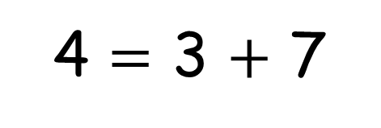
4 $=$ 3 $+$ 7
Have a think
Oh 3 $+$ 7 is a bond to 10!

Slide 6
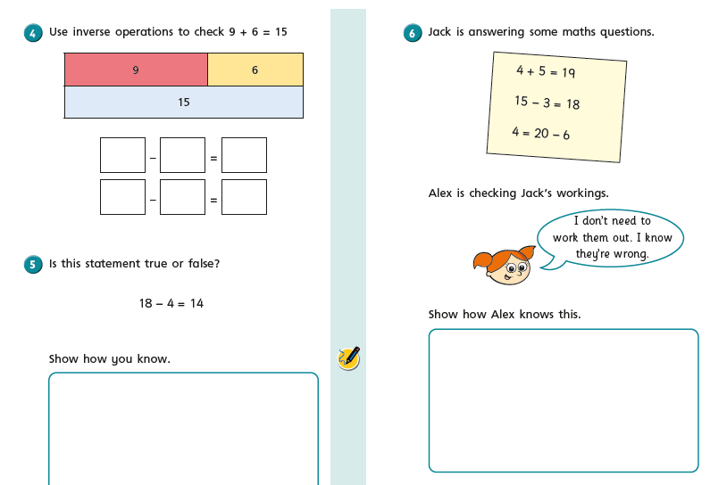
Have a go at the rest of the worksheet

Slide 7
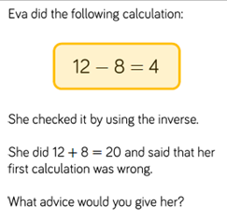

1.7.21
LO: Check calculations

Slide 8
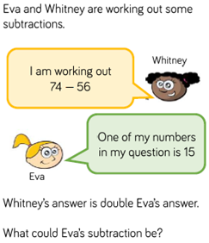

Slide 9
28.6.21
LO: Check calculations

Slide 11



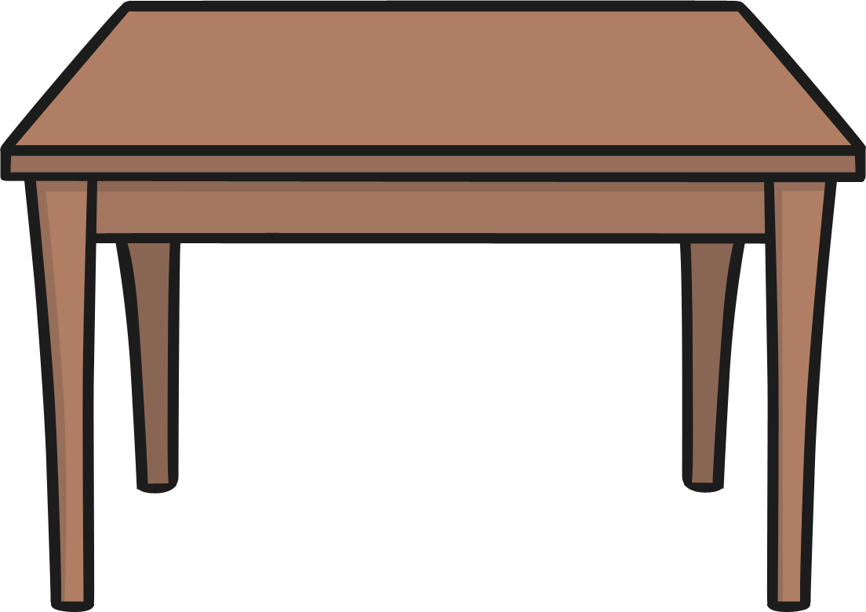
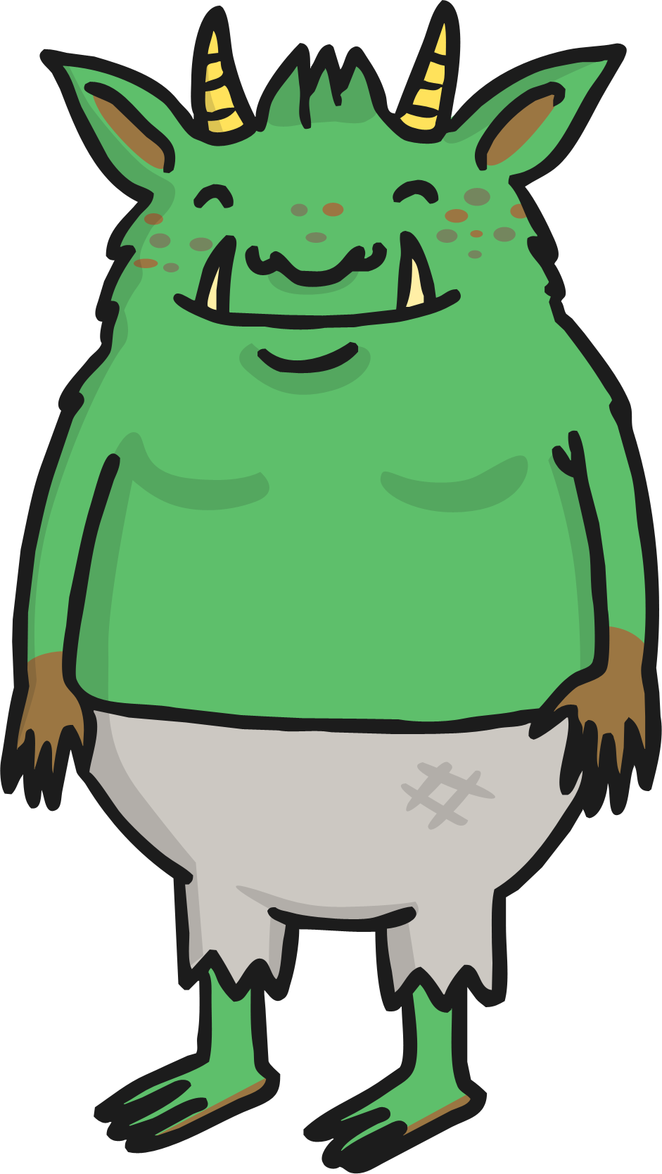

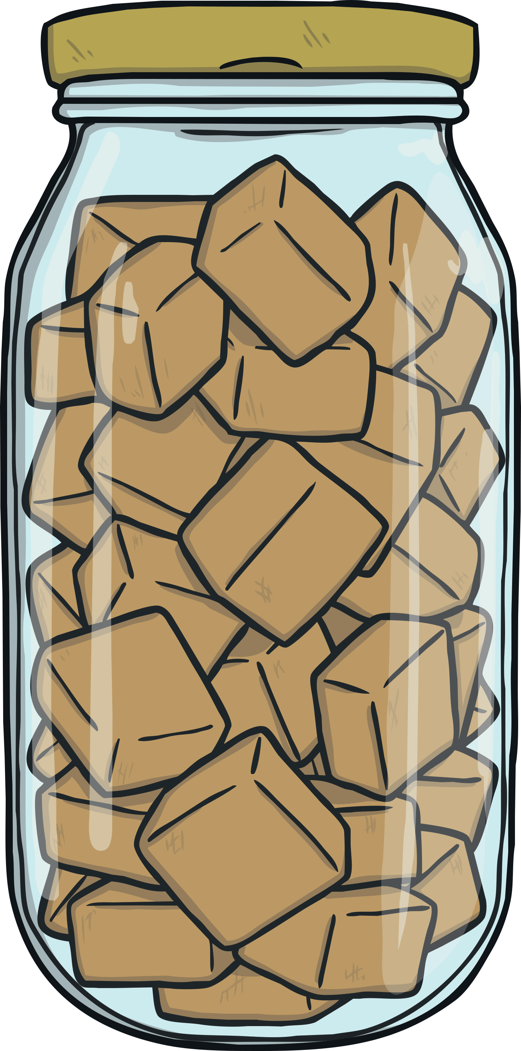
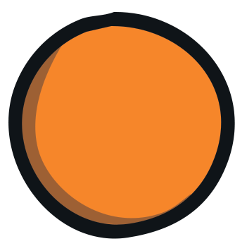
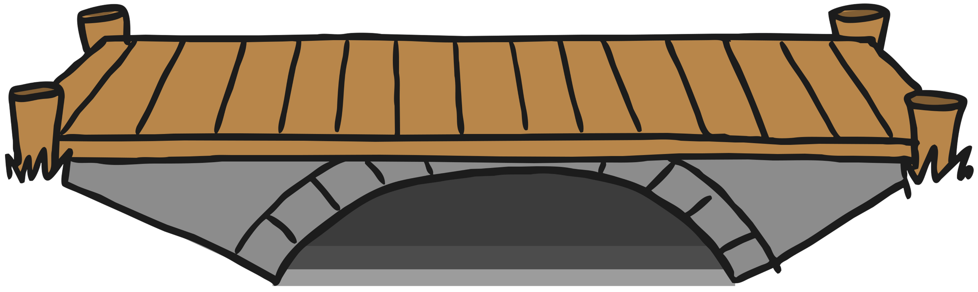
/j/ Spelt ‘-dge’
At the end of a word, the /j/ sound is spelt ‘-dge’
after the short vowel sounds /a/, /e/, /i/, /o/, /u/.
badge
edge
bridge
dodge
fudge

Slide 12
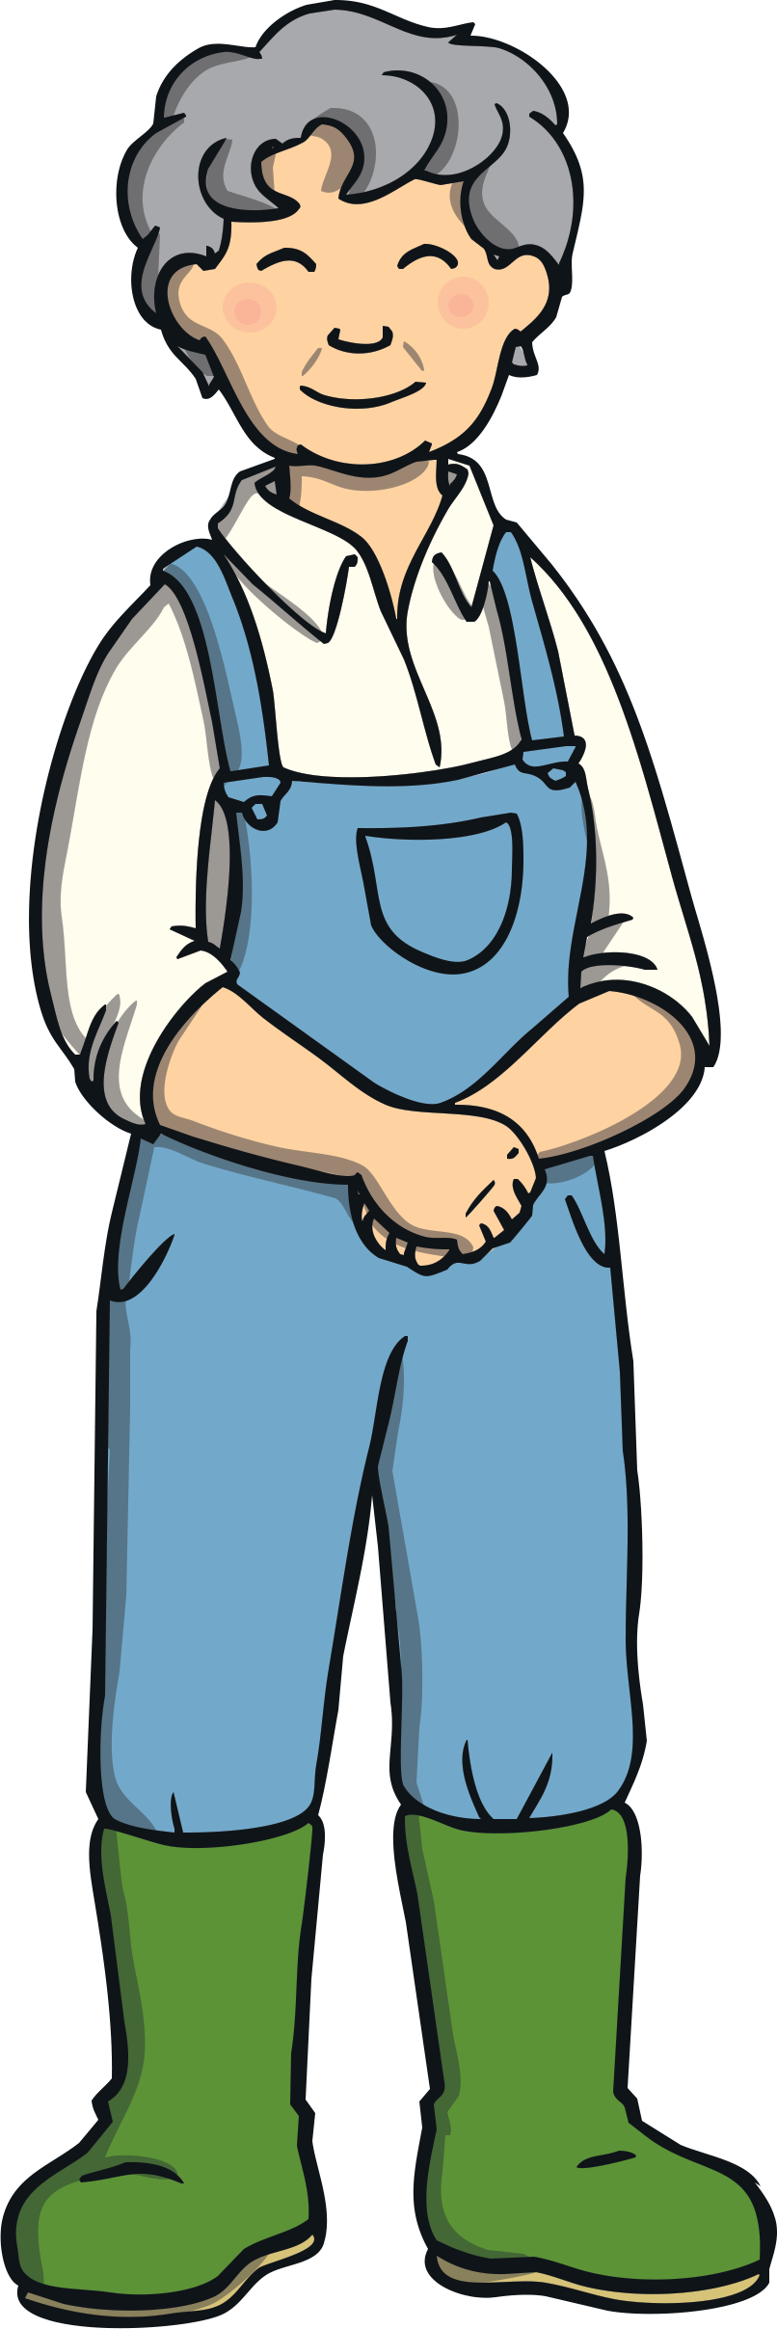

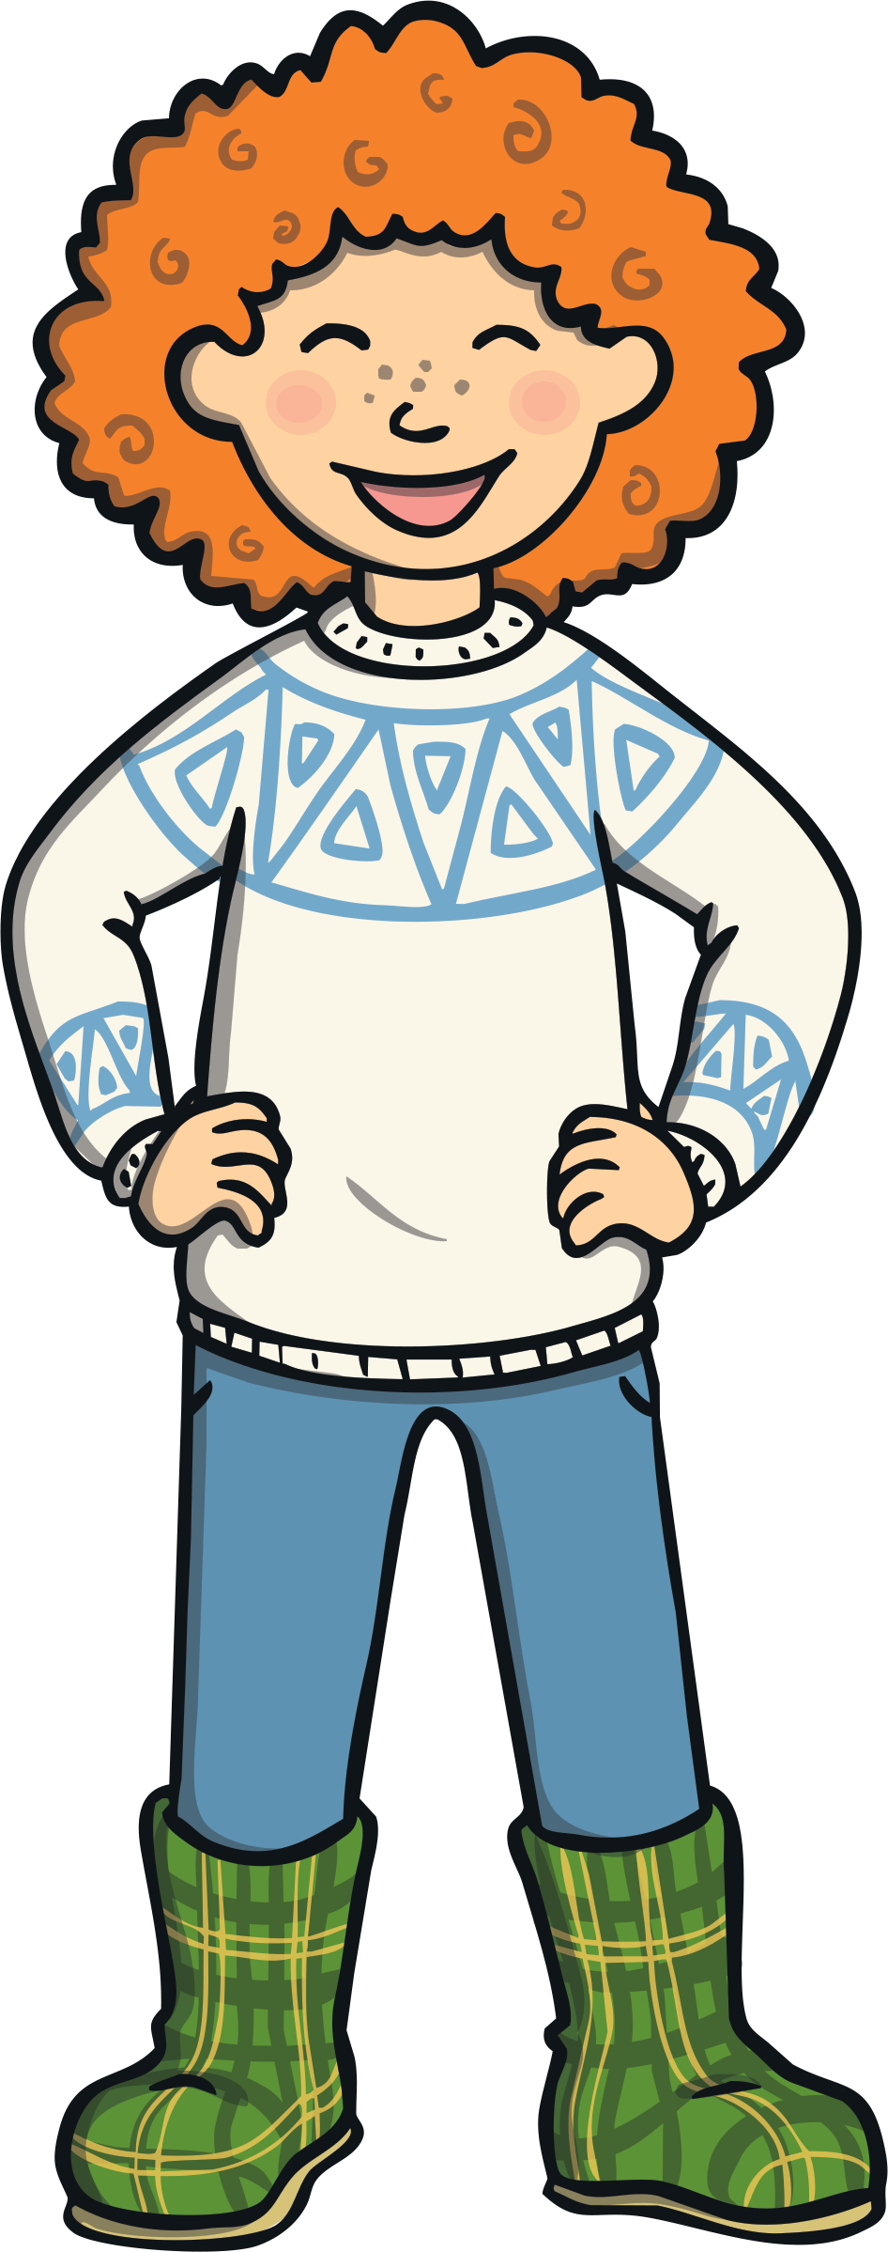
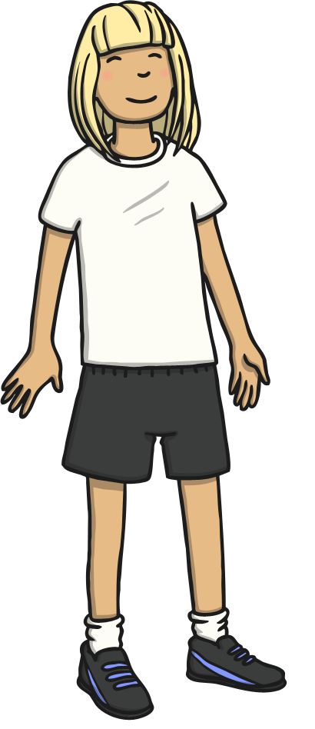


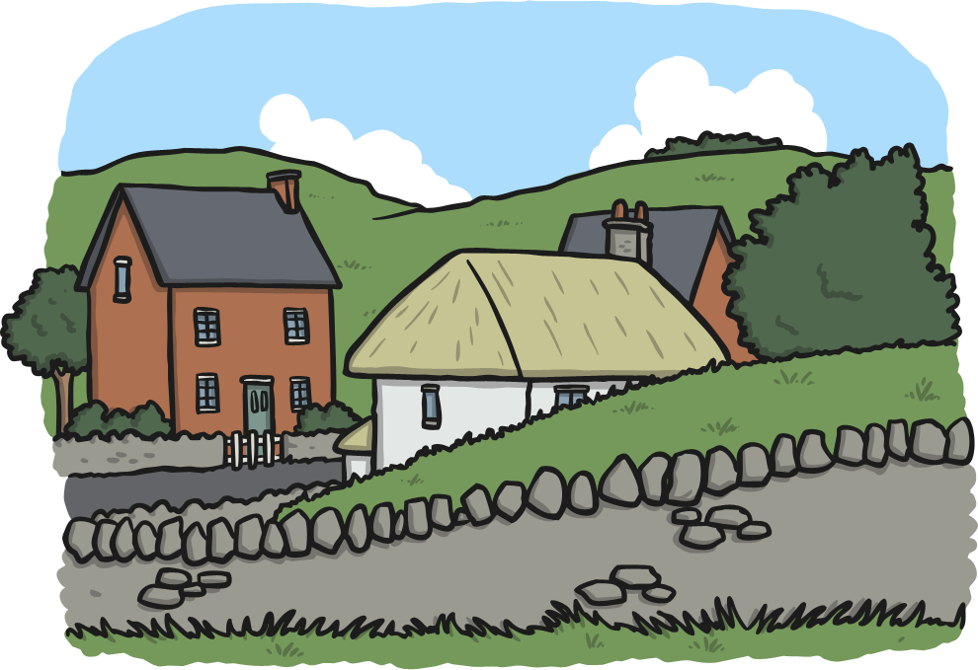
/j/ Spelt ‘-ge’
After all other sounds (vowels or consonants)
the /j/ sound is spelt ‘-ge’ at the end of a word.
age
huge
change
charge
village

Slide 13
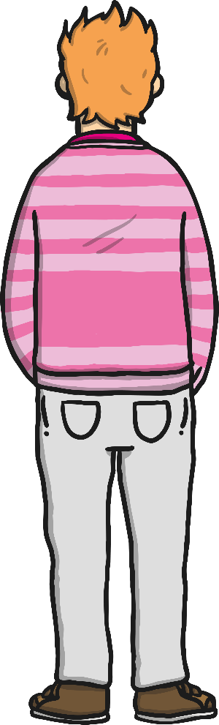

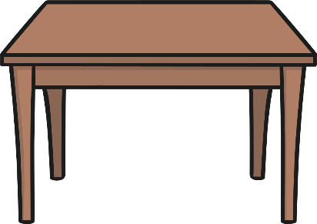



/j/ Spelt ‘-ge’
After all other sounds (vowels or consonants) the /j/ sound is spelt ‘-ge’ at the end of a word.
Can you air write a
‘-dge’ with your finger?
Can you write a ‘-ge’
on your table or
the carpet?
Can you write either a ‘-ge’ or a ‘-dge’ on a
partner’s back?
Can they tell what letters you have written?

Slide 14
Here are this week’s spellings to practise.
badge
edge
bridge
dodge
fudge
age
huge
change
charge
village

Slide 15
BREAK

Slide 16
Thursday 2nd July
LO: To discuss and answer questions on books
Print questions from book

Slide 17
Thursday 1st July
LO: write a recount in the first person
Title
Introduction
Beginning
Middle
End / concluding sentence

Slide 18
Picture Plan of recount

Slide 19
Write the middle and end of recount

Slide 20

Writing- watch to recap each day the sequence of events in story
https://www.youtube.com/watch?v=JtQ4DdzCZMA

Slide 21
Times tables 3 x table
https://www.youtube.com/watch?v=0LjzvbTw8E4
0 3 6 9 12 15 18 21 24 27 30 33 36

Slide 22
LUNCH

Slide 23
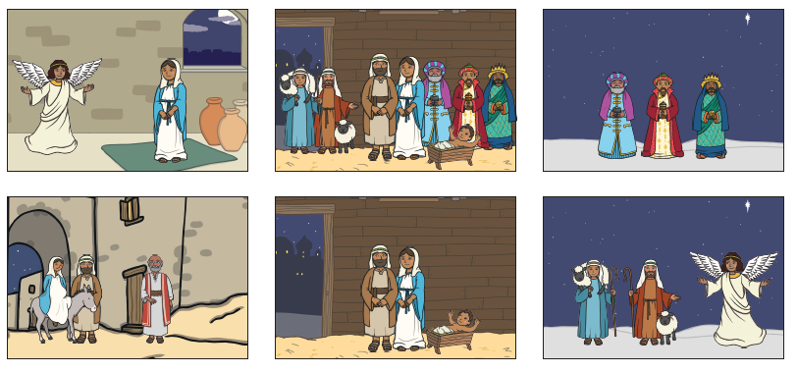
RE
Thursday 1st July
LO: to tell religious stories
https://www.youtube.com/watch?v=FrTFAZPQxpE

Slide 24
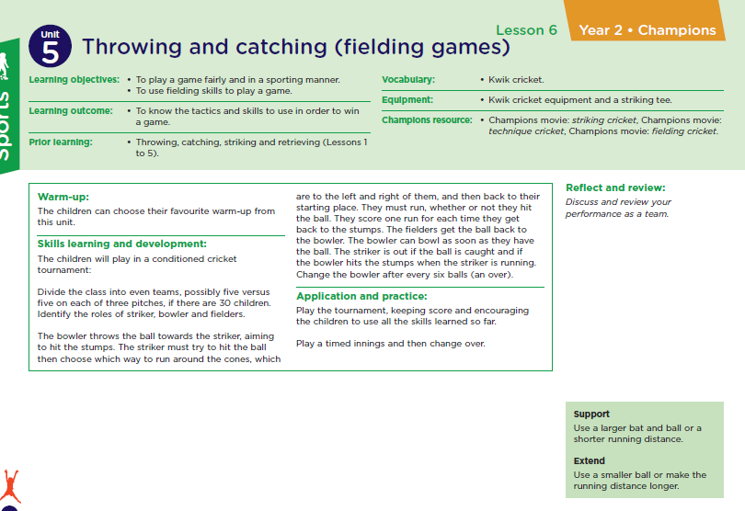
PE
To practise throwing skills in circuit.

