Slide 2


Slide 4

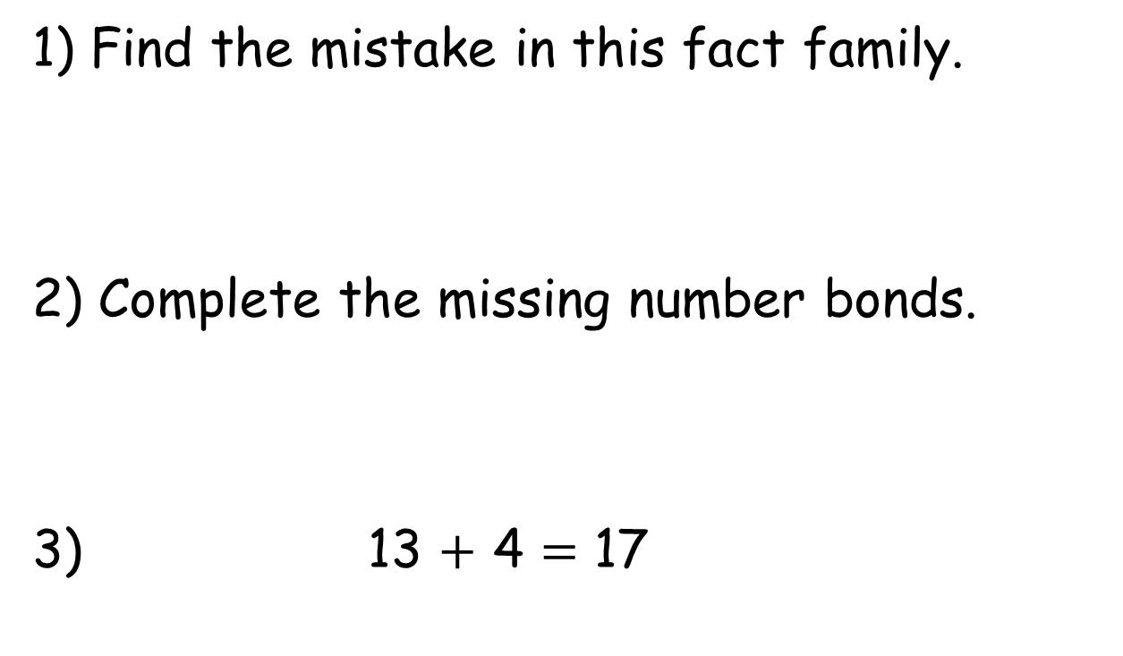
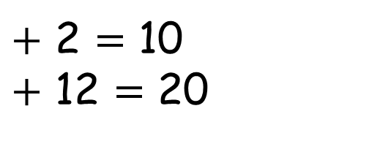
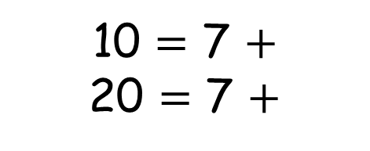
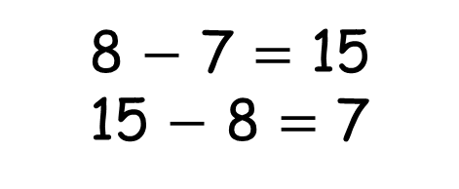
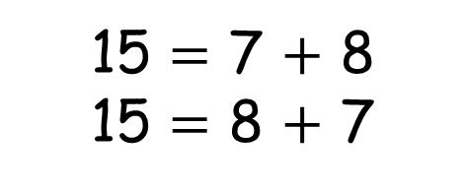
1) Find the mistake in this fact family.
2) Complete the missing number bonds.
3) 13 $+$ 4 $=$ 17
15 $=$ 7 $+$ 8
15 $=$ 8 $+$ 7
8 $−$ 7 $=$ 15
15 $−$ 8 $=$ 7
10 $=$ 7 $+$
20 $=$ 7 $+$
$+$ 2 $=$ 10
$+$ 12 $=$ 20

Slide 5

1) Find the mistake in this fact family.
2) Complete the missing number bonds.
3) 13 $+$ 4 $=$ 17
15 $=$ 7 $+$ 8
15 $=$ 8 $+$ 7
8 $−$ 7 $=$ 15
15 $−$ 8 $=$ 7
10 $=$ 7 $+$
20 $=$ 7 $+$
8
$+$ 2 $=$ 10
$+$ 12 $=$ 20
3
13
8
17
17
13
4
13
4

Slide 7






There are 6 blue cars and 3 silver cars in a car park. There are 9 cars altogether.
I can use counters and a ten frame.
I can draw a picture to help me check.

Slide 8


7
10
11
8
9
7 $+$ 4

Slide 9

Oh I can remember another way
12
16 $−$ 4

Slide 10


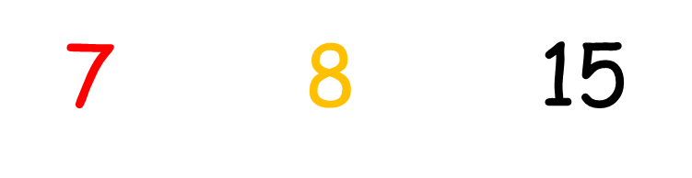




7
$$=$$
7 $+$ 8 $=$ 15
8
15
8
$$=$$
7
$$−$$
$$+$$

Slide 11




7
$$+$$
$$=$$
7 $+$ 8 $=$ 15
8
15
$$−$$
8
$$=$$
7
15
$$−$$
8
$$=$$
7

Slide 12



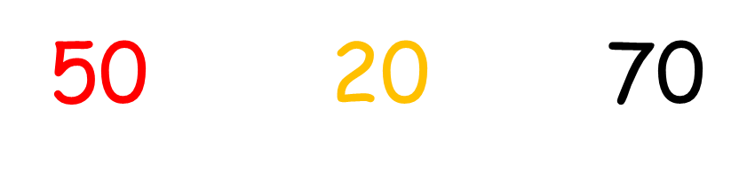
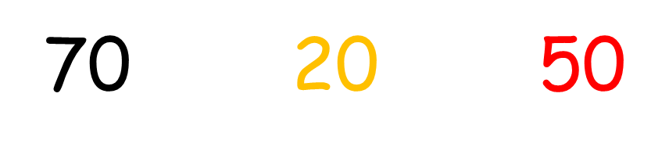

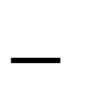

Have a think
50 $+$ 20 $=$ 70
70 $+$ 20 $=$ 50
$$=$$
$$−$$
$$+$$
$$=$$

Slide 13
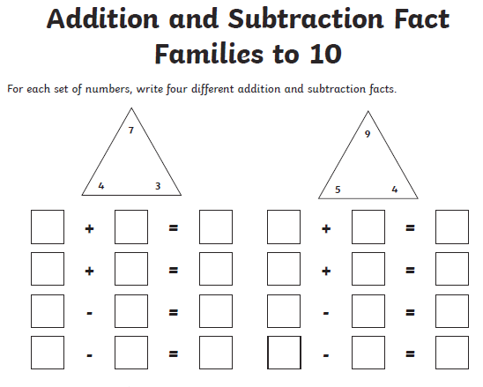
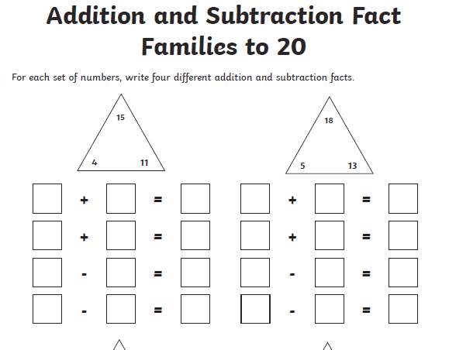
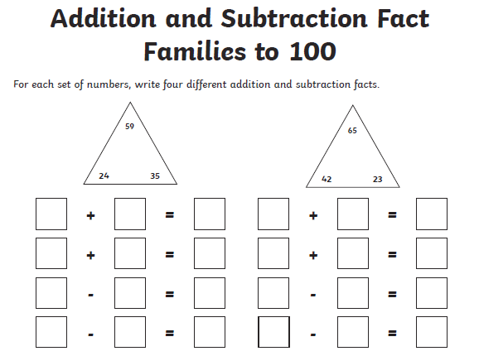

Slide 14
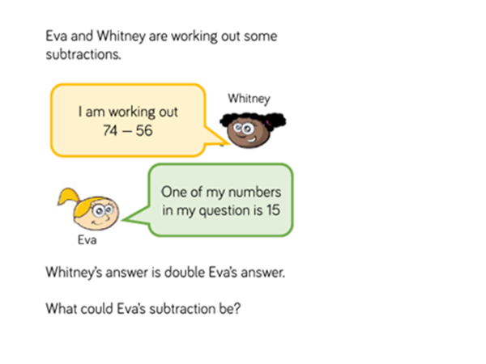
Have a think …

