Slide 1
Friday 2nd July
LO: to read and spell words with the j sound
LO: To form lower-case letters of the correct size relative to one another
badge
edge
bridge
dodge
fudge
age
huge
change
charge
village

Slide 2
Maths compare calculations

Slide 3


Year 2 – Autumn Block 2 – Addition and Subtraction
Step 3: Compare Number Sentences
© Classroom Secrets Limited 2018

Slide 4
Introduction
Match the sums that make the same totals.
5 + 3 |  | 8 + 6
9 + 5 |  | 5 + 4
7 + 5 |  | 4 + 4
2 + 7 |  | 6 + 6
© Classroom Secrets Limited 2018

Slide 5
Introduction
Match the sums that make the same totals.
5 + 3 |  | 8 + 6
9 + 5 |  | 5 + 4
7 + 5 |  | 4 + 4
2 + 7 |  | 6 + 6
© Classroom Secrets Limited 2018

Slide 6
Varied Fluency 1
Complete the part whole models.
A.
B.
3
12
4
12
C.
D.
5
12
6
12
© Classroom Secrets Limited 2018

Slide 7
Varied Fluency 1
Complete the part whole models.
15
16
A.
B.
3
12
4
12
17
18
C.
D.
5
12
6
12
© Classroom Secrets Limited 2018

Slide 8
Varied Fluency 2
Choose the correct calculation to complete the statements.
1. | 16 – 9 | >
2. | 16 – 7 | <
3. | 16 + 4 | =
A. | 15 + 5 | B. | 16 – 10 | C. | 17 – 7
© Classroom Secrets Limited 2018

Slide 9
Varied Fluency 2
Choose the correct calculation to complete the statements.
1. | 16 – 9 | > | B
2. | 16 – 7 | < | C
3. | 16 + 4 | = | A
A. | 15 + 5 | B. | 16 – 10 | C. | 17 – 7
© Classroom Secrets Limited 2018

Slide 10
Varied Fluency 3
Tick the statements that are true. Correct those that are false.
A. | 5 + 11 | < | 5 + 12
B. | 13 – 9 | = | 14 – 9
C. | 12 + 3 | < | 12 + 2
D. | 15 – 5 | = | 16 – 6
© Classroom Secrets Limited 2018

Slide 11
Varied Fluency 3
Tick the statements that are true. Correct those that are false.
A. | 5 + 11 | < | 5 + 12
B. | 13 – 9 | < | 14 – 9
C. | 12 + 3 | > | 12 + 2
D. | 15 – 5 | = | 16 – 6
✓
✓
© Classroom Secrets Limited 2018

Slide 12
Problem Solving 1
Use the digit cards to find all of the possible combinations that will make this statement correct.
1 | 5 | – | 2 | = |  |  |  | –
0 |  | 1 |  | 1 |  | 3 |  | 4 |  | 5 |  | 6
© Classroom Secrets Limited 2018

Slide 13
Problem Solving 1
Use the digit cards to find all of the possible combinations that will make this statement correct.
Various answers, for example: 16 – 3, 14 – 1, 13 – 0
1 | 5 | – | 2 | = | 1 |  | 6 | – | 3
0 |  | 1 |  | 1 |  | 3 |  | 4 |  | 5 |  | 6
© Classroom Secrets Limited 2018

Slide 14
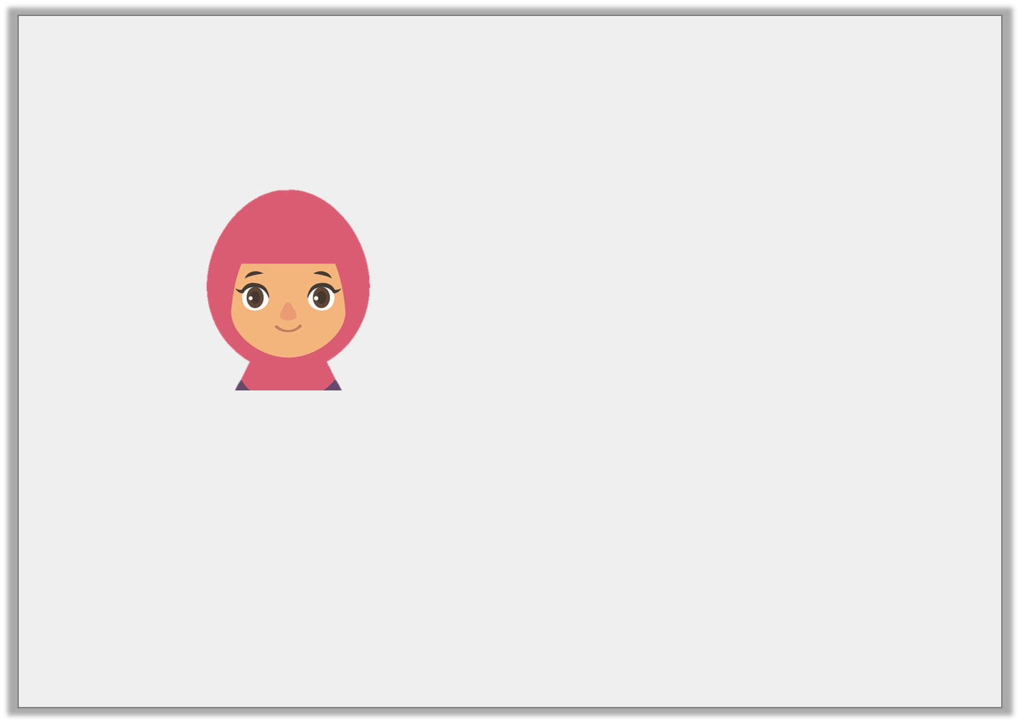
Reasoning 1
Zahra says,
Is she correct? Convince me.
2 + 16 = 3 + 16
© Classroom Secrets Limited 2018

Slide 15
Reasoning 1
Zahra says,
Is she correct? Convince me.
Zahra is incorrect because…
2 + 16 = 3 + 16
© Classroom Secrets Limited 2018

Slide 16
Reasoning 1
Zahra says,
Is she correct? Convince me.
Zahra is incorrect because 2 + 16 = 18 and 3 + 16 = 19.
This means that 2 + 16 < 3 + 16.
2 + 16 = 3 + 16
© Classroom Secrets Limited 2018

Slide 17
Problem Solving 2
These digit cards have been placed incorrectly.
Rearrange them to make the statement correct.
5 | + | 9 | > | 4 | + | 10
© Classroom Secrets Limited 2018

Slide 18
Problem Solving 2
These digit cards have been placed incorrectly.
Rearrange them to make the statement correct.
Various answers, for example:
5 + 10 > 4 + 9; 10 + 9 > 5 + 4
5 | + | 10 | > | 4 | + | 9
© Classroom Secrets Limited 2018

Slide 19
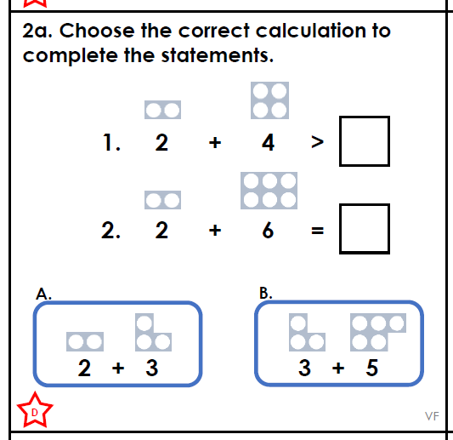

Slide 20
Spelling
Apostrophes for contracted forms

Slide 22
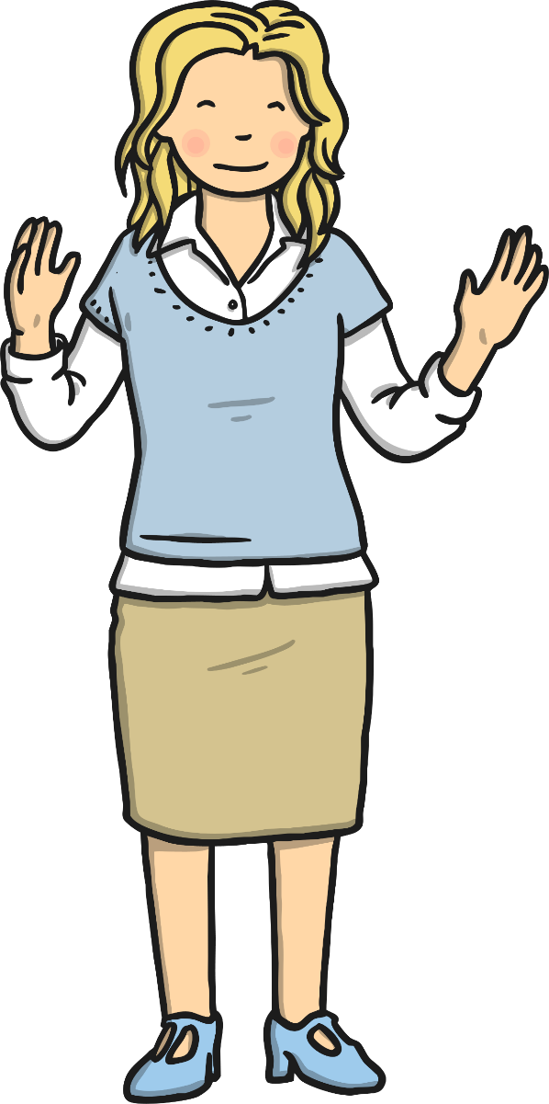
Shortened Words
Sometimes, we join two words together to make
them shorter.
We call these contractions.
In today’s lesson, we will learn some rules for using contractions correctly.

Slide 23
I am
If ‘I’ is one of the words in the contraction, the ‘I’ must be a capital letter.
When shortening ‘am’ with ‘I’, remove the ‘a’ and replace it with an apostrophe.
I am
I am
=
I’m

Slide 24
Are
If ‘are’ is one of the words in the contraction, remove the ‘a’ and replace it with an apostrophe.
we are
we are
you are
you are
they are
they are
=
=
=
we’re
you’re
they’re

Slide 25
Is
If ‘is’ is one of the words in the contraction, remove the ‘i’ and replace it with an apostrophe.
he is
he is
she is
she is
it is
it is
that is
that is
=
=
=
=
he’s
she’s
it’s
that’s

Slide 26
Will
If ‘will’ is one of the words in the contraction, remove the ‘w’ and the ‘i’ and replace them both with an apostrophe.
I will
I will
you will
you will
he will
he will
she will
she will
=
=
=
=
I’ll
you’ll
he’ll
she’ll
it will
it will
we will
we will
they will
they will
=
=
=
it’ll
we’ll
they’ll

Slide 27
Has
If ‘has’ is one of the words in the contraction, remove the ‘h’ and the ‘a’ and replace them both with an apostrophe.
she has
she has
he has
he has
it has
it has
that has
that has
=
=
=
=
she’s
he’s
it’s
that’s

Slide 28
Had
If ‘had’ is one of the words in the contraction, remove the ‘h’ and the ‘a’ and replace them both with an apostrophe.
I had
she had
I had
you had
you had
she had
=
=
=
I’d
you’d
she’d
he had
he had
they had
they had
we had
we had
=
=
=
he’d
they’d
we’d

Slide 29
Have
If ‘have’ is one of the words in the contraction, remove the ‘h’ and the ‘a’ and replace them both with an apostrophe.
I have
I have
you have
you have
we have
we have
they have
they have
=
=
=
=
I’ve
you’ve
we’ve
they’ve

Slide 30
Not
If ‘not’ is one of the words in the contraction, remove the ‘o’ and replace it with an apostrophe.
could not
could not
do not
do not
does not
does not
had not
had not
=
=
=
=
couldn’t
don’t
doesn’t
hadn’t
have not
have not
is not
is not
should not
should not
would not
would not
=
=
=
=
haven’t
isn’t
shouldn’t
wouldn’t
But watch out!
can not = can’t (remove one n) will not = won’t

Slide 31
Edit the passage by using contractions.
I’m going shopping today. My friend Lucy will be going too. She’s a lovely girl. She’ll get the bus there but I’ll go by train. We’re going to get lunch in town. I’m going to bring an umbrella because it’s going to rain. We’ll be meeting my sister and her friends this afternoon because they’re going shopping too. My mum can’t collect us so we’ll get the bus home. We’ll have to be home at seven o’clock this evening and we’ll not be late.
I am going shopping today. My friend Lucy will be going too. She is a lovely girl. She will get the bus there but I will go by train. We are going to get lunch in town. I am going to bring an umbrella because it is going to rain. We will be meeting my sister and her friends this afternoon because they are going shopping too. My mum can not collect us so we will get the bus home. We will have to be home at seven o’clock this evening and we will not be late.

Slide 32
Friday 2nd July
LO: To answer questions on a text
Print questions from book

Slide 33
Friday 2nd July
LO: write a recount in the first person
Title
Introduction
Beginning
Middle
End / concluding sentence

Slide 34
Picture Plan of recount

Slide 35
Re-read out loud and edit to improve your writing

Slide 36
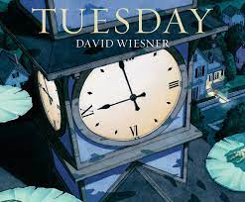
Writing- watch to recap each day the sequence of events in story
https://www.youtube.com/watch?v=JtQ4DdzCZMA

Slide 37
Times tables 3 x table
https://www.youtube.com/watch?v=0LjzvbTw8E4
0 3 6 9 12 15 18 21 24 27 30 33 36

Slide 38
Topic
Practise cutting and sewing two pieces of fabric together

