Slide 1
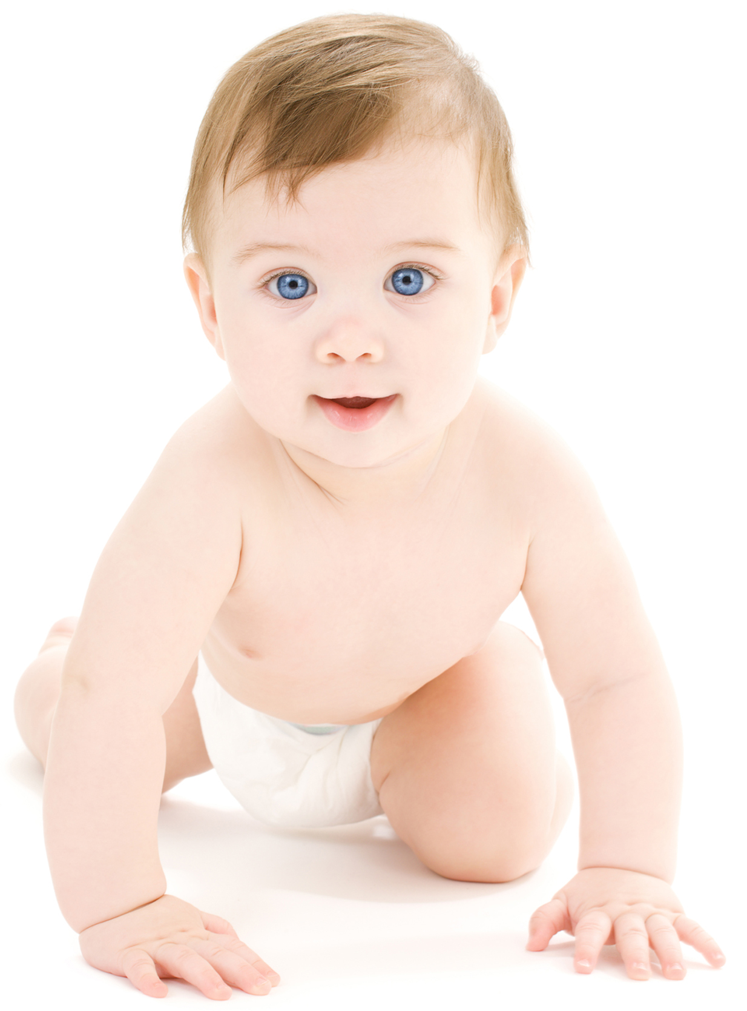



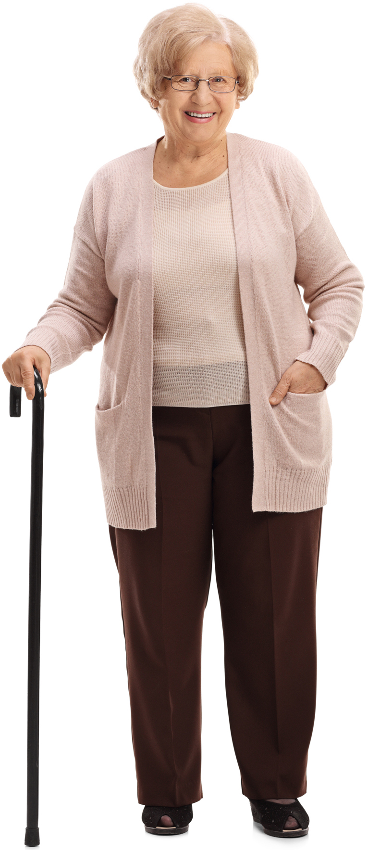

adult
baby
child
elderly
teenager
toddler

