Slide 1

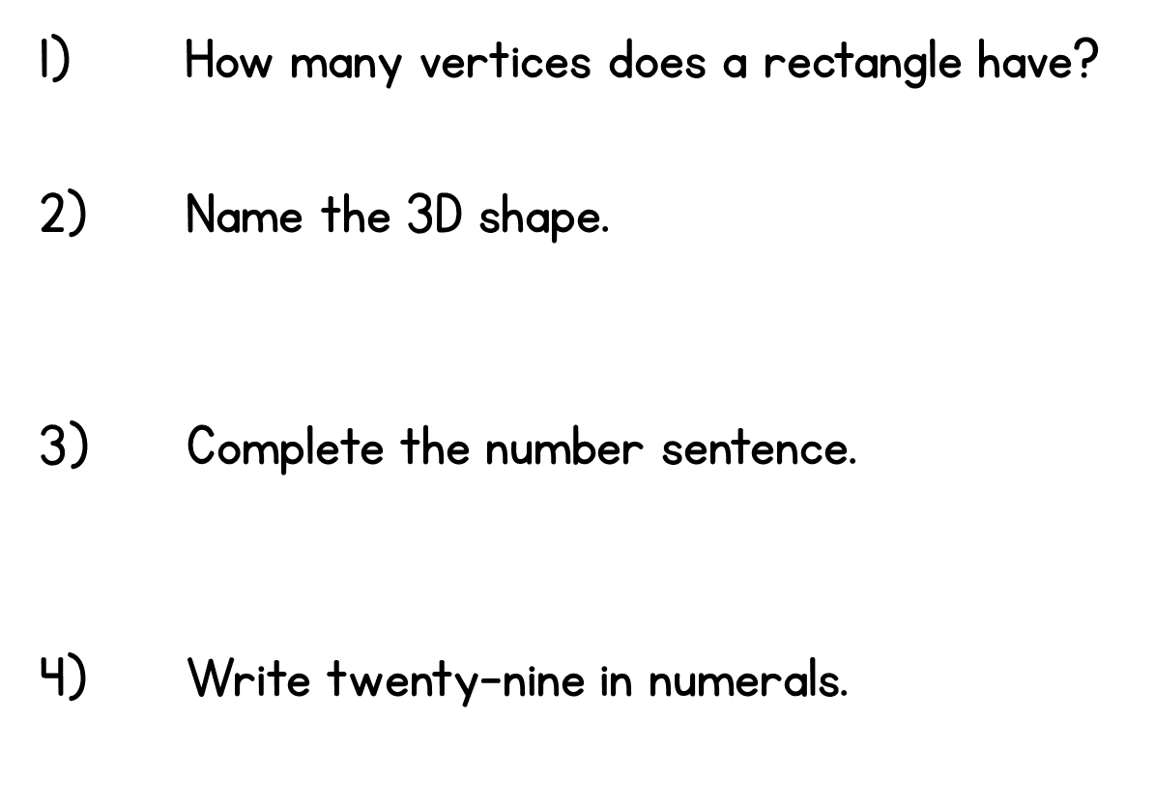
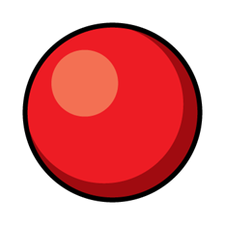


Year 2 | Week 6 | Day 1

Slide 2
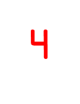

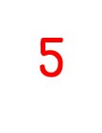
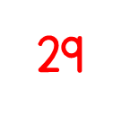
Year 2 | Week 6 | Day 1

Slide 3
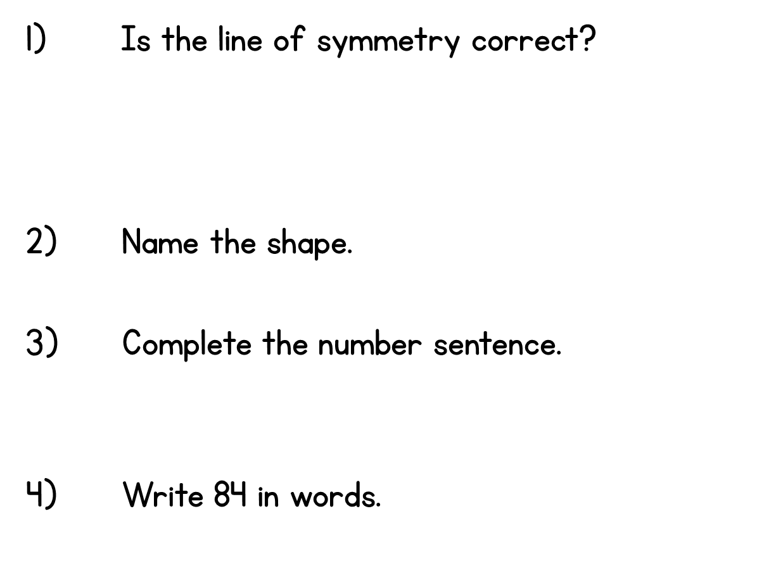



Year 2 | Week 6 | Day 2

Slide 4


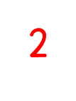

Year 2 | Week 6 | Day 2

Slide 5
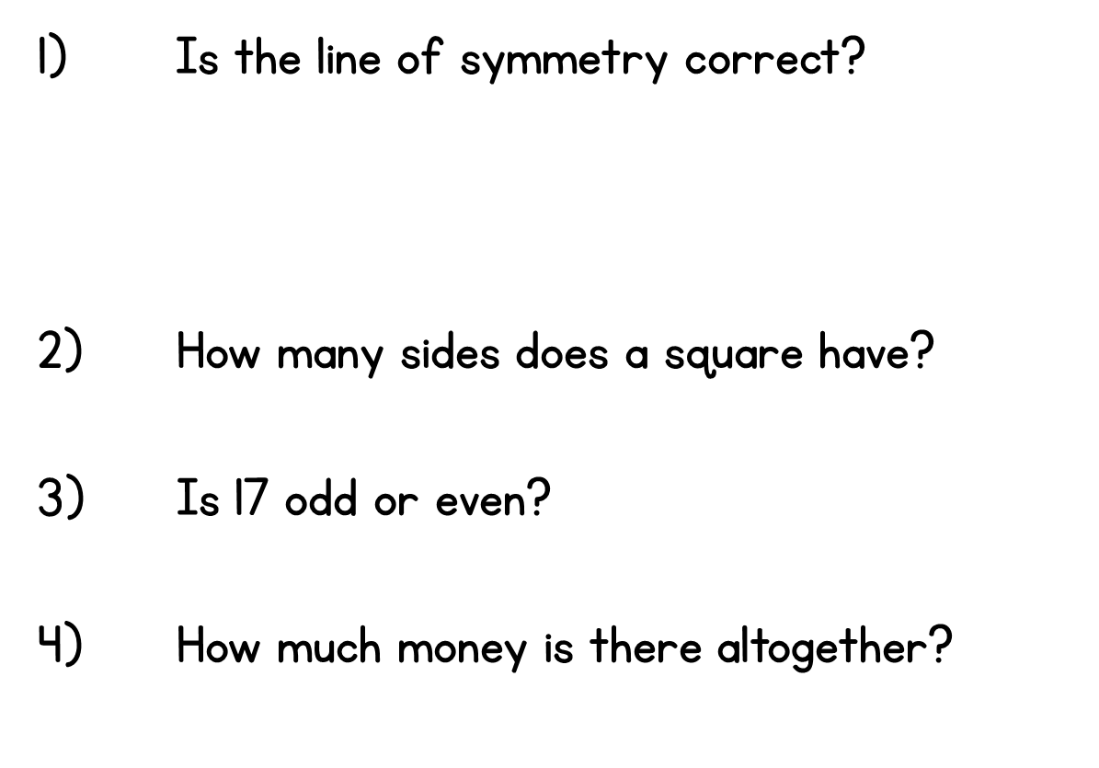


Year 2 | Week 6 | Day 3

Slide 6
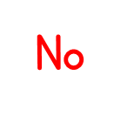
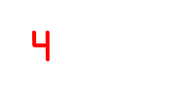


Year 2 | Week 6 | Day 3

Slide 7
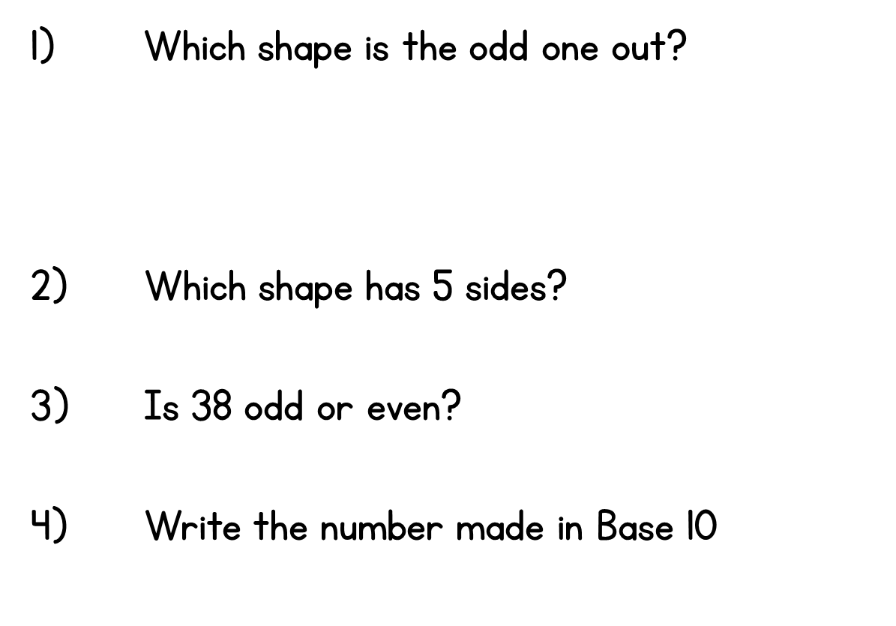






Year 2 | Week 6 | Day 4

Slide 8
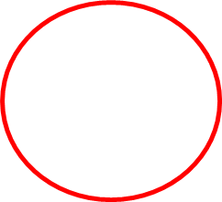


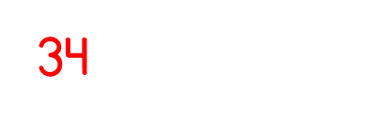
Year 2 | Week 6 | Day 4

Slide 9
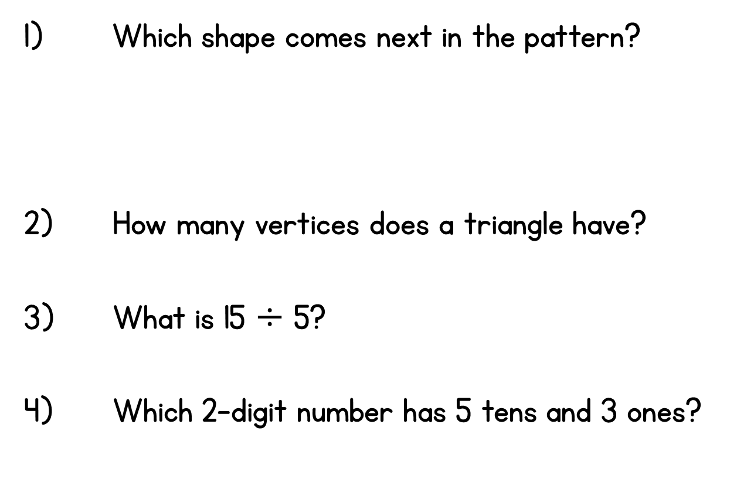



Year 2 | Week 6 | Day 5

Slide 10

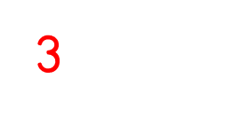
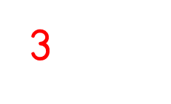
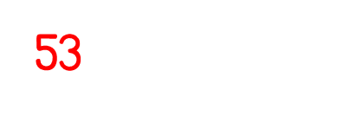
Year 2 | Week 6 | Day 5

