Slide 1
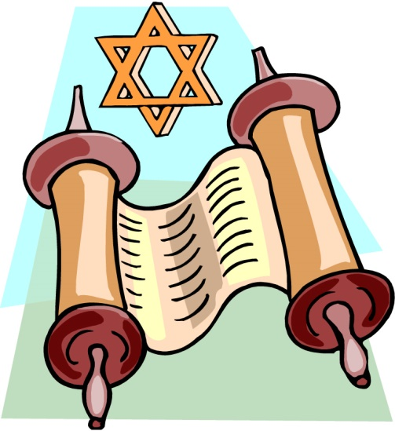
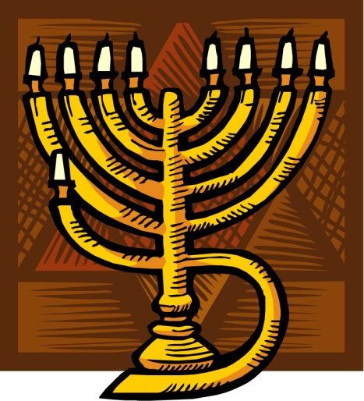
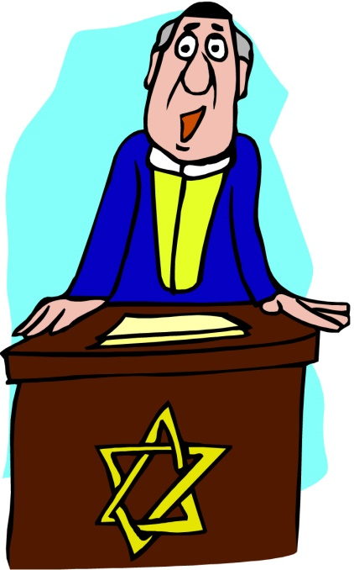
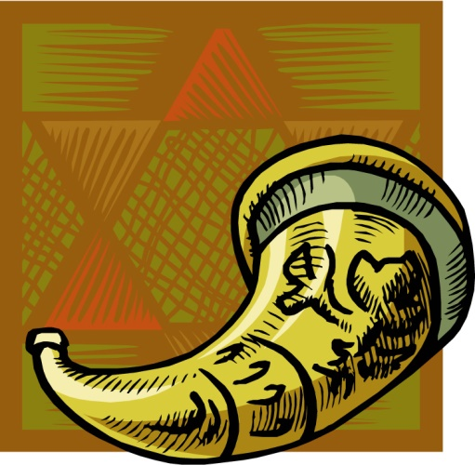
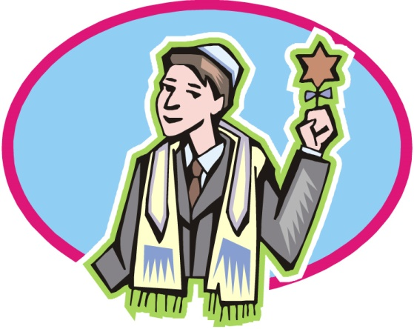
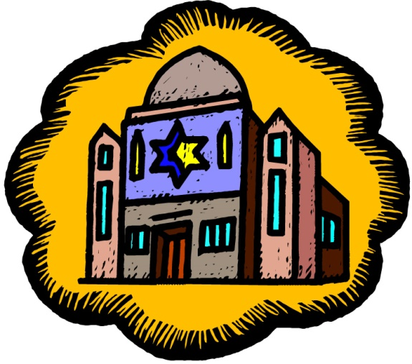
Judaism
© www.SaveTeachersSundays 2016

Slide 2
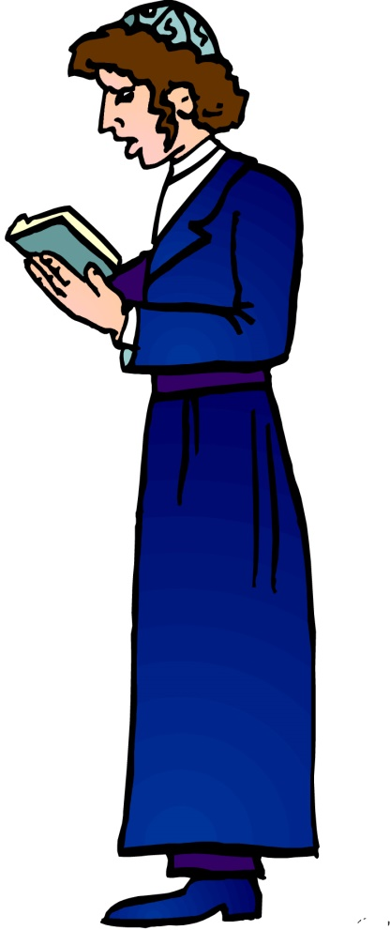
What is Judaism?
Judaism is a religion
People who follow the religion of Judaism are known as Jews
© www.SaveTeachersSundays 2016
Notes:
The image is the symbol for Allah

Slide 3
When did Judaism begin?
Judaism began in 2000 BC (about 2,000 years before Jesus was born)
Judaism
begins
Christianity begins
2000 BC
0BC / AD
2000 AD
© www.SaveTeachersSundays 2016
Notes:
Give a simple explanation of BC / AD

Slide 4
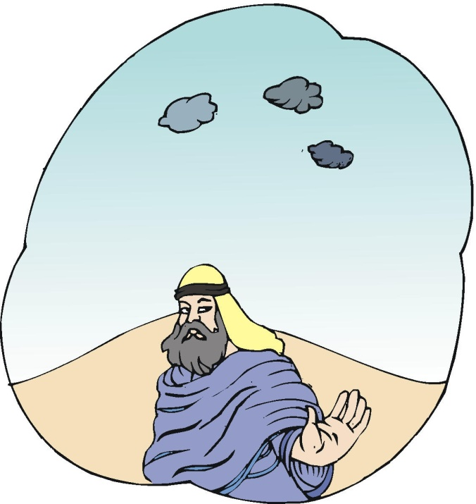
How did Judaism begin?
Jews believe that around 4,000 years ago, God spoke to a man named Abram
(who was renamed Abraham)
Jews believe that God
told Abraham to search
for a ‘promised land’
This time is when Jews believe that Judaism began
© www.SaveTeachersSundays 2016

Slide 5
Other important Jewish historical figures
There are a number of other important figures in the early history of Judaism, such as:
Moses (who led the Jews to freedom from slavery)
Jacob (Abraham’s grandson)
Elijah, Isaiah and Jeremiah (important prophets)
© www.SaveTeachersSundays 2016

Slide 6
What do Jews believe?
that there is only one God
that God made a covenant (special agreement) with them
that God gave them the Torah and the Ten Commandments to tell them how to live their lives the right way
© www.SaveTeachersSundays 2016

Slide 7
Do Jews have a holy book?
Jews have 3 main holy books:
1) The Torah (the Books of Teaching)
2) The Nevi’im (the Books of the Prophets)
3) The Ketuvim (the Books of Writings)
Together these books are called the Tenakh
© www.SaveTeachersSundays 2016

Slide 8
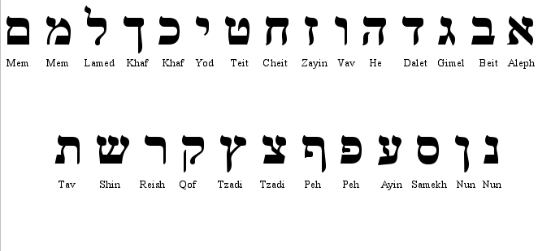
What language do Jews use?
The main Jewish language is Hebrew
Hebrew is the ancient language of the Jews
Hebrew is used for prayer
© www.SaveTeachersSundays 2016

Slide 9
What festivals do Jews celebrate?
There is at least one Jewish fast or festival in all but one month of the Jewish calendar
Some of these are:
Rosh Hashanah (New Year)
Yom Kippur (the Day for Atonement)
Pesach (Passover)
Shavuot (celebrating receiving the Torah)
© www.SaveTeachersSundays 2016

Slide 10
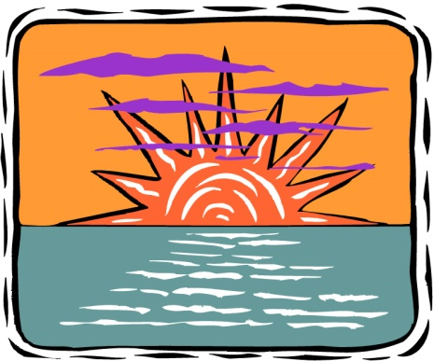
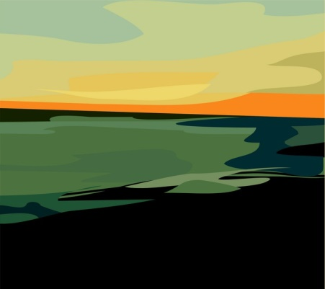
What festivals do Jews celebrate?
Shabbat (in Hebrew) / Sabbath (in English) is the most important Jewish festival
Shabbat lasts from before sunset on Friday to after sunset on Saturday every week
Friday
Saturday
© www.SaveTeachersSundays 2016

Slide 11
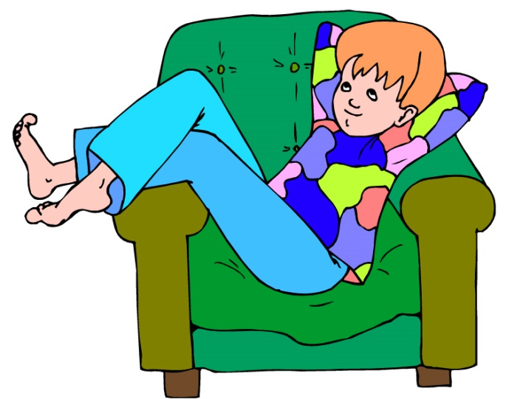
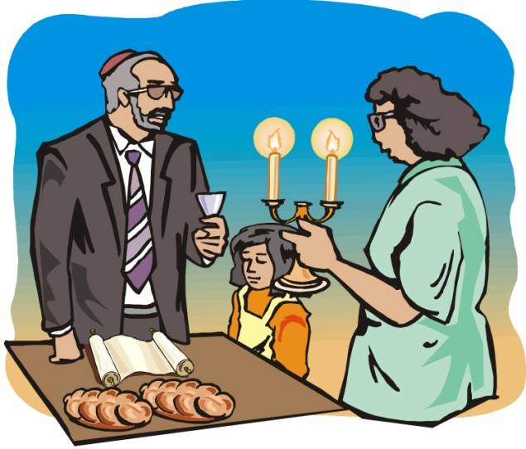
What do Jews do on Shabbat?
On Shabbat Jews rest, because they believe that this is what God did when he created the world
They also light a special candle, say special prayers and share a special meal
© www.SaveTeachersSundays 2016

Slide 12
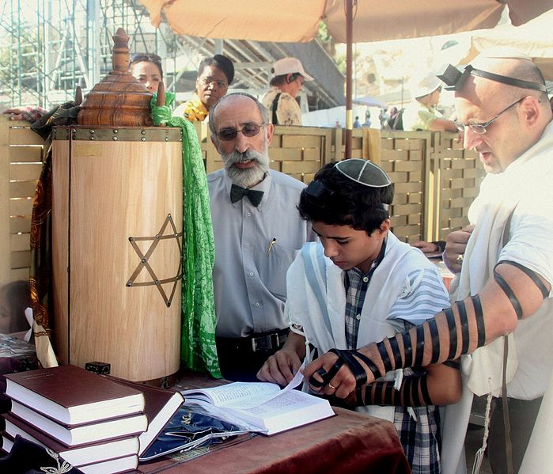
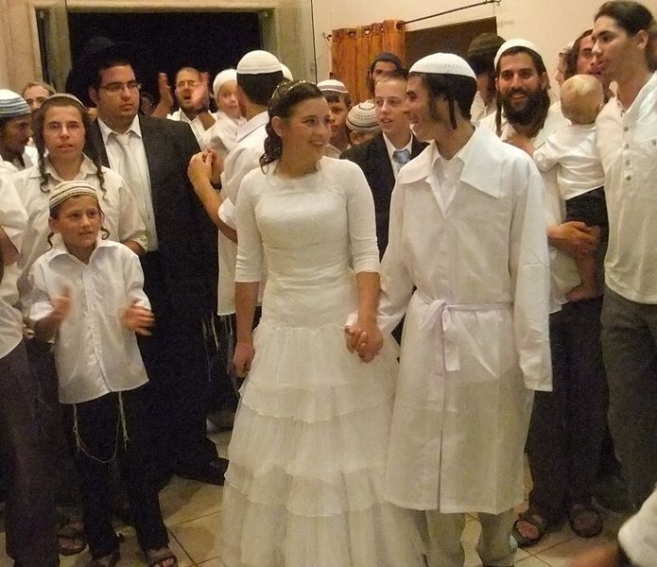
What other times do Jews celebrate?
Jews also have events for special times in people’s lives
Some of these events are for naming a baby, ‘coming of age’ at 12 or 13 years old, marriage and death
© www.SaveTeachersSundays 2016

Slide 13
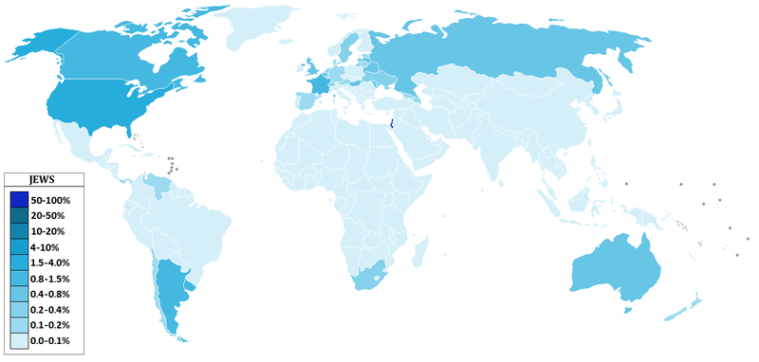
Where do Jews live?
There are Jews all over the world, but the places where the most Jews live are Israel and the USA
© www.SaveTeachersSundays 2016

Slide 14
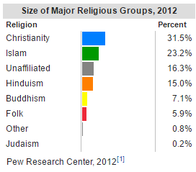
How many Jews are there?
There are around 14 million (14,000,000)
Jews all over the word!
© www.SaveTeachersSundays 2016

Slide 15
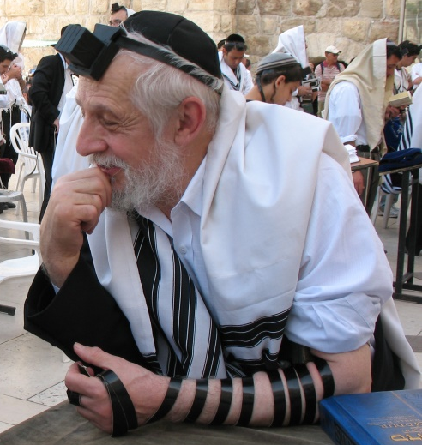
Are there different types of Jews?
There are different types of Jews:
Orthodox Jews: the biggest group – they follow all of the laws of the Torah to the letter
Progressive Jews – they believe that they do not need to obey all of the laws of the Torah, and that the laws for Jews can be changed or ignored if they no longer fit with modern life and ideas
© www.SaveTeachersSundays 2016

Slide 16
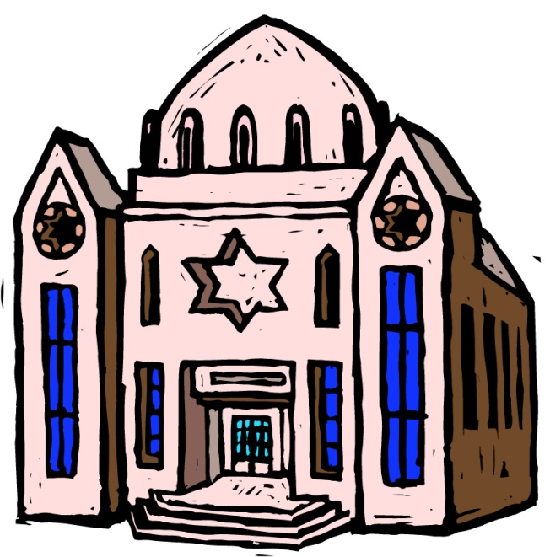
Where do Jews go to pray?
Jews often go to synagogues to pray
However Jews pray elsewhere too – they have special prayers after getting up, before going
to bed, and before and after eating
© www.SaveTeachersSundays 2016

Slide 17

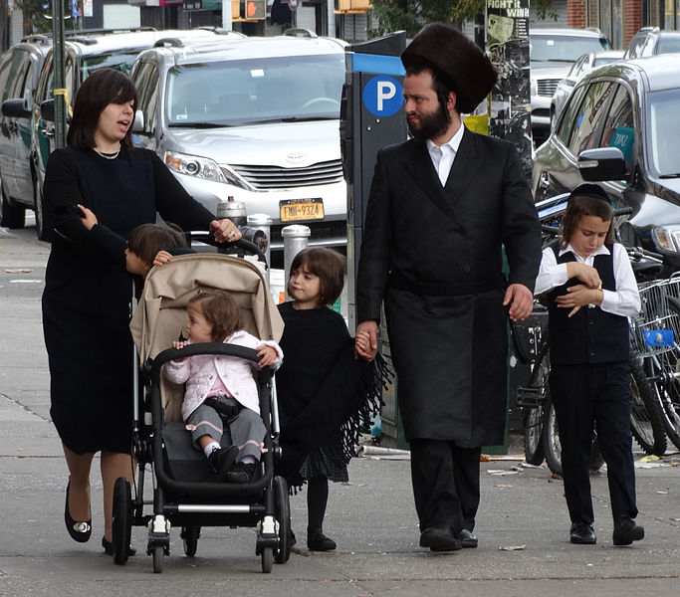
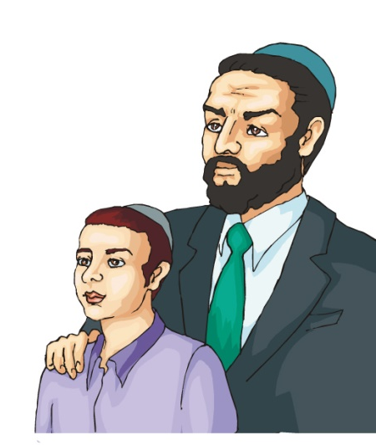
What clothes do Jews wear?
Different types of Jews dress differently
Orthodox Jew
Hasidic Jews
Progressive Jews
However all Jewish men cover their heads during prayer as a sign of respect to God
© www.SaveTeachersSundays 2016

Slide 18

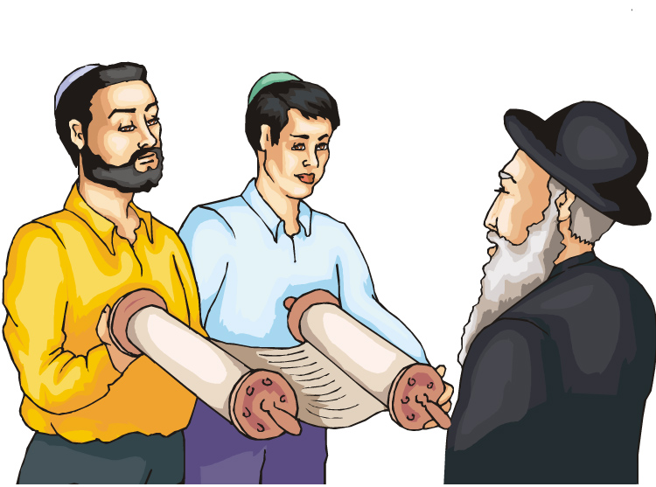
Who are Jewish religious leaders?
Jewish religious leaders are called Rabbis
Rabbis lead prayers in synagogues and help other Jews to learn more about being a good Jew
© www.SaveTeachersSundays 2016

Slide 19
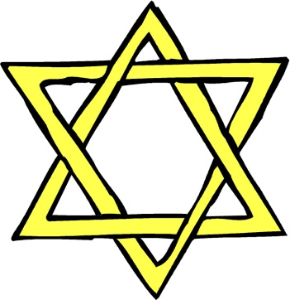
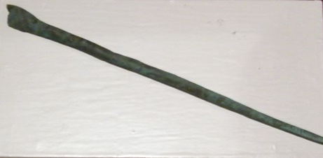
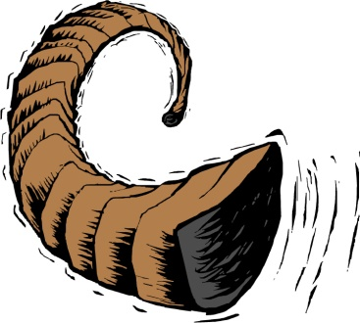
What special symbols and objects do Jews use?
The Star of David
(recalls a great Jewish leader)
Yad (a pointer used when reading a Torah scroll, to avoid touching it with the hands)
Shofar (a ram’s horn that is used to call people on Rosh Hashanah)
© www.SaveTeachersSundays 2016

Slide 20
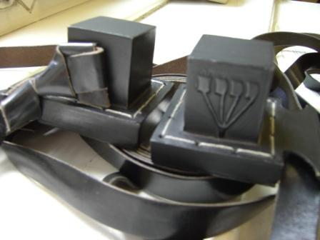
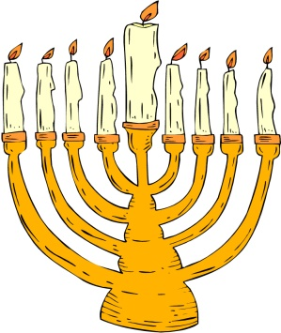
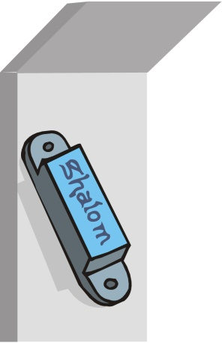
What special symbols and objects do Jews use?
Tefillin
(small leather boxes that contain a special prayer that can be worn)
Menorah
(a special candle holder)
Mezuzah (small container with a small scroll inside it with a summary of what Jews should believe, which is fixed to door frames in homes)
© www.SaveTeachersSundays 2016

Slide 21
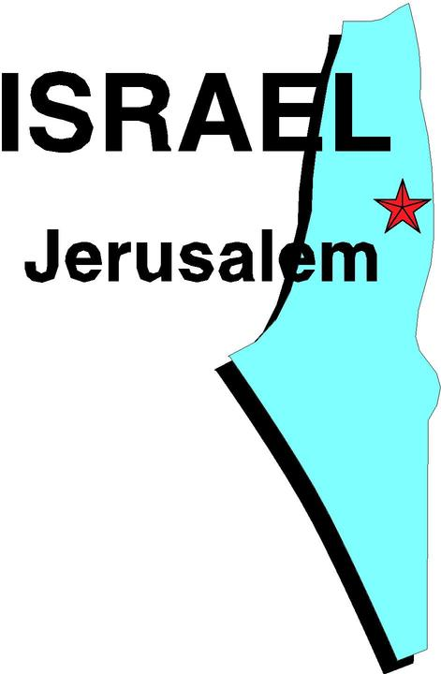
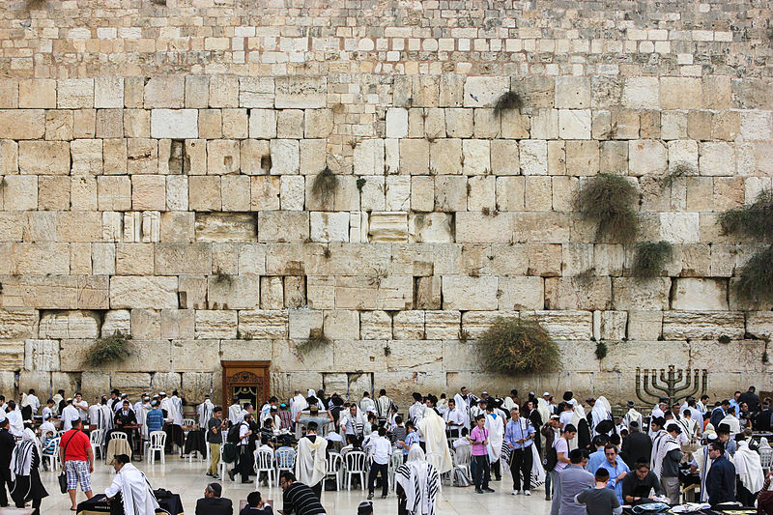
Which places are special for Jews?
These are some of the special places for Jews:
Jerusalem is the most holy city for Jews
The Western Wall (part of a destroyed temple) in Jerusalem is the most holy site for Jews
© www.SaveTeachersSundays 2016

Slide 22
References
Living Religions: Judaism by Cavan Wood
World Beliefs and Cultures: Judaism by Sue Penney
World Faiths: Judaism by Trevor Banres
World Religions: Judaism by Angela Wood
https://en.wikipedia.org/wiki/List_of_religious_populations
Source of images
Map of Canaan - https://commons.wikimedia.org/wiki/File:Canaan_(PSF).jpg
Hebrew alphabet - https://commons.wikimedia.org/wiki/File:Hebrew_alphabet.png
Religious populations graph - https://en.wikipedia.org/wiki/List_of_religious_populations
Distribution of Jews map - https://commons.wikimedia.org/wiki/File:Jewish_distrib_country.png
Bar Mitzvah - https://commons.wikimedia.org/wiki/File:Bar_Mitzvah_is_important_for_jewish_boys.JPG
Jewish wedding - https://commons.wikimedia.org/wiki/File:MinhagYerushalayim3909.JPG
Orthodox Jew - https://www.flickr.com/photos/emeryjl/499799081
Tefillin - https://en.wikipedia.org/wiki/File:Tefillin.JPG
Yad - https://commons.wikimedia.org/wiki/File:Yad.jpg
Western wall - https://commons.wikimedia.org/wiki/File:Prayers_at_the_Western_Wall_2.jpg
All other images www.clipart.com or www.clker.com
© www.SaveTeachersSundays 2016

