Slide 1

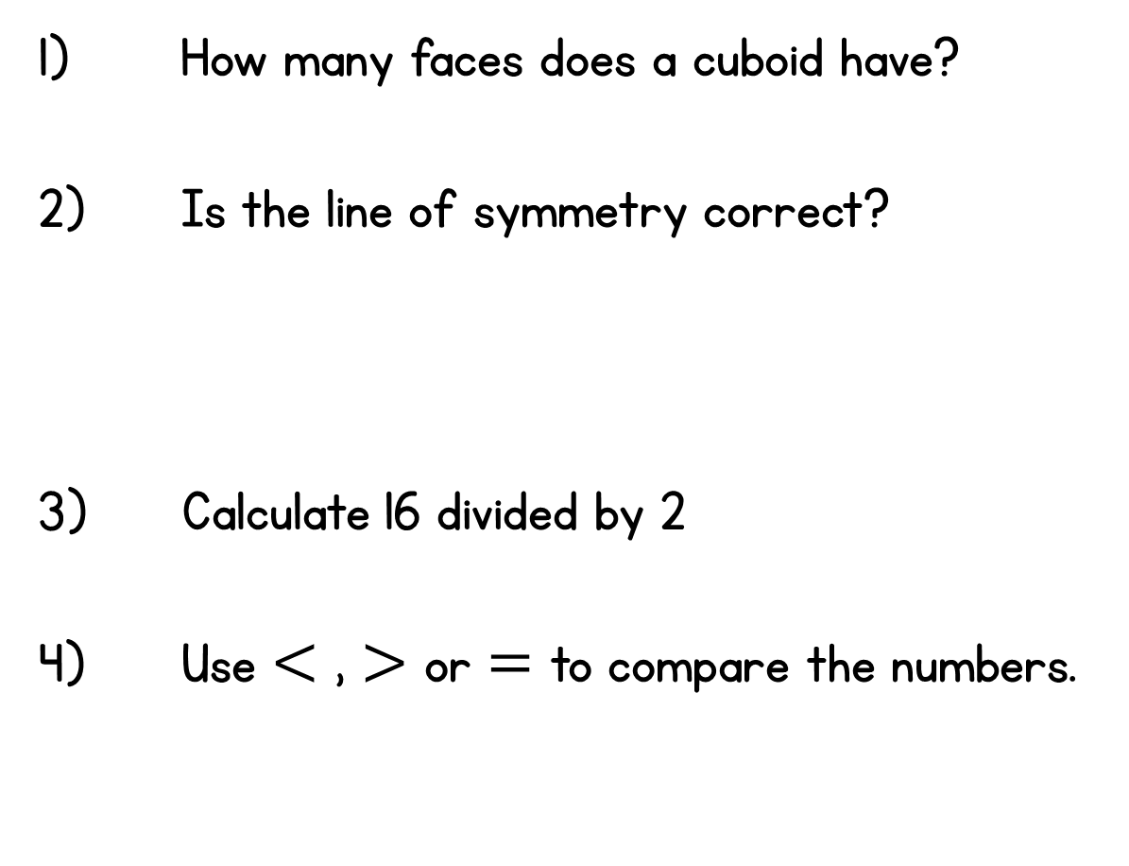



Year 2 | Week 7 | Day 1

Slide 2
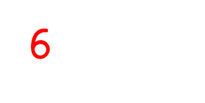

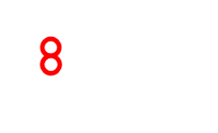

Year 2 | Week 7 | Day 1

Slide 3
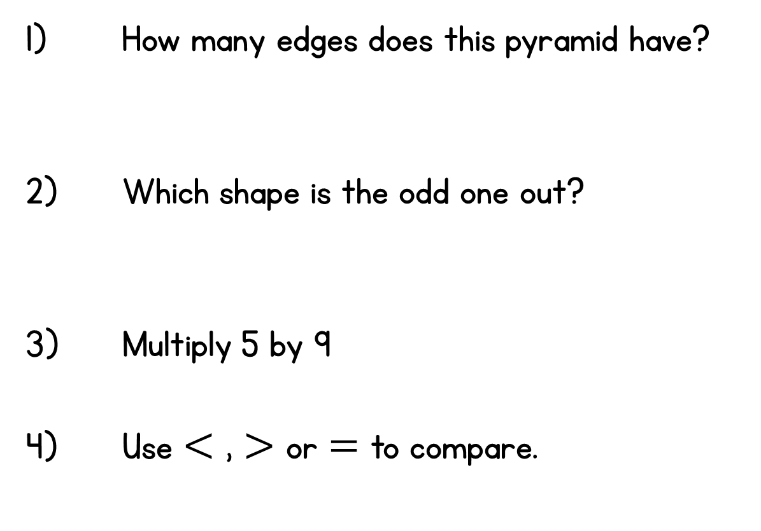






Year 2 | Week 7 | Day 2

Slide 4
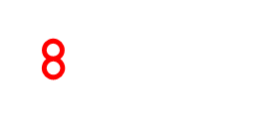

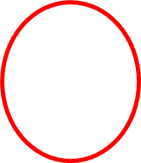
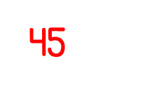

Year 2 | Week 7 | Day 2

Slide 5
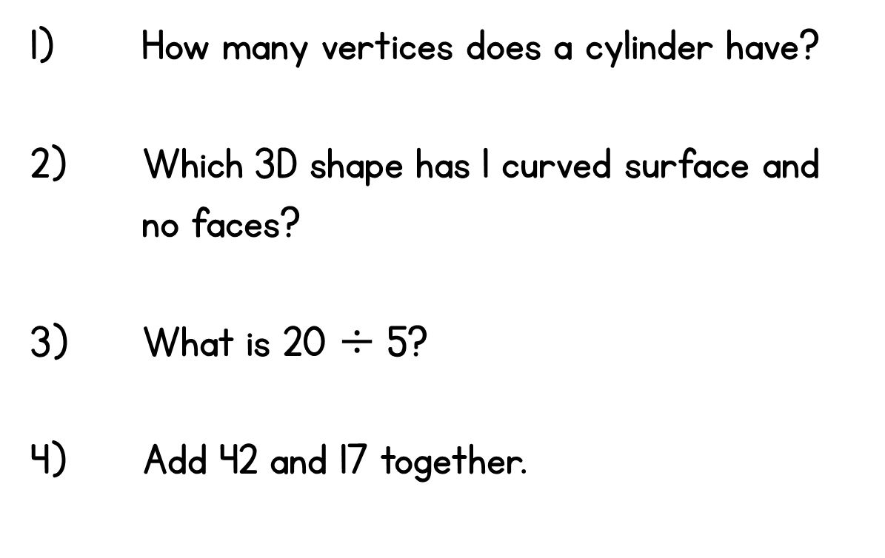
Year 2 | Week 7 | Day 3

Slide 6
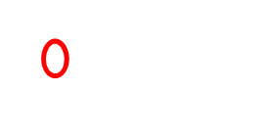

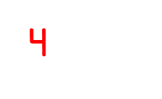
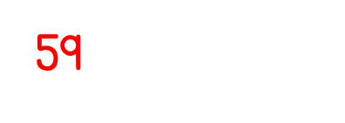
Year 2 | Week 7 | Day 3

Slide 7
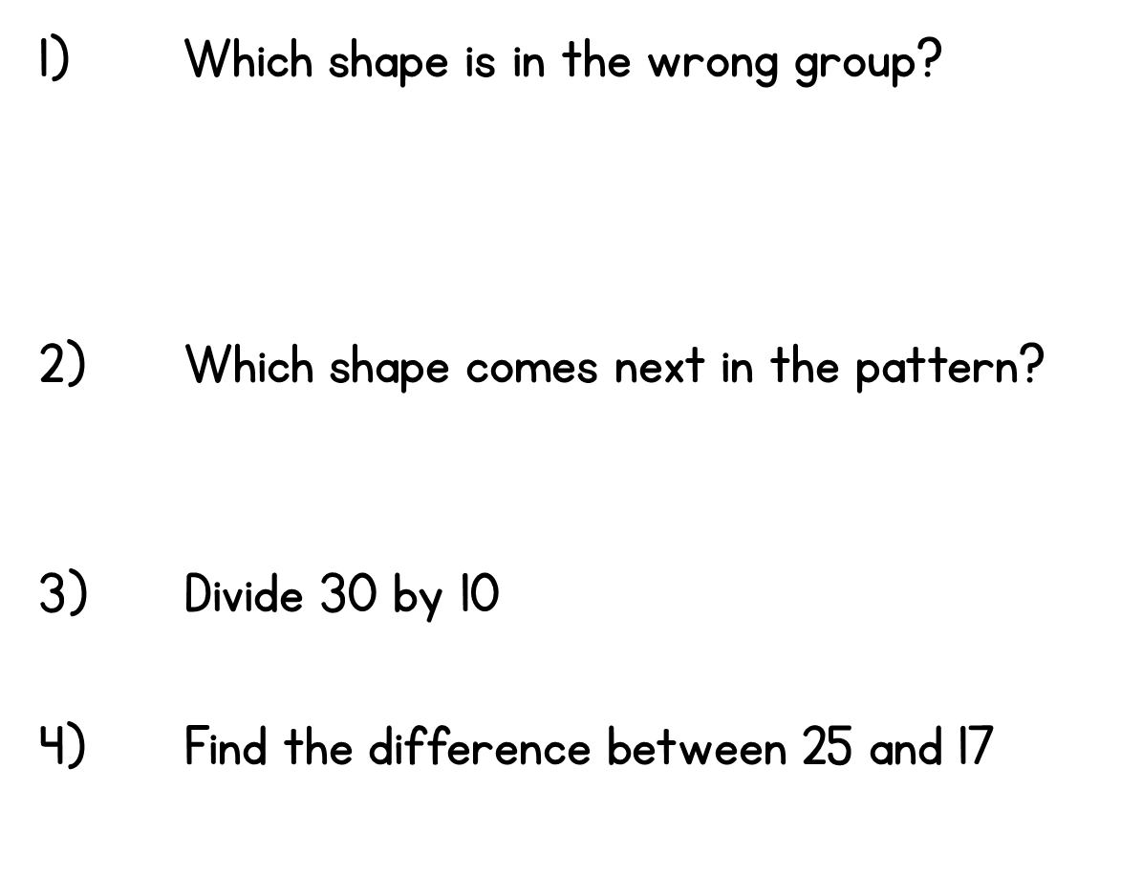









Year 2 | Week 7 | Day 4

Slide 8


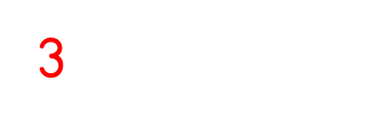
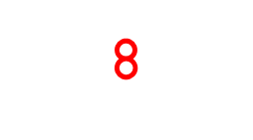
Year 2 | Week 7 | Day 4

Slide 9
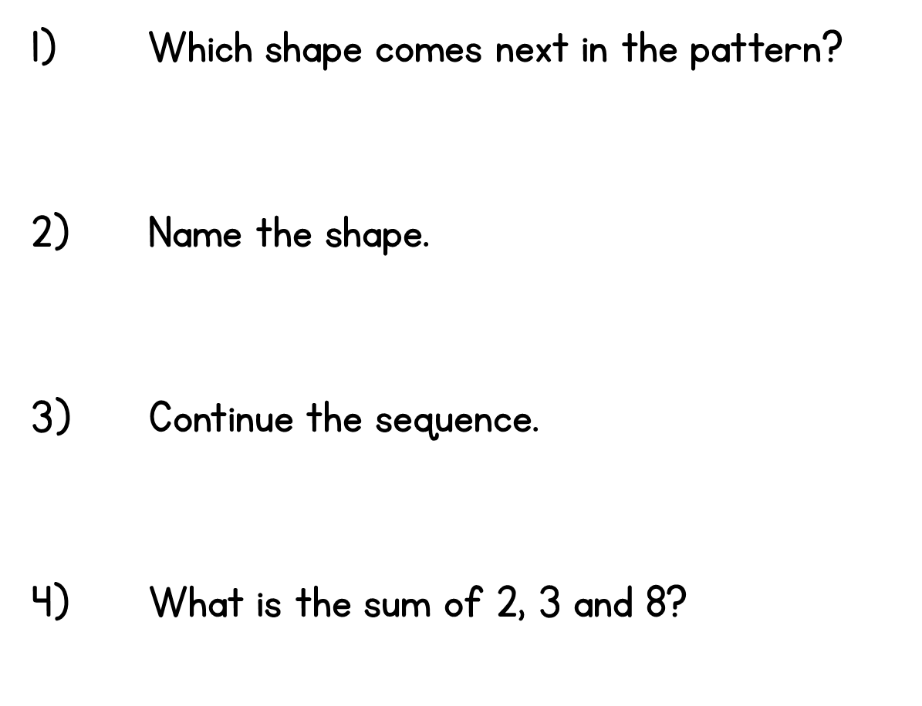




Year 2 | Week 7 | Day 5

Slide 10


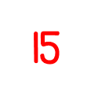
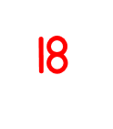
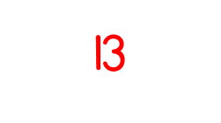
Year 2 | Week 7 | Day 5

