Slide 2
Aim
I understand how to respect my own and other people’s bodies.
Success Criteria
I understand what ‘no’ and ‘stop’ mean.
I know that people’s bodies and feelings can be hurt.
I know who to tell if I am worried that the rules about respecting people’s bodies have been broken.
This resource is fully in line with the Learning Outcomes and Core Themes outlined in the PSHE Association’s Programme of Study.

Slide 3

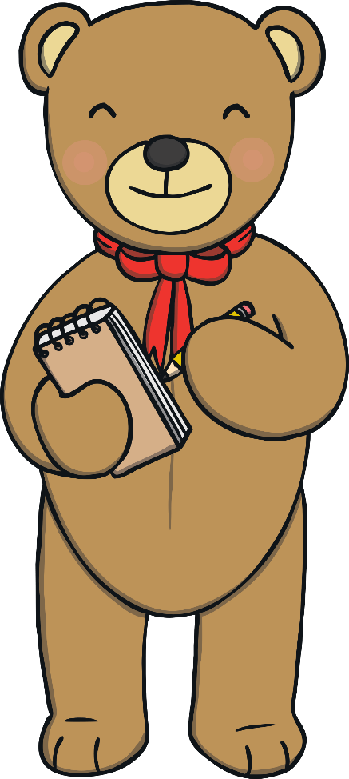
What is ‘consent’ and what are the rules for respecting people’s bodies?
What should we do if these rules are broken?

Slide 4

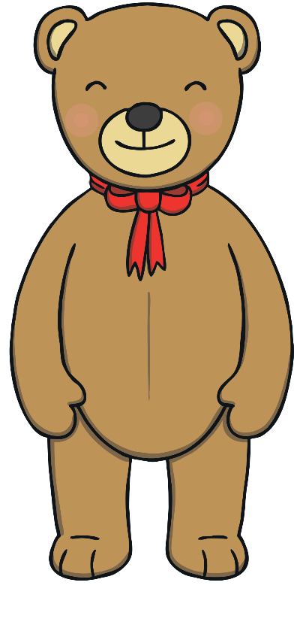
The Circle of Respect
Let’s sit in a circle and show respect for one another.
We can do this by sitting still and quietly, keeping our hands and our feet to ourselves and listening carefully to each other.
Let’s play a naming game. As we go round the circle, suggest a name for this teddy bear that I have brought with me today.

Slide 5

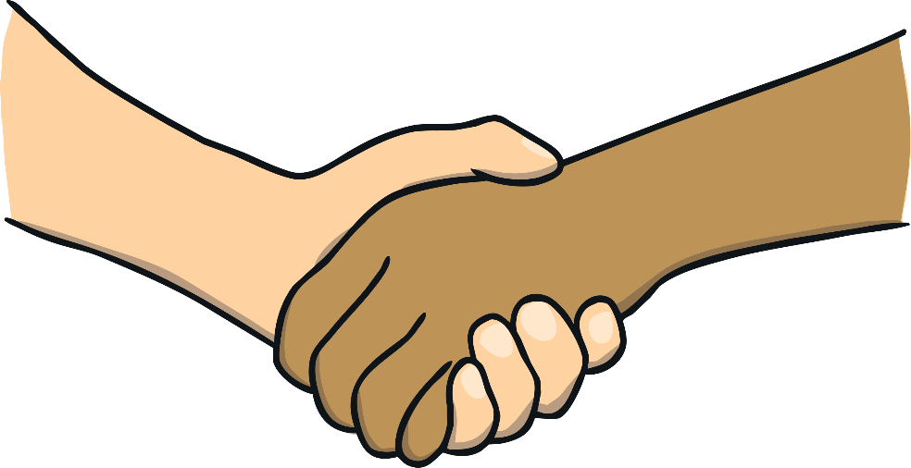
The Circle of Respect
Now in our circle, we are going to show that we respect each other in
a different way.
We are going to ask for consent from the person next to us, before we give them a hug. Getting someone’s consent means they give you permission to do it. It means they are saying it is OK with them and they do not mind.
Remember to hug gently, as that is another way of showing respect.

Slide 6
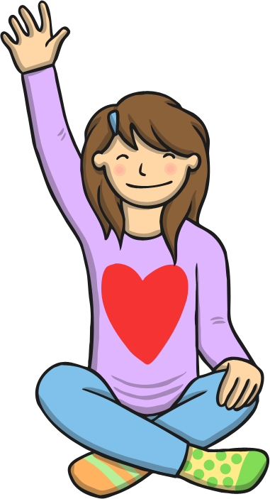
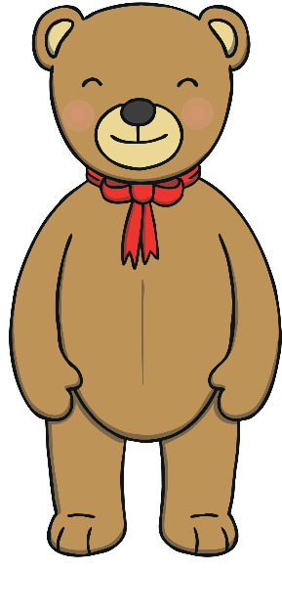
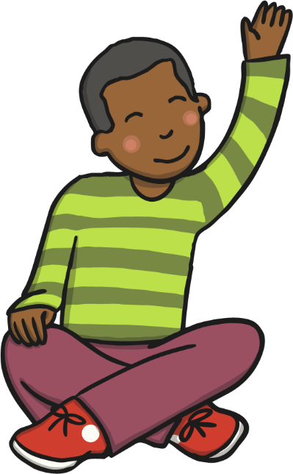
Ask Teddy
Who would like to come and pick a question card and ask Teddy if they can have permission to do something?
If you are chosen, come and read the question on the card aloud to Teddy, then listen carefully to what Teddy says. If Teddy says it is OK, then you can do the thing you have asked, but if Teddy says it is not OK, you mustn’t do it, as Teddy hasn’t given consent.

Slide 7
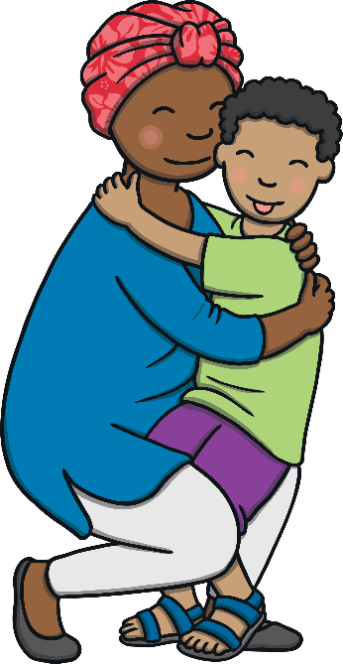
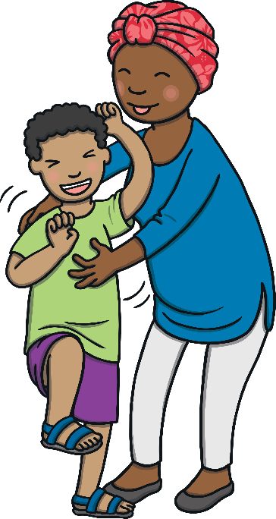
Is It OK?
It is really important that we check with others before we touch them that they are happy to be touched that way.
Everyone is different. Some people like hugs, while others don’t.
Some people like to be tickled, but other people hate it.
We always need to check that others are OK and happy.

Slide 8
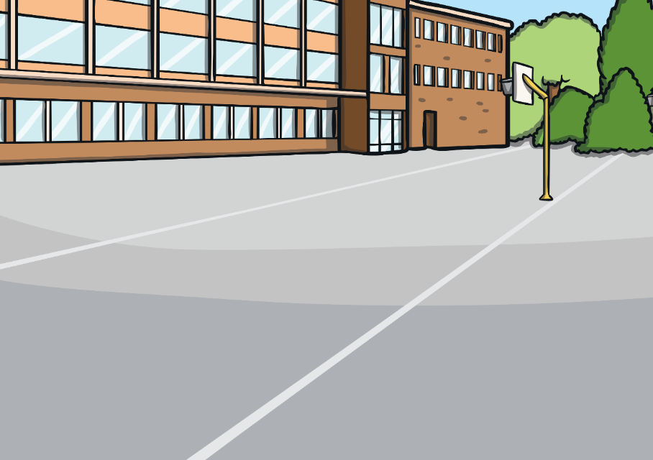
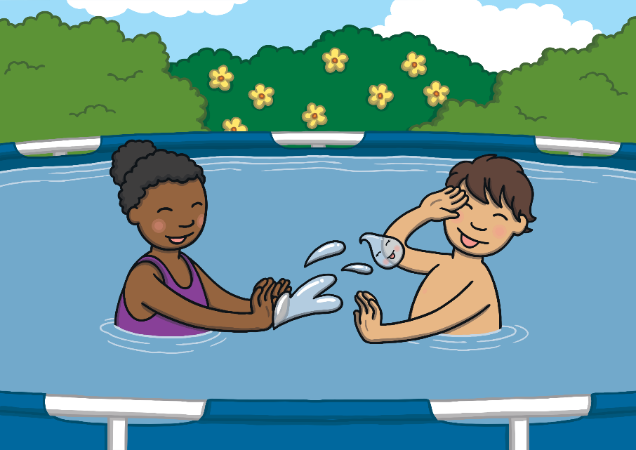
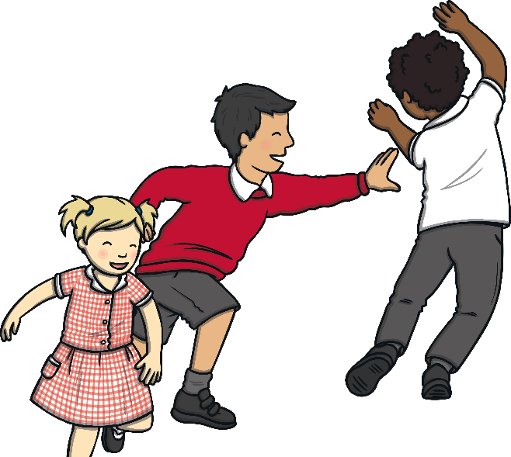
Is It OK?
There is a great phrase to remember when it comes to respecting
others’ bodies…
If everyone isn’t having fun, everyone stops!
How can you tell if someone is unhappy, or not having fun? What might they look like? What might they do? What might they say?

Slide 9
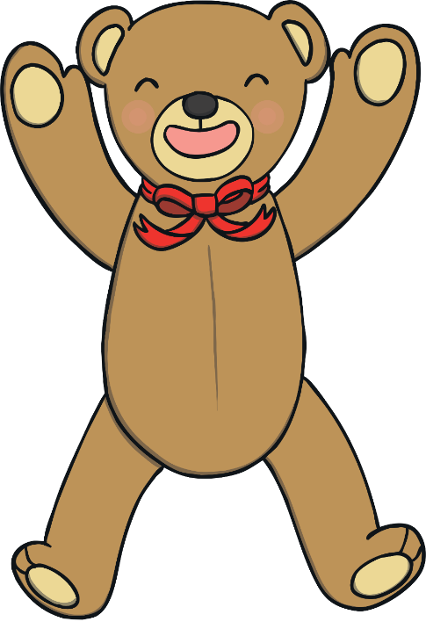
Is It OK?
Consolidating
Reflecting

Slide 10
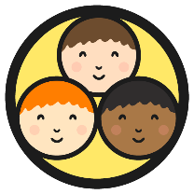
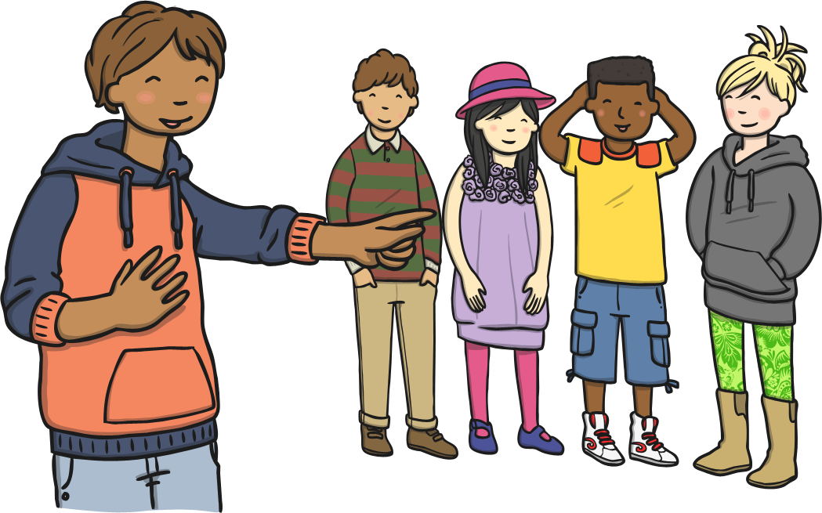
Act It Out
In small groups, you are going to get a card with a scenario on it. A scenario is a situation that could happen.
In your group, take on roles of the people involved in the situation. Think about how the people would act, what they would do, how they would feel and what they might say.

Slide 11
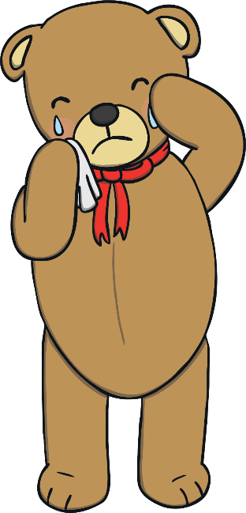
What Should Teddy Do?
Teddy has a problem. Can you help?
Last week, somebody squeezed Teddy in a way that Teddy wasn’t happy about. It was uncomfortable and even hurt Teddy a bit.
Teddy is worried about the next time that person comes round, in case they do it again.
What advice would you give to Teddy?
Talk to your partner about what you think Teddy should do.

Slide 12

The Big Questions
What is ‘consent’ and what are the rules for respecting people’s bodies?
What should we do if these rules are broken?

