Slide 1
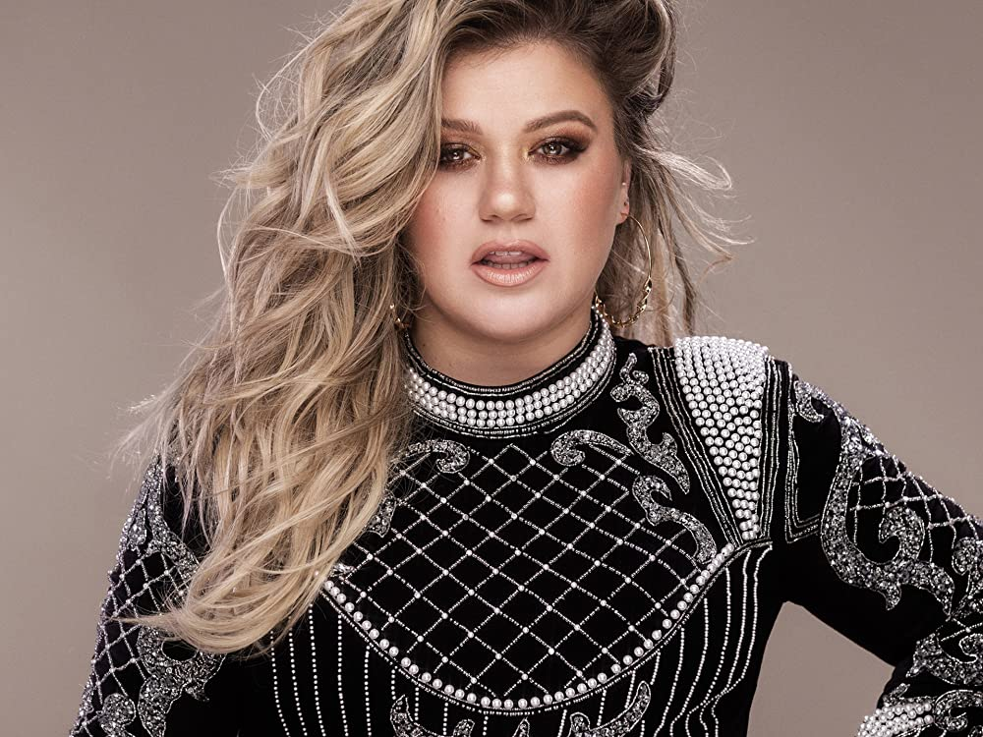
Piece By Piece
Kelly Clarkson

Slide 2
Vocabulary Check
faith - complete trust or confidence in someone or something.
restored - to bring something back to how it was before.
fall flat - failure to get the desired response.

Slide 3

Partnered Talk
Listen to the song and look at the lyrics.
What do you think the song is about?
Who might the ‘he’ and ‘her’ the lyricist refers to be?
Find evidence for your reasoning.

Slide 4


Individual Thinking
Explain what you think the underlined lyrics mean.

Slide 5
Partnered Talk
The name of the song is ‘Piece by Piece’.
What do you think the lyricist means by this phrase?
Why do you think they’ve chosen to use it in this song?
Think about the meaning of the song in your discussion.

Slide 6

Individual Thinking
Find three pieces of evidence in the lyrics that show how her faith in men and fathers was restored.

Slide 7
Partnered Talk
‘The apple doesn’t fall far from the tree’ is a common idiom.
How does that idiom relate to this song?

Slide 8

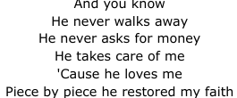
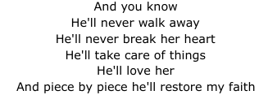
Solo Work
What is similar and what is different about these two parts of the song?
Why do you think the lyricist made them different? Why might it be important to the songs message?

