Slide 1
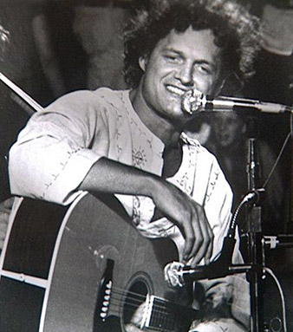
Cat’s In The Cradle
Harry Chapin

Slide 2
Vocabulary Check
And the cats in the cradle - a game played by two people, using string. It is also a Dutch fairytale.
I've long since retired - when you stop working, usually due to old age.
You see my new job's a hassle - something that is an annoyance or bother.

Slide 3

Partnered Talk
Listen to the song. Discuss with your partner what you think the song is about.
Give reasons for your thinking.

Slide 4

Individual Thinking
Find and list three reasons the lyricist gave for why he couldn’t spend time with his son.

Slide 5
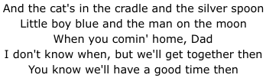
Partnered Talk
The chorus lists some characters from popular nursery rhymes and fairy tales.
What importance might they have to the message of the song?

Slide 6

Individual Thinking
How does this part of the first verse foreshadow what will happen later on in the song?

Slide 7

Partnered Talk
Think about the meaning of these sentences.
Is it an accurate way to describe a child being born?
What does it tell us about how the lyricist feels towards having a child?

Slide 8
Individual Thinking
The phrase ‘cats in the cradle’ is now used as an idiom - a common phrase that means something different from its usual meaning.
Thinking about the meaning of the song, what do you think it means when someone says ‘the cats in the cradle’ nowadays?

Slide 9

Solo Work
What happened at the end of the song?
Was it fair or right? Why or why not?
Whose fault was the ending?
Think about the relationship between the father and son throughout the song.

