Slide 1
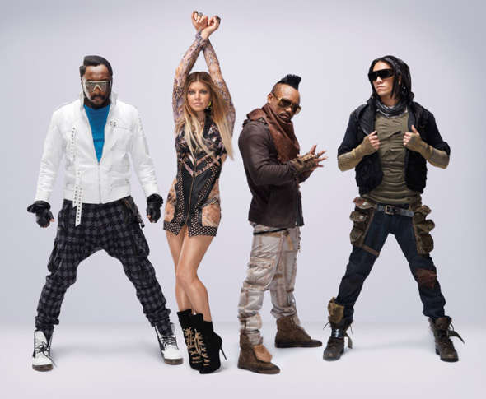
Where Is The Love?
The Black Eyed Peas

Slide 2
Vocabulary Check
discriminate - to treat a person or group of people unfairly based on their gender, religion, nationality, ethnicity or other personal trait.
gravitate - to drift towards something or someone as though being pulled by gravity.

Slide 3

Partnered Talk
The song is called ‘Where is the Love?’ which is a question.
Before looking at the lyrics, discuss what you think this song is about and who is being asked the question.

Slide 4

Partnered Talk
What is the lyricist saying in this part of the song? Why do you think these lyrics resonate with The Black Eyed Peas?

Slide 5

Partnered Talk
Discuss with your partner who the ‘father’ might be.
What makes you think this? Is there any more evidence in this section to support your idea?

Slide 6

Individual Thinking
‘Can you practice what you preach?
Or would you turn the other cheek?’
Explain what you think the lyricist means by this.

Slide 7
Individual Thinking
The lyricist repeatedly asks us ‘Where is the Love?’ in this song.
Find three pieces of evidence from the lyrics that show love is missing from our world.

Slide 8

Partnered Talk
Why do you think the lyricist repeats the phrases underlined? Discuss with your partner what significance it has in the song.

Slide 9

Solo Work
Read through the lyrics again.
Summarise what you think the whole song is about in your own words.
Why do you think the lyricist wrote this song?

