Slide 1


Eva sets off on a bike ride.
When she stops for lunch, she has cycled two fifths
of the whole route and still has 42 km to cycle.
How far does Eva cycle in total?
Have a think

Slide 2

A café has 4 flavours of ice-cream to choose from and 2 toppings.
How many different possible combinations are there?
Ice-cream | Sauce
chocolate | chocolate
chocolate | strawberry
strawberry | chocolate
strawberry | strawberry
vanilla | chocolate
vanilla | strawberry
mint | chocolate
mint | strawberry
Menu
Chocolate
Strawberry
Vanilla
Mint
With chocolate or strawberry sauce
Have a think

Slide 3
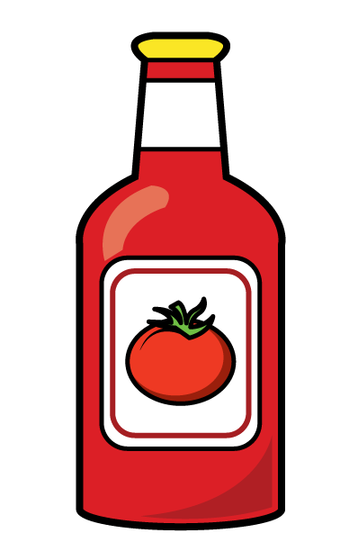



A salad bar has 8 different salads on the menu.
You can top your salad with salad cream, mayonnaise or chilli sauce.
How many different possible combinations are there?
Have a think

Slide 4



A potato and 2 carrots costs £1.45
Mr Rose buys a potato and 3 carrots.
He pays £1.64
What is the price of one potato?
£1.45
£1.64
Have a think

