Slide 1


Ron is helping around the house doing some Spring cleaning.
He dusts for 35 minutes and organises his cupboard for three quarters of an hour.
Ron also has a 20 minute break during his cleaning.
When he finishes cleaning he looks at the clock and it says
Does Ron start cleaning before 10am?
12 : 08
Have a think

Slide 2
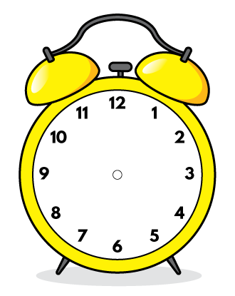

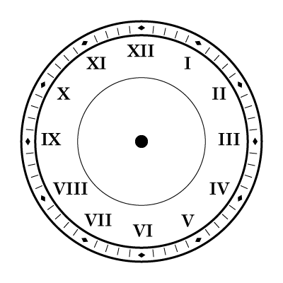
In Spring, the clocks move forward an hour.
Ron has forgotten to change the times on his clocks.
What should the correct times be if they went forward that morning?
a.m.
a.m.
Have a think

Slide 3

In Spring the temperature starts to increase a little.
Ron has been recording some temperatures, measured in degrees Celsius.
He wants to convert the temperatures to Farenheit because his friend lives in the USA, where Farenheit is used.
An approximate way to convert to Farenheit is to double then add 30
Ron records a temperature of 13 degrees Celsius.
Calculate this temperature in Farenheit (approximately)
Have a think

Slide 4
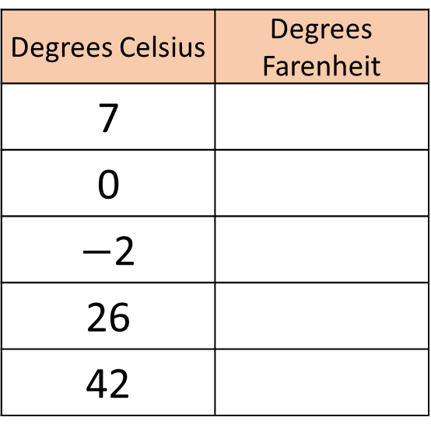
An approximate way to convert to Farenheit is to double then add 30
Have a think
Degrees Celsius | Degrees Farenheit
7
0
$−$2
26
42

