Slide 1

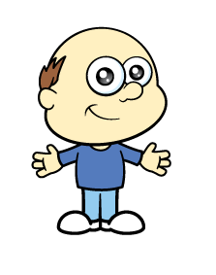


Roses Florist takes a delivery of daffodils
on Monday morning.
Have a think
Mr Rose sells two fifths of the daffodils during Monday.
On Tuesday he sells one sixth of the remaining daffodils.
He has 90 daffodils unsold at the end of Tuesday.
How many daffodils were delivered on Monday morning?

Slide 2



A flower bed is 3 m long and 225 cm wide.
10 flower seeds can be planted in a square this size
10 flower seeds cost £3
What is the cost of filling the flower bed?
75 cm
75 cm
Have a think

Slide 3

Amir is planting daffodils in three pots.
The large pot is three times the size of the small pot.
The medium pot is half the size of the large pot.
The medium pot is two thirds full and contains 22 daffodil seeds.
How many daffodils can be planted in the large pot?
Have a think

Slide 4


Annie buys some tulips and roses, and spends exactly £3
Which flowers could she have bought?
Tulips
30p each
Roses
40p each
Have a think

