Slide 1
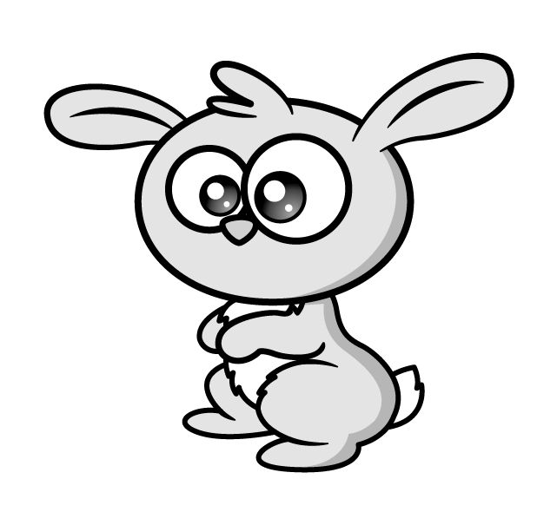


There are 24 rabbits in a field.
Some bunnies are born.
There are now 19 times as many rabbits in total.
How many rabbits are there now?
24 $×$ 19
Have a think

Slide 2

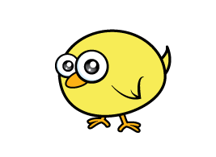
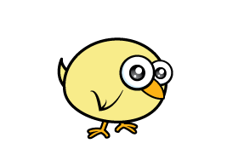
At Maltings Farm there are three times
as many chicks as there are lambs.
There are 4 fewer rabbits than chicks.
There are 31 animals altogether.
How many rabbits are there?
Have a think

Slide 3
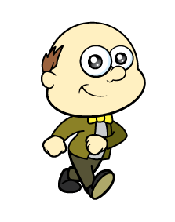
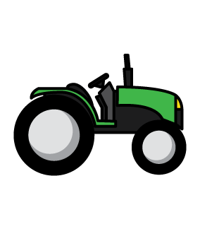
Farmer Rose is planning how to use her field.
What is the area of her field?
How many different ways can you calculate the area?
6 m
Not drawn accurately
6 m
30 m
24 m
Have a think

Slide 4

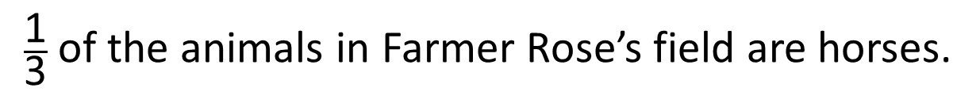
$\frac{\text{1}}{\text{3}}$ of the animals in Farmer Rose’s field are horses.
40% of the rest of the animals are rabbits.
The rest of the animals are sheep.
There are 42 sheep.
What can you find out?
Have a think

