Slide 1

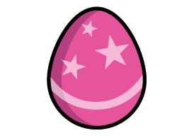

Some chocolate eggs are shown on the balance scale.
One large egg has a mass of 245 g.
Have a think
What is the mass of three small eggs?

Slide 2
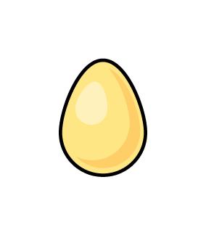
Which is better value for money?
OneShop
Buy More
CHOCO
CHOCO
£2.59
4 for £10
Have a think

Slide 3
Which is better value for money?
XL EGG
CHOCO
MILK
300 g
£2.40
90 g
80p
500 g
£4.10
Have a think

Slide 4

Alex is making chocolate nests.
She has fewer than 30 eggs.
Alex wants to put the same amount of eggs into each nest.
She puts 5 in each nest and has 2 left over.
She puts 8 in each nest and has 3 left over.
How many eggs does Alex have?
Is there a way to put an equal number of eggs into each nest with no remainders?
Have a think

