Slide 1
LO: To design a setting

Slide 2
This week you will be designing and making your very own setting.
What makes a good setting?

Slide 3
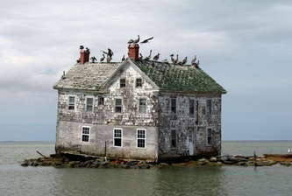
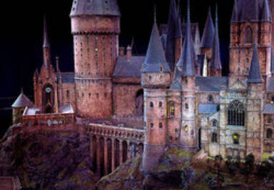
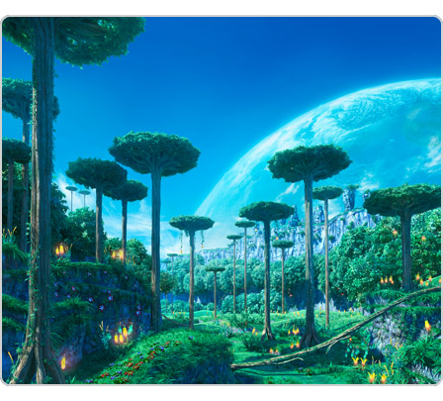
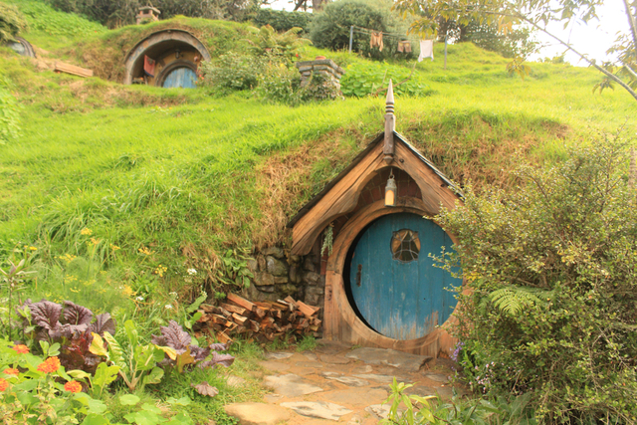

Which photo would make a good setting?

Slide 4

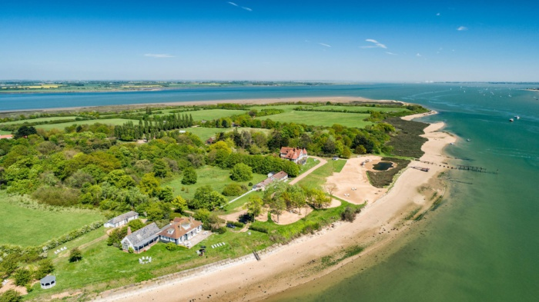
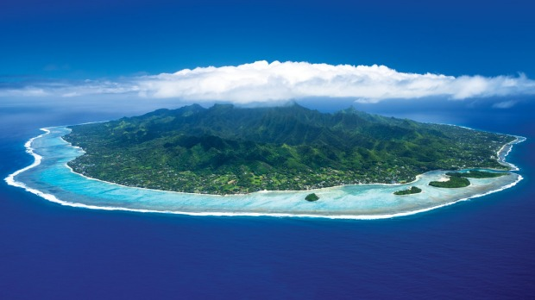
Which of these could be your Alchemy island?

Slide 5
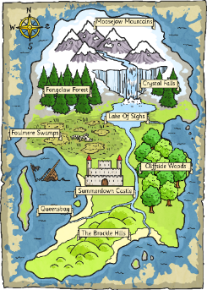
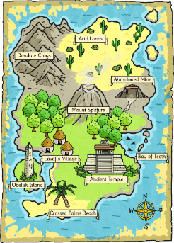
Designing the Island
Now is your chance to design the island.
What will it be called? What geographical features or landmarks will it have? As it is undiscovered, only natural landmarks will be there. What will you call these features?
Look at these maps for some inspiration…

Slide 6
LO: To create a setting
SC:
I can use my design to create my setting
I will include some special/mystical features

Slide 7
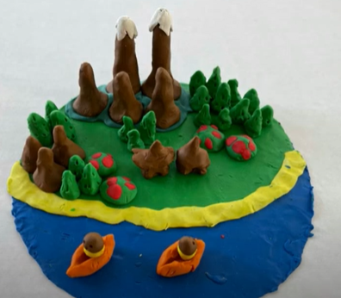
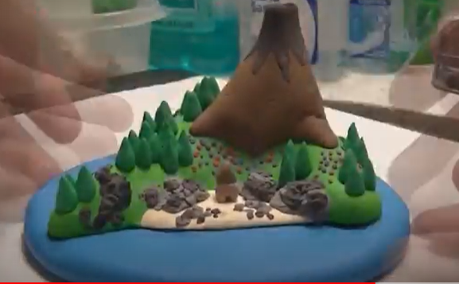
https://www.youtube.com/watch?v=LvWKyUKmJXI
https://www.youtube.com/watch?v=YQCsbtepz4c

Slide 8
LO: To design a character

Slide 9
What makes a character interesting?

Slide 10
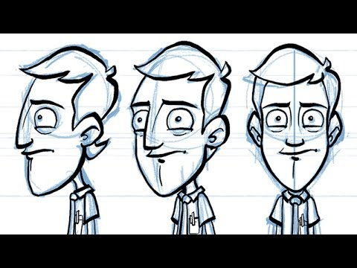
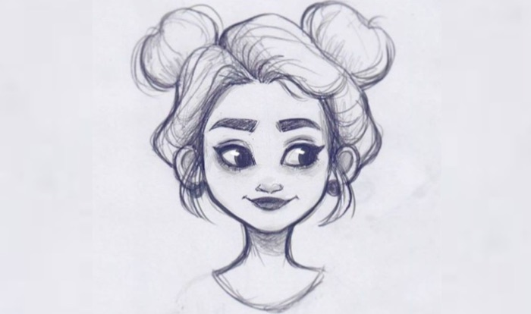
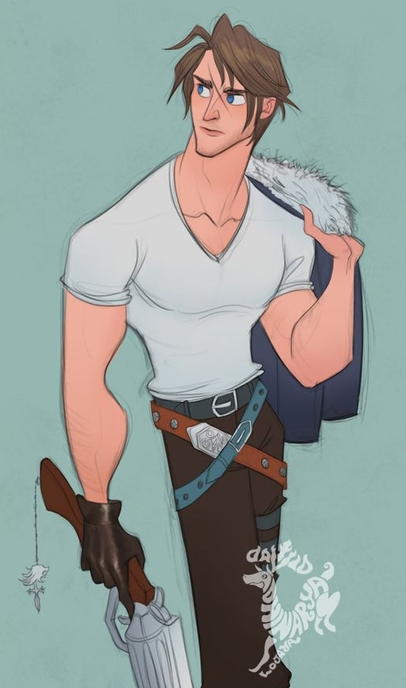
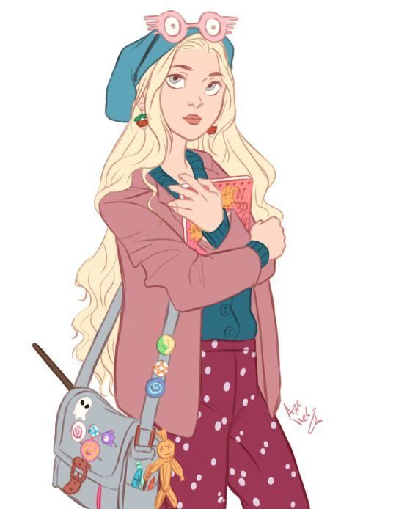
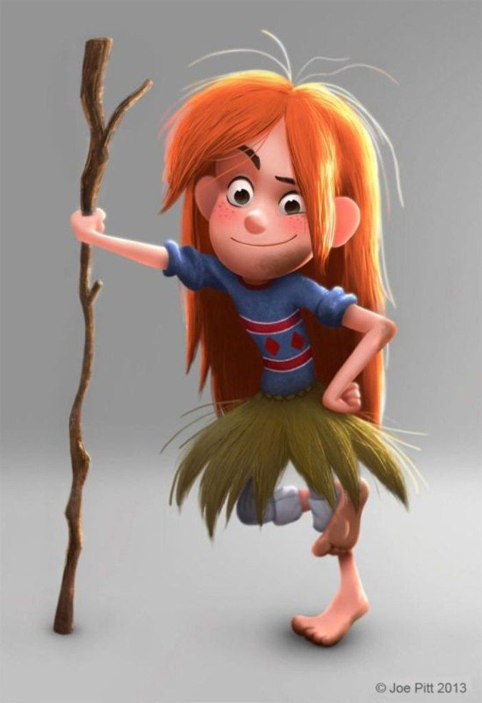
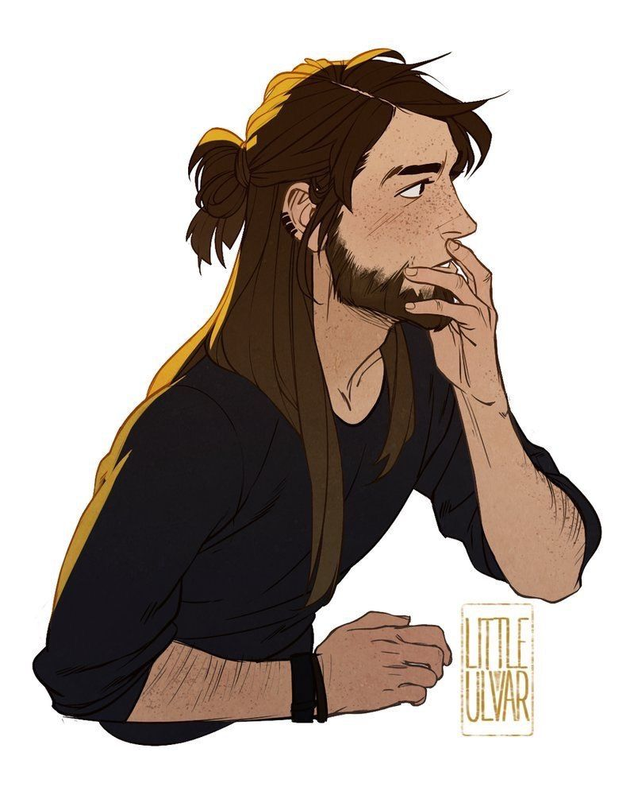

Slide 11
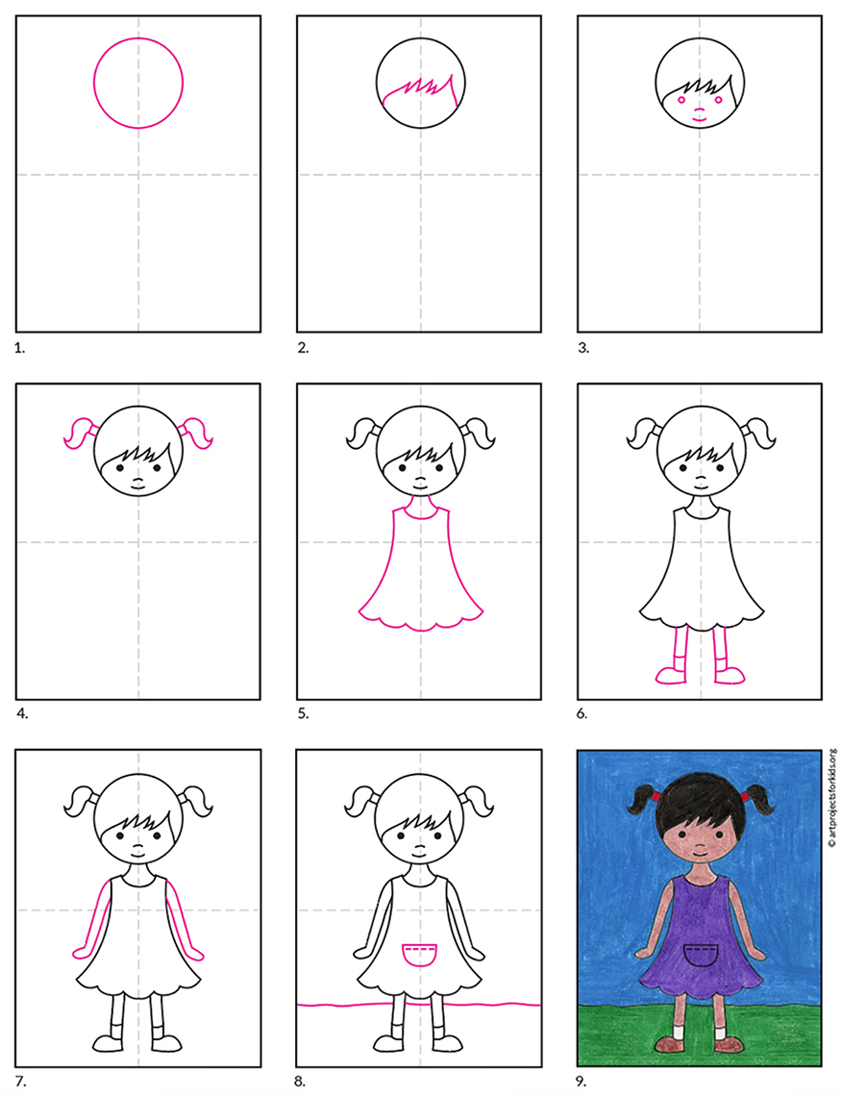
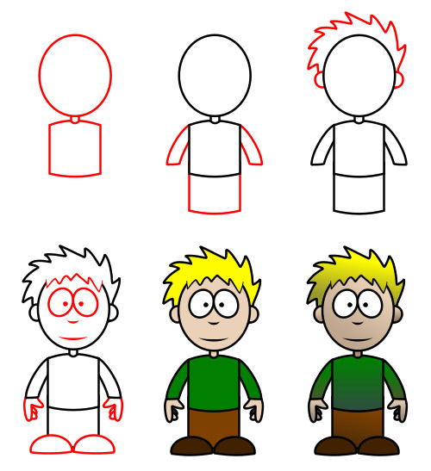

Slide 12
Give your character an unusual feature, something that makes them unique. This will make them more interesting.
For example. Freckles, a mark or scar, untameable hair.

Slide 13
LO: To write a character description

Slide 14
What Is a Character Description?
What do we learn about Serla from this description?
An enormous white wolf was walking stiffly towards them on its hind legs. It was dressed in a breastplate and a red cape, which swished lazily around the creature’s furred feet. Its eyes were a burning orange, and a glint around its mouth gave the merest suggestion of sharp fangs.
The wolf stopped directly in front of Cole and gazed down at him, amber eyes bulging. “Who is this?” she growled.
Cole held his breath as the wolf prowled around him in a circle, looking him up and down. She had long, grey streaks in the fur on her nose.
An enormous white wolf was walking stiffly towards them on its hind legs. It was dressed in a breastplate and a red cape, which swished lazily around the creature’s furred feet. Its eyes were a burning orange, and a glint around its mouth gave the merest suggestion of sharp fangs.
The wolf stopped directly in front of Cole and gazed down at him, amber eyes bulging. “Who is this?” she growled.
Cole held his breath as the wolf prowled around him in a circle, looking him up and down. She had long, grey streaks in the fur on her nose.
An enormous white wolf was walking stiffly towards them on its hind legs. It was dressed in a breastplate and a red cape, which swished lazily around the creature’s furred feet. Its eyes were a burning orange, and a glint around its mouth gave the merest suggestion of sharp fangs.
The wolf stopped directly in front of Cole and gazed down at him, amber eyes bulging. “Who is this?” she growled.
Cole held his breath as the wolf prowled around him in a circle, looking him up and down. She had long, grey streaks in the fur on her nose.
These words and phrases tell us about Serla’s appearance.
These words and phrases give us clues about Serla’s personality. What kind of person do you think she is?

Slide 15
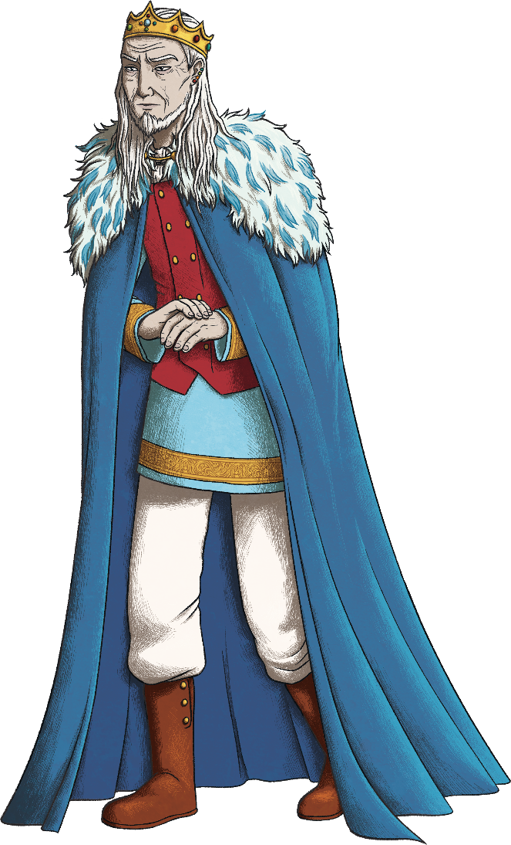
Describing a Character’s Appearance
It is important that a character description allows the reader to picture what that character looks like.
wears crown
long hair
thin face
wears nice robes
wears a cloak
Look at King Enk. What features would you want the reader to picture?
slim

Slide 16

Describing a Character’s Appearance
What adjectives would work well to create a picture of the king?
Think carefully about what is most important for your reader to know.
shoulder-length
gold
wispy
long hair
wears crown
bejewelled
snowy white
heavy
pale
expensive
thin face
wears nice robes
sunken
fine
embroidered
velvet
wears a cloak
blue
stooped
slim
floor-length
slender

Slide 17
Describing a Character Using Your Senses
As well as thinking about what the character looks like, we could consider the other senses.
What would the character sound like? What would they smell like? What would their clothes feel like?
Focus on describing things that will tell the reader something important. What clues can we give that the king is wealthy, powerful and old?
silky voice
soft fur
heavily perfumed
leather boots click clack loudly

Slide 18

Figurative Language
To keep your reader engaged, and to create a comparison which is easy for your reader to understand, why not use figurative language?
The jewels in his crown were stars plucked from the night sky.
hair as white as snow
A simile compares two things using the words ‘like’ or ‘as’.
A metaphor compares two things without using the words ‘like’ or ‘as’. It simply says that one thing is another.
The cloak hung lazily over his shoulders.
Personification describes a non-living object or animal using the features of a human.

Slide 19
What Is a Character Description?
Let’s look again at the description of Serla the wolf. As well as Serla’s physical features, this character description told us about her character.
An enormous, white wolf was walking stiffly towards them on its hind legs. It was dressed in a breastplate and a red cape, which swished lazily around the creature’s furred feet. Its eyes were a burning orange, and a glint around its mouth gave the merest suggestion of sharp fangs.
The wolf stopped directly in front of Cole and gazed down at him, amber eyes bulging. “Who is this?” she growled.
Cole held his breath as the wolf prowled around him in a circle, looking him up and down. She had long, grey streaks in the fur on her nose.
An enormous, white wolf was walking stiffly towards them on its hind legs. It was dressed in a breastplate and a red cape, which swished lazily around the creature’s furred feet. Its eyes were a burning orange, and a glint around its mouth gave the merest suggestion of sharp fangs.
The wolf stopped directly in front of Cole and gazed down at him, amber eyes bulging. “Who is this?” she growled.
Cole held his breath as the wolf prowled around him in a circle, looking him up and down. She had long, grey streaks in the fur on her nose.
What key features of King Enk’s personality could you show? How could you show this?

Slide 20

Describing a Character’s Personality
How could we show these character traits without simply listing them?
You should try to show the reader what they are like rather than tell them.
Manipulative
“You trust me, don’t you Cole?” King Enk smirked.
Although his words were kind, Cole felt uneasy.
Powerful
With a click of his fingers, the wolves appeared.
The king waved a delicate hand and the table filled instantly with delicious fruits and cakes.

Slide 21

Putting It All Together
When putting all of your planning together, it is important to remember that:
you don’t need to include every single detail of the character, only those which give the reader useful clues;
you should group similar points together and follow the gaze of your main character;
varied word choices and sentence structures will help to make the writing engaging;
speech and action can help you show your reader about the character’s personality rather than telling them everything in a long description.

Slide 22
Putting It All Together
King Enk’s tall, slender frame appeared in the doorway. As he entered the room, every creature and person fell silent. As the long, velvet cape that hung limply around his narrow shoulders swept across the floor, his servants bowed low. A heavy, bejewelled crown sat on top of his wispy, white hair and the soft, faux fur that trimmed the top of his cloak framed his grey face. From the end of his pointed chin sprouted a pointed beard as white as snow. At a click of his spindly fingers, a dozen wolves appeared.
“Guards,” he said in a silky voice which oozed confidence, “show our visitor how we greet elseworlders.” A cruel smile twisted on the king’s face and his silver eyes flashed dangerously.

Slide 23
What Makes an Effective
Character Description?
Create a clear picture of your character in the reader’s head.
Think carefully about the senses.
Use figurative language.
Show the reader what the character is like through the use of action or speech.
Vary your vocabulary and sentence structure to keep the reader engaged.

