Slide 1
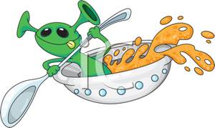
Lesson 4/5 - To decide how materials might be separated.
To explain your scientific processes.
Alien Soup!

Slide 2
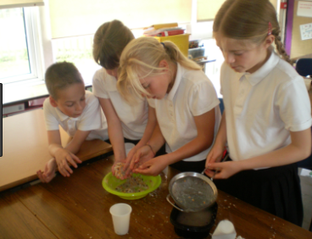
Your task…
Today you will need to find out what is in this mysterious soup using all the skills you have learned about separating materials so far.

Slide 3
Decide in your group how you will separate the ingredients and in which order you will do this. You can use any equipment on the table.
Follow your own plan and try to get all the ingredients into separate plastic cups.
Take photographs of each stage on the iPad.

Slide 4
You are now going to create a big book to explain the processes you went through to separate the ‘alien soup’. Use the scientific vocabulary and your photos in the book.
Key vocabulary
sieving
filtration
dissolving
soluble
insoluble
mixture
solution

