Slide 1
L.I. To discuss the thoughts and feelings of Mary and Joseph on the birth of Jesus.

Slide 2
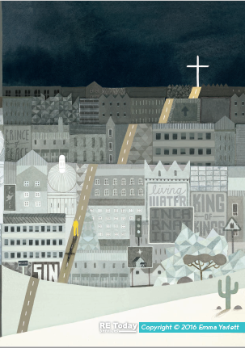
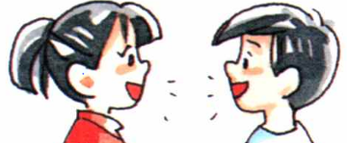
Re-cap! Incarnation (unexpected solution)
What does the word incarnation mean?
What does the word Messiah mean?
Incarnation:
Incarnation is when a deity (a god or goddess) takes human form. In Christianity, this is believed to have happened when God came to Earth as Jesus. This occurred through Jesus being born to the Virgin Mary. Though Jesus is described as the ‘Son of God’, Jesus is a part of God. He is both God and human.
Messiah:
The promised deliverer of the Jewish nation prophesied in the Hebrew Bible.
Jesus regarded by Christians as the Messiah of the Hebrew prophecies and the saviour of humankind.
A leader regarded as the saviour of a particular country, group, or cause.

Slide 3

Independent Learning
Remember this term you are going to be investigative journalists and you have been employed to answer the question.
Was Jesus the hoped-for Saviour?
Was Jesus the Messiah?
Today you are going to investigate some key witnesses who were there when Jesus was born…Mary and Joseph?
Who were Mary and Joseph?
Why would they be important witnesses?

Slide 4
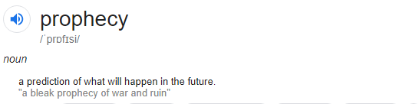
Re-cap! What is a prophecy?
Christians believe the Old Testament contains prophecies about what the Messiah would be like and where he would be born.
The People of God used these prophecies to look forward to God sending them a rescuer — a Messiah.
Christians believe that these prophecies apply to Jesus.
Joseph and Mary would have been familiar with these prophecies, today we are going to read the Christmas story and think about how Mary and Joseph would have felt and what they would have thought.
Let’s re-cap what the prophecies were before we begin…

Slide 5

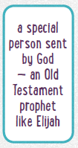
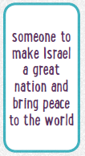
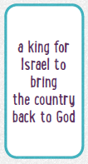
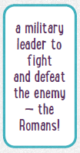
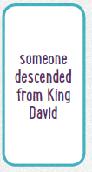
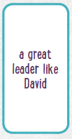
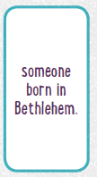
Re-cap! Can you remember how the prophecies described the Messiah?
The Jewish people were waiting for a Messiah, or ‘anointed one’: a Saviour.
They expected the Messiah to be:

Slide 6
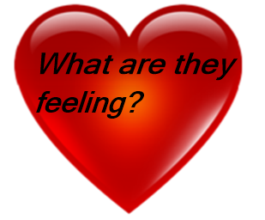
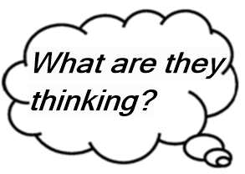
While we are reading the story you will see some symbols.
Think about the questions with your learning partner and then we will talk about it together.

Slide 7
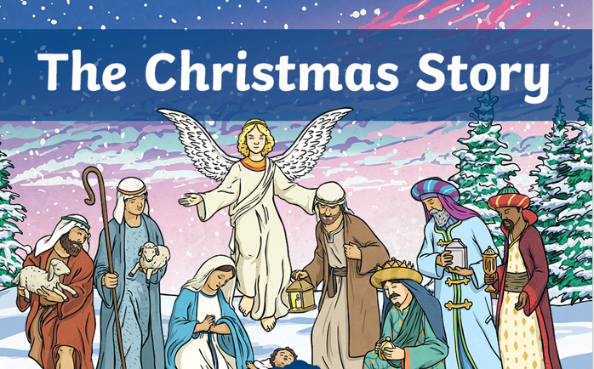

Slide 8
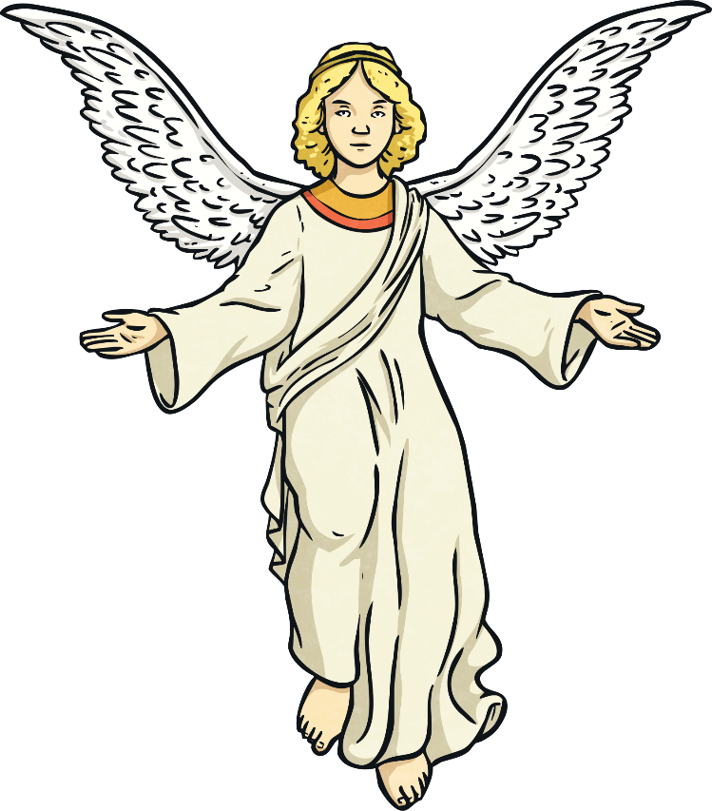
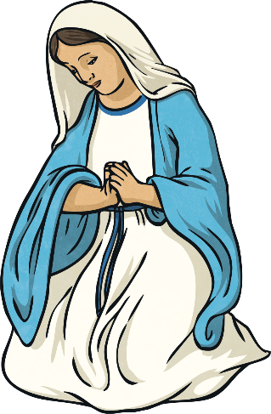
The angel Gabriel appeared to Mary and told her that she would have a baby. Angel Gabriel told Mary that her baby would be God’s son and be called Jesus. Mary was very shocked by this but knew that she was very special to be chosen by God.

Slide 9
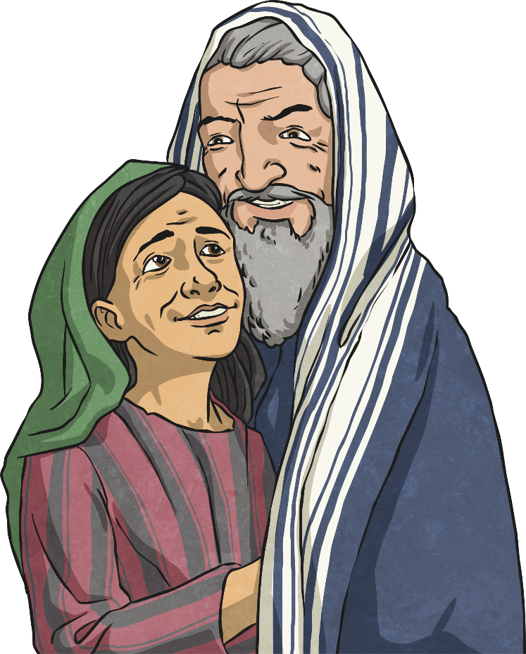
After Mary had been visited by the angel, she went to visit her relative, Elizabeth. Elizabeth and her husband, Zechariah were also expecting a very special baby. Zechariah had been told by an angel that their baby should be called John.

Slide 10
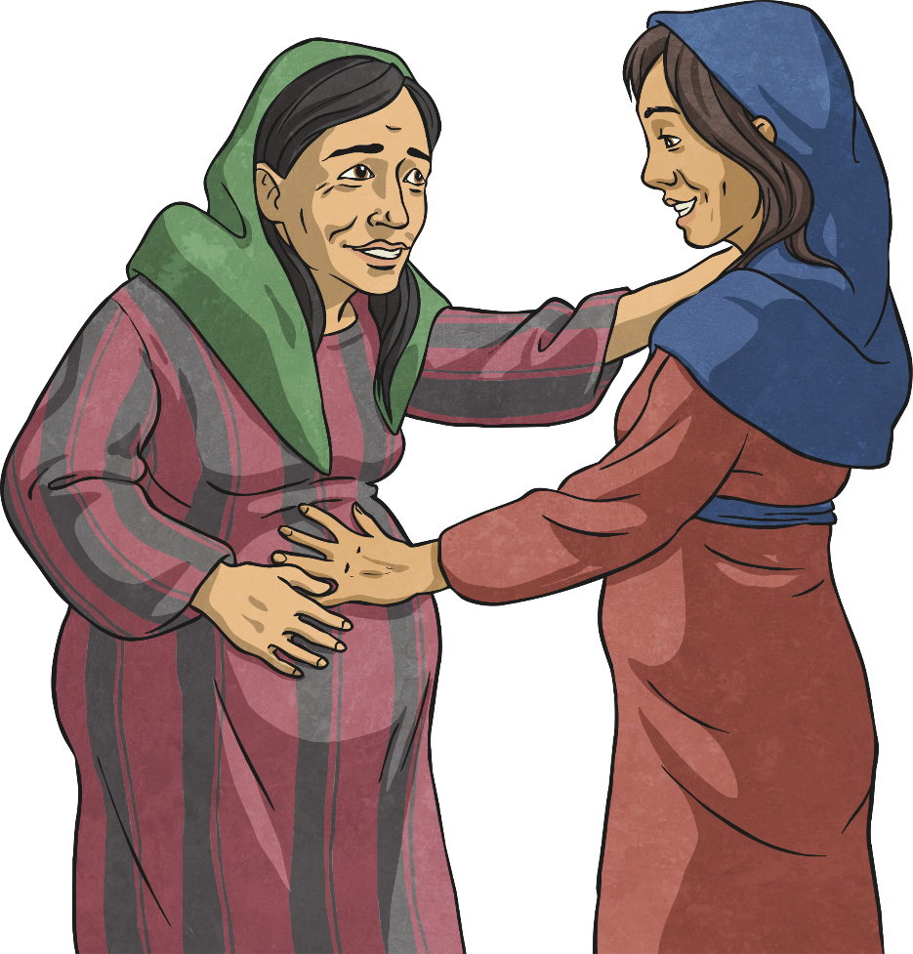
When Mary arrived, Elizabeth’s baby leaped for joy. ‘You are a very special woman, Mary!’ cried Elizabeth.

Slide 11
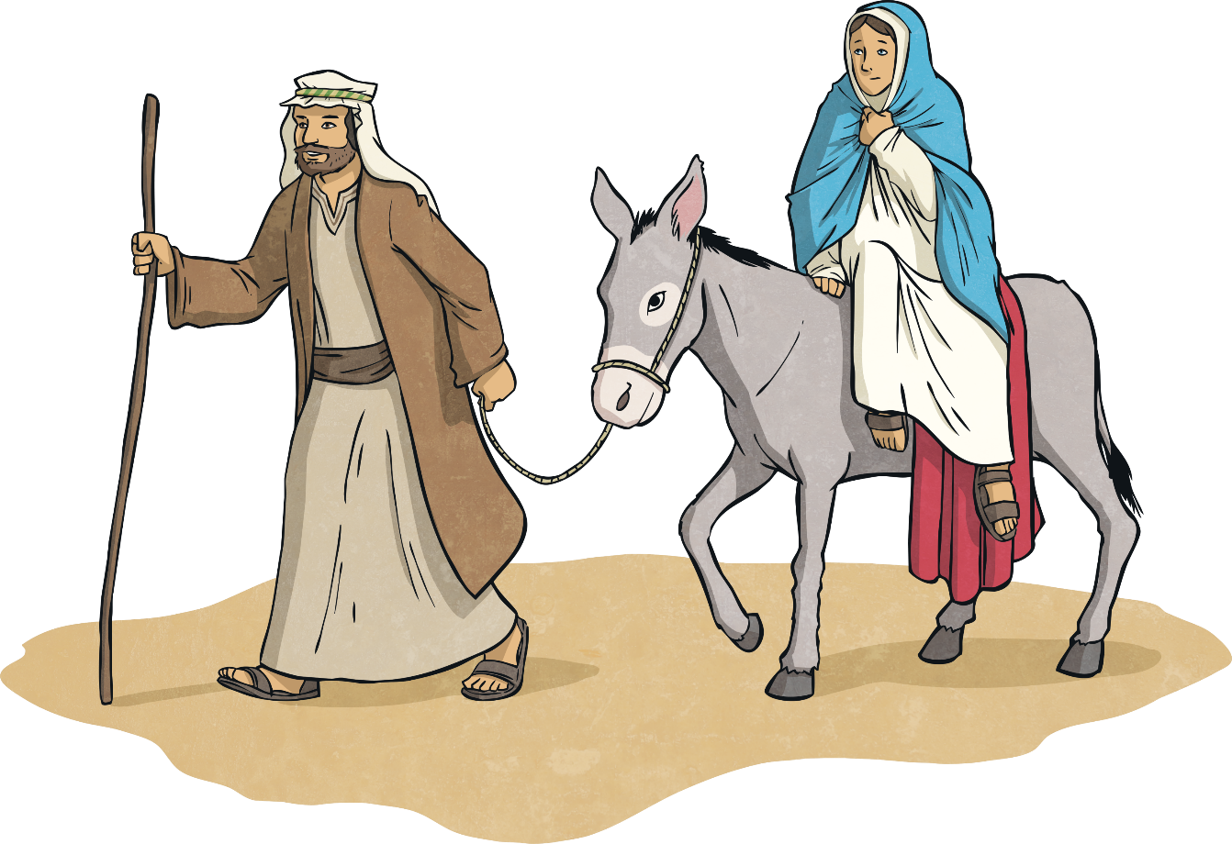
Mary was engaged to Joseph. An angel also appeared to him and explained about Mary’s special baby. At the same time, there was a census of all people in the land. This meant everyone had to travel to the town of their birth.

Slide 12
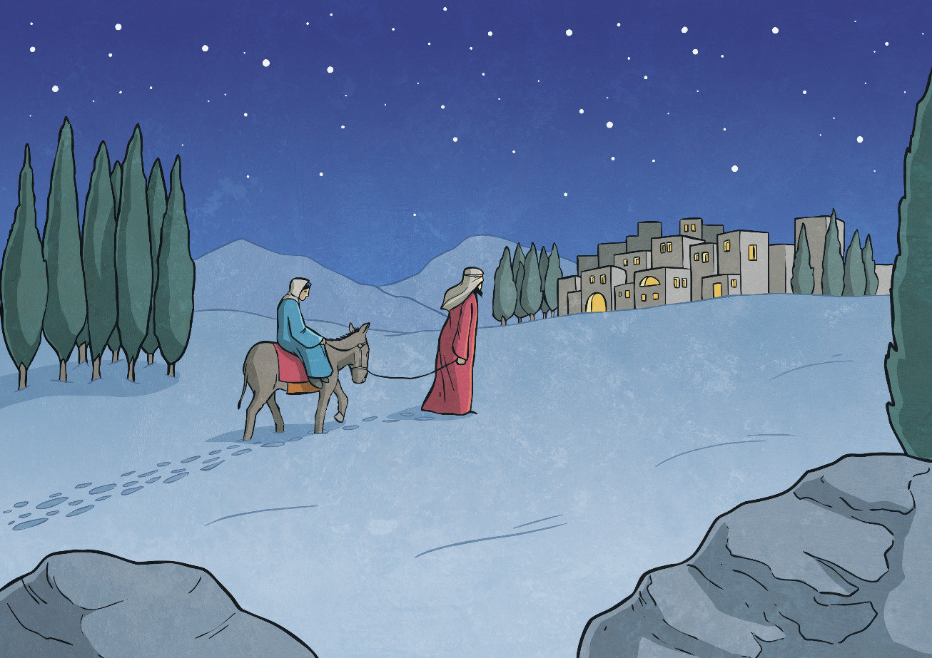
Mary and Joseph travelled to Bethlehem, the town of Joseph’s birth. Mary travelled on a donkey as she was heavily pregnant and unable to walk such a long distance. The journey was very long and hard.

Slide 13
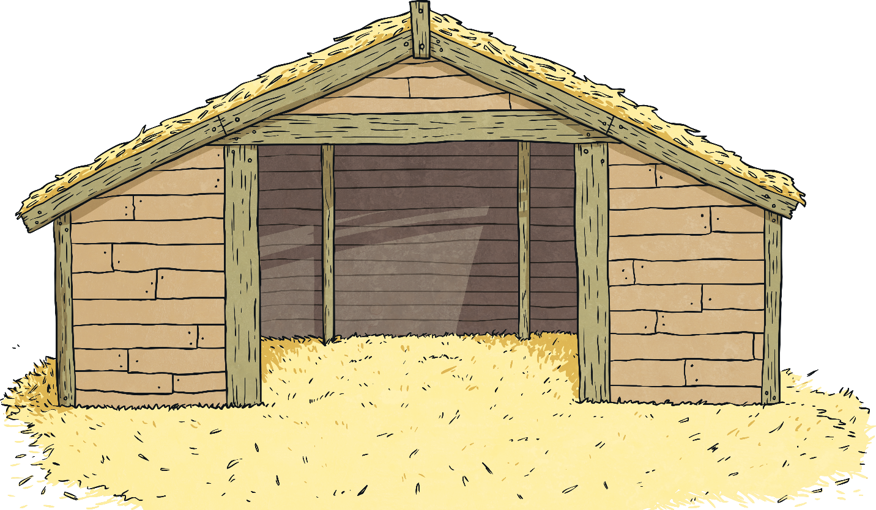
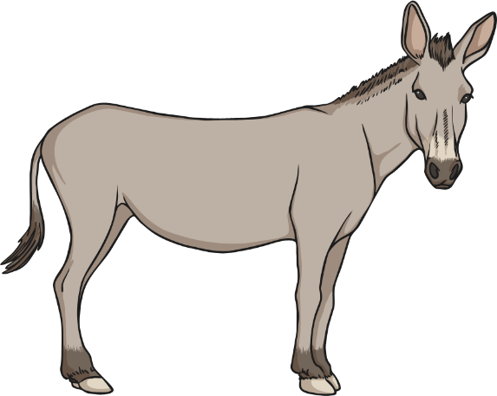
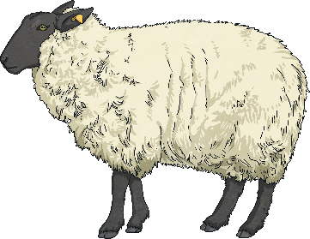
Finally, Mary and Joseph arrived in the town of Bethlehem, the City of David. Unfortunately, it was very busy with fellow travellers and there was nowhere left to stay in the town.
Eventually, Joseph found an innkeeper who had a stable outside for his animals. Mary and Joseph settled into the stable alongside the animals.

Slide 14

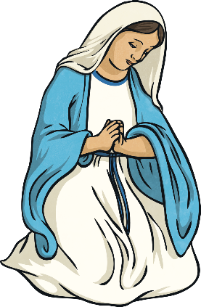
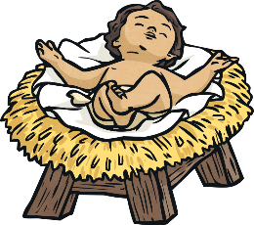
That night, Jesus was born in the stable.
Mary placed the baby Jesus in a manger, wrapped in swaddling cloths. It was a very humble beginning for Jesus as he was the Son of God.

Slide 15

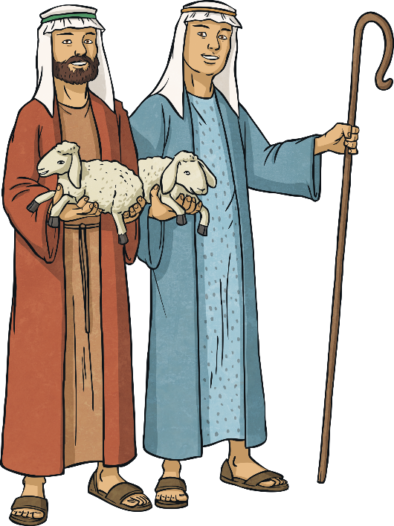

Later that night, an angel appeared to shepherds who were tending to their sheep on a hillside. The angel told the shepherds that the Son of God had been born and they should visit him in Bethlehem. The shepherds immediately left to find Jesus, following a bright star over the stable.

Slide 16
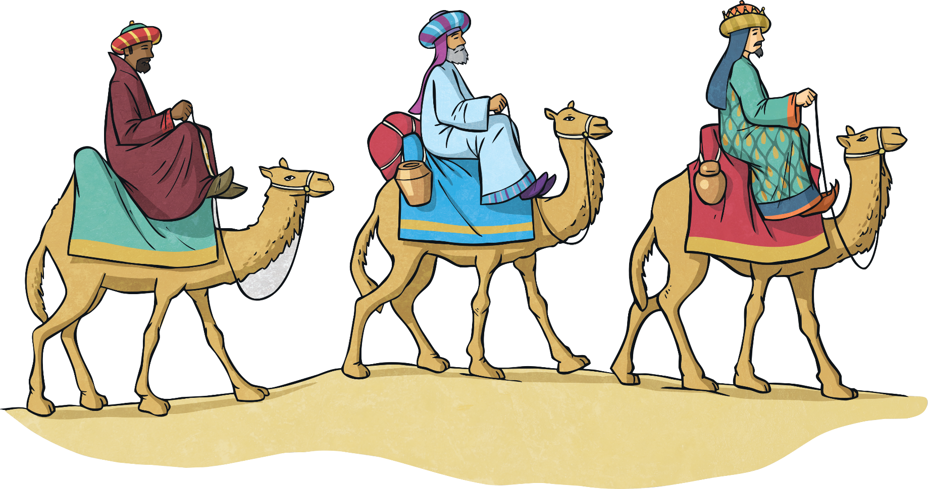
In the East, Wise Men spotted a very bright star in the sky. They knew this meant a king had been born, so they travelled with different gifts to give to the new king.

Slide 17
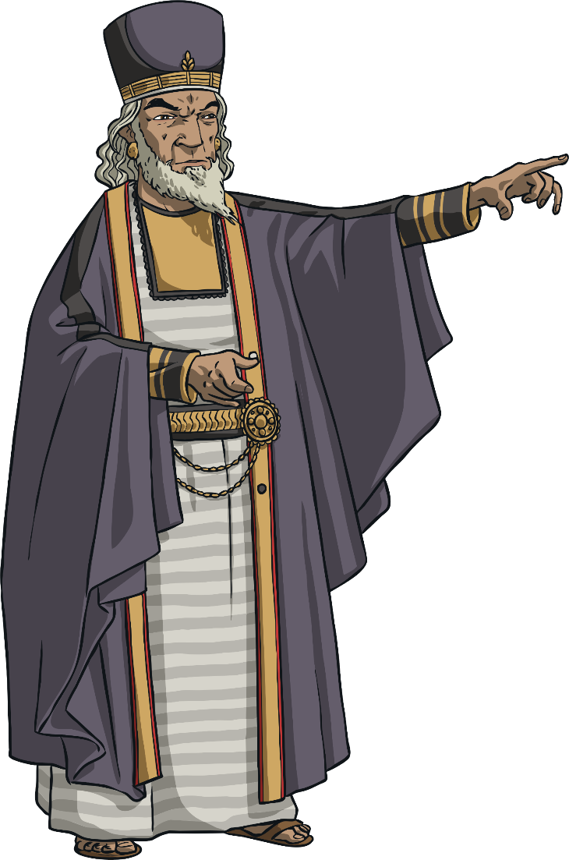
On the way, the Wise Men visited King Herod to ask whether he knew anything about the new king and where he was. King Herod was worried about the birth of a new king. He told the Wise Men to return and tell him where the new king was once they found him.

Slide 18
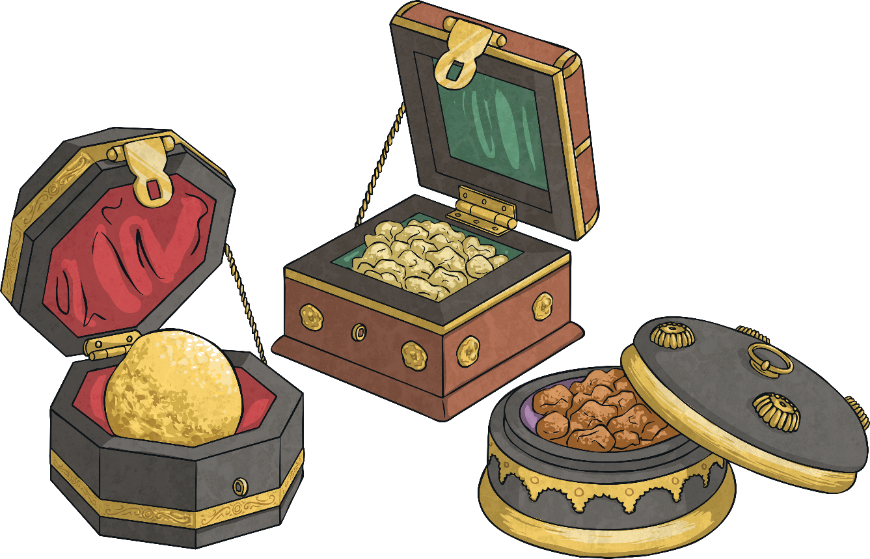
The Wise Men followed the bright star all the way to Bethlehem and found Jesus in the stable. They gave baby Jesus gifts of gold, frankincense and myrrh. That night, the Wise Men had a dream warning them not to tell King Herod that Jesus was in Bethlehem. Wanting to keep Jesus safe, they returned home.

Slide 19
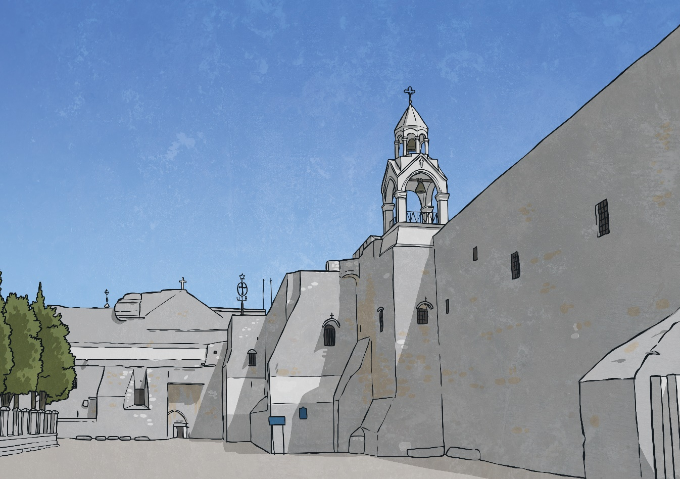
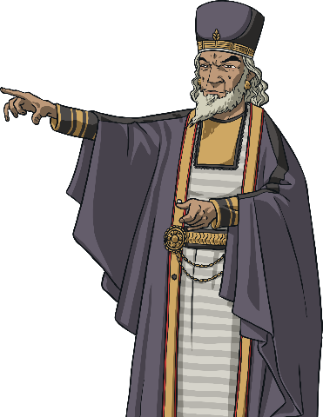
King Herod discovered baby Jesus was in Bethlehem. He ordered all baby boys in Bethlehem to be killed by his soldiers in order for this new king to be removed.

Slide 20
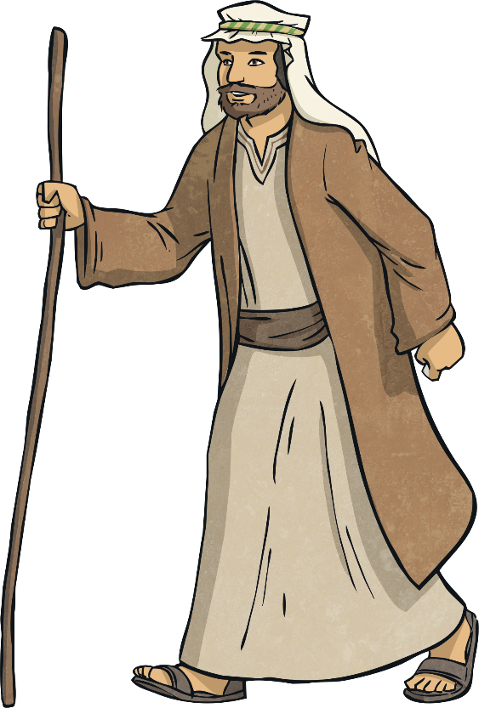
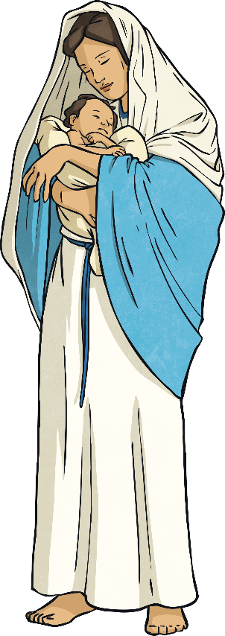
Joseph had a dream about Angel Gabriel telling him to take Mary and Jesus to Egypt and escape danger.
Mary, Joseph and Jesus travelled to Egypt immediately to escape King Herod’s soldiers and they were safe.

Slide 21
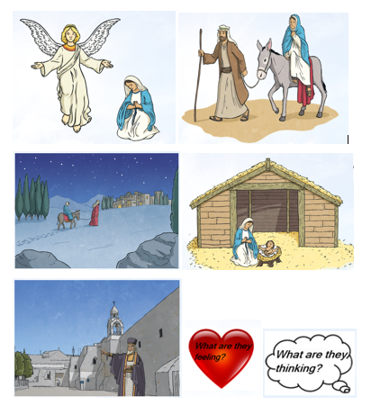
Independent Task
Cut out the thought and feeling pictures and stick them at the top of your page.
Cut out a picture and stick it in the middle of your page between your symbols.
Underneath each symbol, write the thoughts and feelings of the people in the part of the story.
Repeat for all pictures.
Challenge
In your books answer these questions in role as Mary and Joseph…
Answer in full sentences.
How do you feel about your task? Explain
What might this mean for the world? Why?
Does anything scare you? Why
Do you feel privileged? Explain
Do you think your son is the Messiah? Why?

