Slide 1
Monday 8th March 2020
LO: To sequence the events of an Antarctic exploration.

Slide 2
This week you will be writing a newspaper report, to inform the readers about the miraculous journey of Ernest Shackleton and his crew.

Slide 3


Slide 4
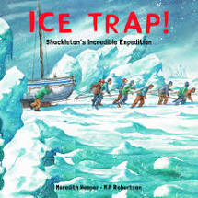

Slide 5
Review the Features of a Newspaper report.
Headline
Introductory Paragraph – To capture the readers interest.
5 W’s (Who, what, where, when, why)
Pictures and Captions
Fact and opinion
3rd Person
Quotes
Concluding Paragraph
Time adverbials

Slide 6
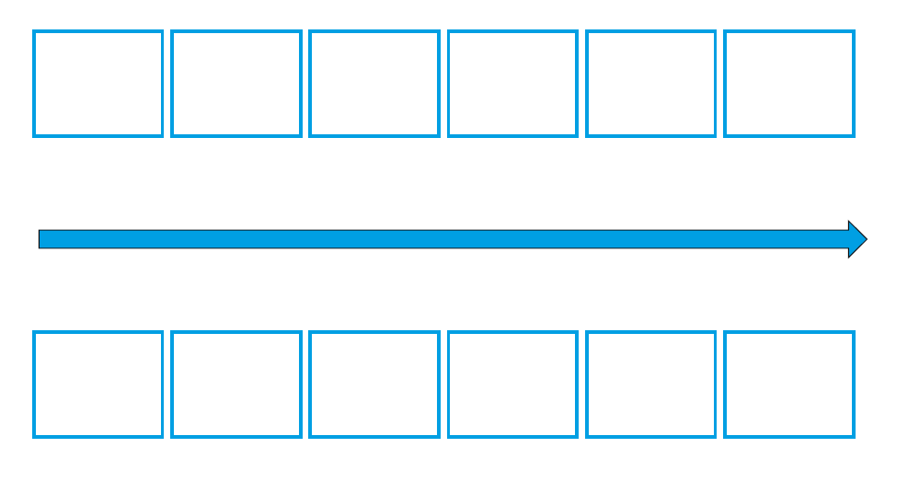
Create a timeline of events of Shackleton’s journey

Slide 7
Tuesday 9th March 2020
LO: To plan a newspaper report.

Slide 8
https://www.bbc.co.uk/bitesize/topics/z2yycdm/articles/z2gk9qt

Slide 9
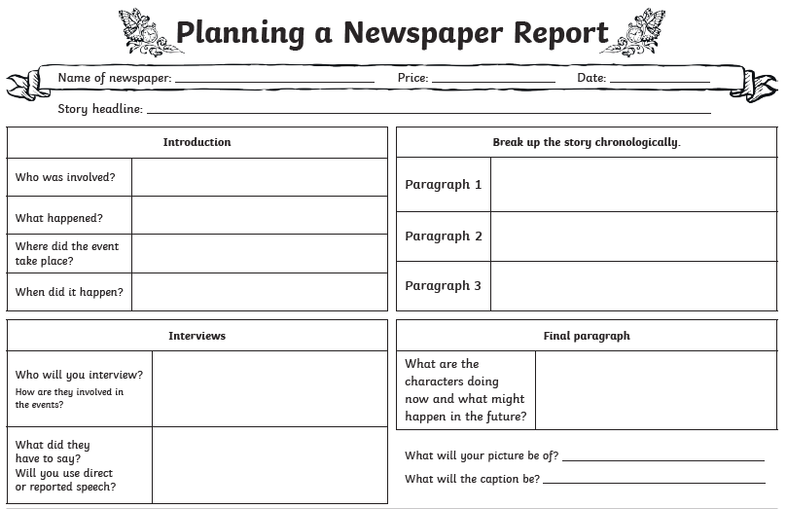

Slide 10
Wednesday 10th March 2020
LO. To draft and edit the introduction and P2 of a newspaper report

Slide 11
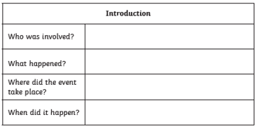
Focus today on the Headline and the Introduction paragraph
Why did it happen?

Slide 12
Things to consider when drafting your report.
Write on every other line – this will help with the next stage in the process.
Form each sentence in full before you write it down.
Consider the punctuation needed for each sentence as you write it.
Once you have written a sentence read it through to check it makes sense.

Slide 13
Introduction:

Slide 14
Paragraph 1:

Slide 15
Things to consider when editing your letter.
Read each sentence at a time
– ask yourself, does it make sense? Have I used
capital letters, full stops, question marks and
other punctuation accurately?
Choose 5 words that could be improved. Use a thesaurus to make stronger word choices.
Add 2 adjectives
Add 2 adverbs
Check you have used all of the features of letter writing.
When you have done this, swop your letter with your learning partner. Ask them to check against the list above to ensure you haven’t missed anything.

Slide 16
LO. To draft and edit a newspaper report

Slide 17
Paragraph 2:

Slide 18
Paragraph 3:

Slide 19
Conclusion:

Slide 20
Things to consider when editing your letter.
Read each sentence at a time
– ask yourself, does it make sense? Have I used
capital letters, full stops, question marks and
other punctuation accurately?
Choose 5 words that could be improved. Use a thesaurus to make stronger word choices.
Add 2 adjectives
Add 2 adverbs
Check you have used all of the features of letter writing.
When you have done this, swop your letter with your learning partner. Ask them to check against the list above to ensure you haven’t missed anything.

