Slide 1
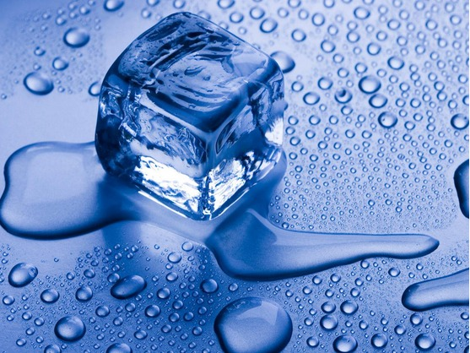
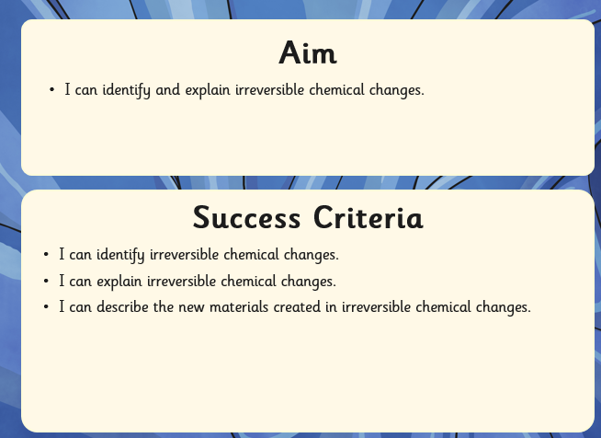
Lesson 6 - To identify reversible and irreversible changes.

Slide 2
Kitchen Creations
The kitchen is where our food is made and cooked. But did you know it is also home to many scientific reactions?
Watch this clip to find out more about the science of cooking.
http://www.bbc.co.uk/food/techniques/how_to_fry_eggs

Slide 3
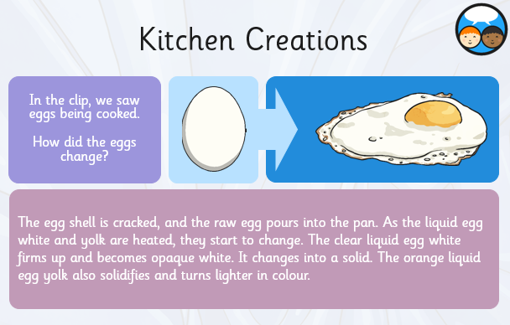

Slide 4
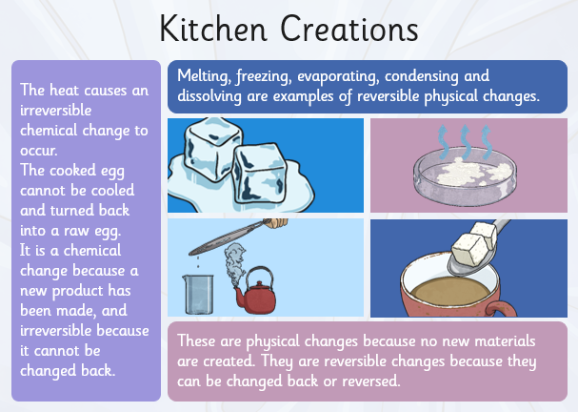

Slide 5
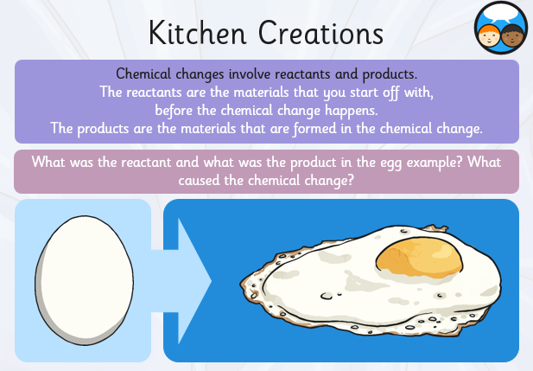

Slide 6
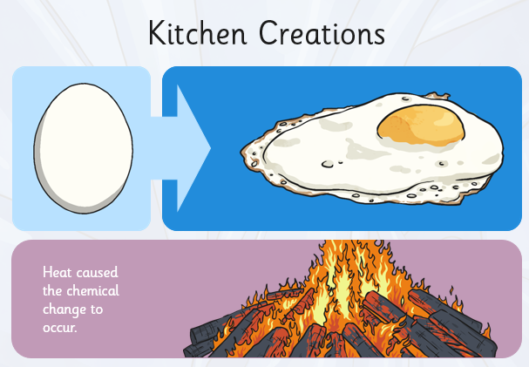

Slide 7
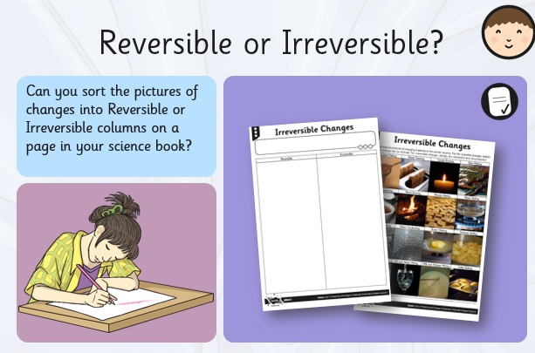

Slide 8
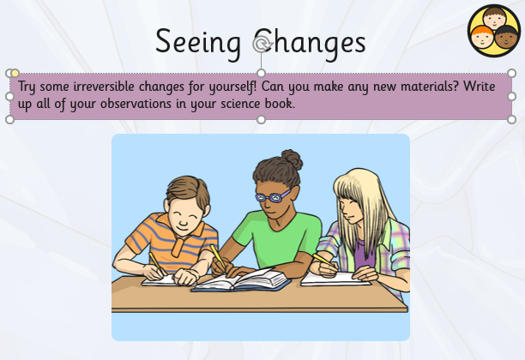

Slide 9
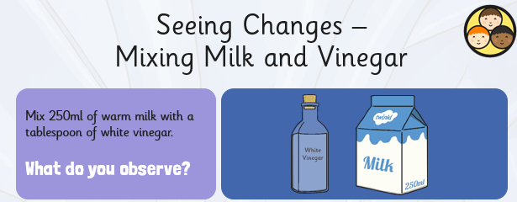

Slide 10


Slide 11
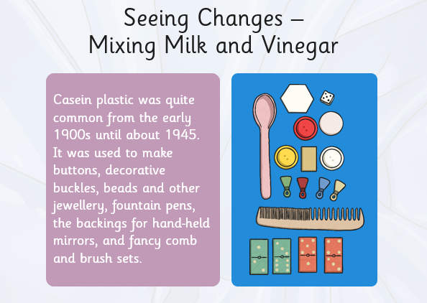

Slide 12
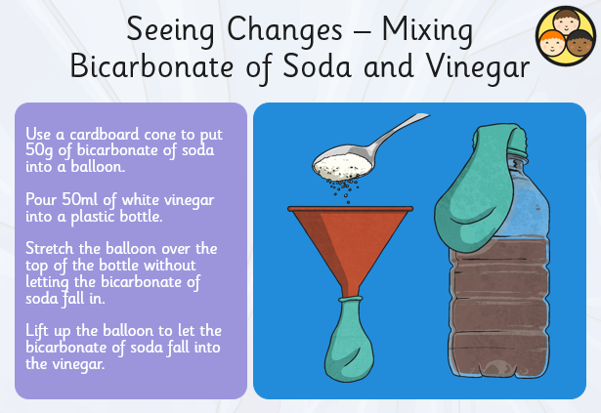

Slide 13
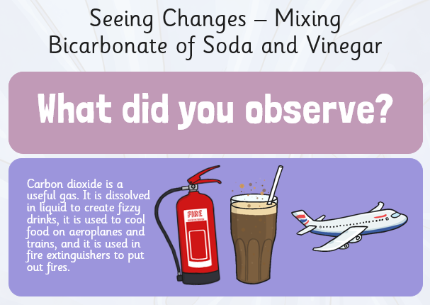

Slide 14
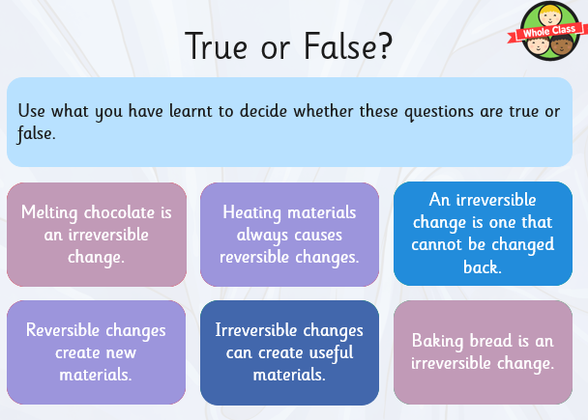

Slide 15
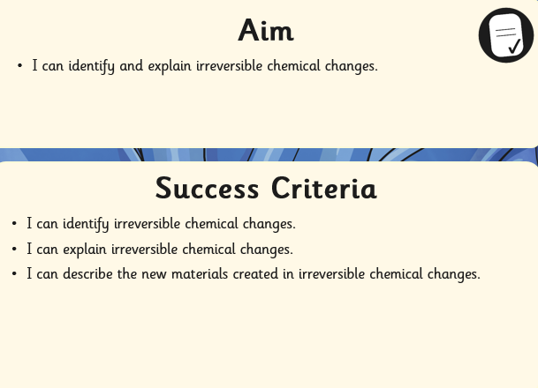
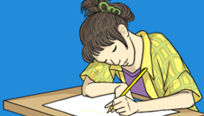
Review you learning

