Slide 2
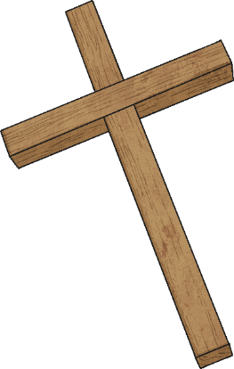
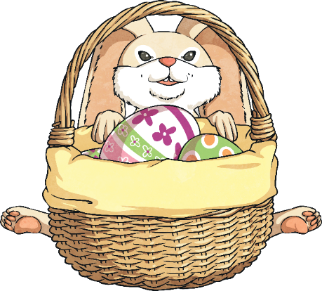
What Is Easter?
Easter is a celebration full of fun, happiness, colorful Easter eggs, cute bunnies, and spring lambs!
But Easter is also an important religious celebration for Christians. It is a time to remember Jesus’ suffering and His resurrection.
The week leading up to Easter Sunday is called Holy Week. There are several important days during Holy Week.
Maundy Thursday (when The Last Supper happened)
Good Friday (when Jesus died on the cross)
Easter Sunday (when Jesus was resurrected)

Slide 3
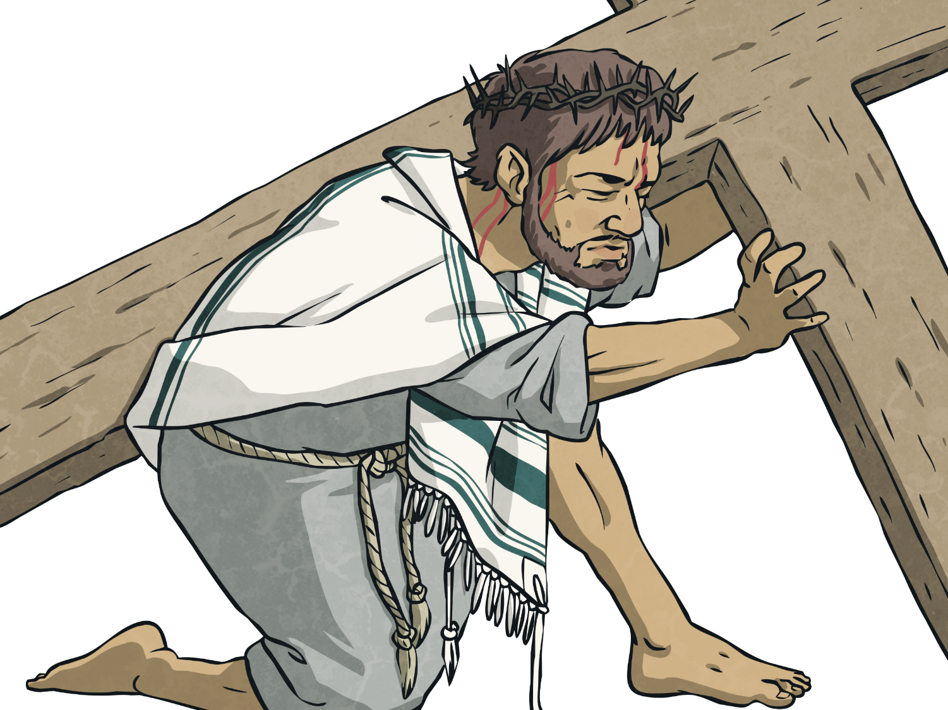
Cross
Jesus was crucified on a cross. Christians believe He rose again after His death and that the cross symbolizes both God’s sacrifice and the good news of His victory over death.

Slide 4


Palm Branches
When Jesus entered Jerusalem, crowds of people welcomed Him and waved palm branches as He passed by. Today, many churches make palm crosses out of palm leaves to remember His arrival in Jerusalem.

Slide 5
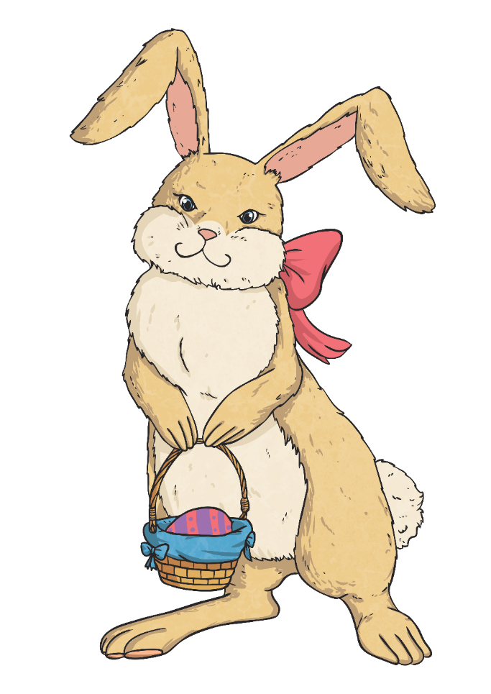
Easter Bunny
Some believe European pagan religions first incorporated rabbits and hares into the celebration of Easter as they symbolize new life.
While others believe the Easter Bunny originated from Germany. German children believed in “Osterhase” or “Oschter Haws.”
It is said they colored nests for the bunny to lay the eggs. This tradition is thought to have come to the U.S. with German immigrants in the 1700s.

Slide 6
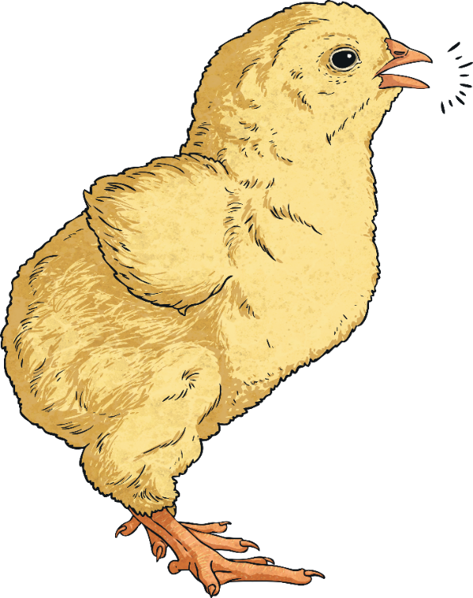
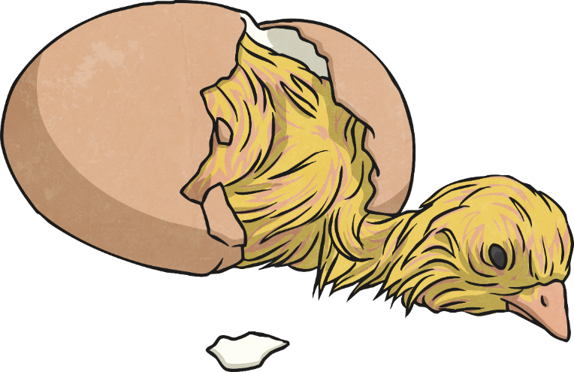
Chicks
Similar to bunnies, chicks hatching are said to symbolize new life.

Slide 7
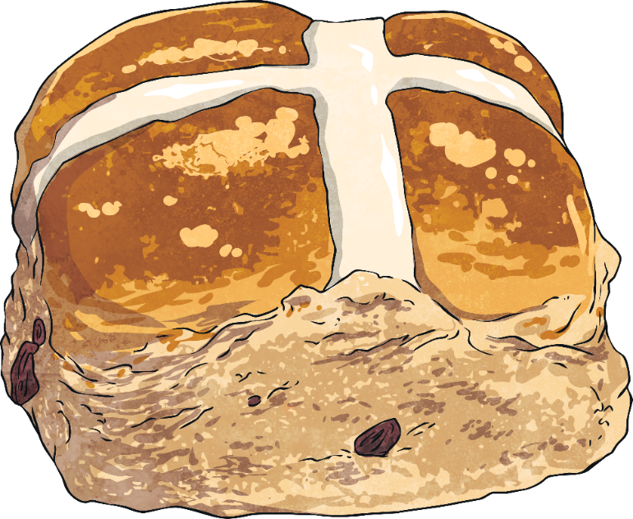
Hot Cross Buns
Tasty, sweet bread rolls, baked with raisins and spices, are commonly eaten during Holy Week. They are marked with a cross to symbolize the crucifixion of Jesus.

Slide 8
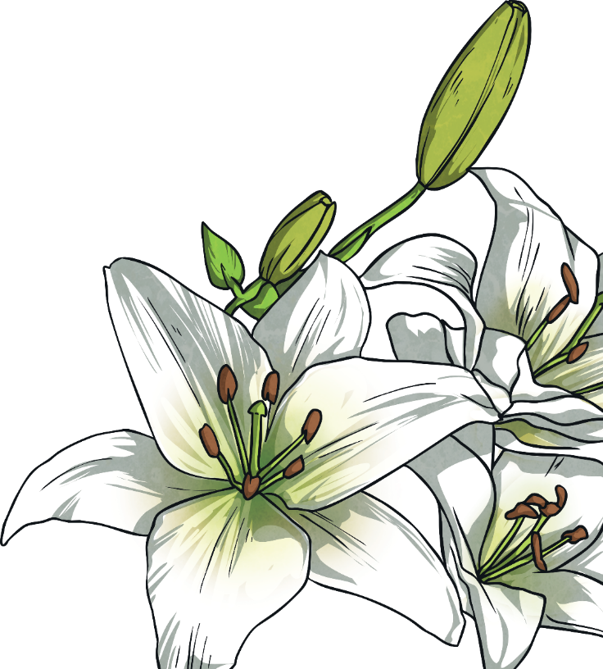
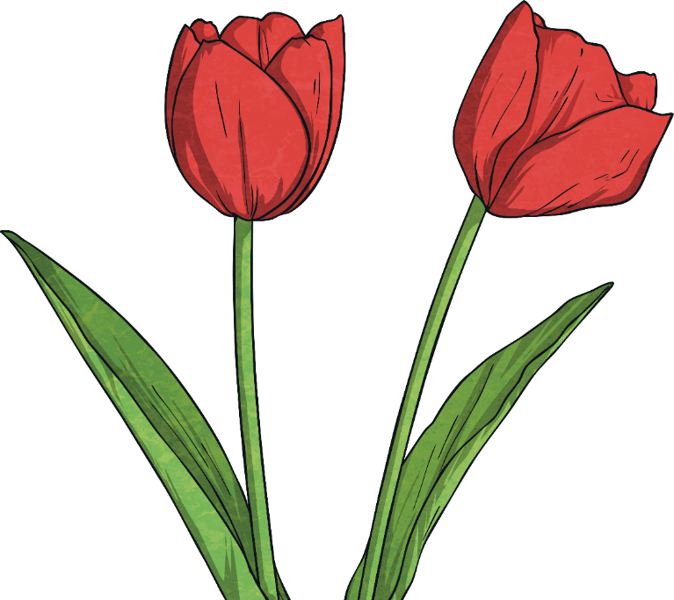
Flowers
Easter lilies have white blossoms which represent the purity of Jesus.
Lilies and tulips bloom in spring; a beautiful display of new life.
They are often used in flower arrangements in churches during Holy Week.

Slide 9
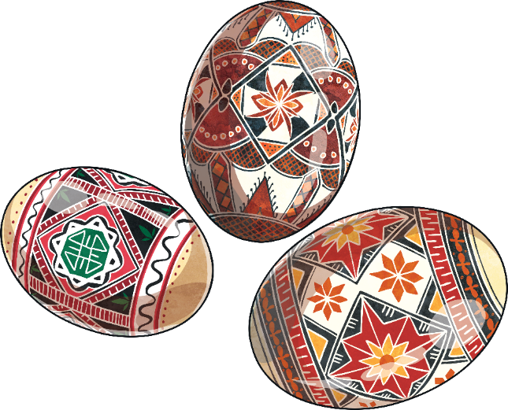
Easter Eggs
Traditionally, Easter eggs are painted chicken’s eggs. This practice of painting eggs is thought to have originated in Mesopotamia, where eggs were stained red in memory of the blood of Jesus. Eggs also symbolize the empty tomb from which Jesus emerged when He came back to life.
Easter eggs today are often made of delicious chocolate and filled with toys and candy!
Some countries still have finely
painted eggs, like these beautiful
examples in Romania.

