Slide 2

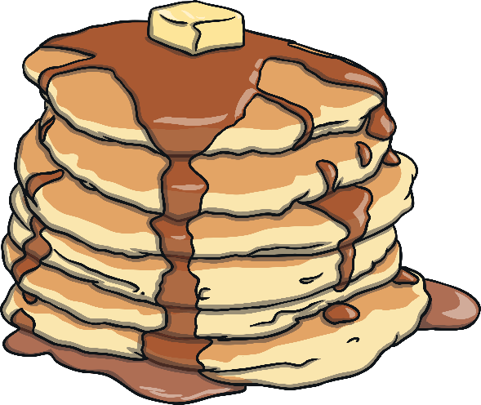

What is Lent?
Lent is a period of time that leads up to Easter.
It begins on Ash Wednesday (which is the day after Pancake Day.)
It is a very important time for Christians.
Lent lasts for 40 days (not including Sundays).

Slide 3
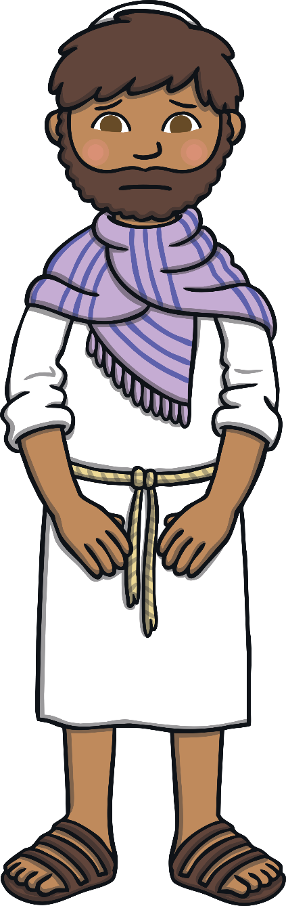

Why is Lent 40 Days Long?
Lent is 40 days long because this is how
long Jesus spent in the desert to be with God.
  During this time he had no food and nothing to drink. He was also tempted by the Devil. Christians use Lent as a time to think about Jesus.

Slide 4
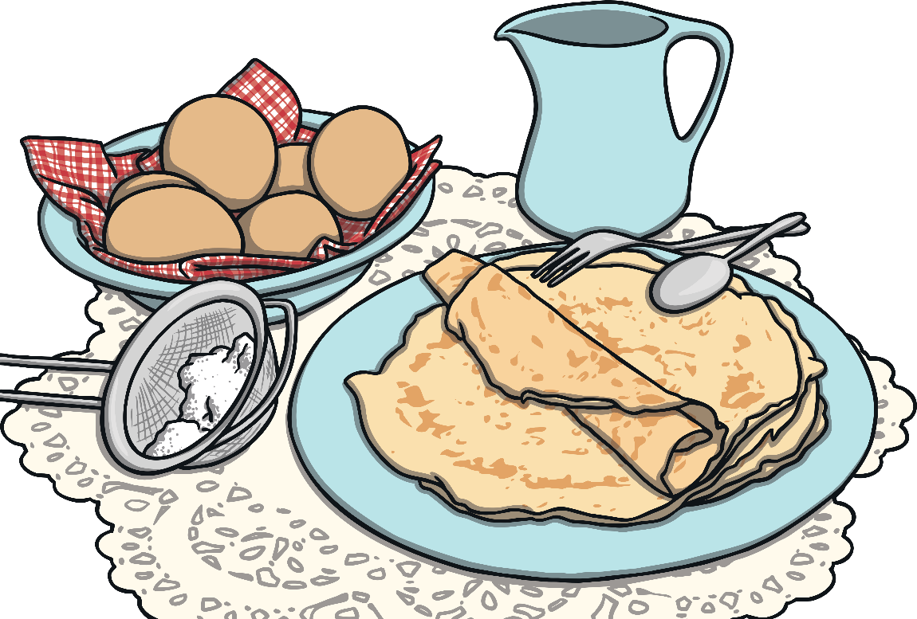
What Do Christians
Do During Lent?
In the past, Christians would give up all ‘rich’ food and drink during Lent. This meant food such as meat, eggs, fats and milk products weren’t eaten.
People used up their ‘rich’ foods before Lent began by making pancakes. This is why we have Pancake Day.

Slide 5


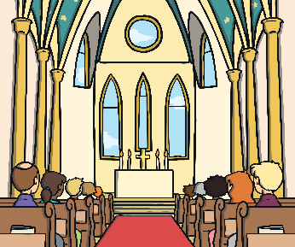
What Do Christians
Do During Lent?
During Lent, many Christians try to ‘give up’ or ‘stop having’ something they like. It might be chocolate or something like video games.
They do this to remember Jesus’ struggles in the desert, when he didn’t have food or drink and also to see if they can resist being tempted, like Jesus did in the desert.
  Lots of churches also hold special Lent services.

Slide 6
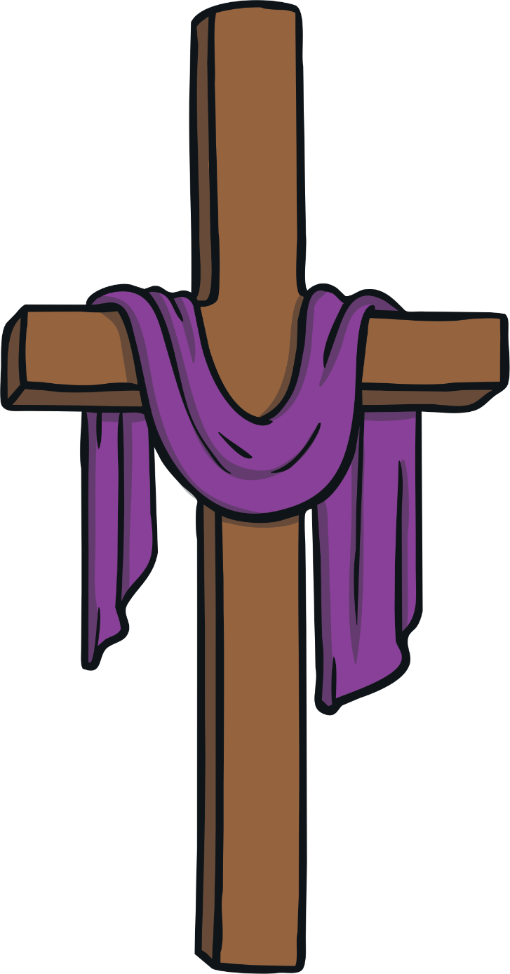
When Does Lent Finish?
  Lent ends at Easter, when Christians remember
  when Jesus died on the cross and came back to life.

Slide 7

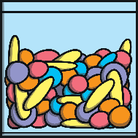

What Would You
Give Up for Lent?
Lent is a time for Christians to remember Jesus’ struggles
in the desert and how he didn’t give in to temptation.
If you were giving up something for Lent,
what would it be?
Why would it be difficult for you to give it up?

