Slide 1
Charlotte’s Web
EB White
Up to ‘then you’ll see what trouble a pig can be’.
https://www.lovereading4kids.co.uk/extract/10138/Charlottes-Web-by-E-B-White.html

Slide 2
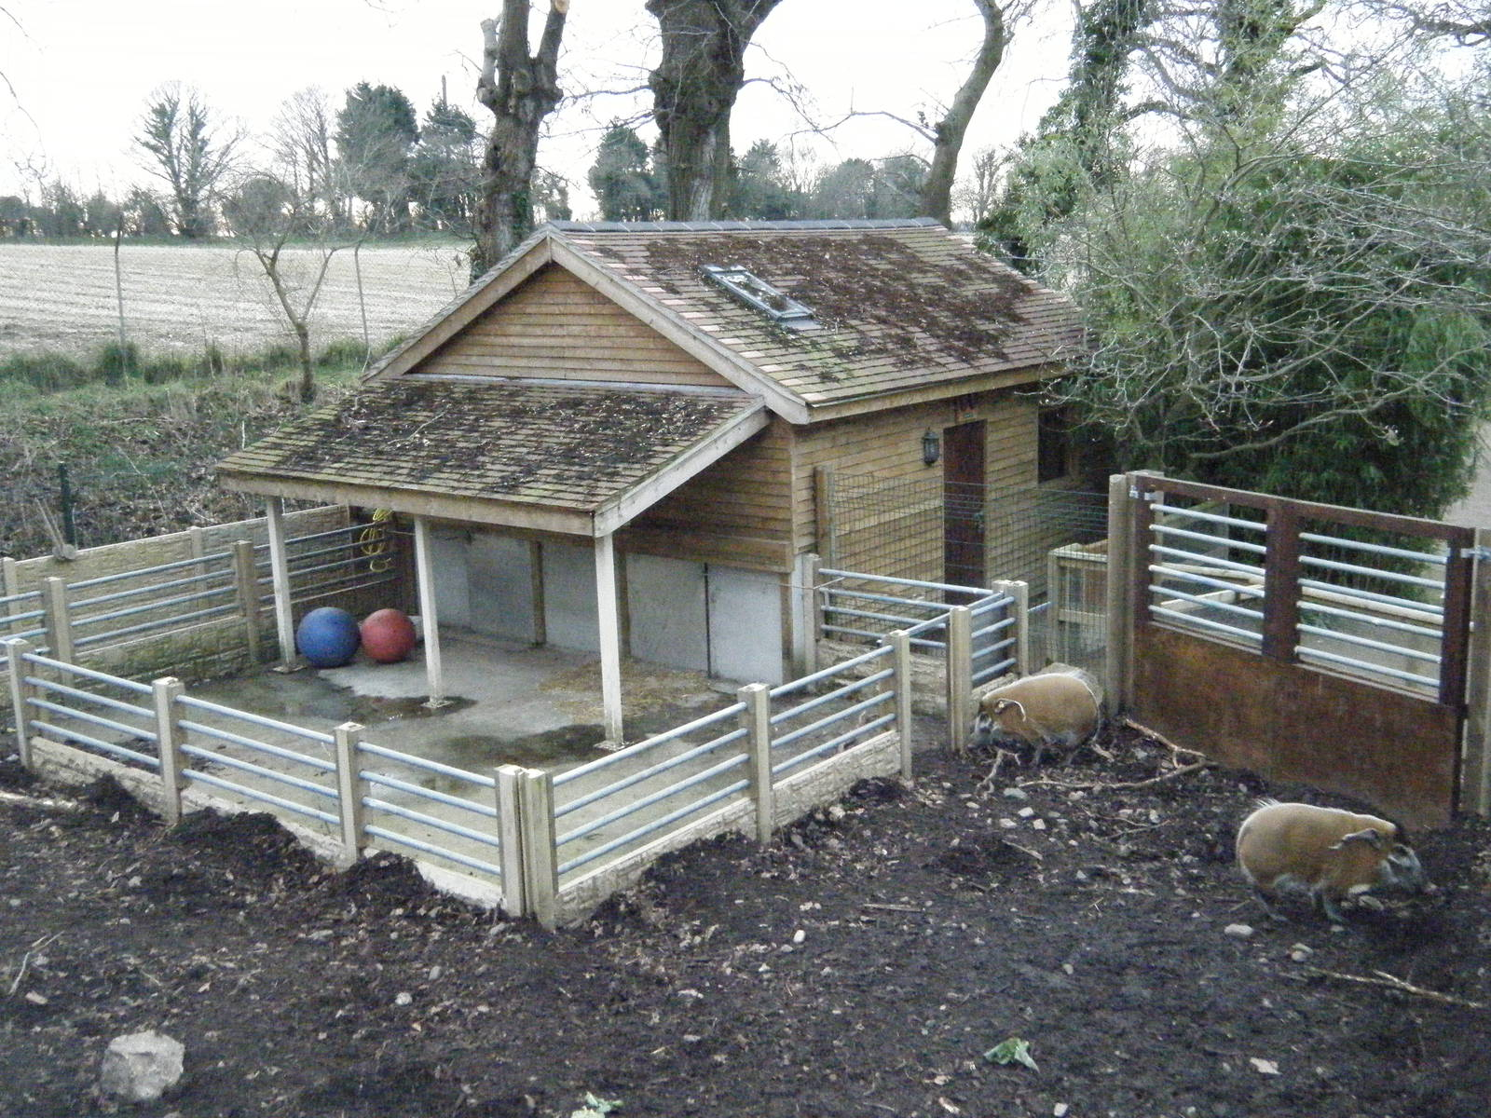
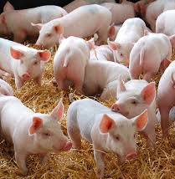
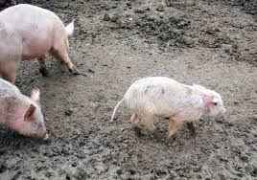
Vocabulary Check
sopping - very wet
a runt
a litter
a hoghouse

Slide 3
Quick Start
What was Papa carrying?
How old is Fern?
Why does Fern cry?
What does Papa say will happen to the runt?

Slide 4

Partnered Talk
‘Where’s papa going with that axe?’
Do you think this is a good opening line for a story? Why? How does it affect the reader?

Slide 5

Individual Thinking
Where is Papa going with the axe? What is he going to do?

Slide 6
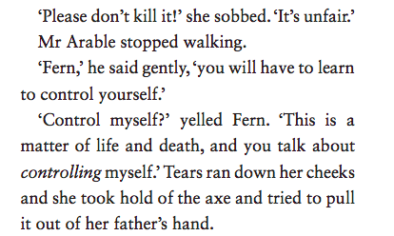
Partnered Talk
How do the two characters’ emotions differ here? Why do they feel the way they feel?

Slide 7
Individual Thinking
Why do you think Papa decided to let Fern keep the runt?
What do you think will happen?

Slide 8

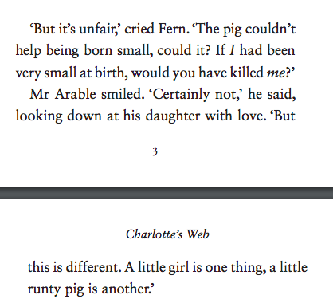
Solo Work
Do you agree with this statement? Write a few sentences to explain your answer.

