Slide 1
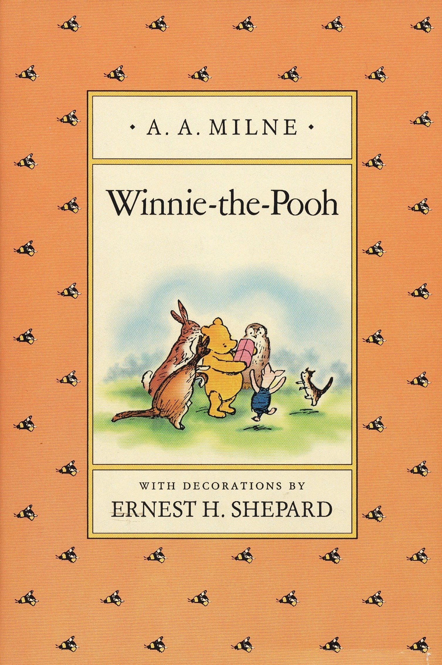
Winnie The Pooh
AA Milne
https://www.lovereading4kids.co.uk/extract/10644/Winnie-the-Pooh-the-Complete-Collection-of-Stories-and-Poems-by-A-A-Milne.html

Slide 2
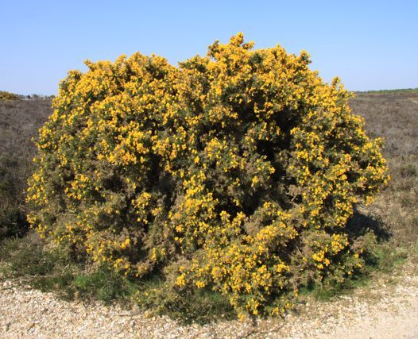
Vocabulary Check
growly - harsh sounding
complaining - moaning
feet - units of measurement
slithered - slid quickly
gracefully - move smoothly / beautifully
a gorse bush

Slide 3
Quick Start
Who owns the bear?
What is the bear’s name?
In the story, where did the bear live?
What was making the buzzing sound?
What does the bear want from the bees?

Slide 4

Partnered Talk
Someone tells the story to Christopher Robin. Who might be telling the story? What makes you think this?

Slide 5
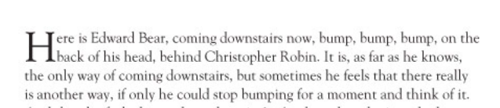
Partnered Talk
How does Christopher carry the bear down the stairs?

Slide 6


Individual Thinking
What does this tell the reader about Winnie The Pooh?

Slide 7
Partnered Talk
Why do you think the author included pictures? Have a look at some of the pictures and think about what they tell the reader or how they make the reader feel.

Slide 8
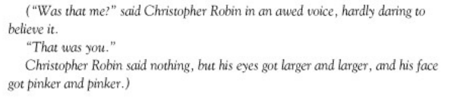
Individual Thinking
How does Christopher Robin feel?

Slide 9

Solo Work
Choose one word to sum up the character of Winnie The Pooh so far. It cannot be a noun such as ‘bear’. It should be a word that sums up his personality. Explain your choice of word

