Slide 1
The Magic Faraway Tree
Enid Blyton
Up to the end of Page 9
https://www.lovereading4kids.co.uk/book/4863/The-Magic-Faraway-Tree-Enchanted-Wood-by-Enid-Blyton.html

Slide 2
Quick Start
Who were the main three children?
Who was coming to stay with the children?
Why is he coming to stay?

Slide 3

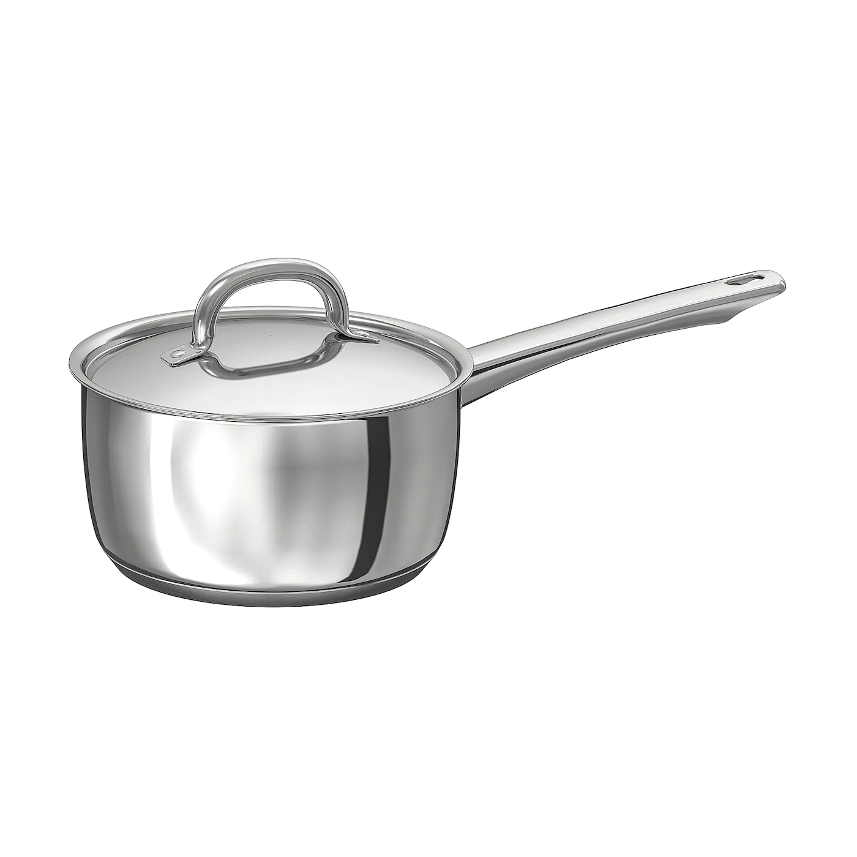
Vocabulary Check
in a little cottage
enchanted wood
Saucepan Man

Slide 4

Individual Thinking
He was a happy boy, rather naughty, and it would be such fun to have him.
Why do you think they thought it would be fun for Rick to stay with them?

Slide 5
Individual Thinking
The three children flew upstairs
What does the word ‘flew’ tell us here?

Slide 6

Partnered Talk
‘Hey! What will Rick say when we tell him about the Enchanted Wood and the Faraway Tree?’ cried Joe. ‘And what will he say when we show him our friends there – Silky, and old Moon-Face, and the dear old deaf Saucepan Man, and everyone!’ said Beth.
What could these things be?

Slide 7

Solo Work
‘Hey! What will Rick say when we tell him about the Enchanted Wood and the Faraway Tree?’ cried Joe. ‘And what will he say when we show him our friends there – Silky, and old Moon-Face, and the dear old deaf Saucepan Man, and everyone!’ said Beth.
What could these things be?
What might Rick say? Write it down.

