Slide 2

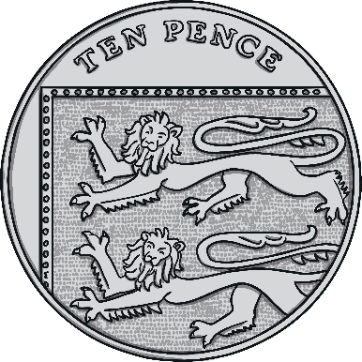
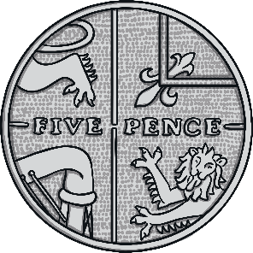
Coins
2p
5p
10p

Slide 3

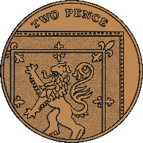

Count the coins in the jar.
4p
Answer

Slide 4
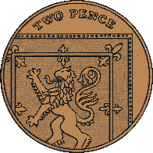
Count the coins in the jar.
14p
Answer

Slide 5
Count the coins in the jar.
20p
Answer

Slide 6
Count the coins in the jar.
24p
Answer

Slide 7

Count the coins in the jar.
15p
Answer

Slide 8
Count the coins in the jar.
45p
Answer

Slide 9
Count the coins in the jar.
55p
Answer

Slide 10
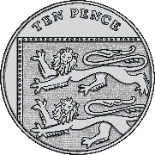
Count the coins in the jar.
40p
Answer

Slide 11
Count the coins in the jar.
Answer
60p

Slide 12
Count the coins in the jar.
50p
Answer

Slide 13
Count the coins in the jar.
90p
Answer

Slide 14


Challenge
If I put 10 10ps in my jar, how much money is in my jar?
=
10p
10p
10p
10p
10p
10p
10p
10p
10p
10p
£1
100p

Slide 15
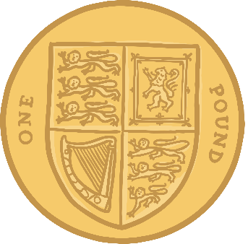
Count the coins in the jar.
£1
Answer

