Slide 2
Aim
I can discuss how change and loss make me feel.
Success Criteria
I can describe a time of change in my life.
I can talk about how I can help myself and others in times of change.
This resource is fully in line with the Learning Outcomes and Core Themes outlined in the PSHE Association’s Programme of Study.

Slide 3


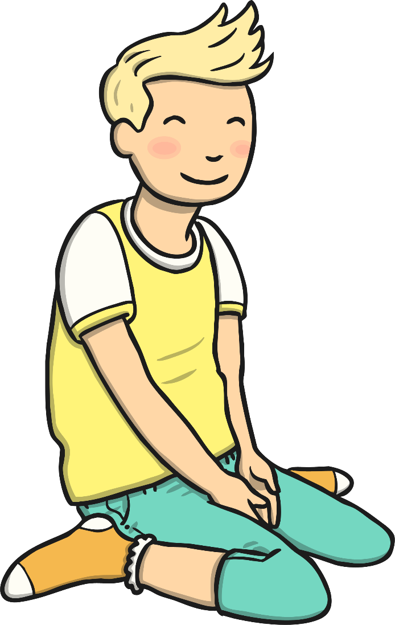
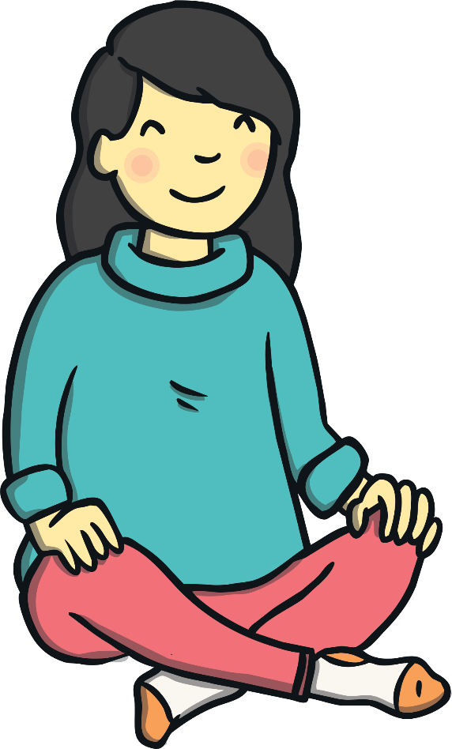
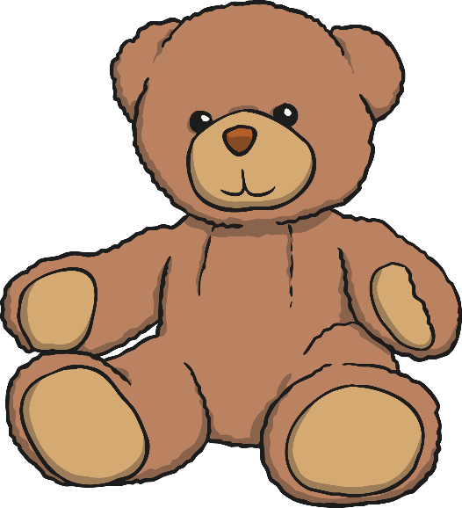
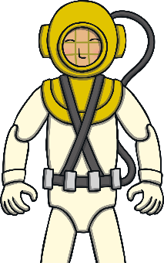

The Big Questions
How does it feel when things change or we lose something precious?
What can we do to help ourselves and others when this happens?
What do these questions make you think about?

Slide 4

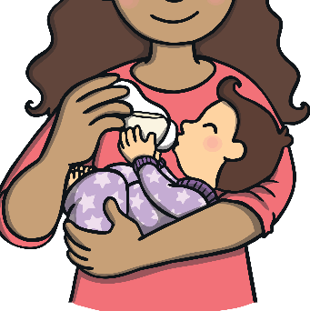
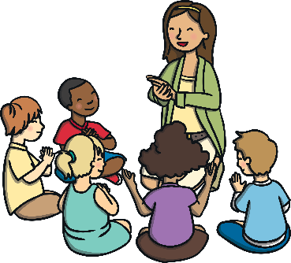
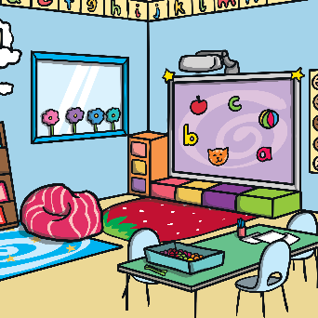
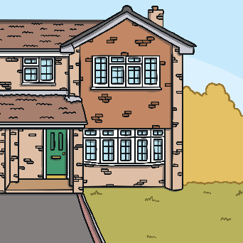
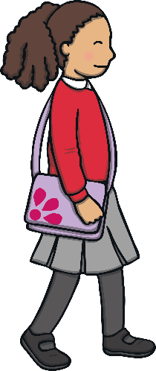
Life Changes
Life changes for us all. These can be happy changes. They might also be changes which make us feel a bit worried or sad.
This is a timeline of Shannon’s life. She is eight years old. It shows some of the big changes that have happened in her life.
What big changes has Shannon gone through in her life so far?
What changes have you gone through in your life so far?
aged
two
aged
three
aged
four
aged
five
aged
seven
born
started infant school
started junior school
baby brother was born
started nursery
moved house

Slide 5
How Change Makes Us Feel
Change can make us feel lots of different things.
We are going to look at some big changes that can happen in our lives and think about how these might make us feel.
For each change, talk about your ideas with a partner and then share your thoughts with the class.

Slide 6

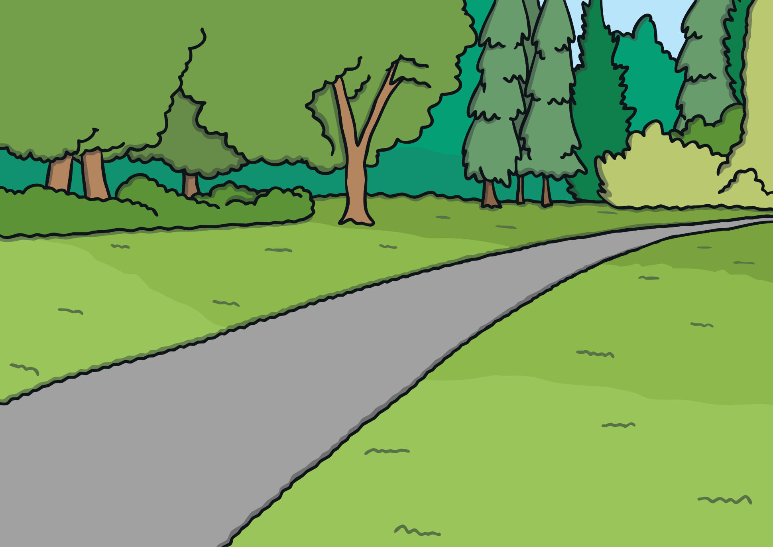
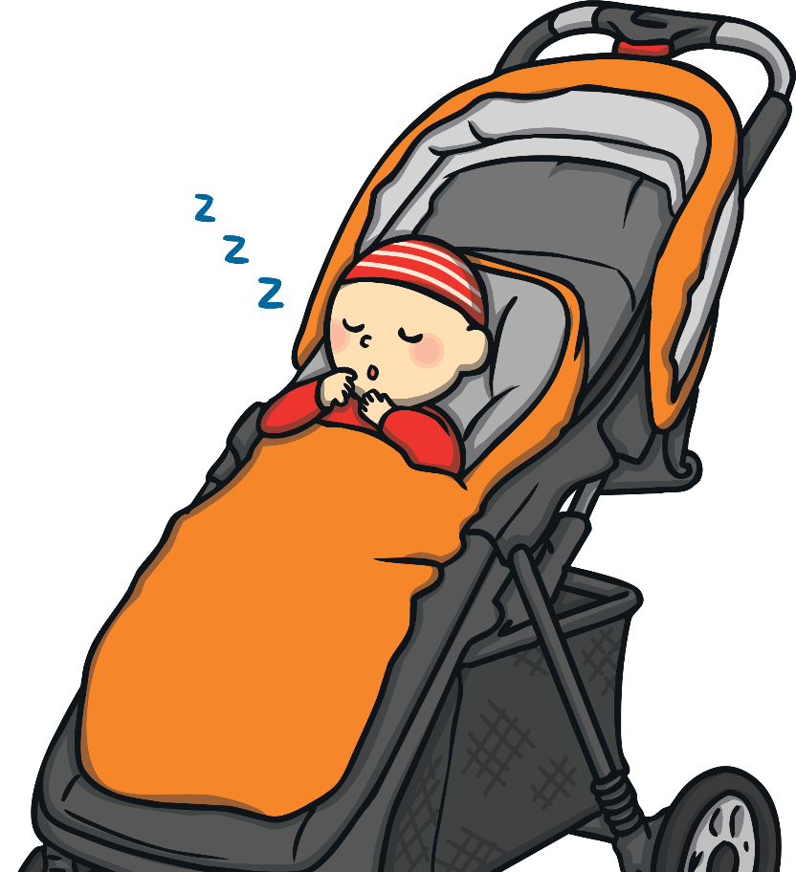
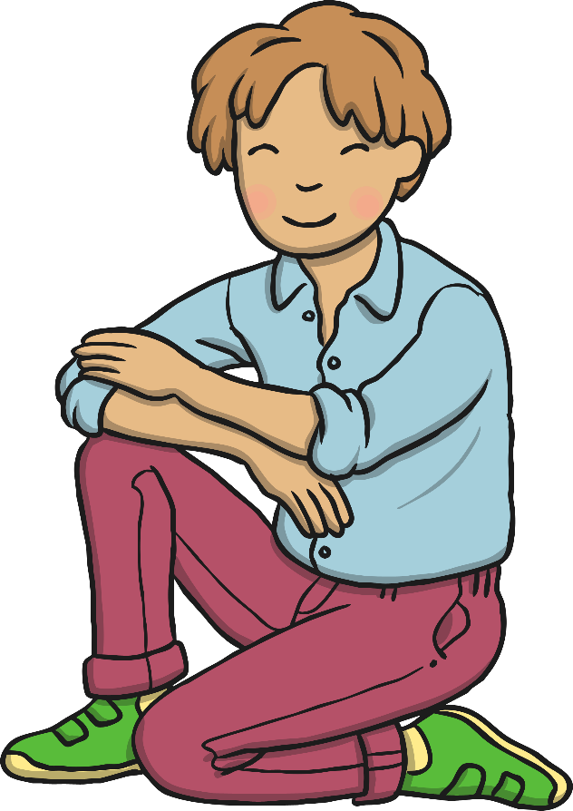
How Change Makes Us Feel
Things change when a new baby arrives in the family.
How do you think it might feel when a child goes from being the only child in the house to a new baby joining the family? Why?

Slide 7
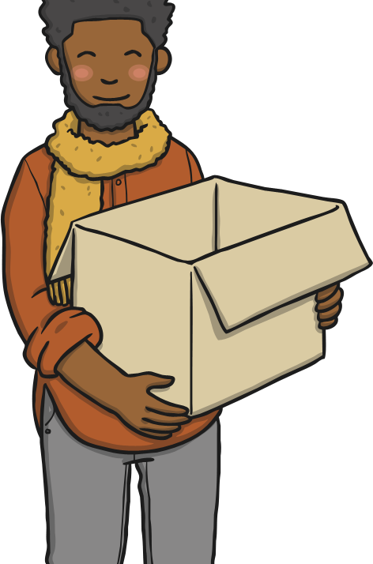

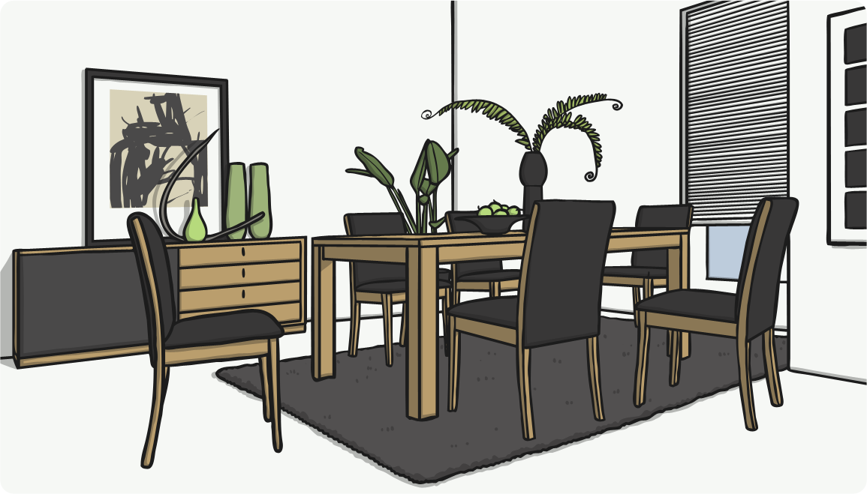
How Change Makes Us Feel
Things change when you move house.
How do you think
it might feel to
move house? Why?

Slide 8
How Change Makes Us Feel
Losing something can be a very hard change to go through. Let’s look now at different situations where children have lost something and think about how they might be feeling.

Slide 9
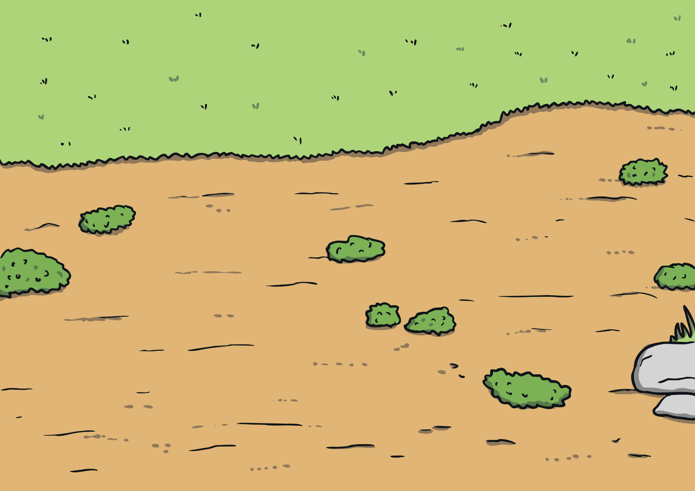

How Change Makes Us Feel
Ahmed is four years old. Ever since
he was a baby he has slept with
a blanket. This morning he left
it in the park. Ahmed is just
about to go to bed and has
realised his blanket is missing.
How might Ahmed be feeling? Why?

Slide 10
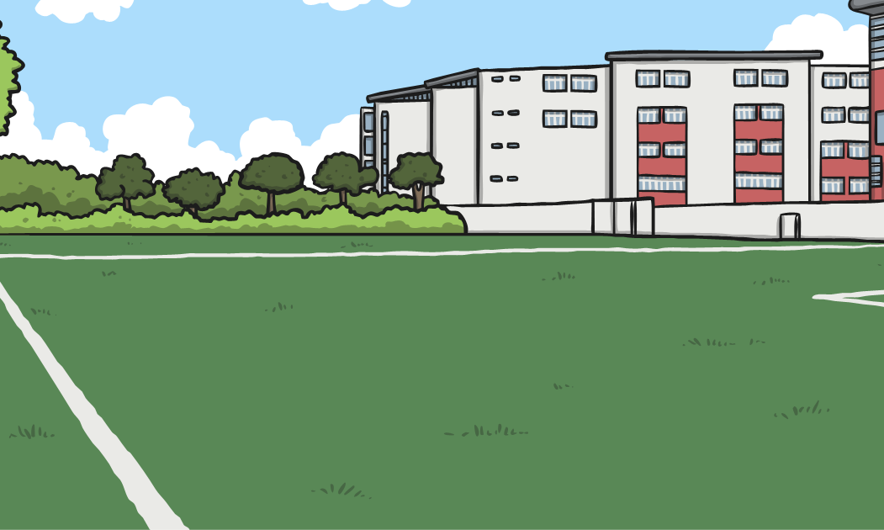
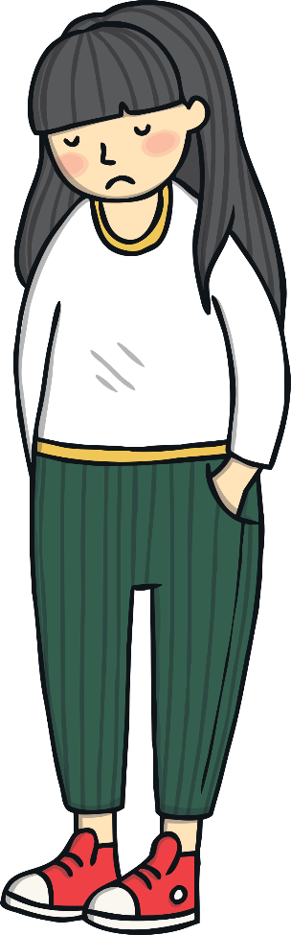



How Change Makes Us Feel
Siana is five years old. When she was four, she went to watch England play football and got her football signed by lots of footballers. Siana loves football, so this football is really precious to her. Sophie took the football to show others in her school and, at lunchtime, it went missing. Everyone in school is looking
for the football but at the moment it is lost.
How might Siana be feeling? Why?
There are some things we can do to help ourselves…
Loss is a very difficult change – it can make us feel very, very sad. It is OK to feel this way and is part of coping with loss.

Slide 11


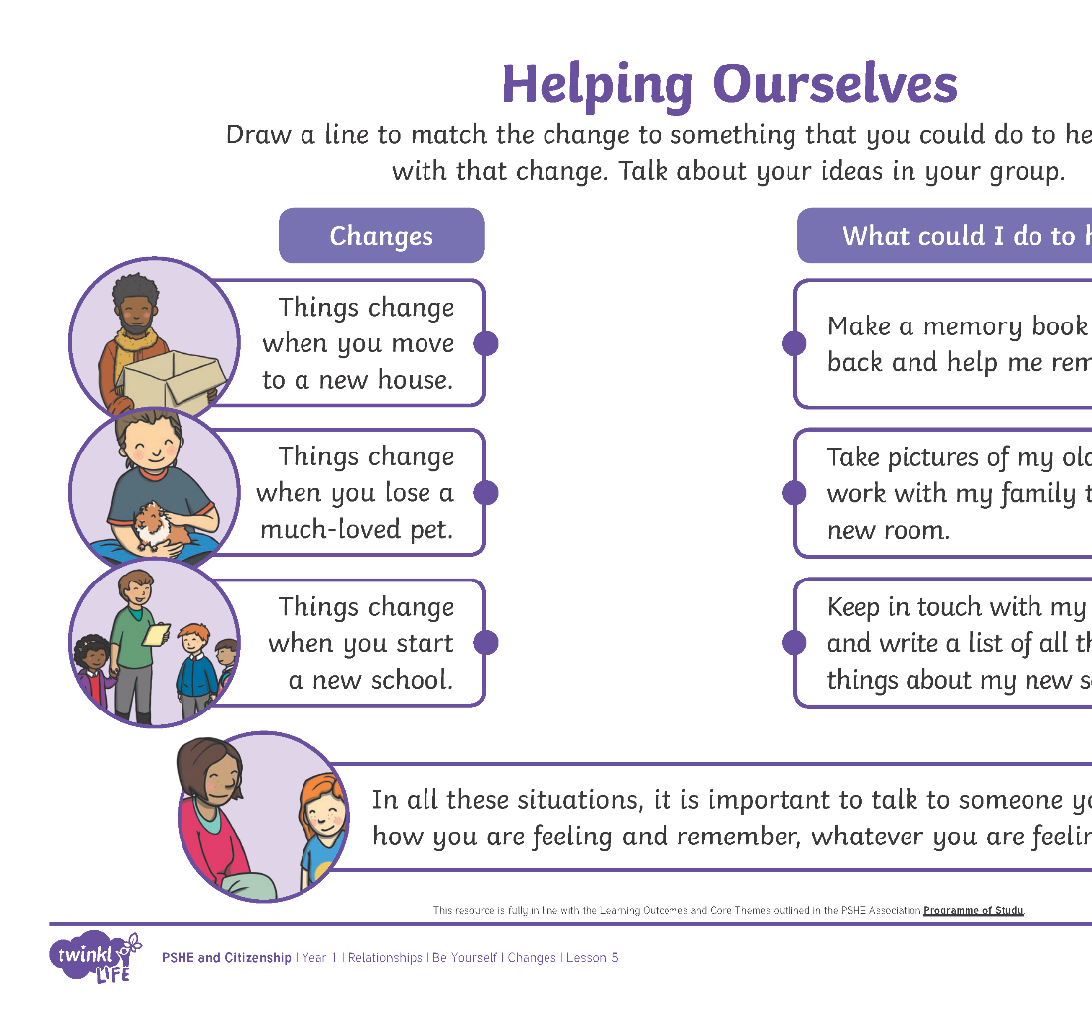

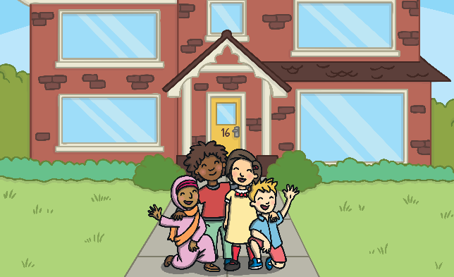
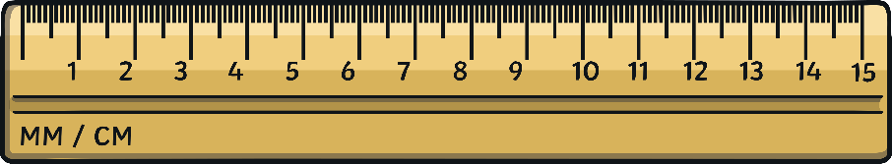

Helping Ourselves
There are lots of ways we can help ourselves when things change and we feel sad, worried or maybe a bit frightened.
Well done! It is OK to feel sad, worried or frightened when things change but remember there are lots of things we can do and people who are there
to help us cope. It is important to talk to someone you trust about how you are feeling.
In your groups, match
the change to the thing you could do to help you cope with that change.

Slide 12

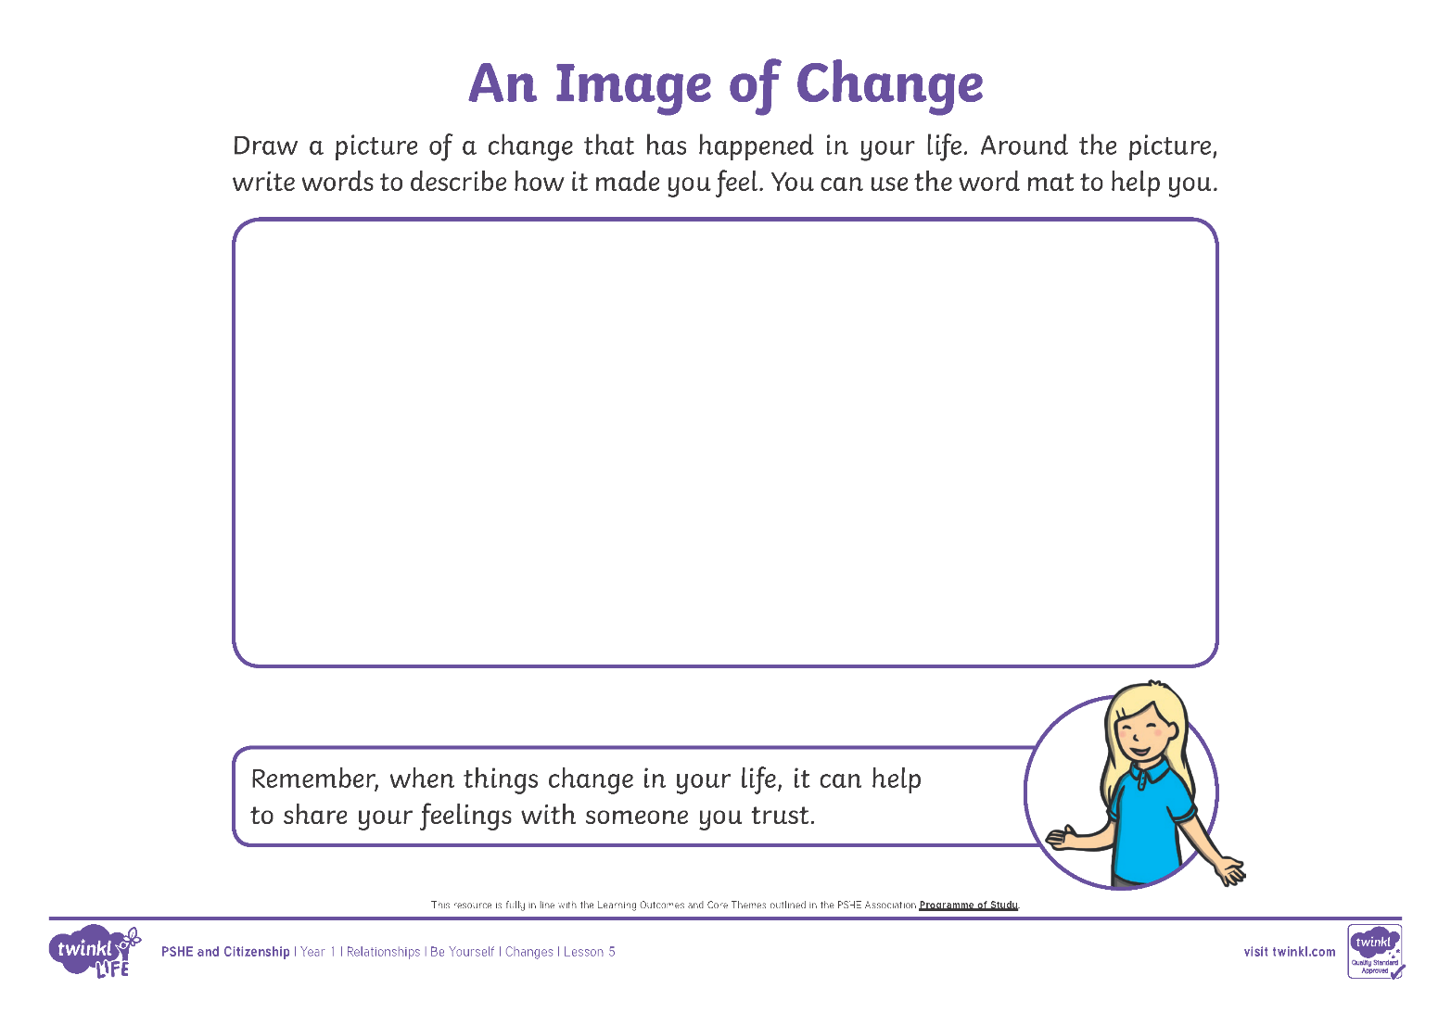

An Image of Change
Draw a picture of a change that has happened in your life. Around the edge of your picture, write words to describe how the change made you feel.

Slide 13
An Image of Change
We have thought a lot about different changes that can happen in our lives and how these changes might make use feel.

Slide 14
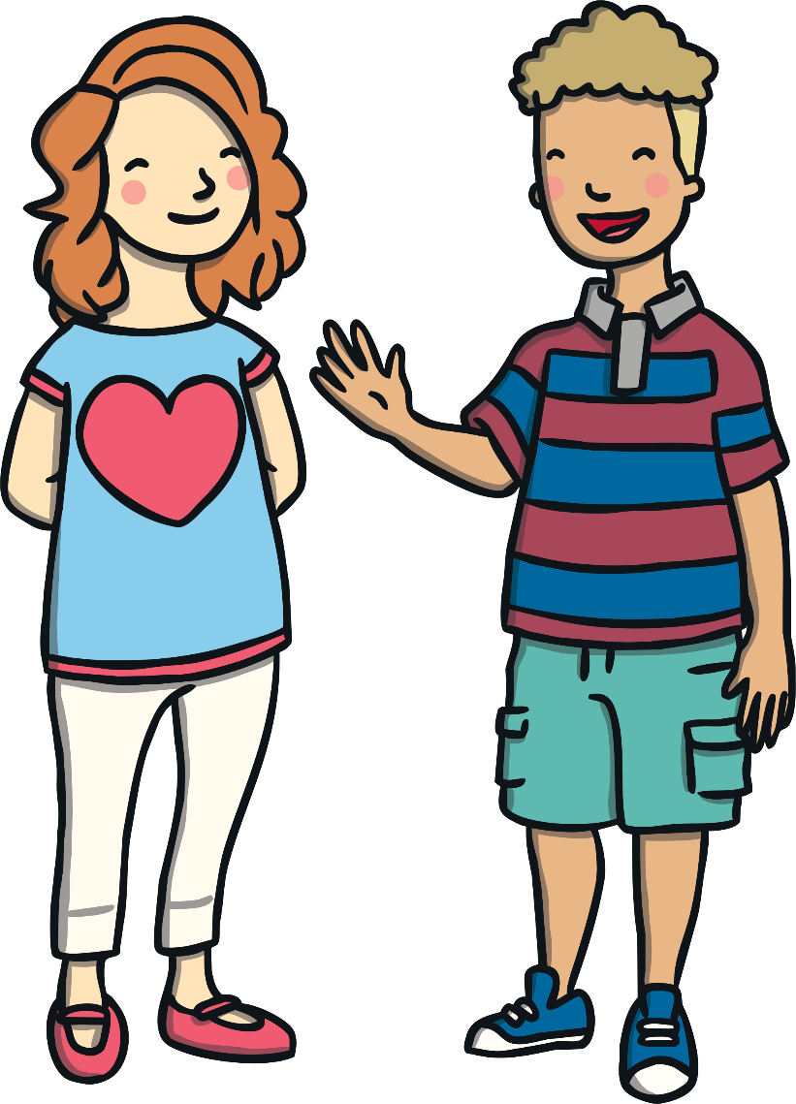
Helping Others
When we are going through any change, it is important to talk to people around us about our feelings and to give ourselves time to cope with the change. Remember to be kind to yourself and let yourself feel the different feelings you have.
We can be a good friend to others who are finding change hard too.
Think about your answer to
this question.
How could you help your friends when they are finding change difficult?

Slide 15
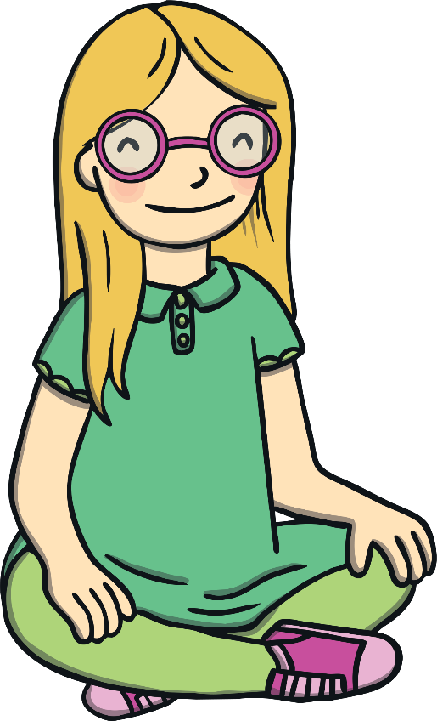
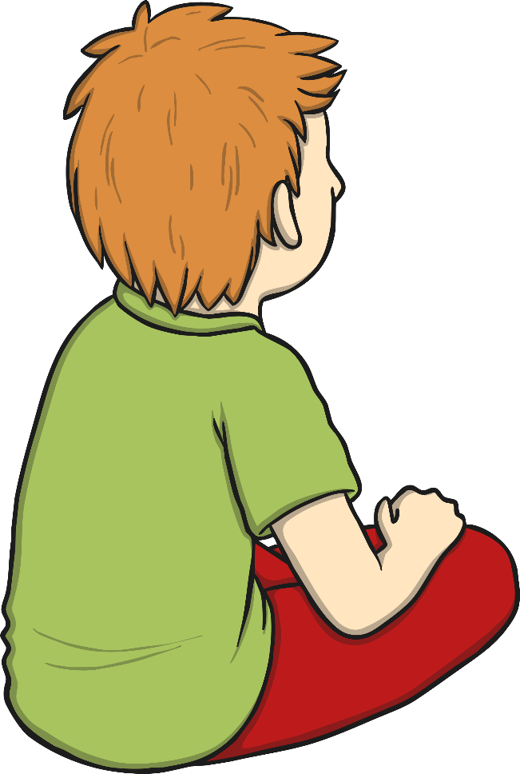
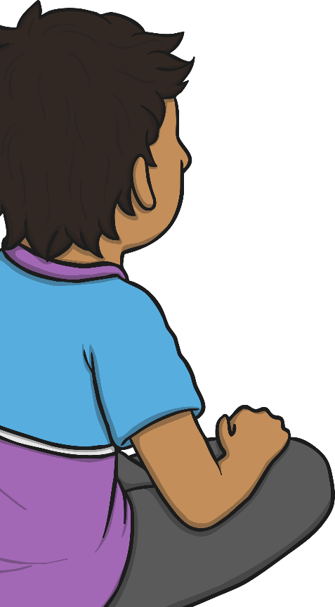
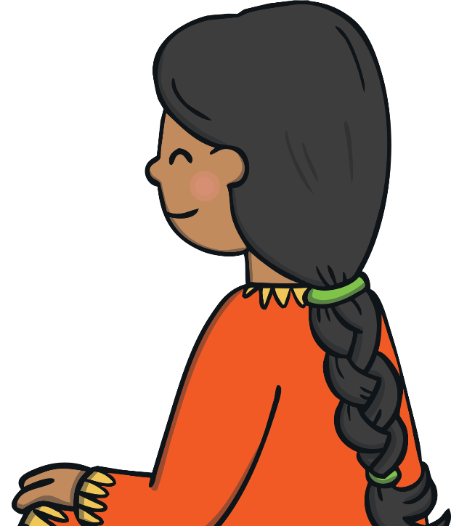

Helping Others
Now take turns to share your ideas. Remember you can say pass if you would like to.
What caring children we have in this class. Thank you!

Slide 16
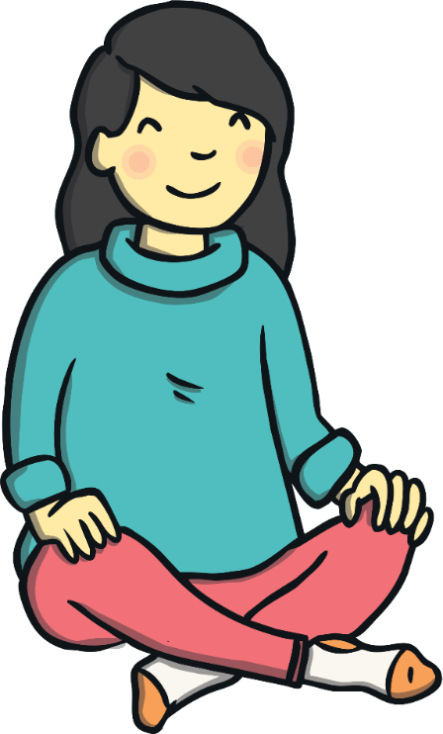
The Big Questions
How does it feel when things change or we lose something precious?
What can we do to help ourselves and others when this happens?
What have you learnt today?

