Slide 2
Aim
I can share what I think and feel with confidence.
Success Criteria
I can recognise that my own thoughts and feelings are important.
I can speak confidently and respectfully.
This resource is fully in line with the Learning Outcomes and Core Themes outlined in the PSHE Association’s Programme of Study.

Slide 3

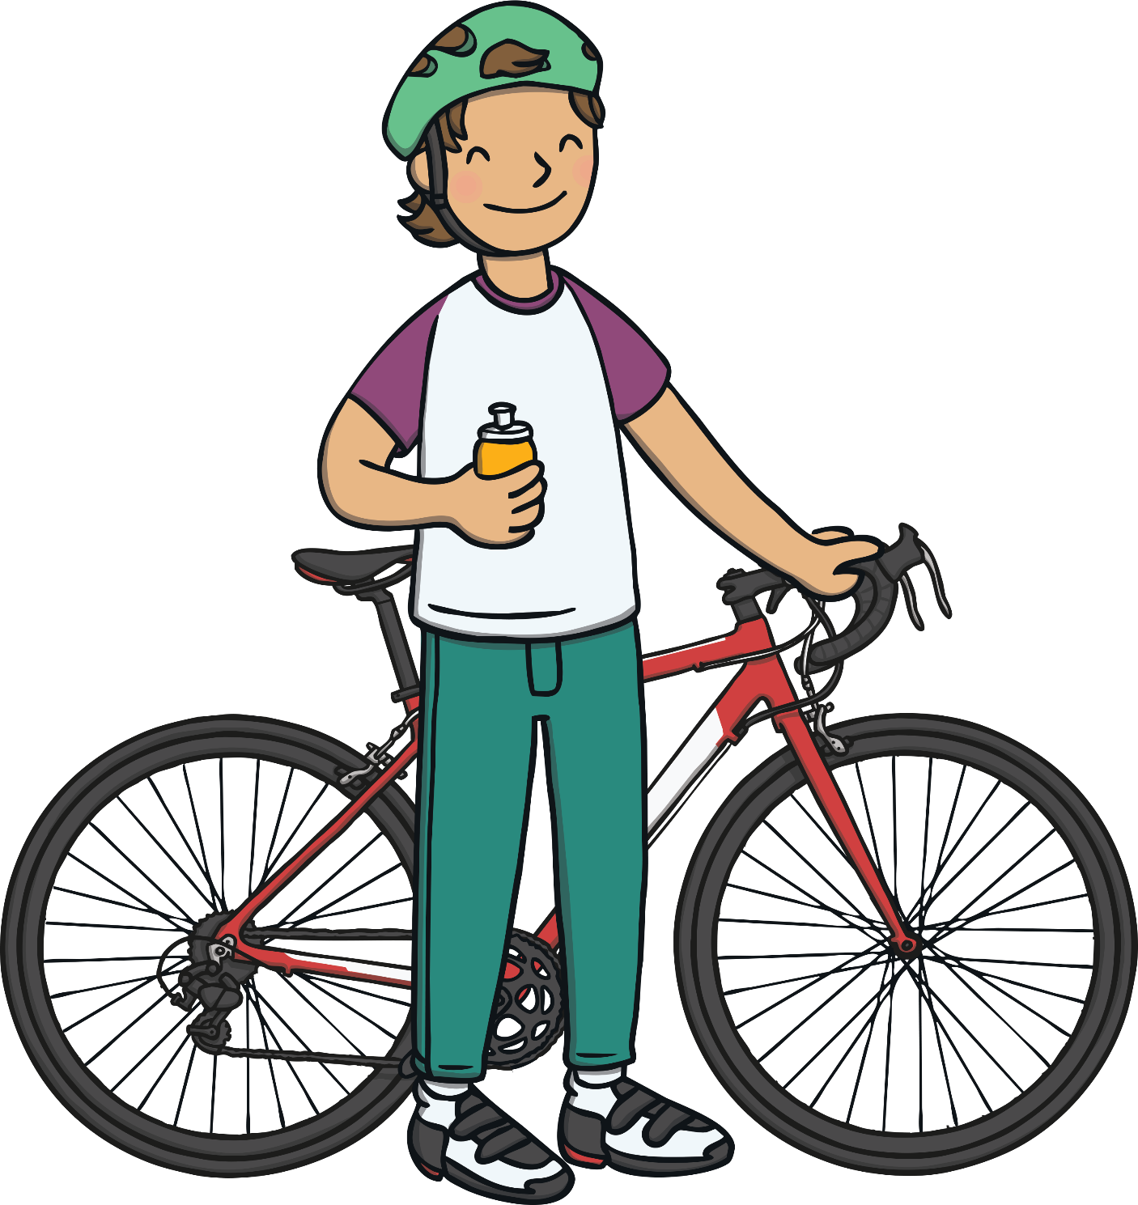
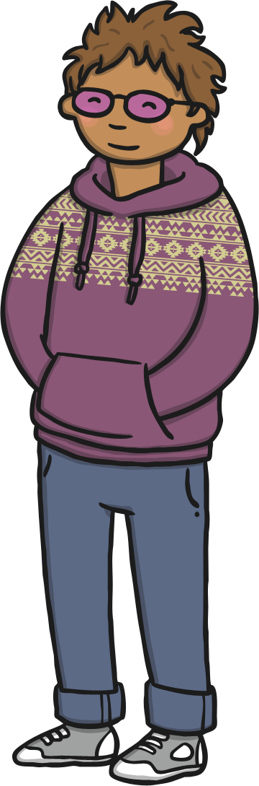
The Big Questions
Why are our feelings and thoughts important?
How can we explain our thoughts and feelings to others?

Slide 4



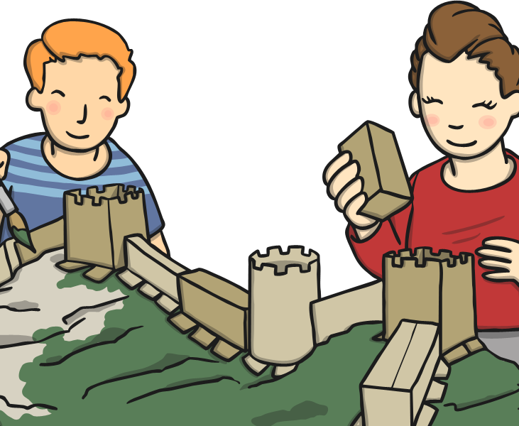
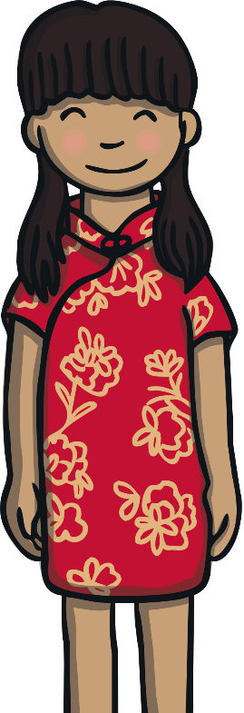
Thoughts and Feelings
Why do we all have different thoughts and feelings?
We are all different people with different personalities. We
all have different families and
different likes
and dislikes.
Because of this, what we think and feel will be different from how another person does. This is exciting!

Slide 5
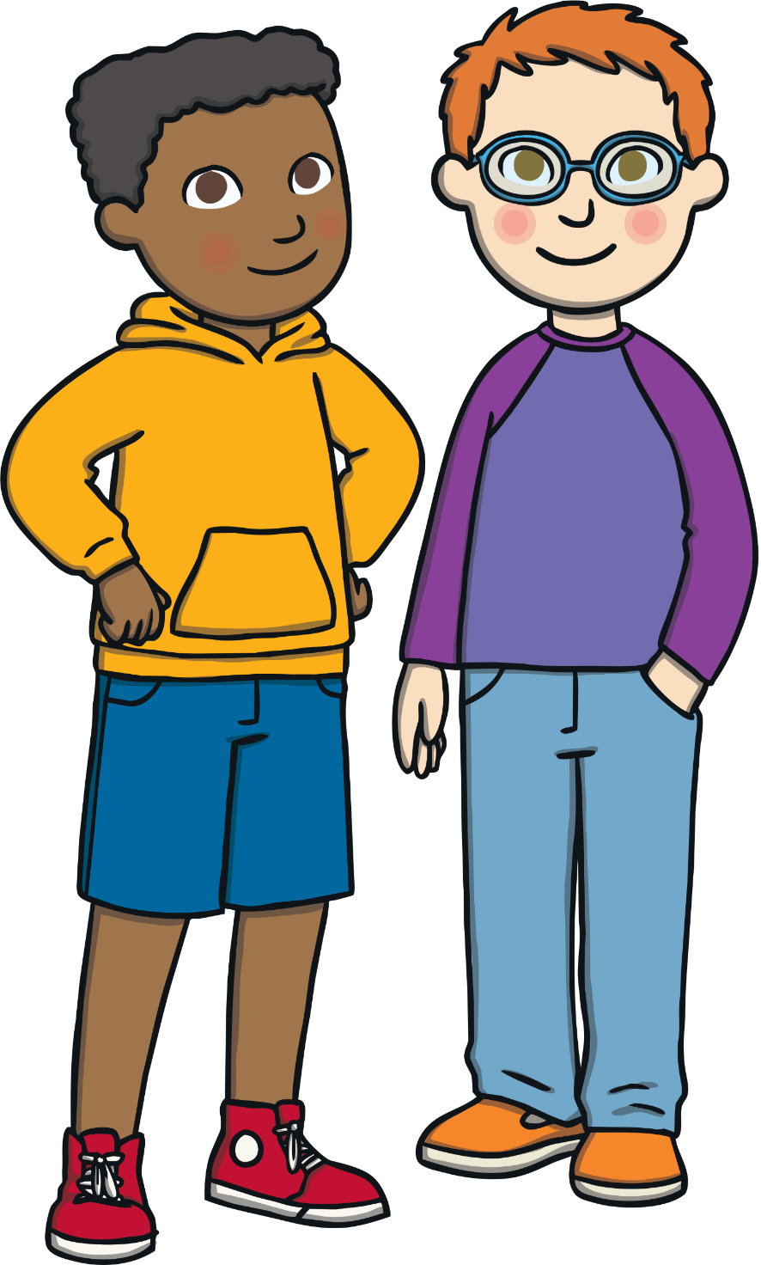
Thoughts and Feelings
What would happen if we felt like we couldn’t say what we were thinking and feeling?
We might feel cross, frustrated or like we didn’t matter if we couldn’t say what we were thinking and feeling. Sharing our thoughts and feelings can help us feel happy and valued.

Slide 6
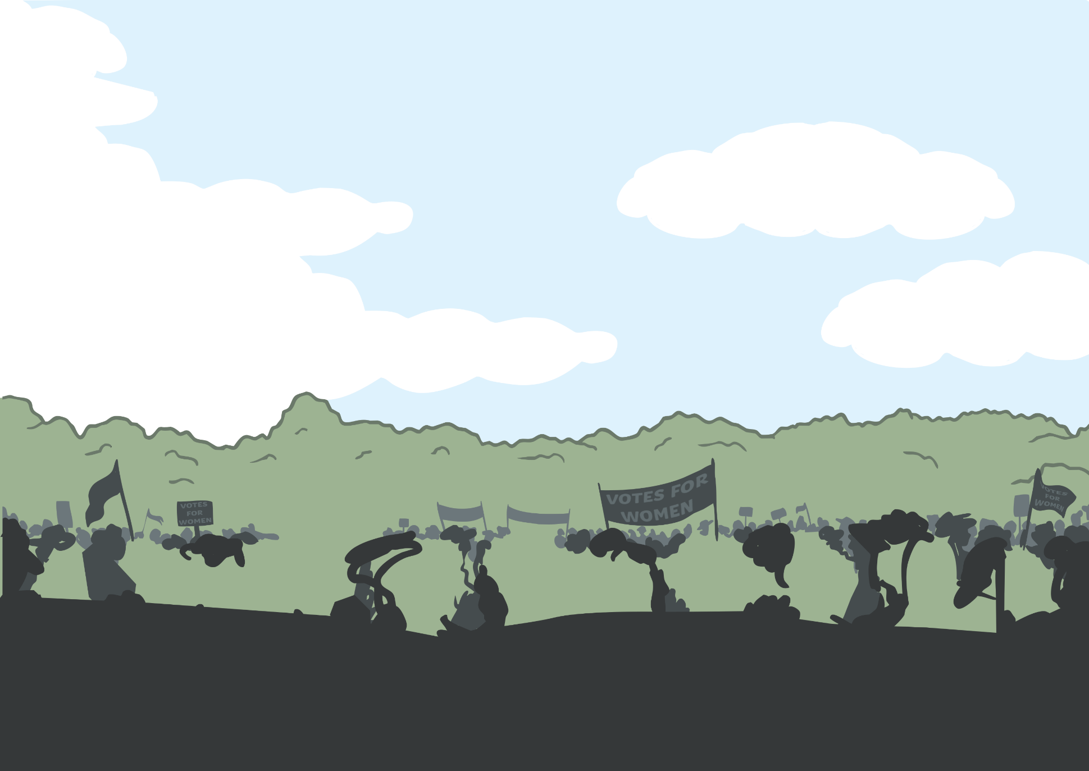

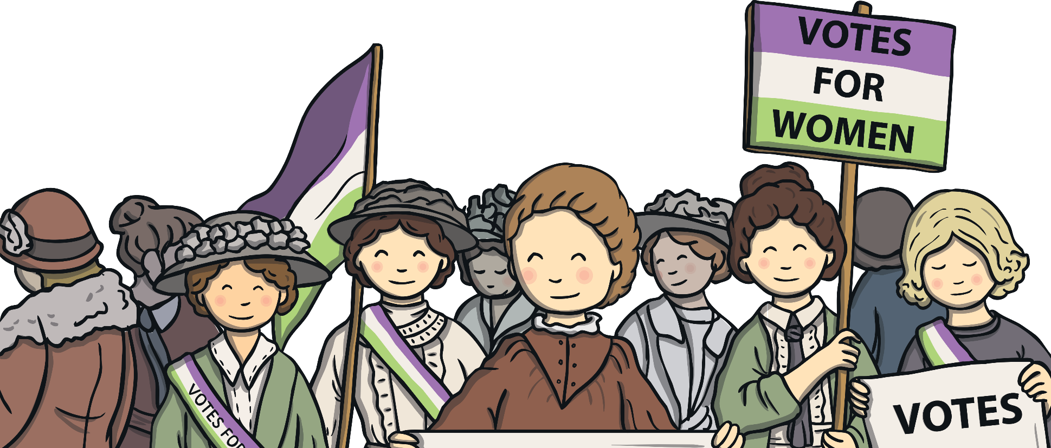

History
In the past, only men were allowed to vote in Britain. Some women, called the Suffragettes, didn’t think this was fair and wanted women
to be allowed to vote and share their thoughts and feelings
too. They led a campaign to
let others know how they felt
and women were given the
right to vote – they were
able to share their thoughts
and feelings.
Adults in Britain are allowed to vote for the people they want to be in the government - to run the country.

Slide 7
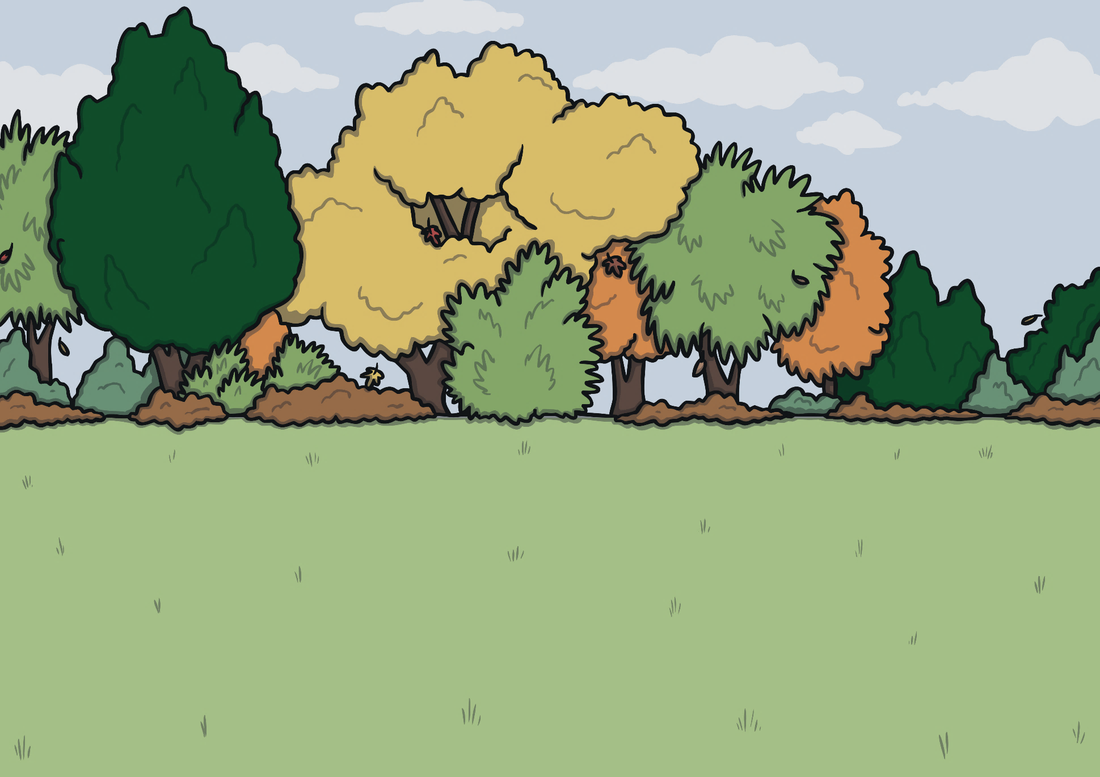
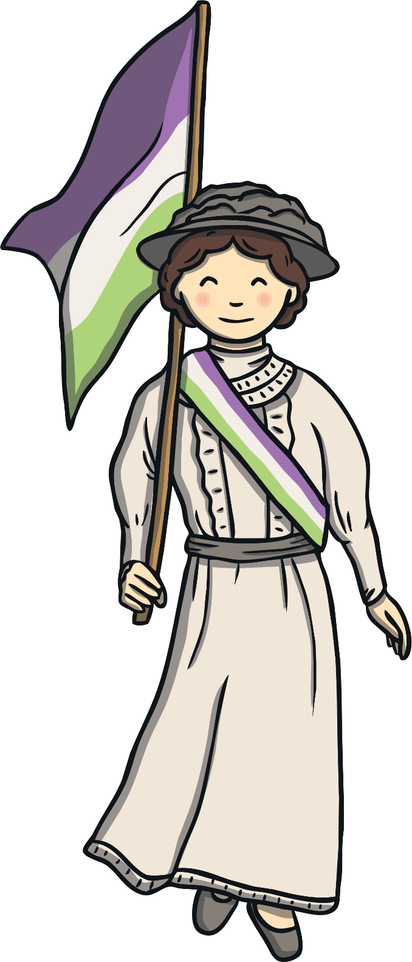

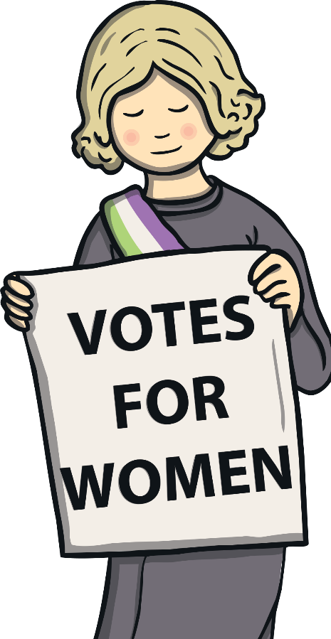
History
Share you answers to these questions with a partner and then with the class.
We are all important and
our thoughts
and feelings are
equally important.
How did they feel when they could not share their thoughts and feelings?
Why did the Suffragettes campaign?

Slide 8
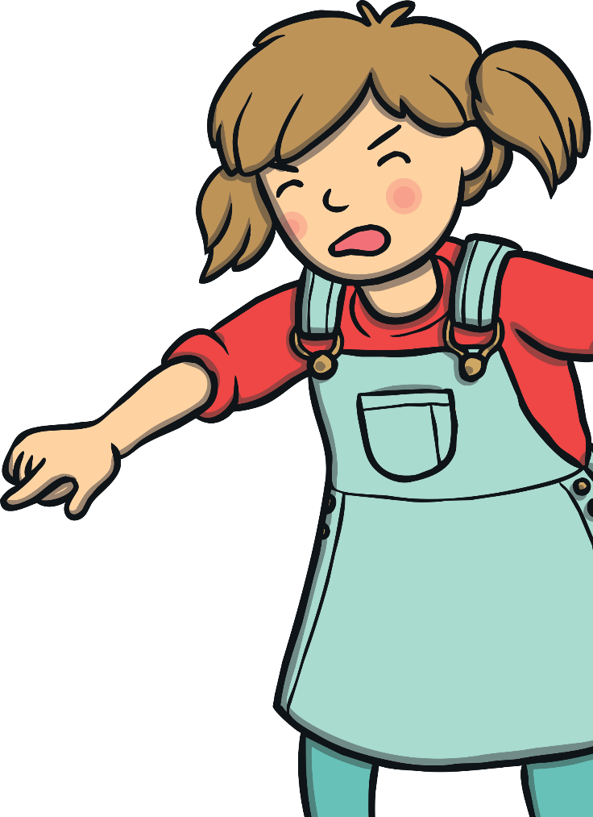
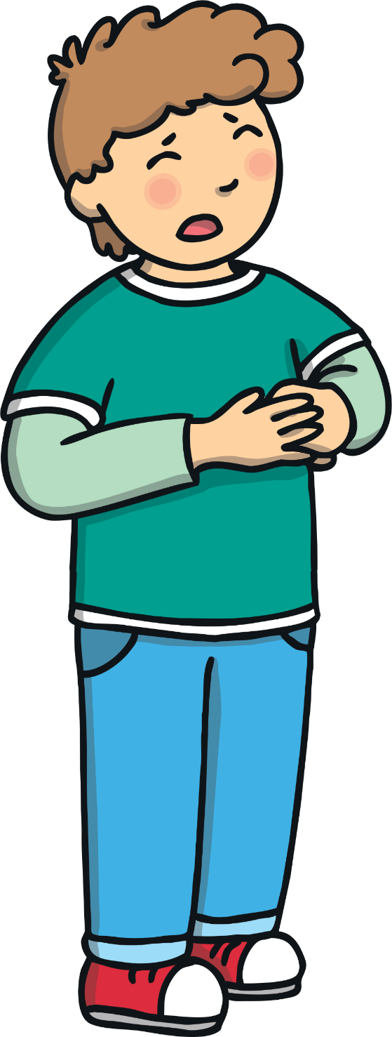
Speaking Confidently
It is important we share our thoughts and feelings but what could happen if we said what we thought in a way that made others feel unhappy or uncomfortable – if we shouted or spoke rudely?
If other people feel uncomfortable or unhappy when we are sharing our thoughts and feelings, they might not listen to us because of how they are being made to feel.
We must always speak kindly and respectfully to others.
Consolidating
Reflecting

Slide 9


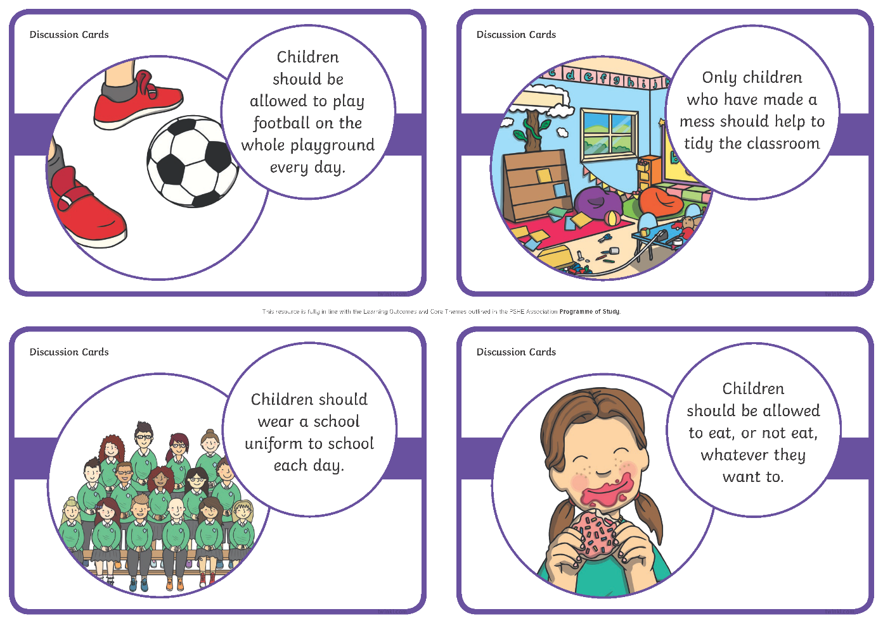


How to Speak Up
Let’s look at the thoughts shared below.
You are going to practise
sharing your thoughts
and feelings respectfully.
This will help you do this
more confidently.
With a partner, take it in
turns to share your thoughts
and feelings about the card
you have been given. Have a go
at another if you have time!

Slide 10

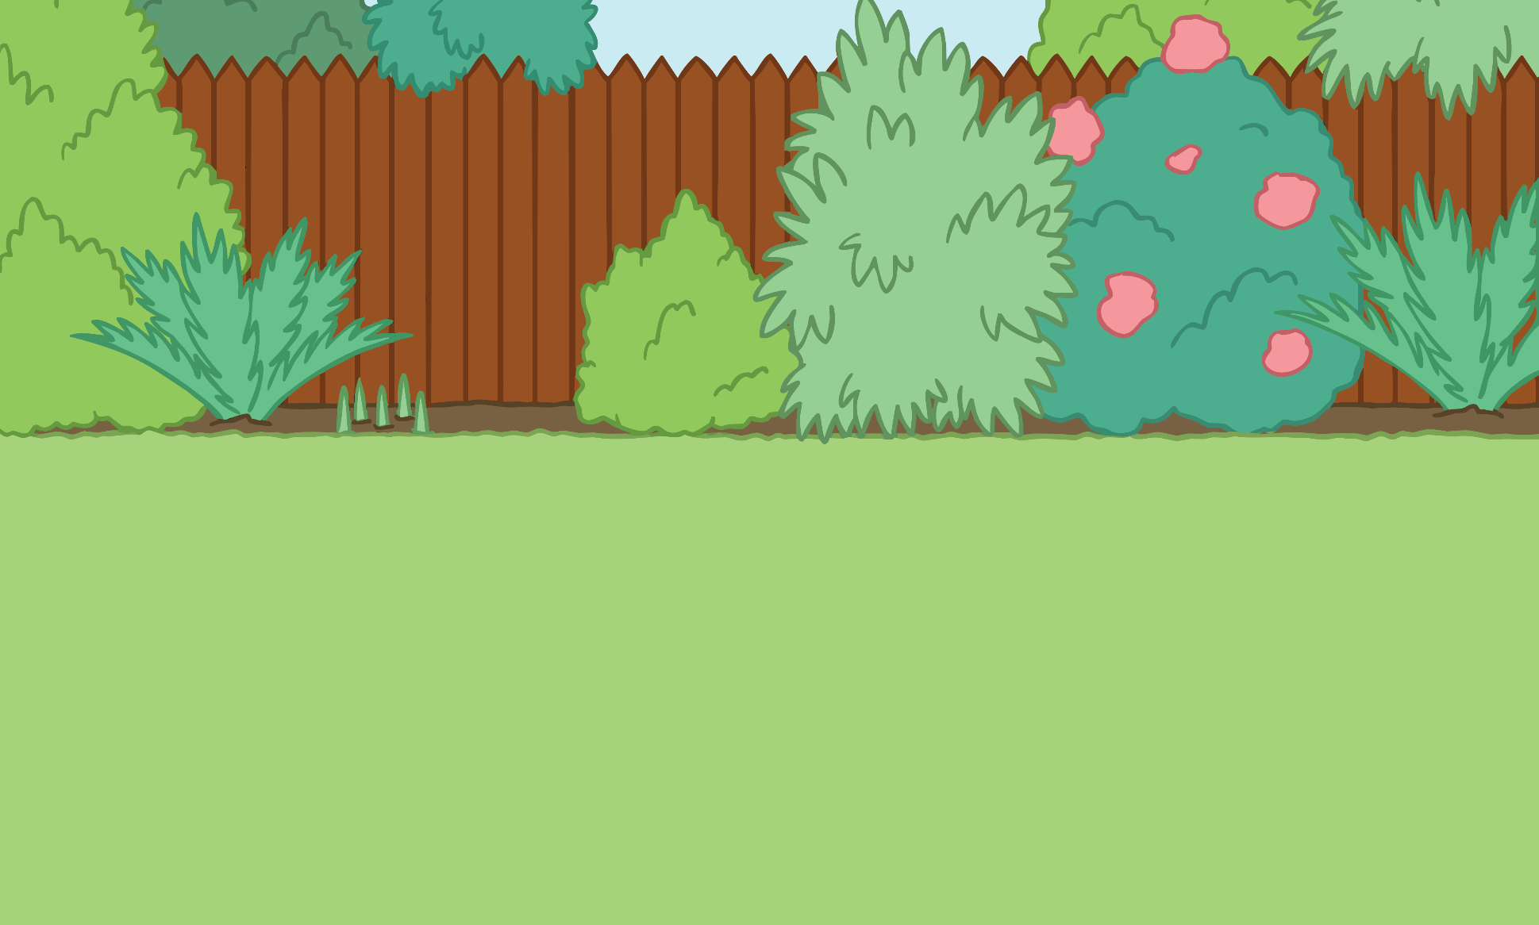
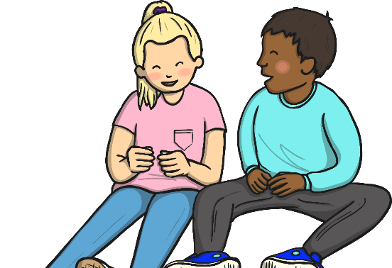
Tricky Times
There are times when it can be a bit harder to share our thoughts and feelings:
When you think differently to all of your friends.
If you are finding it tricky to share your thoughts and feelings, talk to an adult you trust and ask them to help you.
Share your thoughts in your groups and then
with the class.
When you are trying to share your thoughts and feelings with someone who doesn’t want to listen.
When other people are not taking you seriously.
When other people do not seem interested in what you are saying.
What could you do in these situations?

Slide 11

The Big Questions
Why are our feelings and thoughts important?
How can we explain our thoughts and feelings to others?
What have you learnt today that is going to help you?

