Slide 1

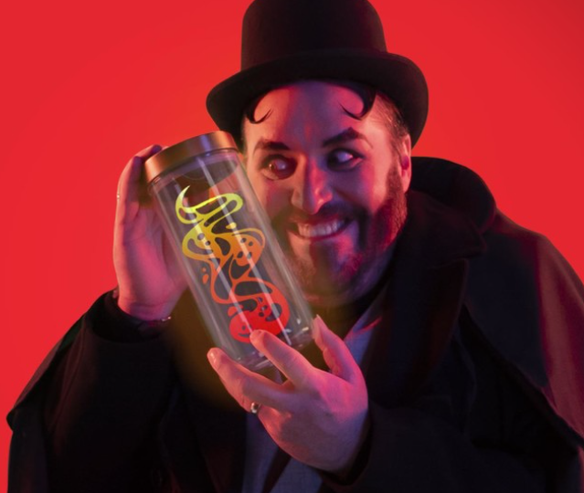


Can our school family rescue the nations laughter?

Slide 2
MISSION ONE:
CAN YOU HANDLE THE HEAT?
YOU’VE JUST ARRIVED AT DOOMY MCGLOOMY’S VOLCANO LAIR TO RESCUE THE LAUGHTER...
But he has other plans for you. He’s going to put your family's superpowers to the test in a quest for clues. If you're going to get out of this alive, here's what you'll need to do:
Come together as a family in your classroom.
Gather 5 cushions or pillows - these will be vital for your mission.
Hit play on the video and listen carefully.
As we are working as a school family we will be attempting to cross the lava in 10 minutes
Remember, we're all counting on you.
Collect your clue.
https://www.comicrelief.com/rednoseday/fundraise/family-challenge/mission1/

Slide 3
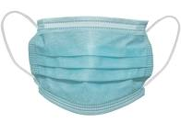
Mask decorating competition
Time to be creative and transform a boring face mask, into a mask that makes people smile!
Use whatever materials you have in your classroom to create the funniest mask EVER!
There will be a prize for the mask that makes Mrs Booth laugh the most for each class.
Look at the next slide for some inspiration

Slide 4
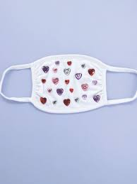
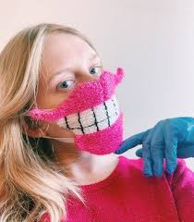
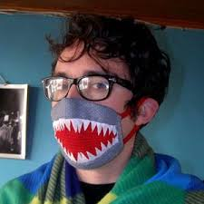
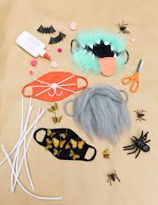
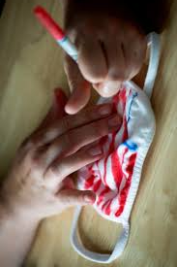
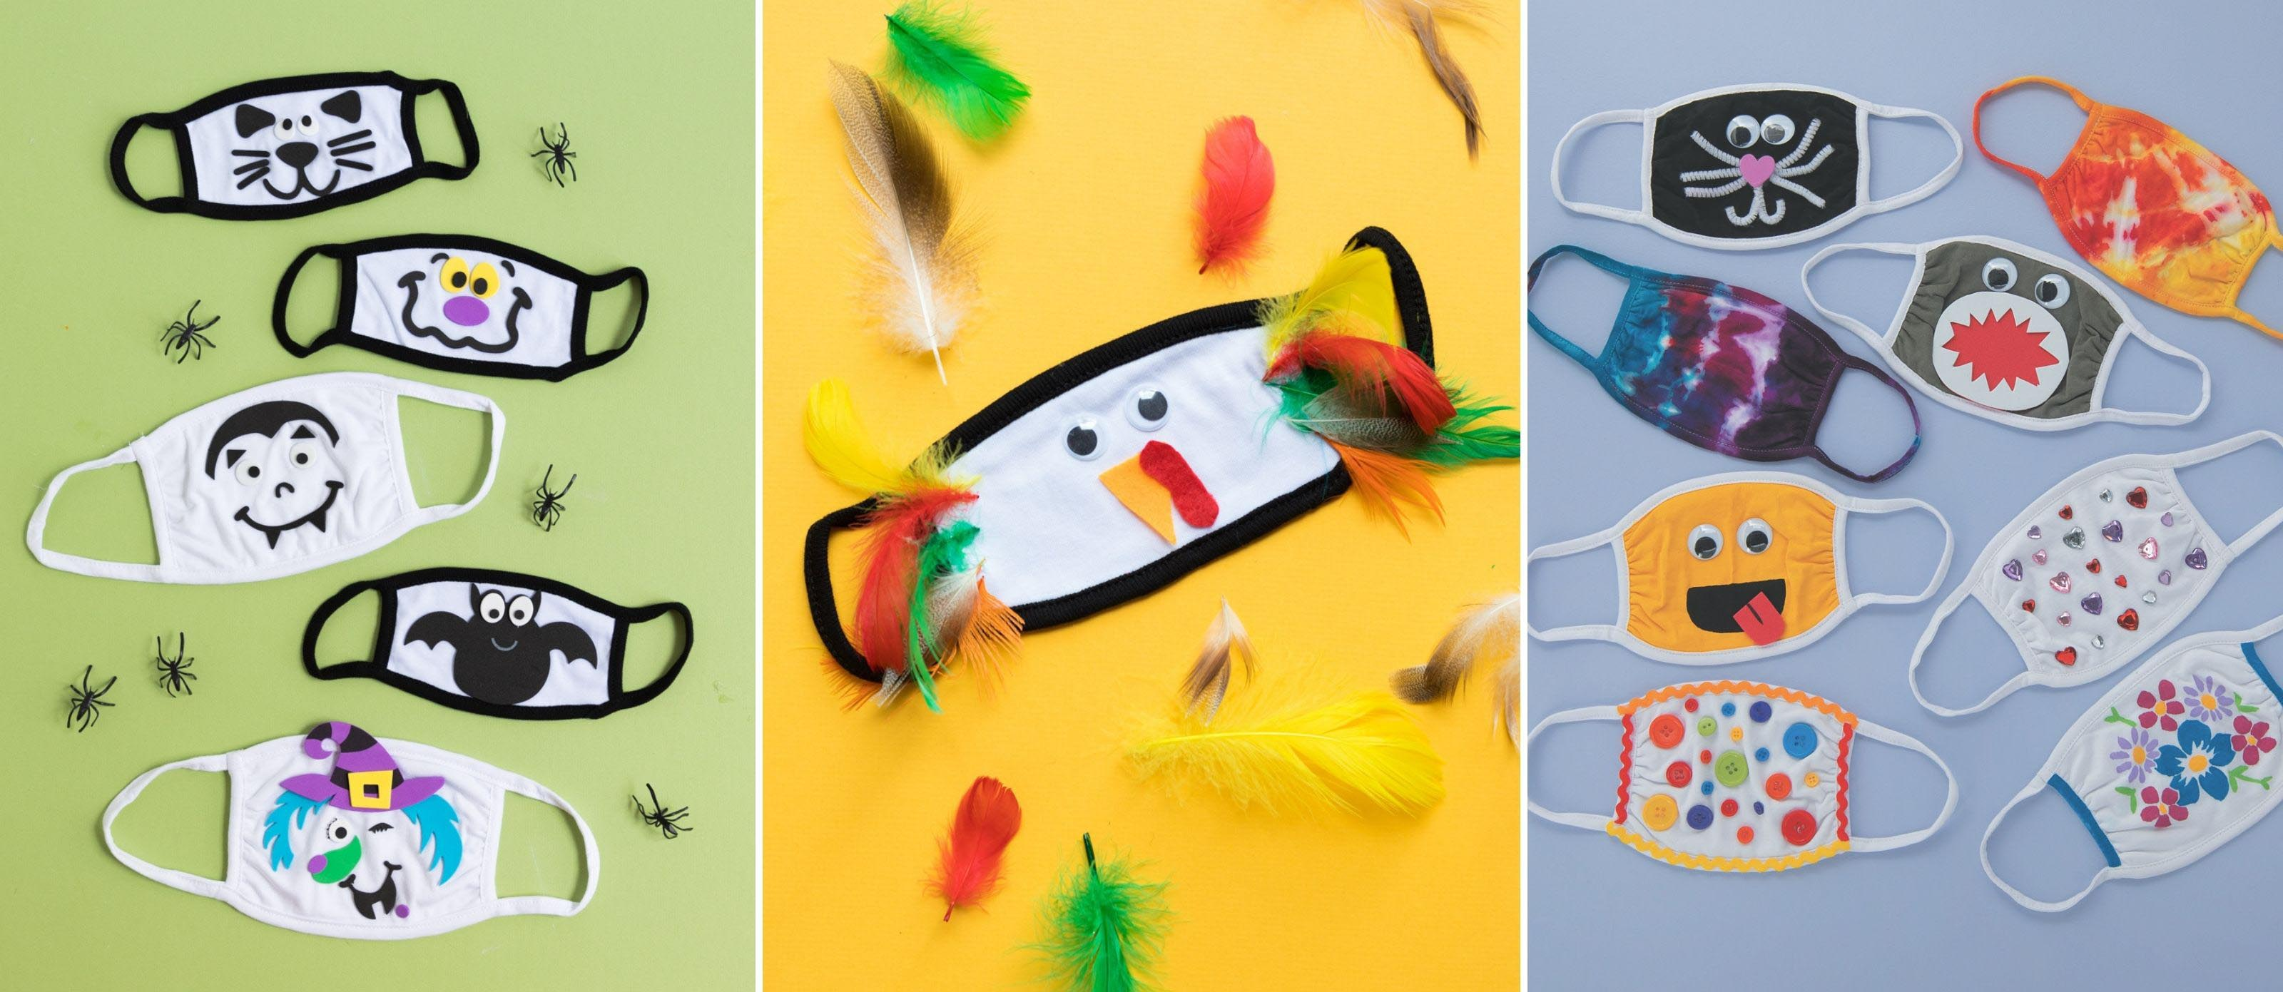
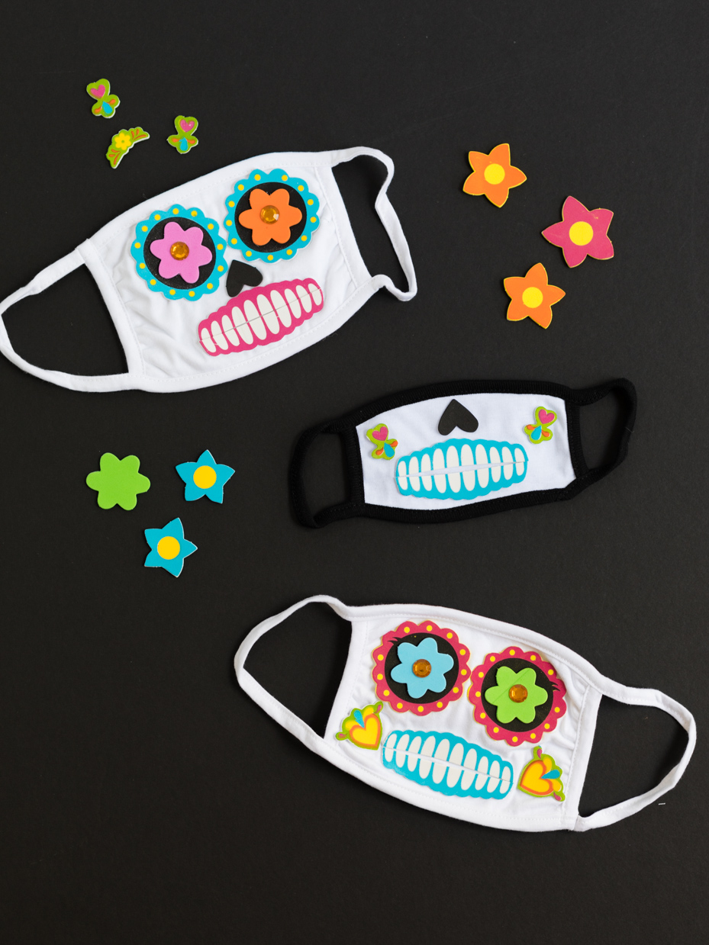

Slide 5
MISSION TWO:
POWER UP YOUR VOCAL CHORDS...
SHATTER THE MAGIC JAR
The laughter has been locked in a magic jar. Can your family find the perfect pitch to release it?
Watch the video
Practise learning the song.
Working as a team, sing the song ‘pitch perfect’ to shatter the magic jar.
Collect your second clue
https://www.comicrelief.com/rednoseday/fundraise/family-challenge/mission2/

Slide 6
MISSION THREE:
PENGUIN POWER!
BREAK THE ICE
Doomy McGloomy may have fled to Antarctica, but our family are hot on his heels. Will we be able to break the ice?
Learn the penguin stomp routine
Wrap yourself up – its cold in the Antarctic
Perform the penguin stomp
Collect your next clue
https://www.comicrelief.com/rednoseday/fundraise/family-challenge/mission3/

Slide 7
MISSION FIVE:
LIMBO THE LASERS
YOUR FINAL MISSION IS NOT FOR THE FAINT HEARTED. OR CLUMSY-FOOTED.
Doomy McGloomy has installed a high security laser maze that only the bravest family can conquer. Here's what you need to do:
1. Find one loo roll and something sticky like blu tac or sellotape.
2.Watch the video below for further instruction.
3. Everyone in your class needs to make it through the laser beams without touching it.
Have your wits about you agents! There's something fishy about Doomy McGloomy.
https://www.comicrelief.com/rednoseday/fundraise/family-challenge/mission5/

