Slide 1
Islamic Stories
Today we are going to become familiar with Islamic stories that relate to the treatment of creation.

Slide 2
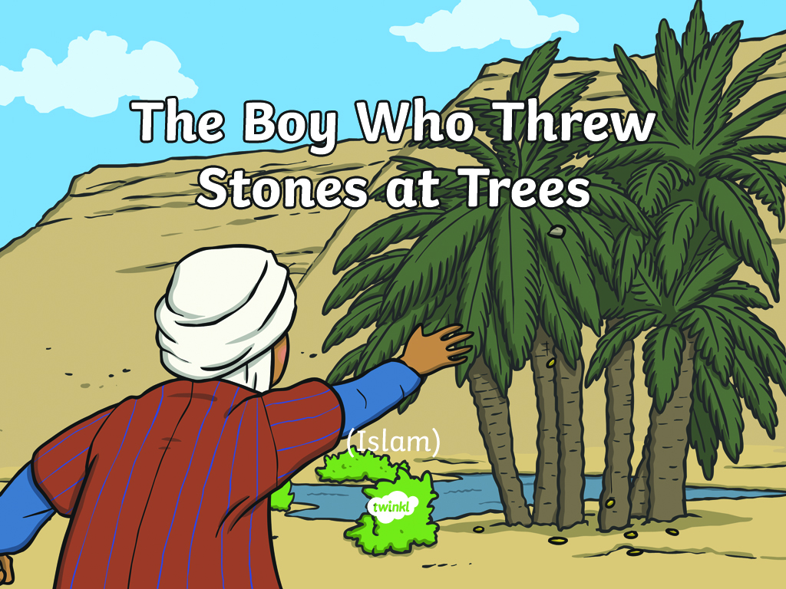

Slide 3
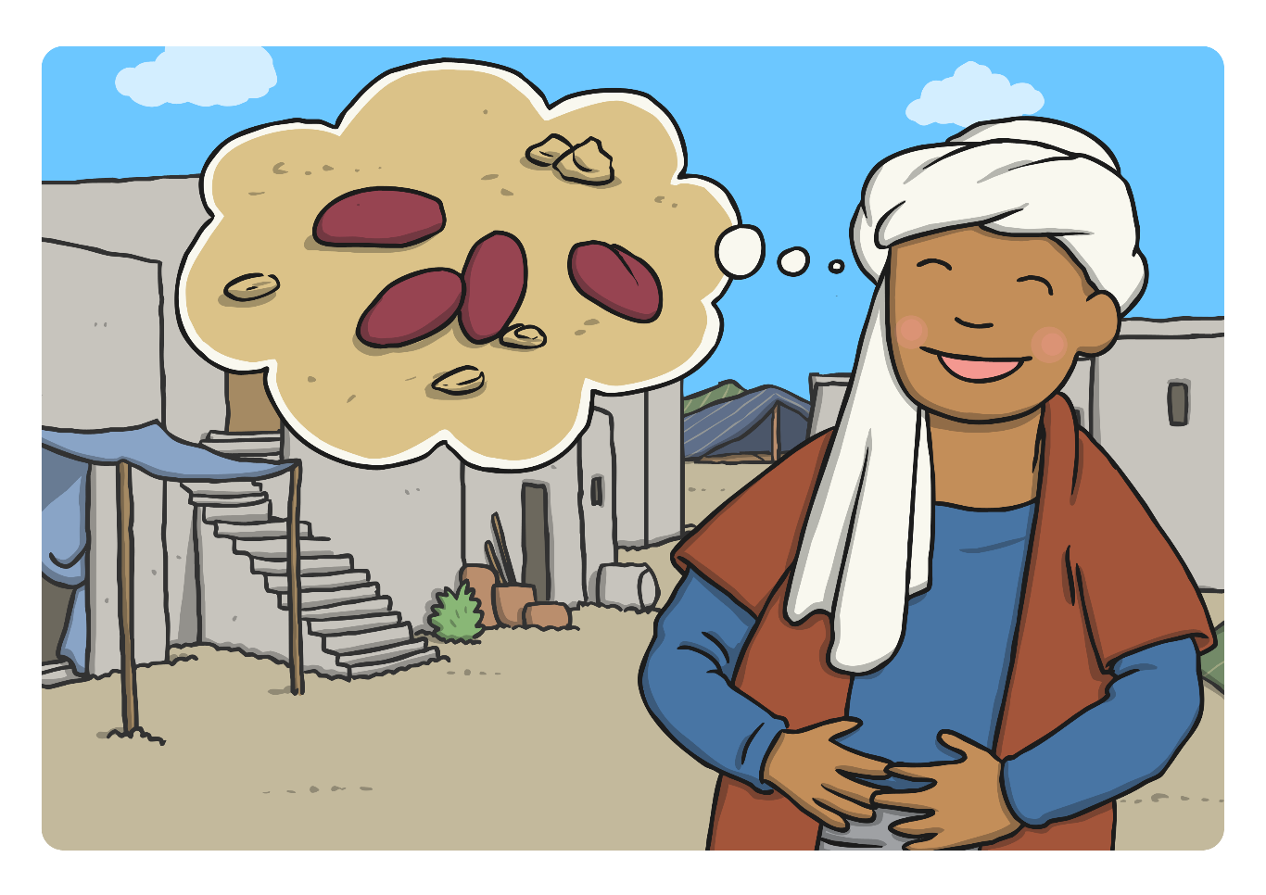
The Boy Who Threw Stones at Trees
Once there was a boy who lived in Madinah who loved the taste of fresh dates.

Slide 4
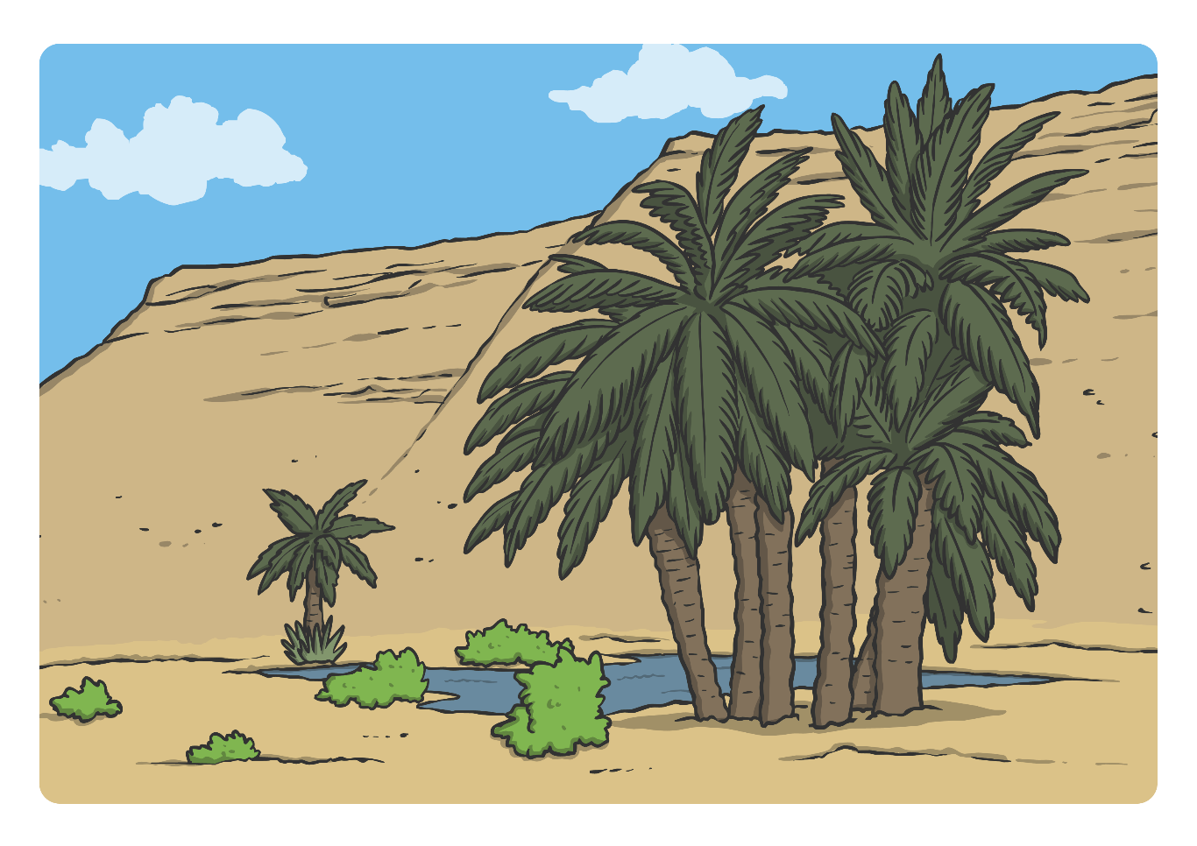
Outside of the city, there was an oasis. Around the pool were palm trees which grew delicious dates.

Slide 5
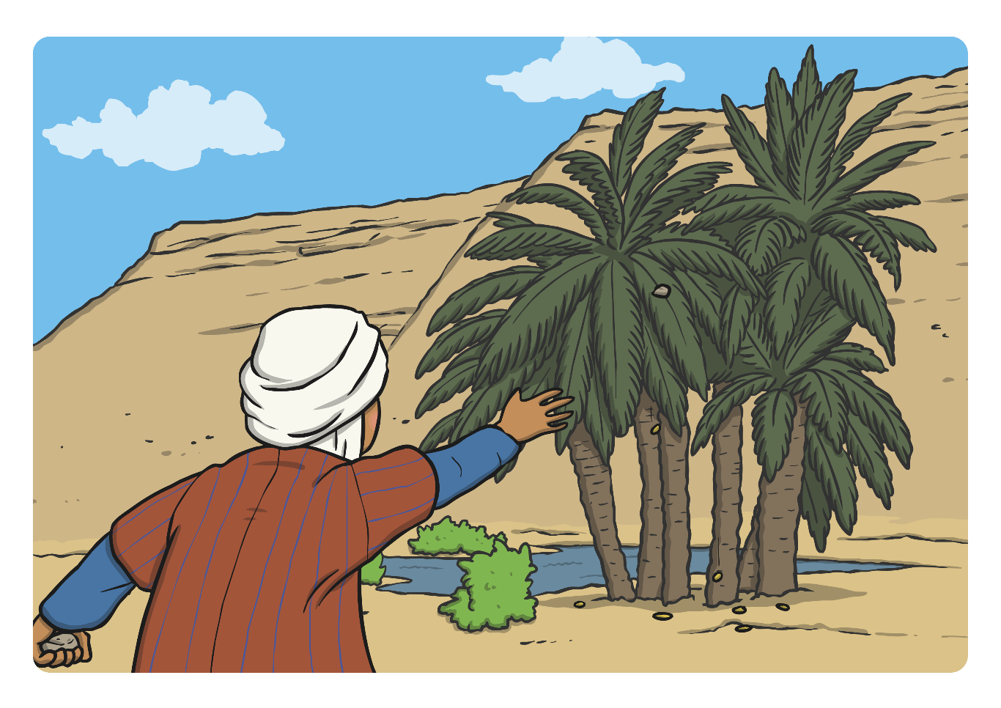
Each day, the boy collected stones which he threw at the trees. If he hit the tree in the right place dates would fall onto the sand and he could eat them. The boy never thought about the damage he was doing to the trees.

Slide 6
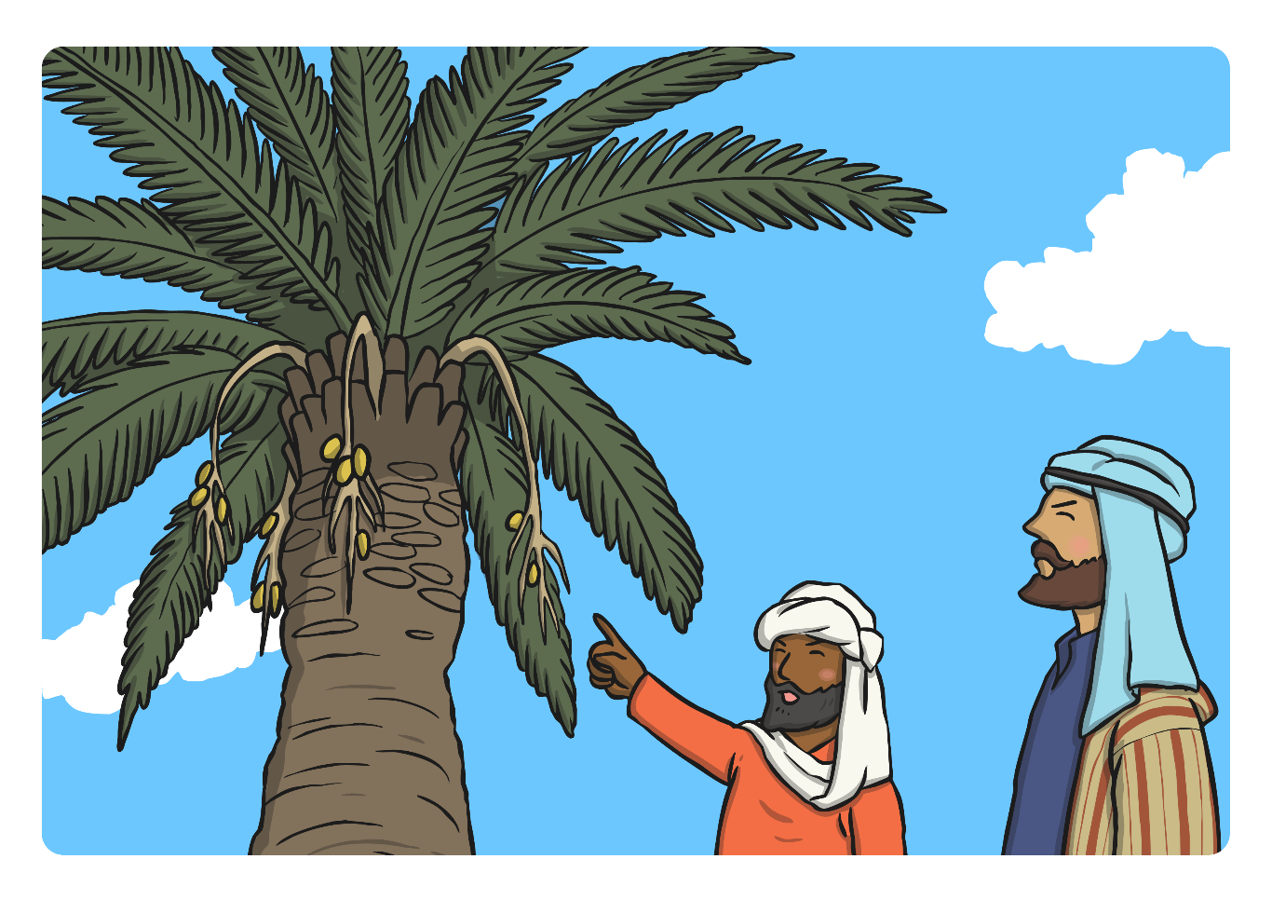
The farmers who owned the trees were worried that there weren’t many dates left on them and that the trees didn’t look very healthy. They decided to watch the trees for a day to find out what was happening.

Slide 7
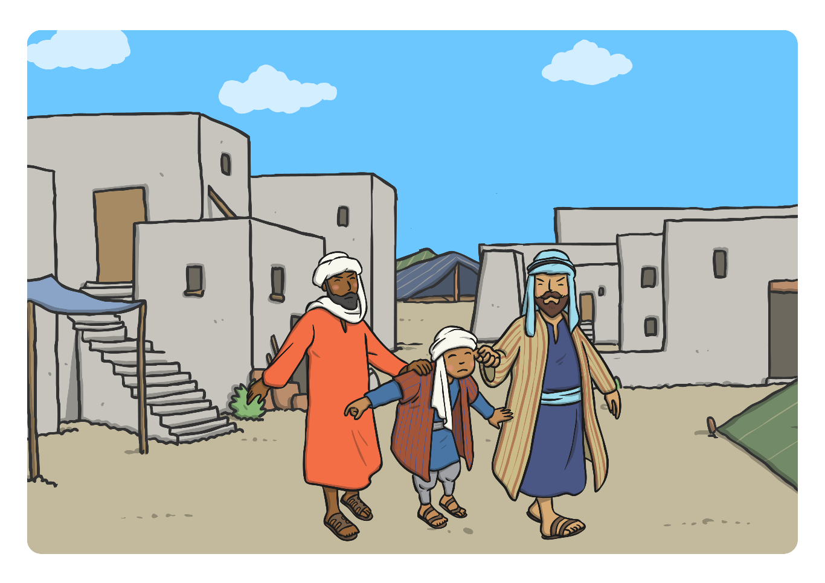
They saw the boy throw stones at the trees to get the dates. They were very angry and took the boy to see the Prophet Muhammad. The boy was frightened, he had never been in trouble before, and he just liked eating the dates.

Slide 8
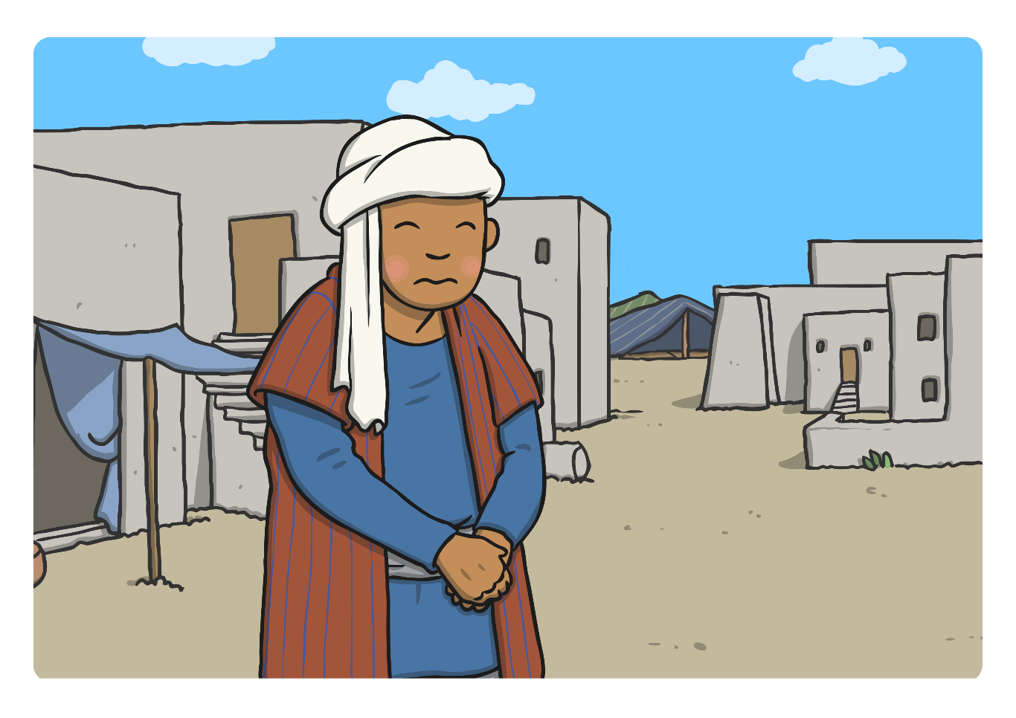
Prophet Muhammad asked the boy quietly, “Why have you been throwing stones at trees? Don’t you know that it hurts them?” The boy said “I had not thought about the damage I was doing to the trees, I just like eating the dates. I’m sorry.”

Slide 9
Prophet Muhammad said “Why don’t you wait until the dates are ripe, and fall from the trees themselves? They will taste even better.” The boy smiled as he realised he could still enjoy his dates and keep the trees healthy at the same time.

Slide 10

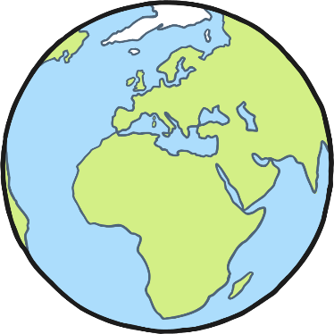
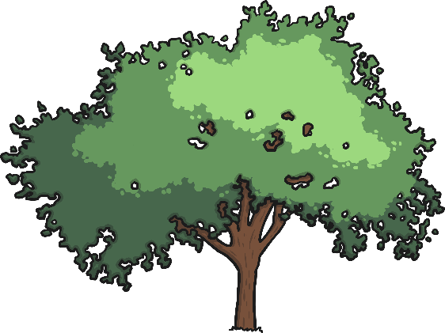
Looking After Nature
Many Muslims believe that Allah made the world and that it is their responsibility to look after it.
Why is it important to look after trees?
How can we look after trees?

Slide 11

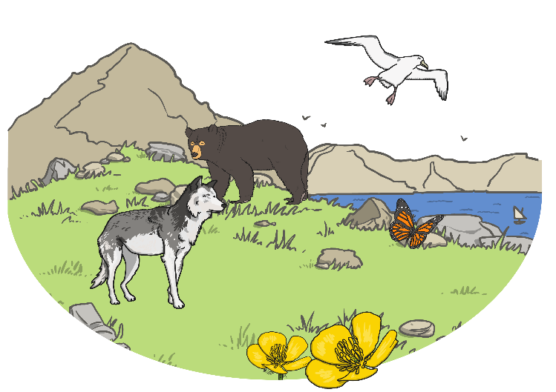
How Can The Story
Help Us?
Why it is important for people to look after and protect nature?
Remember nature doesn’t just include trees, but also animals, plants and the environment.
What would happen if humans didn’t protect nature?
Challenge:
Write down a rule to say how Muslims believe we should treat Allah’s creation.

Slide 12
Aim
I can explain the message in the story The Boy who Threw Stones at Trees.
Success Criteria
I can tell you what Prophet Muhammad told the boy.
I can tell you why it can be important to look after trees.
I can tell you how the story might help me in my own life.

Slide 13


