Slide 1


Slide 3




1) Can you count the dots?
2) Can you count the dots?
3) How many straws?
4) What is the name of this shape?

Slide 4
1) Can you count the dots?
2) Can you count the dots?
3) How many straws?
4) What is the name of this shape?
10
25
40
cube

Slide 6

Make arrays
How many rows?
4
How many are in each row?
3

Slide 7
Make arrays
How many columns?
3
How many are in each column?
4

Slide 8


Make arrays
Have a think
How many rows?
2
How many columns?
3
How many are there altogether?
6

Slide 9
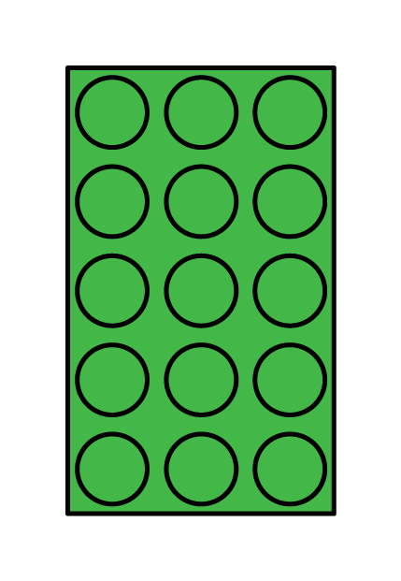
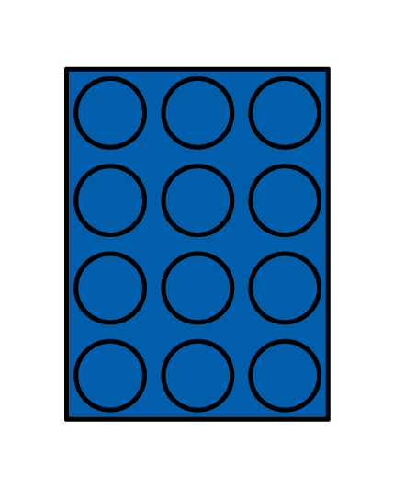
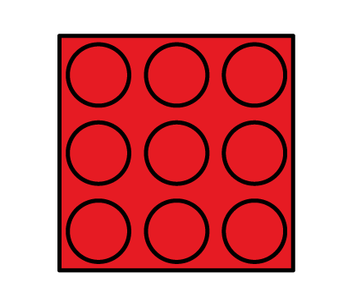
Have a think
3 columns
3 columns
3 columns
3 rows
4 rows
5 rows
What is the same?
columns
rows
What is different?

Slide 10
Have a go at questions 1 and 2 on the worksheet

Slide 11
Can you make an array with
5 rows and 3 columns?
Have a think
There are ___ rows.
5
There are __ counters in each row.
3
There are ___ counters altogether.
15

Slide 12
Can you make an array with
3 rows and 3 columns?
Have a think

Slide 13
This array has
3 rows and 3 columns.
Have a think
There are ___ columns.
3
There are ___ counters in each column.
3
There are ___ counters altogether.
9

Slide 14
Have a go at question 3 on the worksheet

