Slide 1


Slide 3


Let’s talk about arrays!
No Tiny, not rays from the sun… arrays… let me show you!

Slide 4


Arrays have columns.
Arrays have rows.
Arrays are when we build rows and columns.

Slide 5


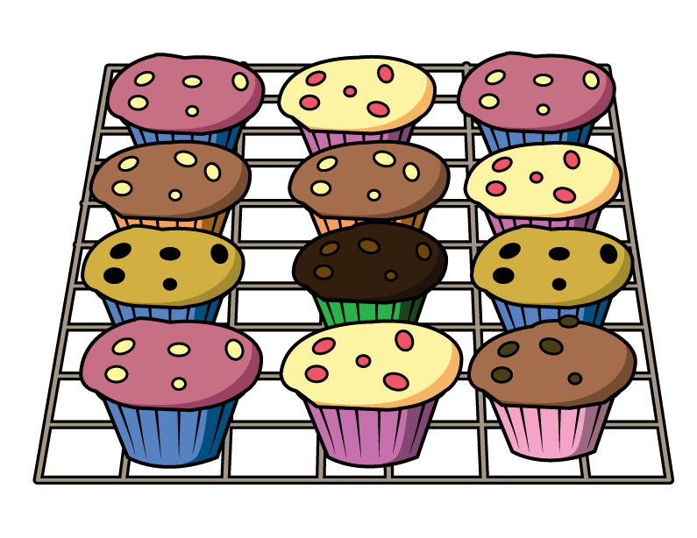




Where have you seen arrays?
Have a think

Slide 6
Can you find any arrays?

Slide 7
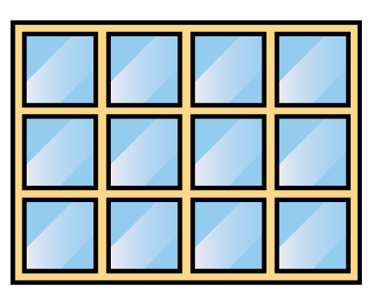
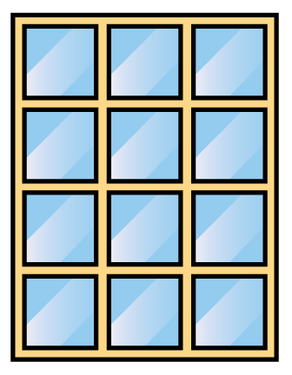
Let’s look at arrays!
Have a think
1
1
2
2
3
3
4
This window has rows.
3
This window has rows.
4

Slide 8
Let’s look at arrays!
Have a think
1
2
3
4
1
2
3
This window has rows.
3
It has columns.
4
This window has rows.
4
It has columns.
3

Slide 9

Is a ten frame an array?
1
2
1
2
3
4
5
1
1
2
2
3
4
This has rows.
2
5
It has columns.
5
This has rows.
5
It has columns.
2

Slide 10
Can you build an array?
How many rows?
How many columns?

