Slide 1


Slide 3
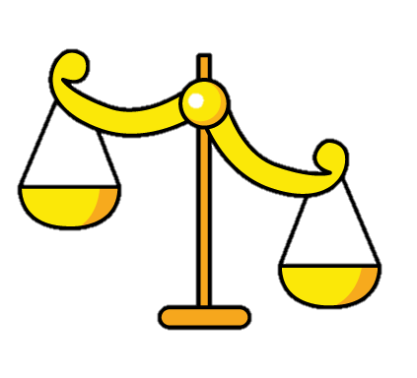
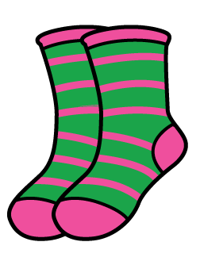




1) What is 4 + 4 ?
2) What is 5 + 5 ?
3) What does this symbol mean? =
4) Which of these balance scales shows both objects have an equal mass?

Slide 4
1) What is 4 + 4 ?
2) What is 5 + 5 ?
3) What does this symbol mean? =
4) Which of these balance scales shows both objects have an equal mass?
8
10
= means is equal to

Slide 6

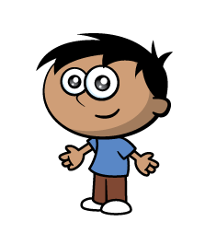




Equal or Unequal ?
4
4
4
3

Slide 7
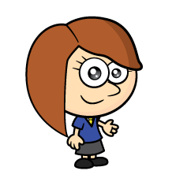
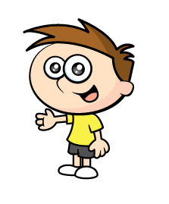


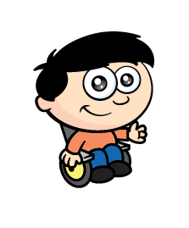
Equal or Unequal?
6
6
6
There are children.
They each have marbles.
3
6
There are equal groups of
3
6

Slide 8


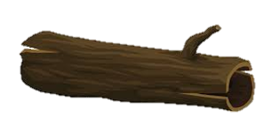
Have a think
5
There are
They each have
3
There are equal groups of
5
3

Slide 9
Have a go at question 1 on the worksheet

Slide 10
These are unequal groups.
How can we make them equal?
4
4
I need one more apple.
3
4
4

Slide 11








How can we make 3 equal groups of 4 ?
Have a think
I need one more.
I have 4! So I need zero.
I need 2 more.

Slide 12
Have a go at questions 3 and 4 on the worksheet

Slide 13

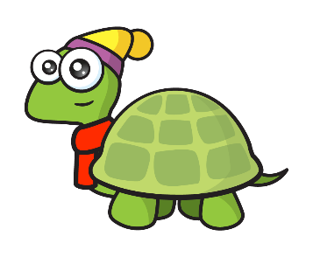

Have a think
Tiny, can you make equal groups of ?
5
2

Slide 14
Have a think
2
Tiny, can you make equal groups of ?
5

Slide 15
Have a go at question 5 on the worksheet

