Slide 1
To know that the Muslim place of worship is a Mosque. To know what key features are in the Mosque and why they are important (Qibla)

Slide 2
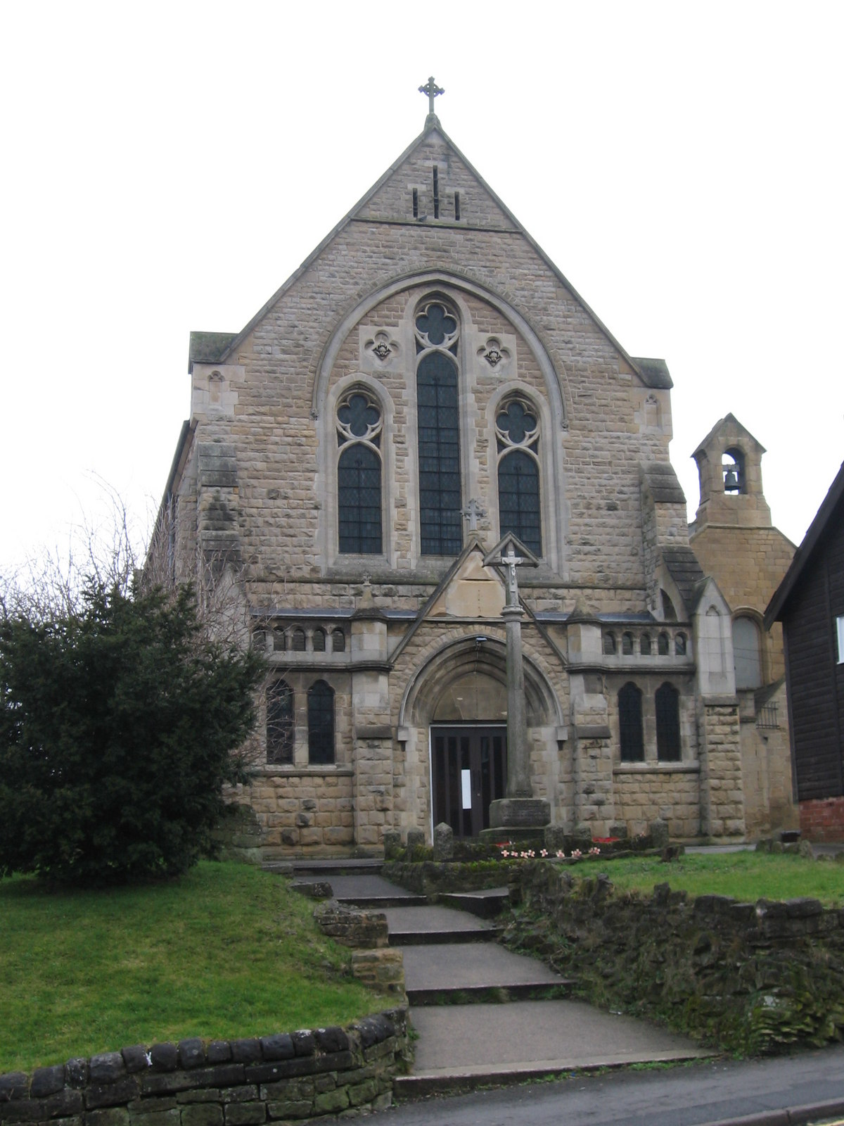
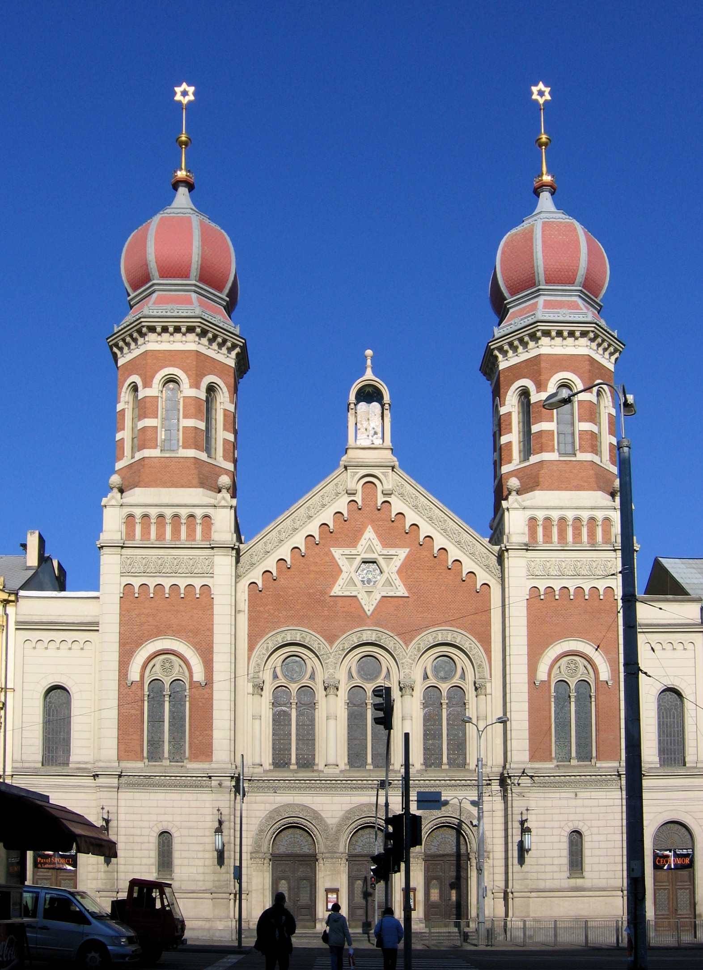
What places of worship have we learnt about so far?
This Photo by Unknown Author is licensed under CC BY-SA
The Church is the place of worship for Christians.
The synagogue is the place of worship for Jews.
Can you remember anything special about these places of worship?
This Photo by Unknown Author is licensed under CC BY-SA

Slide 3
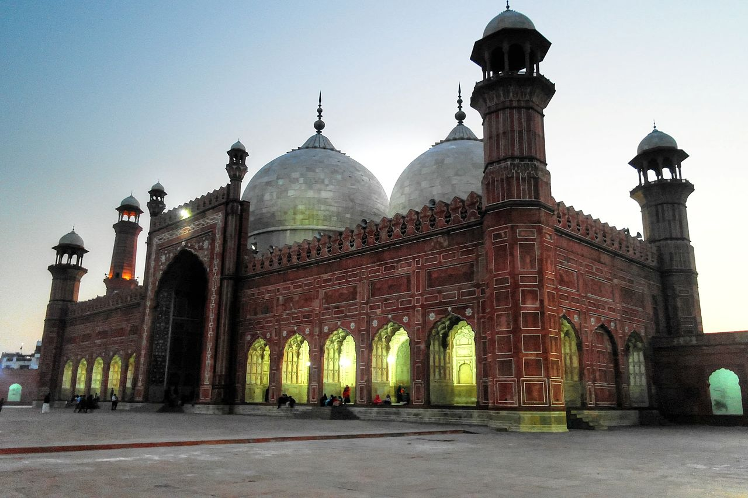
The Islamic place of worship is …..
The Mosque
Last week we started to learn about Muslim Prayer. Can you remember what Muslims sit on to pray?
What did you put on your prayer mat?
This Photo by Unknown Author is licensed under CC BY-SA

Slide 4
Muslim Prayer
When Muslims pray they have to face the Qibla.
The Qibla is the direction of the Kabaah which is a special box in the centre of the most important Mosque in Mecca. Many Muslims travel there each year to say prayers together.
Listen to this story:
https://www.bbc.co.uk/bitesize/clips/z4yr87h

Slide 5
Why do you think Muslims like to all say prayers together?
Discuss.
How do we feel when we do things alone? How do we feel when we do something together?

Slide 6
Our School Value of Unity.
One of our values is unity and this means be are “united” or we all work together.
When do you work together?
Football
Dancing
Lesson time
Playing games
Tidying up

Slide 7
In your book draw a picture of when you have shown unity and write a sentence to explain when you show unity.
Use the sentence starter:
I show unity when I……..
“I show unity when I work together with my friends to tidy up our classroom.”
“I show unity when I play football and we work together as a team to score a goal!”

Slide 8
Next Step:
How do you feel when you work together as a team?
Don’t forget to use the word because to explain your answer!

