Slide 1
To write a simple instruction.
5.1.2021

Slide 2
Instructions - Recap
When someone tells someone else what to do we call this giving the instructions.
Stand up!
Sit down!
Cross your legs!
Can you think of an instruction?

Slide 3

The story
I want you to listen
out for someone being bossy and
telling someone else what to do!
If you hear someone give an
instruction I want you to wag your
Finger like you are telling someone
Off!

Slide 4
Writing instructions
Look at the pictures of Mum in the story. What instructions did she give the boy?
Today we are going to write the instructions.
Model writing instructions for Mum talking to the boy.
For example: Go to sleep!
Notice the use of an exclamation mark. This is a type of full stop we can use when we are being bossy!

Slide 5
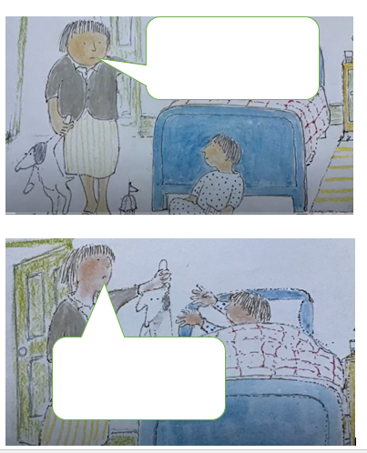
Write your own instructions for Mum

Slide 6
Challenge
What other instructions does your Mum give you? Can you write any down?

