Slide 1




Year 1 - Autumn - Block 4
Place Value (within 20)

Slide 2
Get Ready:
1. What is 4 + 3?
2. What is one more than 14?
3. What is one less than 19?
4. Teddy has 11 sweets. He needs 15. How many more does he need?
5. 7 + 3 = ?

Slide 3
Today’s lesson is all about problem solving and reasoning.
You will need to discuss the questions together. There is a problem solving question on slide 8 which should be recorded in your exercise book.

Slide 4
Use number cards 11 – 20
How many different ways can you complete the boxes?
is 1 more than
11
12
13
14
15
16
17
18
19
20

Slide 5



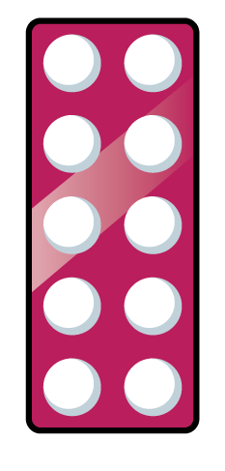








Which image is the odd one out?
Why?

Slide 6
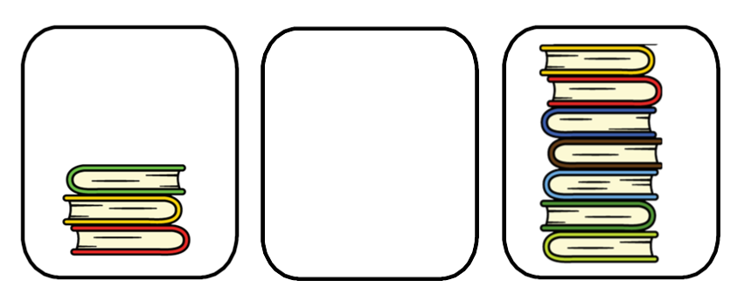

How many books can go in the empty box?
Compare with your partners- have you drawn the same amount of books?
How many possibilities are there?
Is it possible to have 3 or 7 books in the middle pile?
Least
Most

Slide 7

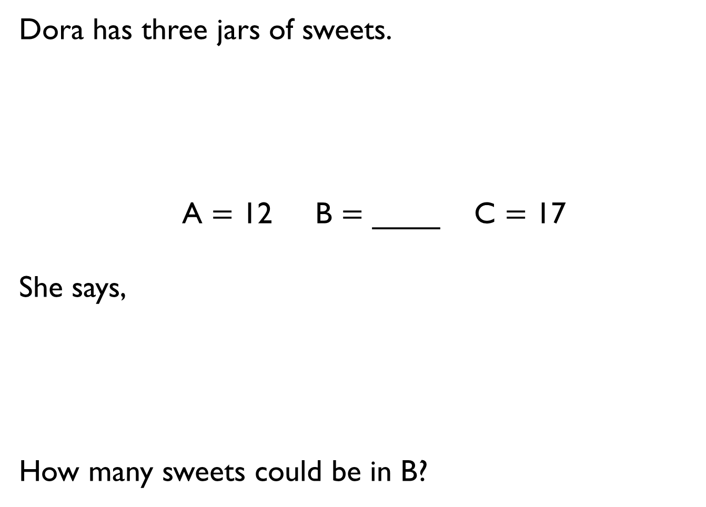
Dora has three jars of sweets.
A $=$ 12 B $=$ ____ C $=$ 17
She says,
How many sweets could be in B?
A has the least sweets.
C has the most sweets.

Slide 8

Record your answers in your exercise book!
All of the eggs are placed into baskets.
How many different ways can you make it correct?
Greatest Least

Slide 9

Mr Monaghan says,
What could his number be?
My number is greater than 8 but less than 15

