Slide 1
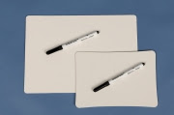
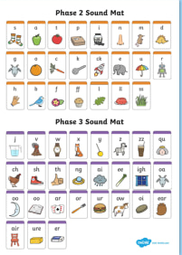
Phonics
Friday
Phase 4
We are learning the alphabet song and practising blending and segmenting.
To be able to read two syllable words

Slide 2
Let’s practise reading some words
Choose a game to play on the phase 3 phonics play website.
https://www.phonicsplay.co.uk/resources/phase/3

Slide 3
Whiteboards and speed sound charts ready
Your adult will say a sound. Your challenge is to find it on the sound chart and write it down.
Phase 3 sounds

Slide 4
Sing the alphabet song.
https://www.youtube.com/watch?v=75p-N9YKqNo

Slide 5
Recap:this word has 2 syllables.
desktop
Clap the word –desktop – it has 2 claps.
When we meet a 2 syllable word it helps to read each syllable separately then put it together.
Can you read the first then the 2nd syllable then read them together?

Slide 6
An adult should read these 2 syllable words. Ask your child to clap the two syllables.
Ask them to write the word in their book.
lunchbox, helpdesk, windmill, treetop, starlight, desktop, sandwich, sandpit.

Slide 7
Can you read my sentences?
Can lightning hit a windmill?
The chimpanzee did a handstand.
This frog is chomping on pondweed.

