Slide 1

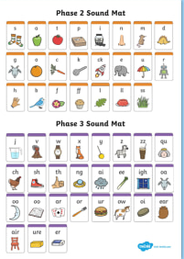
Phonics
Friday
Phase 4
We are learning the alphabet song and practising blending and segmenting.
To be able to read two syllable words

Slide 2
Let’s practise reading some words
Choose a game to play on the phase 3 phonics play website.
https://www.phonicsplay.co.uk/resources/phase/3

Slide 3
Whiteboards and speed sound charts ready
Your adult will say a sound. Your challenge is to find it on the sound chart and write it down.
Phase 3 sounds

Slide 4
Sing the alphabet song.
https://www.youtube.com/watch?v=75p-N9YKqNo

Slide 5
This word has 2 syllables.
lunchbox
Clap the word – lunchbox – it has 2 claps.
When we meet a 2 syllable word it helps to read each syllable separately then put it together.
Can you read the first then the 2nd syllable then read them together?

Slide 6
Try reading these 2 syllable words. Remember to read each syllable then put them together.
Windmill
Starlight
treetop

Slide 7
Practice reading 2 syllable words in this game:
https://www.phonicsplay.co.uk/resources/phase/4
Choose phase 4 sounds and polysyllabic words!

Slide 8
Can you read my sentences?
You put a shampoo sandwich in my lunchbox.
Ring the helpdesk and tell them my cat is stuck.
I stuck a little windmill in this sandpit.

