Slide 1
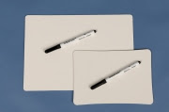
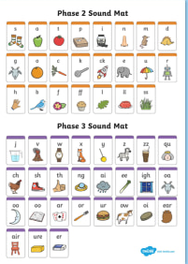
Phonics
Friday
Phase 4
We are learning the alphabet song and practising blending and segmenting.
To be able to read and spell tricky word: were, there, little, one

Slide 2
Let’s practise reading some words
Choose a game to play on the phase 3 phonics play website.
https://www.phonicsplay.co.uk/resources/phase/3

Slide 3
Whiteboards and speed sound charts ready
Your adult will say a sound. Your challenge is to find it on the sound chart and write it down.
Phase 3 sounds

Slide 4
Sing the alphabet song.
https://www.youtube.com/watch?v=75p-N9YKqNo

Slide 5
Today we are learning the new tricky words:
were there
Little one
Practise reading the words. Choose a book you have at home. How many times can you spot these words?

Slide 6
https://www.youtube.com/watch?v=OrwjbulJry4
Practice our phase 4 tricky words with this song!
Perhaps you could practise writing the new tricky words in as many different ways as you can! Big, small, in colours, in chalk, in the garden!

Slide 7
Can you read my sentences?
Were there some chimps at the zoo?
Yuck! There was a paint brush in the coffee cup.
One little brown toad got stuck down a drain.

