Slide 1
L.O. To plan an adventure story.

Slide 2
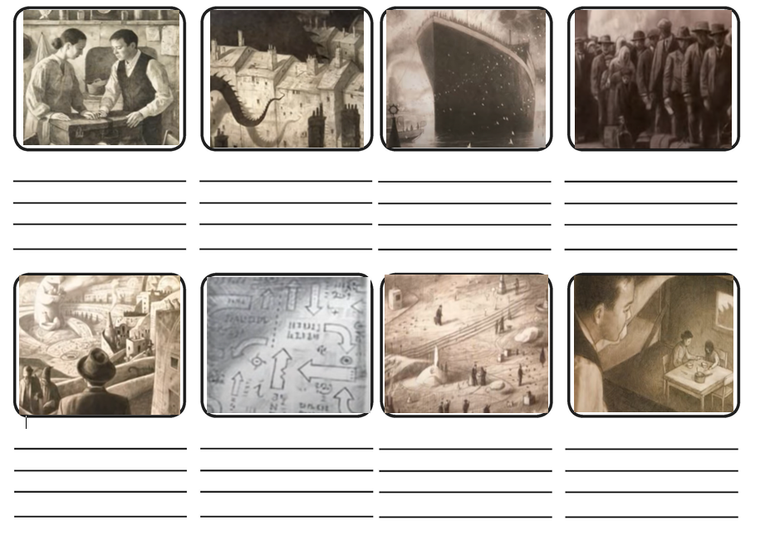

Slide 3
Plan
In your books you will plan your own ending to the story.
You will do it by thinking about each paragraph, and will bullet point for each one.
The bullet points will be notes and ideas, NOT FULL SENTENCES
Paragraph 1 (intro) – Leaving home
Paragraph 2 – Escaping the war
Paragraph 3 – Sailing to a new land
Paragraph 4 – Waiting to see if he is allowed in
Paragraph 5 – Being surrounded by a new world
Paragraph 6 – Finding work to support his family
Paragraph 7 (ending) – His family coming to live in the new world.

