Slide 2

Grammar and Punctuation
Change some of these words to contractions.
You will get hurt if you do not stop doing that.
You’ll get hurt if you don’t stop doing that.
They are going out tonight
They’re going out tonight
What is that noise?
What’s that noise?
We haven’t got time to go there now.
We have not got time to go there now.
I can’t go to the park because I’m
going to my Nan’s house.
I can not go to the park because I am
going to my Nan’s house.

Slide 3
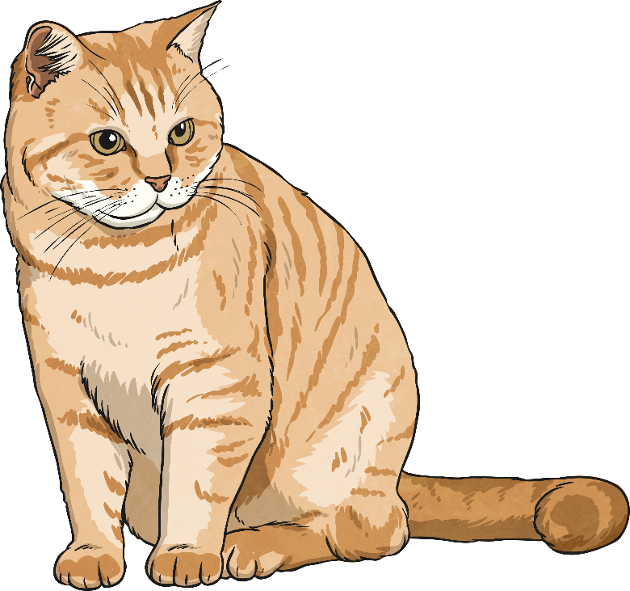
Grammar and Punctuation
Put in the missing conjuctions.
as
Kim was talking on her phone she watched TV.
whilst
The cat ran into the house carrying a mouse!
until
Mix the sugar and butter it looks white.

Slide 4

Grammar and Punctuation
Change the adjectives for different synonyms.
The giant was enormous and angry.
It was a hot day.
The princess was beautiful and glamorous.
It was such a tiny mouse.
The colourful flowers swayed in the warm breeze.

Slide 5

Grammar and Punctuation
What do these prefixes mean?
dis - not con – together/with tele – far/distance bi - two mono – one/singular semi - half
dis con tele bi mono semi
Now write down the meaning of these words:
Bilingual –
Contract –
Semicircle –
Telegram –
Dislike –
Monologue –
Bilingual – speaks two languages
Contract – bring together
Semicircle – half circle
Telegram – distant message
Dislike – not like
Monologue – single speech

Slide 6
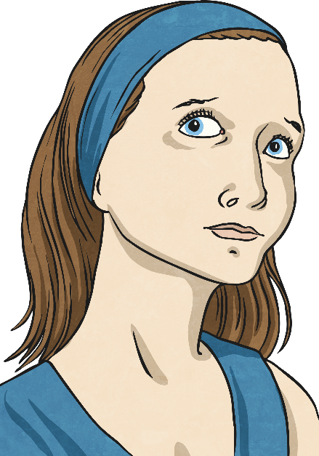
Grammar and Punctuation
Word Investigation
If a word ends in “o” and the letter before it is a vowel, then you add an “s” to make it plural.
If the word ends in an “o” and the letter before it is a consonant, you add “es” to make it plural.
Is this true? Try out your own word investigation.
Example word: radio

