Slide 1
Mayan music
Listen with attention to detail and recall sounds with increasingly aural memory

Slide 2
Recap Mexican music – What do we know?
What instruments do they use?
What style of music is it?
Do you know what lyrics they use?
https://www.youtube.com/watch?v=C-T100dNZXA

Slide 3
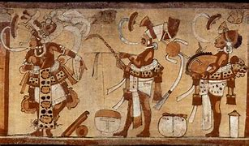
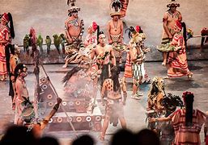
Traditional Mayan Music
Traditional Maya Music Music was a critical part of the ancient Maya lifestyle, featuring in every event from ceremonies, war, celebration, and even ritual sacrifice.

Slide 4
We will listen to three parts of music, which one is your favourite?
https://www.bing.com/videos/search?q=traditional+mayan+music&&view=detail&mid=EC2AC47D367E62DC629DEC2AC47D367E62DC629D&&FORM=VRDGAR&ru=%2Fvideos%2Fsearch%3Fq%3Dtraditional%2Bmayan%2Bmusic%26FORM%3DHDRSC4

Slide 5
Part 1 | Part 2 | Part 3
What instruments did you hear? ________________ ________________ ________________ ________________ | What instruments did you hear? ________________ ________________ ________________ ________________ | What instruments did you hear? ________________ ________________ ________________ ________________
How did this part make you feel? _______________ _______________ _______________ _______________ | How did this part make you feel? _______________ _______________ _______________ _______________ | How did this part make you feel? _______________ _______________ _______________ _______________
Draw pictures of the instruments/sounds you think you heard… | Draw pictures of the instruments/sounds you think you heard… | Draw pictures of the instruments/sounds you think you heard…

