Slide 2
Compact Short Multiplication
Complete the following calculation:
multiplicand
487 × 9
multiplier
Go onto the next slide to see the multiplication process for
this calculation.

Slide 3
Multiply the number in the ones column by the multiplier and carry the tens part of the answer over to the tens column (small digit below)
Th
H
T
O
4
8
7
×
9
3
6

Slide 4
Multiply the number in the tens column by the multiplier and carry over the hundreds to the hundreds column. Remember to add on the tens that were carried over.
Th
H
T
O
4
8
7
×
9
8
3
7
6

Slide 5
Multiply the number in the hundreds column by the multiplier and carry the thousands over to the thousands column. Remember to add on the hundreds that were carried over.
Th
H
T
O
4
8
7
×
9
4
3
8
3
7
6

Slide 6

Now try these multiplication problems using short multiplication:
453 × 4
814 × 5
185 × 7
203 × 6
911 × 3
645 × 6
8044 × 4
2232 × 9
1573 × 6
4307 × 3

Slide 8
Compact Long Multiplication Method
Complete the following calculation:
multiplicand
4533 × 54
multiplier
Go onto the next slide to see the multiplication process for
this calculation.

Slide 9
Multiply the number in the ones column by the ones in the multiplier and carry the tens in the answer over to the tens column (just as we did in the ‘Short Multiplication’).
TTh
Th
H
T
O
4
5
3
3
×
5
4
2
1

Slide 10
Multiply the number in the tens column by the ones in the multiplier and carry over the hundreds to the hundreds column. Remember to add on the tens that were carried over.
TTh
Th
H
T
O
4
5
3
3
×
5
4
3
2
1
1

Slide 11
Multiply the number in the hundreds column with the ones in the multiplier and carry the thousands over to the thousands column. Remember to add on the hundreds that were carried over.
TTh
Th
H
T
O
4
5
3
3
×
5
4
1
3
2
2
1
1

Slide 12
Multiply the number in the thousands column with the ones in the multiplier and carry the ten thousands over to the ten thousands column. Remember to add on the thousands that were carried over.
TTh
Th
H
T
U
4
5
3
3
×
5
4
1
8
1
3
2
2
1
1

Slide 13
Move on to multiplying by the tens in the multiplier. First add the place value holder zero!
TTh
Th
H
T
O
4
5
3
3
×
5
4
1
8
1
3
2
2
1
1
0

Slide 14
Multiply the number in the ones column by the tens multiplier and carry the hundreds over to the hundreds column.
TTh
Th
H
T
O
4
5
3
3
×
5
4
1
8
1
3
2
2
1
1
5
0
1

Slide 15
Multiply the number in the tens column by the tens multiplier and carry over the thousands to the thousands column. Remember to add on the hundreds that were carried over.
TTh
Th
H
T
O
4
5
3
3
×
5
4
1
8
1
3
2
2
1
1
6
5
0
1
1

Slide 16
Multiply the number in the hundreds column with the tens multiplier and carry the ten thousands over to the ten thousands column. Remember to add on the thousands that were carried over.
TTh
Th
H
T
O
4
5
3
3
×
5
4
1
8
1
3
2
2
1
1
6
6
5
0
2
1
1

Slide 17
Multiply the number in the thousands column with the tens multiplier and carry the hundred thousands over to the hundred thousands column. Remember to add on the ten thousands that were carried over.
HTh
TTh
Th
H
T
O
4
5
3
3
×
5
4
1
8
1
3
2
2
1
1
2
2
6
6
5
0
2
1
1

Slide 18
Use column addition to add together the answers.
HTh
TTh
Th
H
T
O
4
5
3
3
×
5
4
1
8
1
3
2
2
1
1
+
2
2
6
6
5
0
2
1
1
2
4
4
7
8
2
1

Slide 19
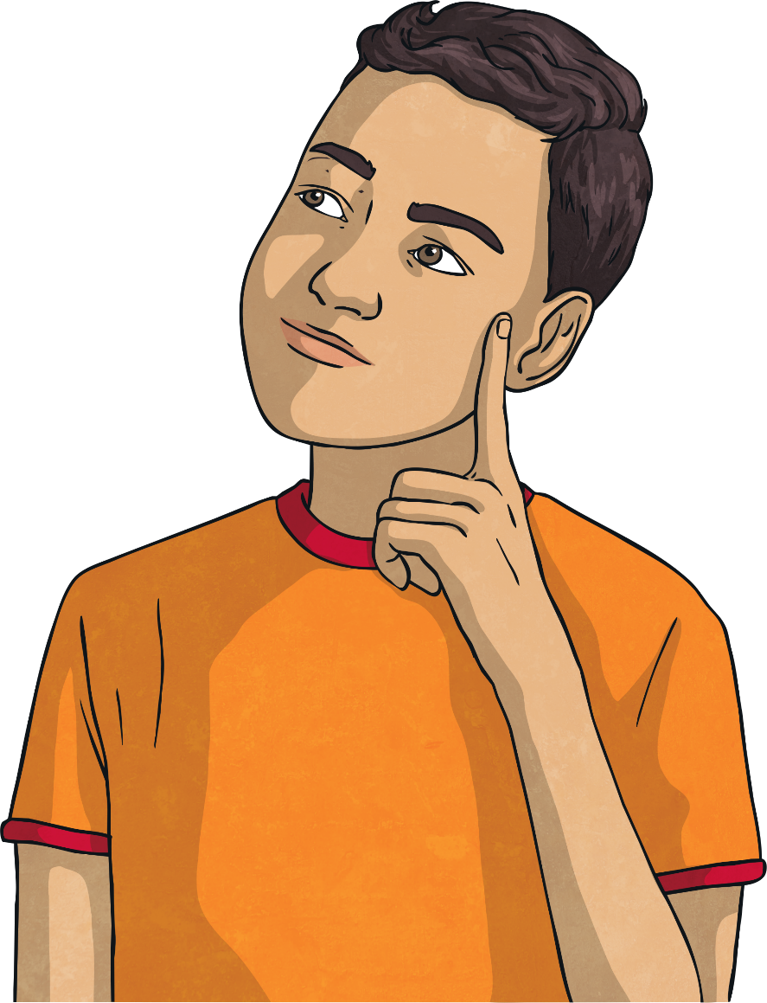
Now try these multiplication problems using long multiplication:
465 × 12
281 × 50
118 × 23
214 × 63
9411 × 54
4365 × 87
8044 × 49
2232 × 89
9573 × 76
4307 × 93

