Slide 1
Evolution and Inheritance
Thursday 25th February 2021
To identify ways in which living things of the same kind vary and to begin to think about why these variations exist

Slide 2
What do these terms mean?
What do you know about these words?
Evolution:
Inheritance:

Slide 3
What do these terms mean?
Evolution: change over time
Inheritance: when something is passed on to the next generation e.g. eye colour, skin-colour, height etc.

Slide 4
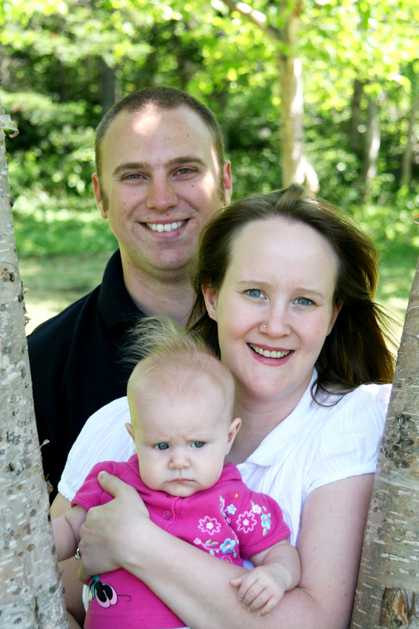
When living things reproduce, the offspring (the young produced) are of the same ‘kind’/species as their parents. Parents pass on characteristics to their offspring but the offspring will not be identical to their parents.
Use the link below to find out more
https://www.bbc.co.uk/bitesize/topics/zvhhvcw/articles/zp9f4qt

Slide 5
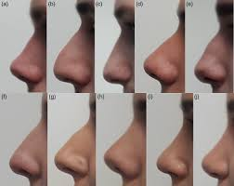
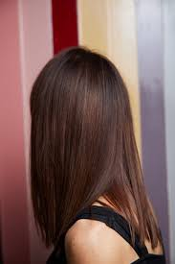
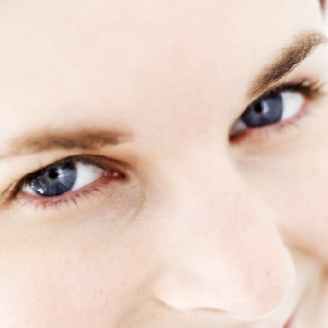
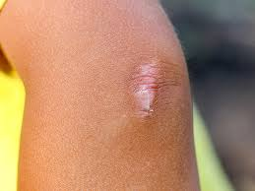

What characteristics can be inherited from your parents?
If it is not dyed!!!
What characteristics do we have because
of the environment we live in?

Slide 6
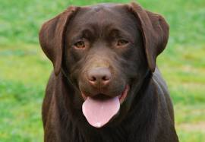
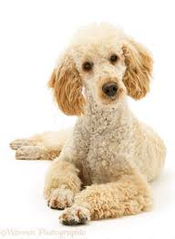
What would happen if a Labrador crossed with a poodle?

Slide 7
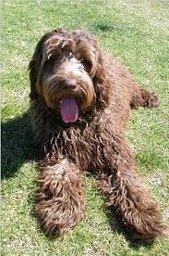
Labradoodle!!!!

Slide 8
Why are offspring not identical to their parents?

Slide 9
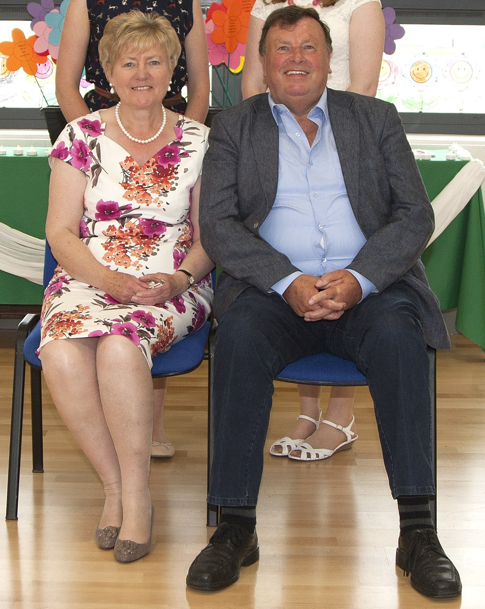

Slide 10
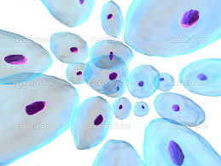
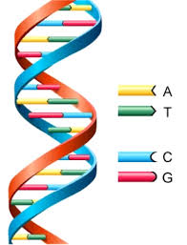
DNA tells the cells what to do
DNA is the boss!!!! It tells the cells how to make a human body.

Slide 11
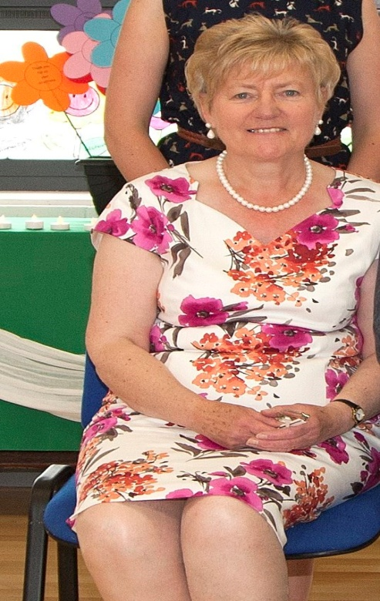
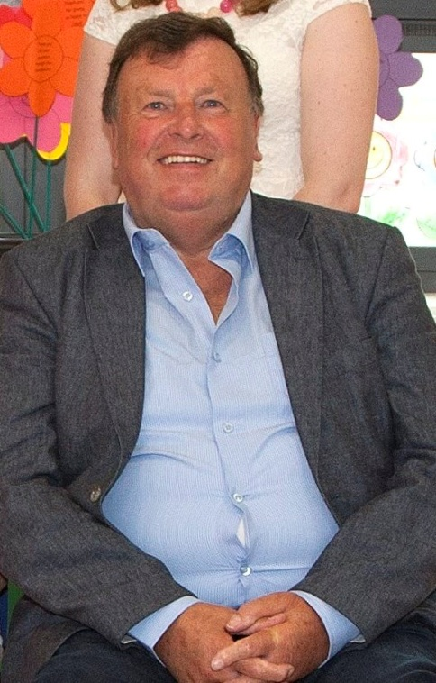
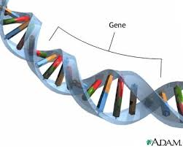
Ge DNA contains Genes
*Each gene is responsible for a different inherited characteristic.
*Offspring get some of their DNA from their mother and some from
their father, that is why offspring are similar but not identical to
their parents.

Slide 12
Your task today
Look at the pictures of dogs. Your job is to sort out which dogs are the parents and which dogs are the offspring. Can you explain why you sorted them the way you did using what you have learned about inherited characteristics?

