Slide 1
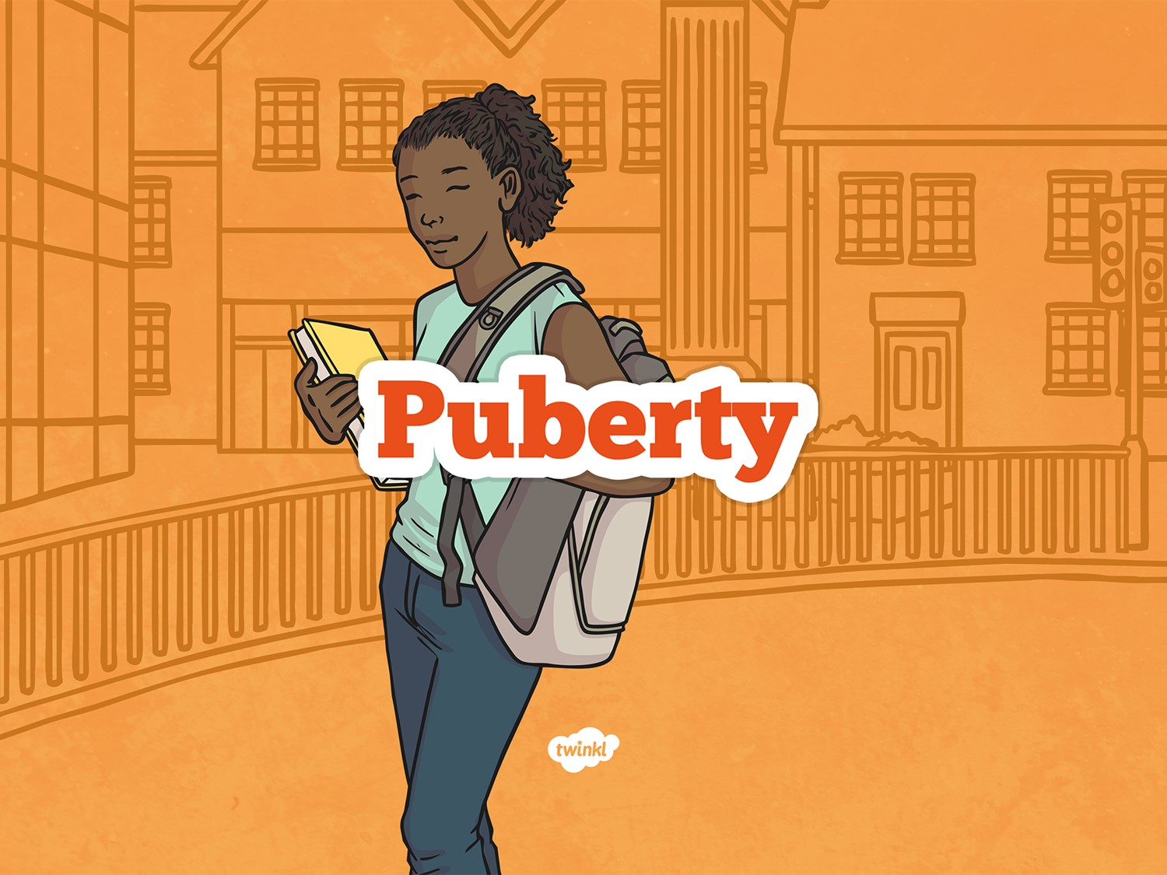

Slide 2

Aim
I can describe and explain the main changes that occur
during puberty.
Success Criteria
I can describe the main changes that occur during puberty.
I can give reasons why changes occur during puberty.
I can analyse the similarities and differences between how boys and girls experience puberty.

Slide 3

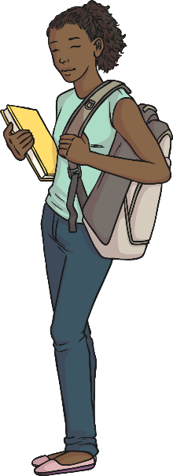
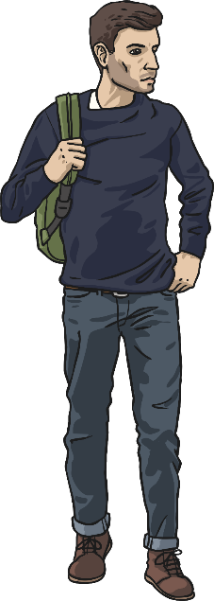
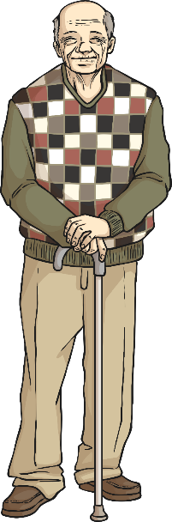
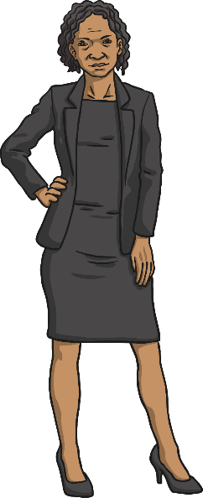
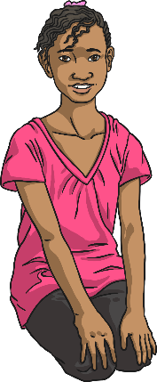
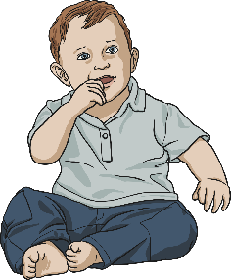
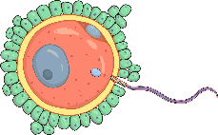
Human Development
Label the pictures with the name of the stage of development they represent:
Early Adulthood
Middle Adulthood
Early Adulthood
Middle Adulthood
Fertilisation
Infancy
Childhood
Puberty
Old age
Puberty
Childhood
Old age
Infancy
Fertilisation
Which stages of development have you undergone?
Which ones will you undergo?
What is your next stage of development?

Slide 4

Human Development
Puberty
Puberty is the stage of development between childhood and adulthood.
Physical growth occurs so that the body changes to that of an adult, which enables reproduction.
Two parts of the brain – the hypothalamus and the pituitary gland – start to make more of some hormones.
LH is the hormone for growth and FSH is the hormone for hair.

Slide 5
Fact or Fiction?
Let’s find out with the
Do you know your facts about puberty?
Are you getting your information from a reliable source?
Or are you starting to believe in fiction?
FACT OR FICTION QUIZ!

Slide 6


Fact or Fiction?
1
If you haven’t started puberty by the age of 11, there is something wrong.

Slide 7

Fact or Fiction?
You’re correct – it’s Fiction!
Puberty occurs at any time between 11 and 17.
It is different for each person and this is perfectly normal.

Slide 8

Fact or Fiction?
You’re incorrect – it’s Fiction!
Puberty occurs at any time between 11 and 17.
It is different for each person and this is perfectly normal.

Slide 9
Fact or Fiction?
2
Both boys and girls grow more hair on their bodies.

Slide 10
Fact or Fiction?
You’re correct – it’s a Fact!
Both boys and girls develop pubic hair and start to grow hair under their armpits.
Overall, boys grow more hair and grow it on more body parts than girls (including the face and chest). However, how ‘hairy’ a person becomes is based the genes you inherit from
your parents.

Slide 11
Fact or Fiction?
You’re incorrect – it’s a Fact!
Both boys and girls develop pubic hair and start to grow hair under their armpits.
Overall, boys grow more hair and grow it on more body parts than girls (including the face and chest). However, how ‘hairy’ a person becomes is based the genes you inherit from
your parents.

Slide 12
Fact or Fiction?
3
During puberty, it is normal to start getting spots.

Slide 13
Fact or Fiction?
You’re correct – it’s a Fact!
Everyone gets some spots during puberty; however, it varies from person to person.
Acne is when you have a severe breakout of
spots and can be painful. Doctors can help to treat this.

Slide 14
Fact or Fiction?
You’re incorrect – it’s a Fact!
Everyone gets some spots during puberty; however, it varies from person to person.
Acne is when you have a severe breakout of
spots and can be painful. Doctors can help to treat this.

Slide 15
Fact or Fiction?
4
When you go through puberty, your sweat smells.

Slide 16
Fact or Fiction?
You’re correct – it’s Fiction!
Sweat does not smell! Sweat is mostly just water after all.
What people refer to as a ‘sweaty’ smell is actually caused by bacteria on your body mixing with the sweat.

Slide 17
Fact or Fiction?
You’re incorrect – it’s Fiction!
Sweat does not smell! Sweat is mostly just water after all.
What people refer to as a ‘sweaty’ smell is actually caused by bacteria on your body mixing with the sweat.

Slide 18
Fact or Fiction?
5
All parts of the body grow at the same rate during puberty.

Slide 19
Fact or Fiction?
You’re correct – it’s Fiction!
All parts of the body grow during puberty but it is not true that they grow at the same rate and the same time.
For example, you may notice that you get taller before your feet grow or that you start growing pubic hair before you start getting spots. It’s normal for growth to be uneven during puberty.

Slide 20
Fact or Fiction?
You’re incorrect – it’s Fiction!
All parts of the body grow during puberty but it is not true that they grow at the same rate and the same time.
For example, you may notice that you get taller before your feet grow or that you start growing pubic hair before you start getting spots. It’s normal for growth to be uneven during puberty.

Slide 21
Fact or Fiction?
There is a normal size that breasts (girls) or the penis (boys) have to grow to, otherwise there is a problem.
6

Slide 22

Fact or Fiction?
You’re correct – it’s Fiction!
There is a wide range of shapes and sizes for breasts and penises, which are all normal.
One of the problems that many teenagers going through puberty face today is coping with the images and messages they get about what is ‘normal’. Often this does not match reality.
As long as you are developing during this period of your life, then there is nothing to worry about.

Slide 23
Fact or Fiction?
You’re incorrect – it’s Fiction!
There is a wide range of shapes and sizes for breasts and penises, which are all normal.
One of the problems that many teenagers going through puberty face today is coping with the images and messages they get about what is ‘normal’. Often this does not match reality.
As long as you are developing during this period of your life, then there is nothing to worry about.

Slide 24
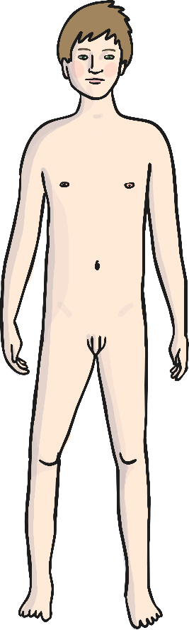
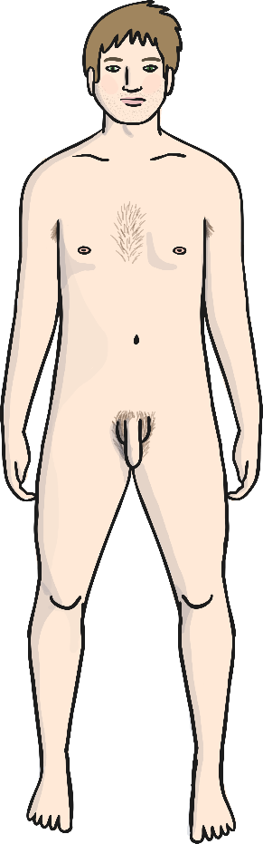
Puberty for Boys
The Facts
Larynx (voice box) grows – ‘Adam’s apple’
Grow taller
Grow facial hair
Sweat glands produce more sweat
Grow hair on chest
Skin becomes oilier
Gain hair on arms and legs
Grow hair under armpits
Scrotum, testes and penis develop
Grow pubic hair
All parts of the
body grow
Become more muscular

Slide 25
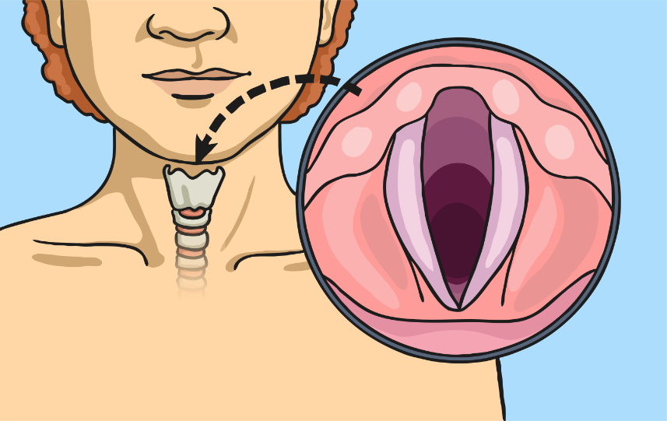
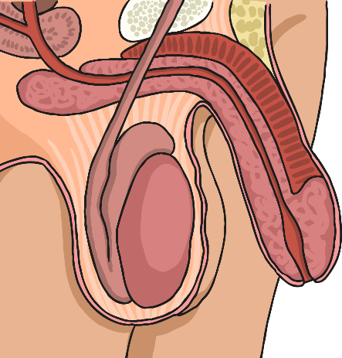
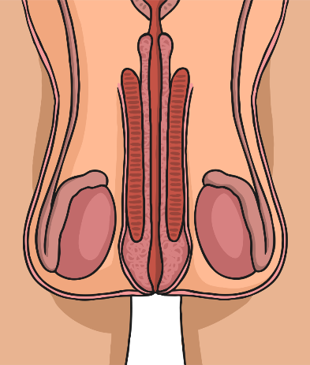
What’s Going on Inside Boys?
The Facts
During puberty, the male sexual organs develop. This includes the testicles, scrotum and penis.
The testicles produce the hormone testosterone which stimulates the production of sperm, develops a deeper voice and bigger muscles as well as causing body and facial hair to grow.
This is the development of the larynx.
This happens to both boys and girls but boys’ develop more so have deeper voices.
More laryngeal cartilage is needed to make a deeper voice. This is why boys develop visible ‘Adam's apples’.

Slide 26
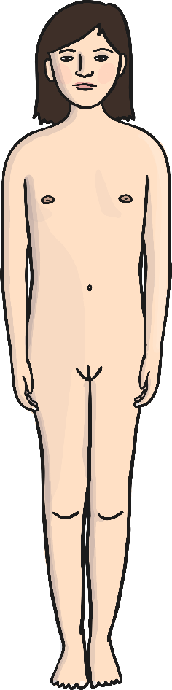
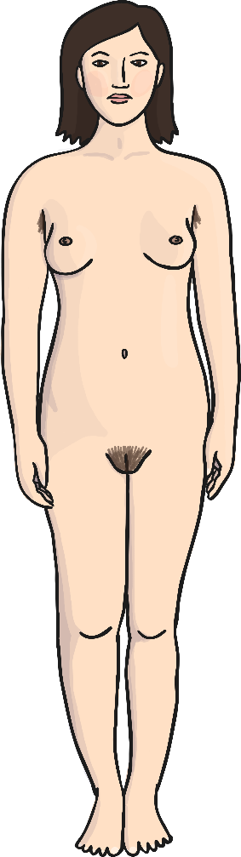
Puberty for Girls
The Facts
Larynx (voice box) grows
Grow taller
Skin becomes oilier
Sweat glands produce more sweat
Grow breasts
Gain hair on arms and legs
Grow hair under armpits
Start to menstruate
Grow pubic hair
All parts of the
body grow

Slide 27
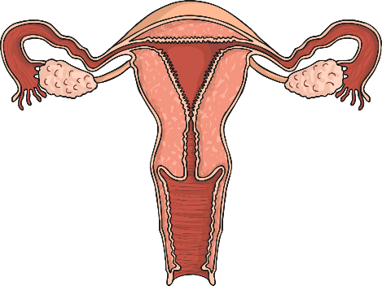
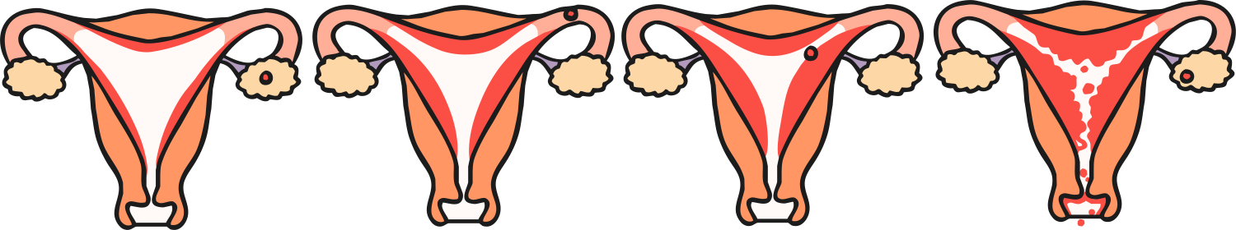
What’s Going on Inside Girls?
The Facts
Menstrual Cycle (Period)
The lining is lost from the uterus. This is called a period.
Days 1-5
The lining of the uterus starts to thicken ready to receive an egg.
Days 15-28
Days 6-13
Ovaries produce the hormones oestrogen and progesterone. They also produce eggs. All girls going through puberty start their periods – this means they have started to produce eggs.
Day 14
The lining of the uterus will stop developing if the egg is not fertilised.
The egg is released into the uterus.

Slide 28
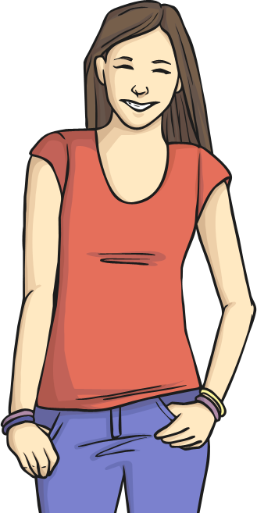
What’s Going on Inside Girls?
The Facts
Emotion
The hormones in your body that cause changes to occur during puberty may also affect your mood. You may have highs and lows and feel a bit more emotional especially near the time of your period.
Ovaries produce the hormones oestrogen and progesterone. They also produce eggs. All girls going through puberty start their periods – this means they have started to produce eggs.

